Slide 1
LGS Master's Programs: Tuition Pricing & Scholarship Analysis
Emory Laney Graduate School — Phase 2
April 22, 2026

Slide 2
Executive Summary — Top 5 Findings
1.
MDP is Emory's costliest and most-discounted master's
$108k average gross, $49k net, 55% discount rate across 135 students over the 8-year panel ($8.4M in LGS scholarships).
2.
Two programs operate at 0% discount
Data Science (n=11) and MBID (n=8) show gross = net for every student. Obvious candidates for a pricing review.
3.
Enrollment is bimodal
Computer Science (154) and MDP (135) together account for 59% of the 493-student sample; eight other programs share the remaining 41%.
4.
Computer Science is 86% international — and still 49% discounted
Emory competes for these students on price as well as visa-friendliness; aid does not scale down as international share rises.
5.
Emory sits mid-pack against peers
Annualized gross tuition ~$47–50k across Data/CS, Economics, and General buckets — below Columbia/NYU ($65–91k) and above Georgia Tech's in-state rates ($31–41k).

Slide 3
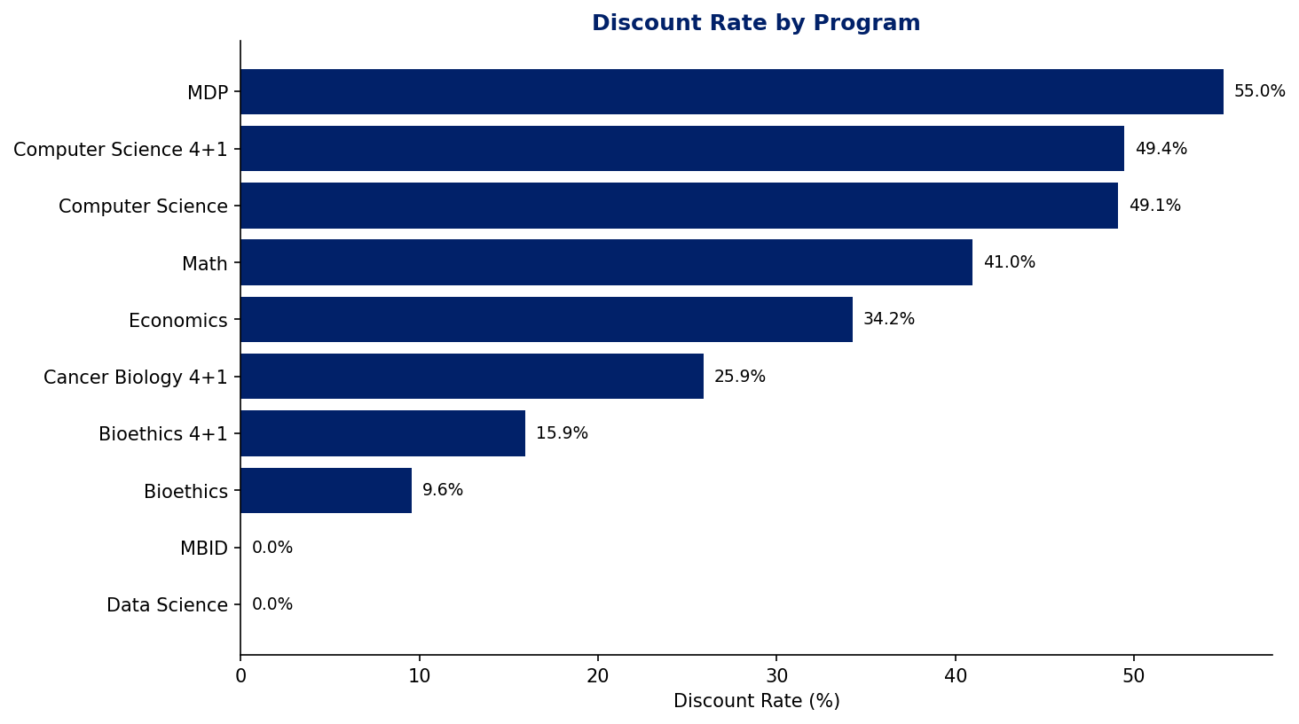
Discount rates vary six-fold across programs — MDP tops the list at 55% while Data Science and MBID give nothing
3

Slide 4
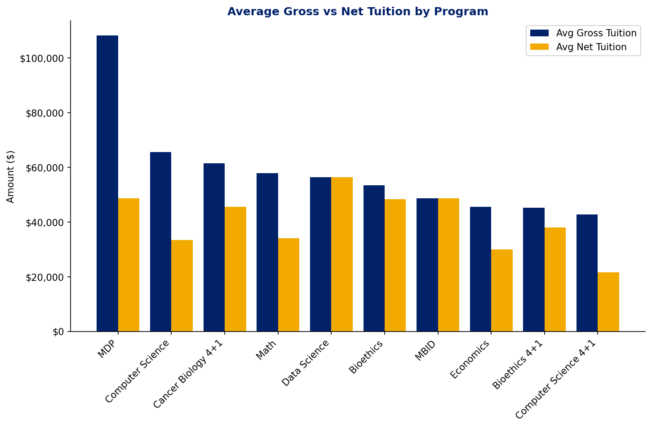
MDP's ~$60k average discount is the biggest absolute tuition give — and its net tuition is still the highest in the portfolio
4

Slide 5
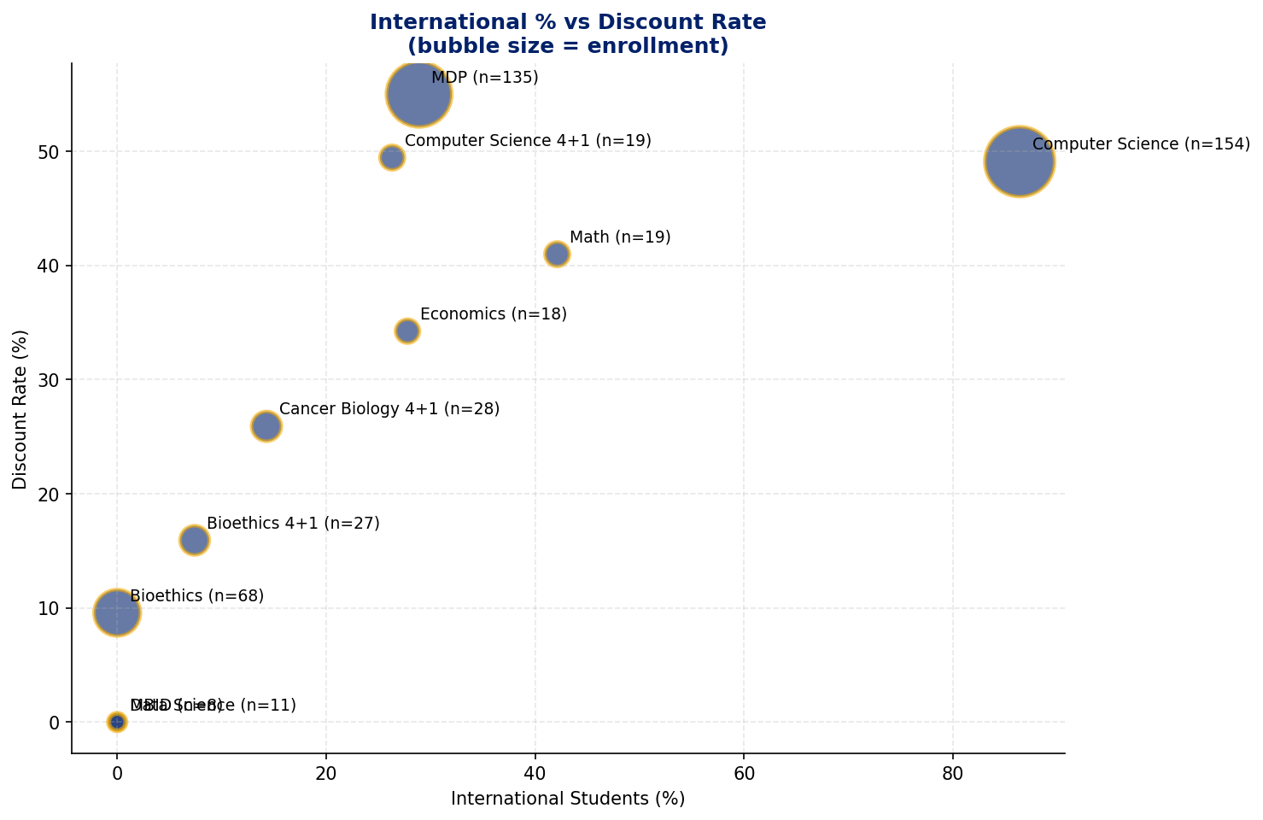
High international share doesn't come with lower aid — Computer Science is 86% international AND 49% discounted
5

Slide 6
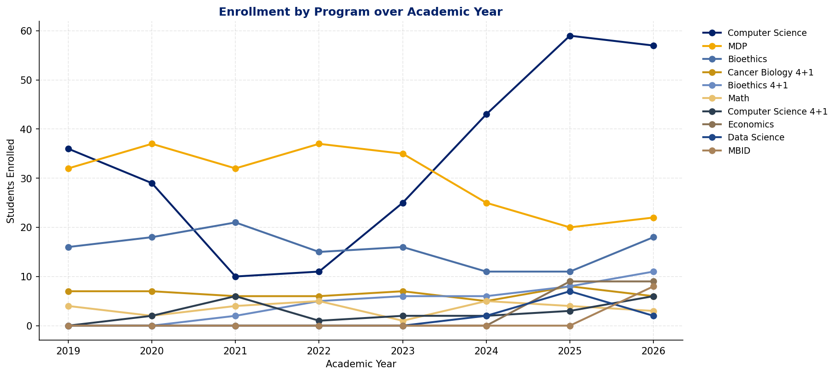
Computer Science enrollment has roughly doubled since 2022 — driving nearly all of Emory's LGS master's volume growth
6

Slide 7
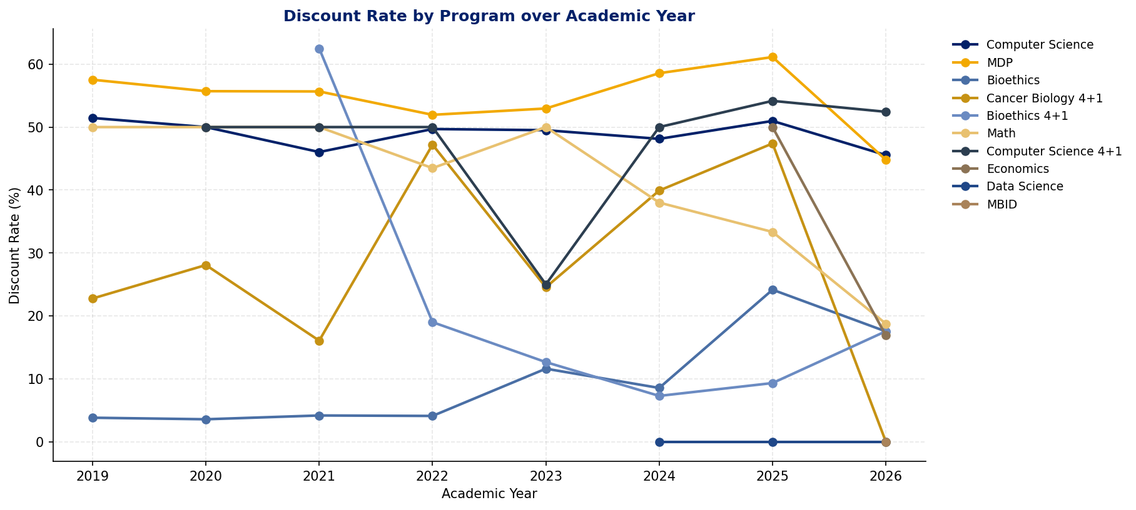
Discount rates are broadly stable year-over-year — no program is systematically tightening aid
7

Slide 8
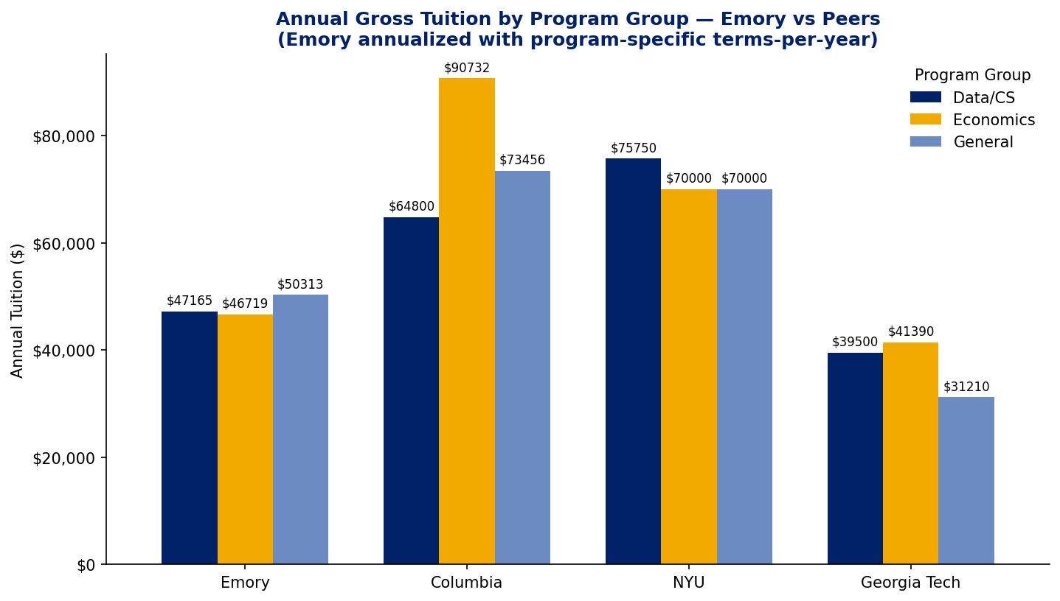
Emory's annualized tuition ($47–50k) undercuts Columbia/NYU by $20–40k and sits above Georgia Tech's in-state rates — mid-market positioning
8

Slide 9
Data Notes & Methodology
• Source data: institutional Excel exports of gross tuition billed and LGS scholarship awards; 8-year panel spanning AY 2019 through AY 2026.
• Net tuition is clipped at zero. In rare cases a kept scholarship exceeds billed tuition for a partial-term student; we report that student as paying $0 rather than a negative amount.
• Scholarship filter retains descriptions containing 'lgs' and drops external/federal awards (Pell, GRFP, Yellow Ribbon, Americorps, etc.) plus generic LGS 'special' awards, so discount rates reflect institutional aid only.
• Small-n programs are merged: ECONMS + ECON4P1MS → Economics; DATASCIMS + QTMMS → Data Science; DEVPRACMDP + HUMANRTCRT → MDP.
• Annualization for peer comparison uses program-specific terms-per-year (from the Information Sheet plus empirical seasonal distribution) rather than a blanket 2-term assumption. This corrects a ~33% understatement for 3-term programs such as MDP and Data Science.
• Programs with zero kept scholarship (Data Science, MBID) are retained in the summary with a 0% discount rate — this is intentional and flags potential pricing discrepancies.

