Slide 1

Ave-short trial
Avelumab short maintenance trial
UPDATE FEBRUARY 2023
Drs. Y. Salhi
Dr. Robbrecht
Prof. R. de Wit

Slide 2


Slide 3
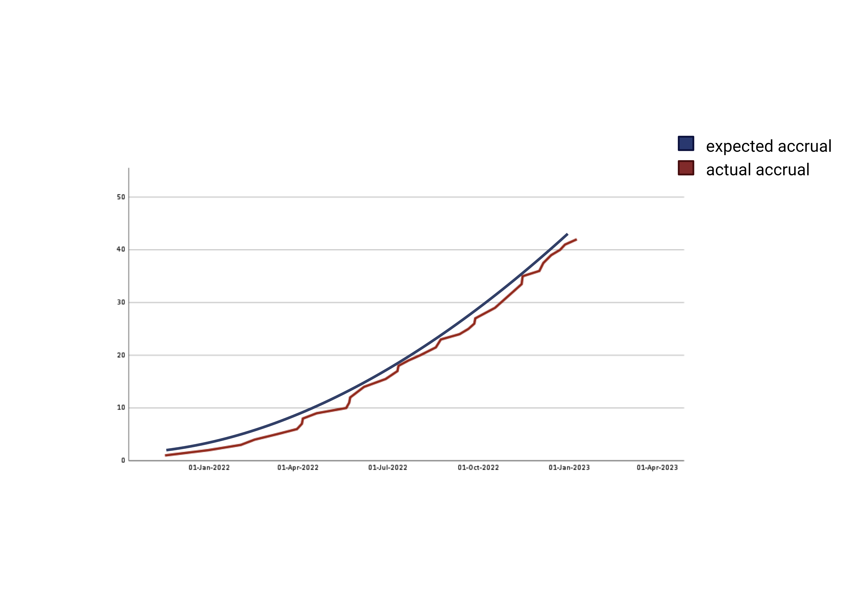
Patient accrual
Number of included patients
Date of registration

Slide 4
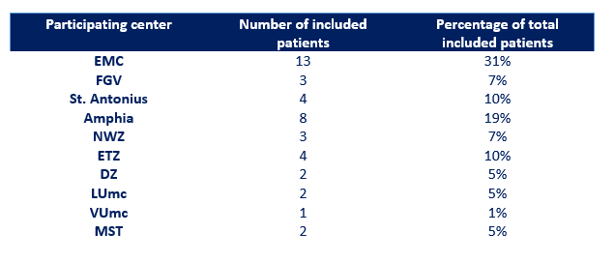
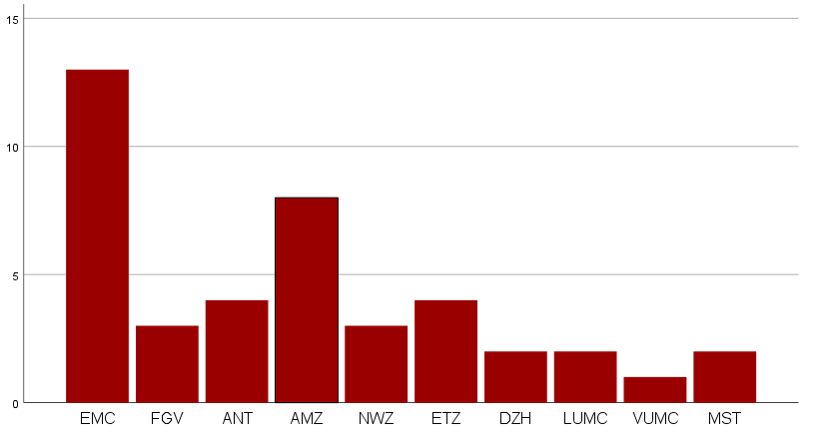
Patient accrual per center
Number of included patients

Slide 5
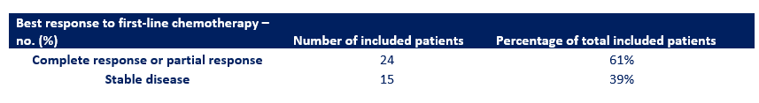

Response to chemotherapy
Ave-short trial
Javelin Bladder 100 trial

Slide 6
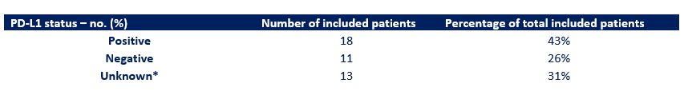
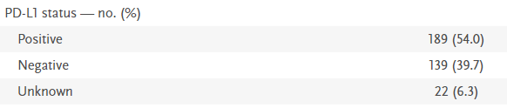
PD-L1 status
Ave-short trial
Javelin Bladder 100 trial

Slide 7
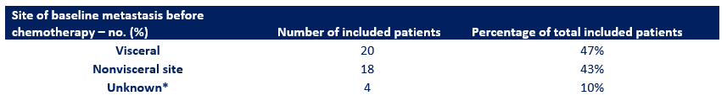

Visceral metastases
Ave-short trial
Javelin Bladder 100 trial

Slide 8
Study team
Debbie Robbrecht d.robbrecht@erasmusmc.nl
Youssra Salhi y.salhi@erasmusmc.nl
CTC ave.short@erasmusmc.nl

