Slide 1


Data Science Applications in Art
Group 2
Project 3

Slide 2
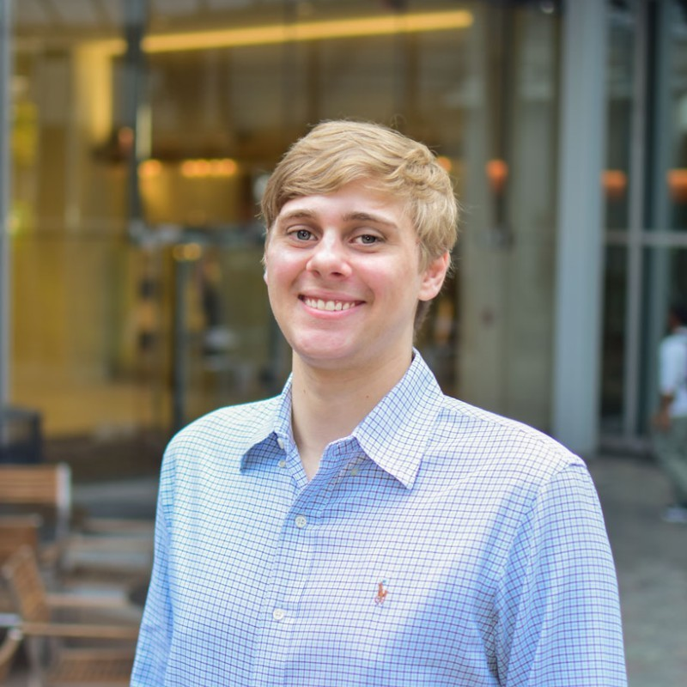
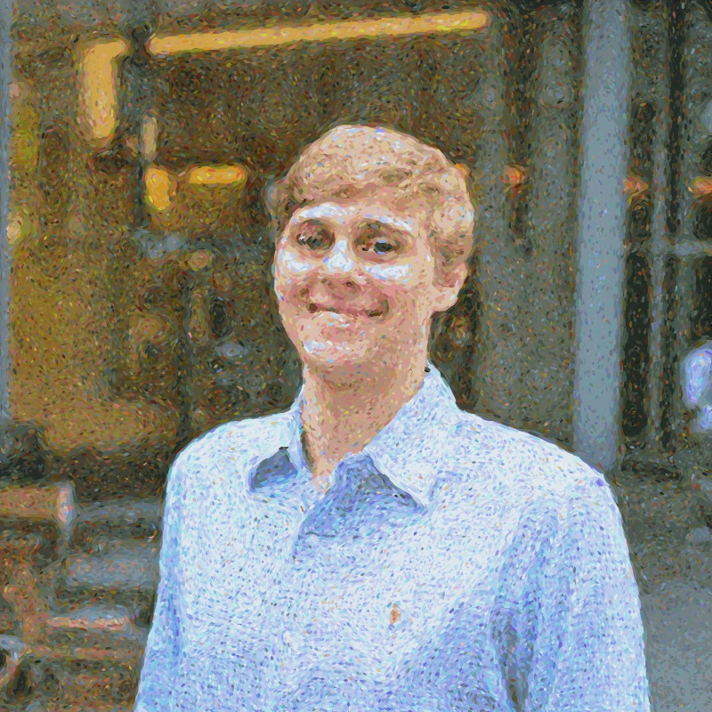
Using K-Means to Create Art
Source: Matteo Ronchettis via hackernoon.com/https-medium-com-matteoronchetti-pointillism-with-python-and-opencv-f4274e6bbb7b

