Slide 1


Data Science Applications in Art
GT-ATL-DATA-PT-09-2020-U-C-2
Project 3 Group 2
Serap Basaran, Lindsey Hoffman, Mia Israel, Rick Kassing, Lisa Rios, and Stephanie Zhu

Slide 2
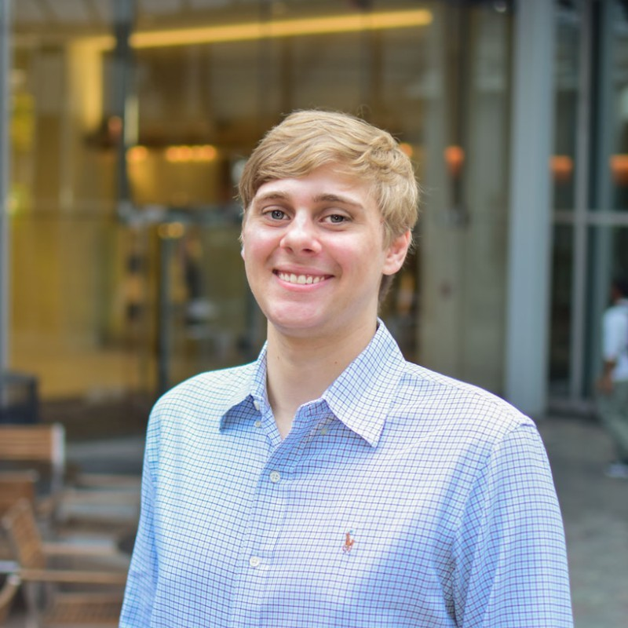
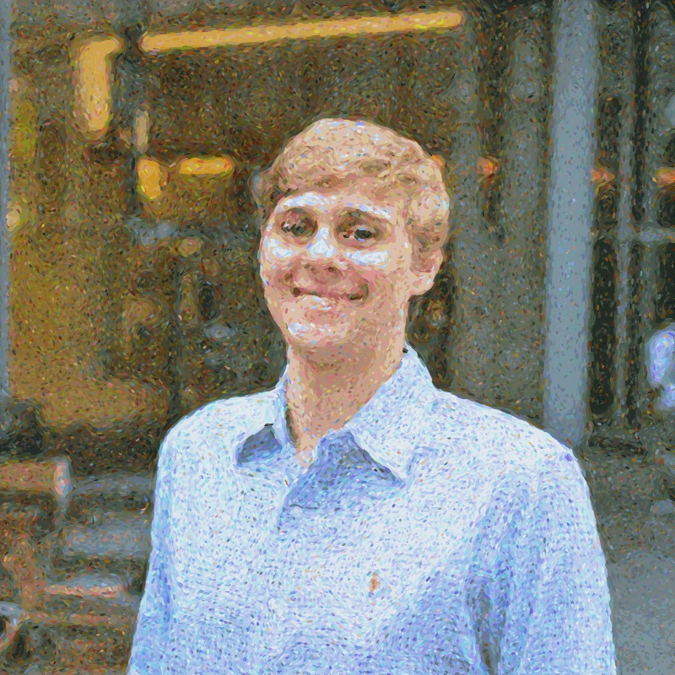
Using K-Means to Create Art
Source: Matteo Ronchettis via hackernoon.com/https-medium-com-matteoronchetti-pointillism-with-python-and-opencv-f4274e6bbb7b

