Slide 1
Automobile Company Customer Segmentation
Submission By: Raj Keswani

Slide 2
Contents
Problem Statement
About the Data
Geographic Distribution of Sales
Sales per Order Distribution
Cancelled Orders Analysis
Sales Distribution Category Wise
High value yielding products
Yearly Trend – Sales
Quarterly Trend – Sales
Monthly Trend – Sales
Weekly Trend – Sales
Time Series Analysis for Sales
Sales Forecast
Summary
RFM
RFM Workflow and Output
Segmentation
Classes
Best Customer
Most Loyal Customers
Churned Good Customers
At Risk Good Customers

Slide 3
Problem Statement
An automobile parts manufacturing company had collected data of transactions for 3 years.
They did not have any in-house data science team.
Thus, they hired us as their consultant.
Our job was to use our magical data science skills to provide them with suitable insights about their data and their customers.
About the Data
We had access to their invoice data which had details of each invoice generated along with the product details such as like selling price, recommended selling price, product line, quantity ordered, and total sales made from that transaction along with customer details such as company name, address, their respective city and country along with first and last names of the POCs to be contacted within the company and the last order placed by that company.

Slide 4
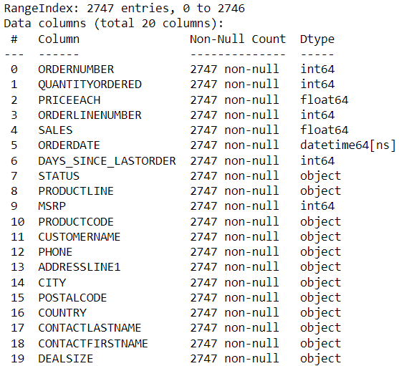
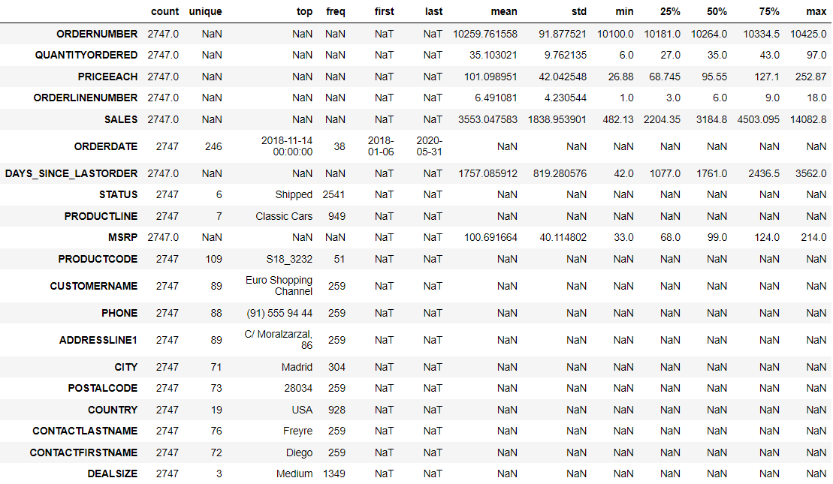
The dataset had no duplicate entries and no null values.
The dataset had 2747 unique records and 20 features.
Dataset info and description is shared below.

Slide 5
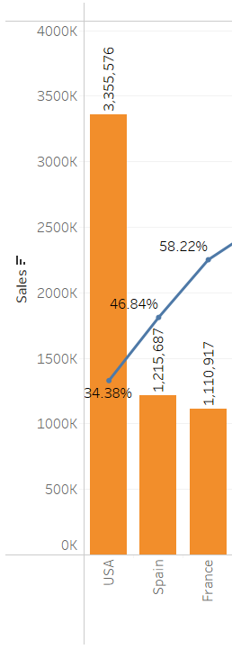
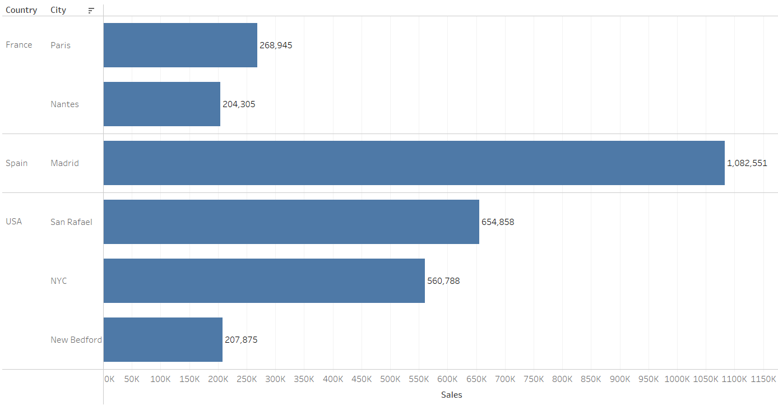
Geographic Distribution of Sales
About 60% of the sales is saturated in USA, Spain and France. Most important cities
within which are San Rafael, NYC, New Bedford, Madrid, Paris and Nantes.
Supply-chain network should be strong there.

Slide 6
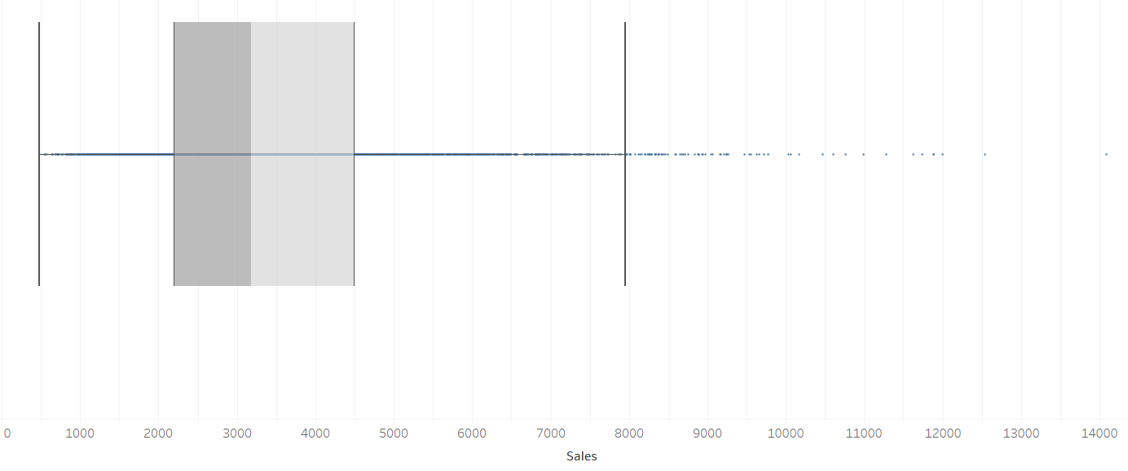
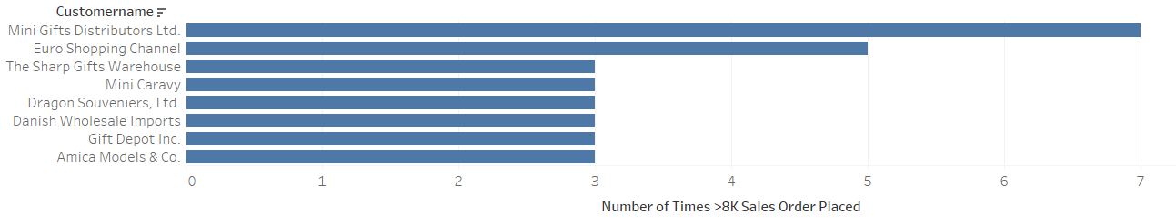
Sales per Order Distribution
Most of the orders yield a sales of 500-8k.
But there are some companies that have placed gigantic orders.
Special care needs to be taken for their requirements.

Slide 7
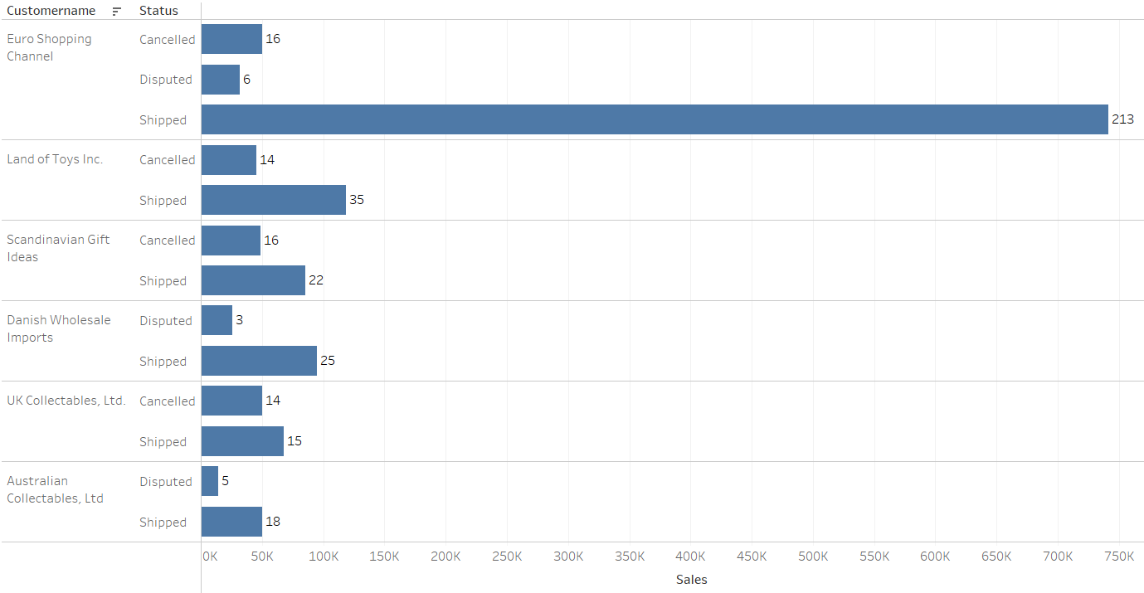
Cancelled\Disputed Orders Analysis
Land of Toys Inc. and UK Collectables have canceled a lot of orders in comparison to the ones that were shipped to them. This needs to be looked at.

Slide 8
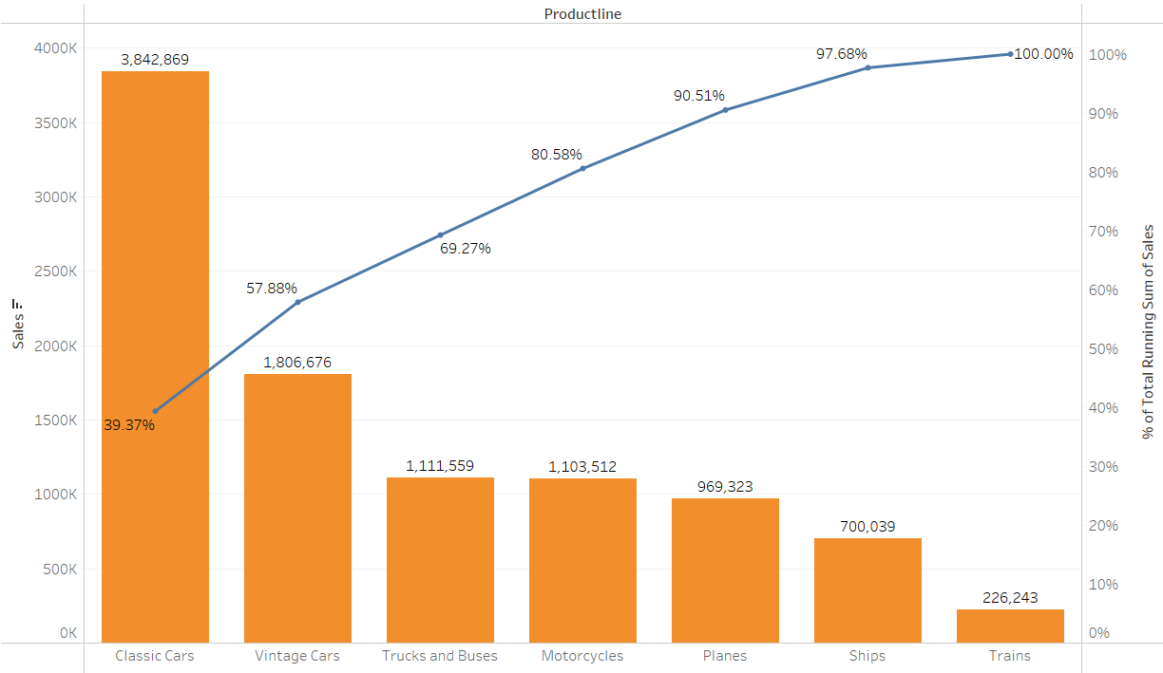
Sales Distribution Category wise
Car parts seem to contribute to about 58% of the sales.

Slide 9
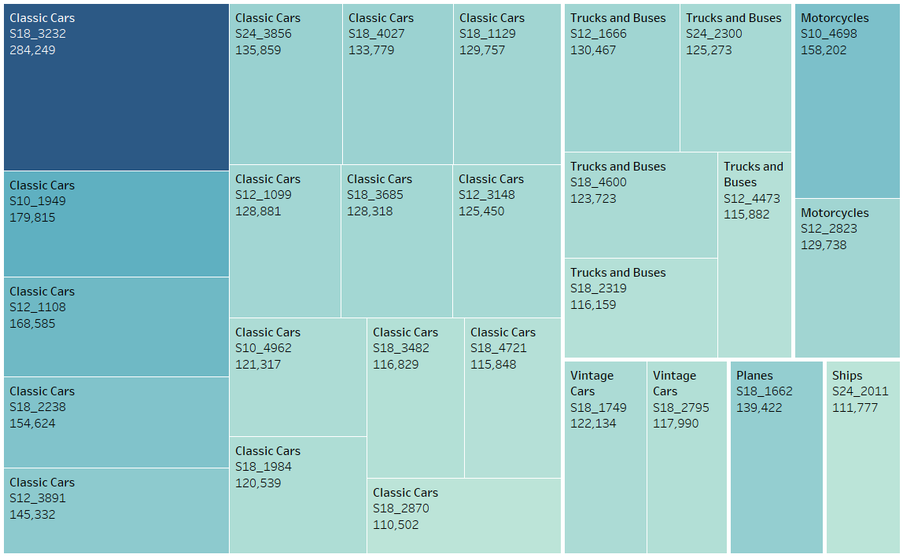
High Value yielding Products

Slide 10
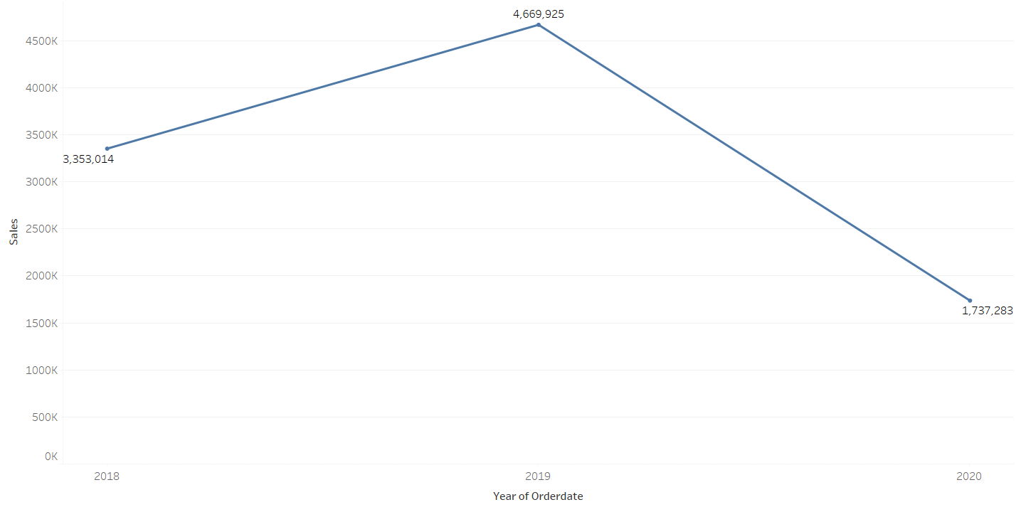
Yearly Trend - Sales

Slide 11
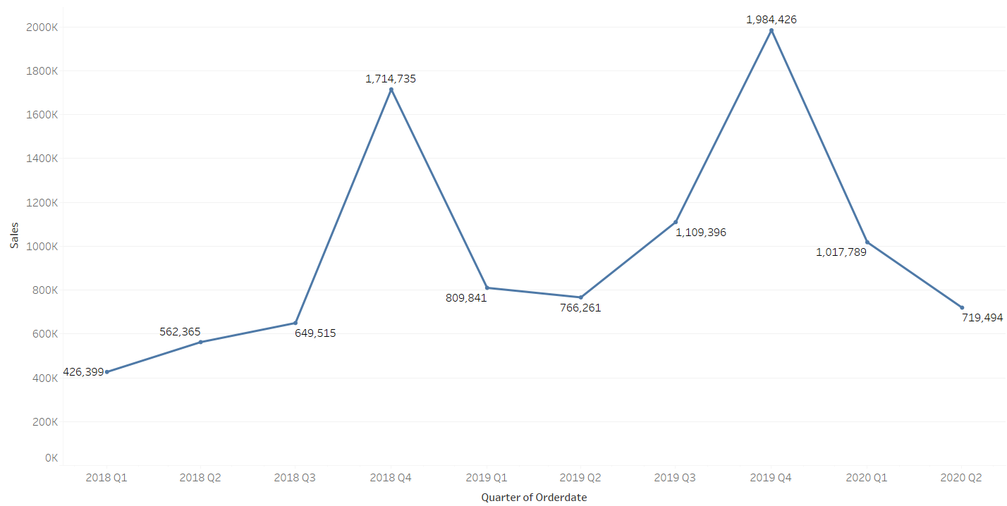
Quarterly Trend - Sales

Slide 12
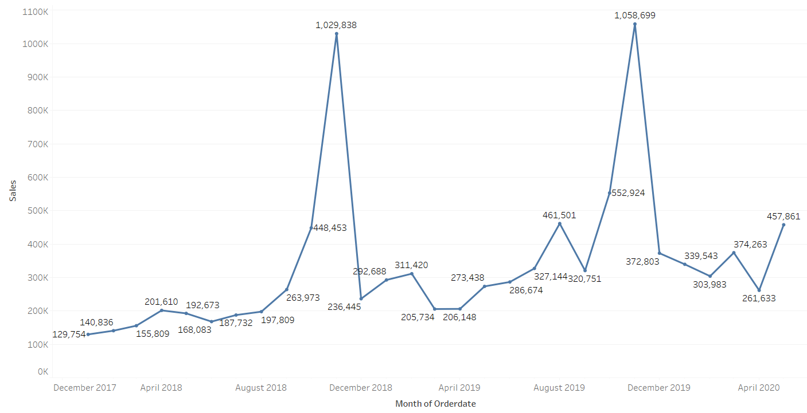
Monthly Trend - Sales

Slide 13
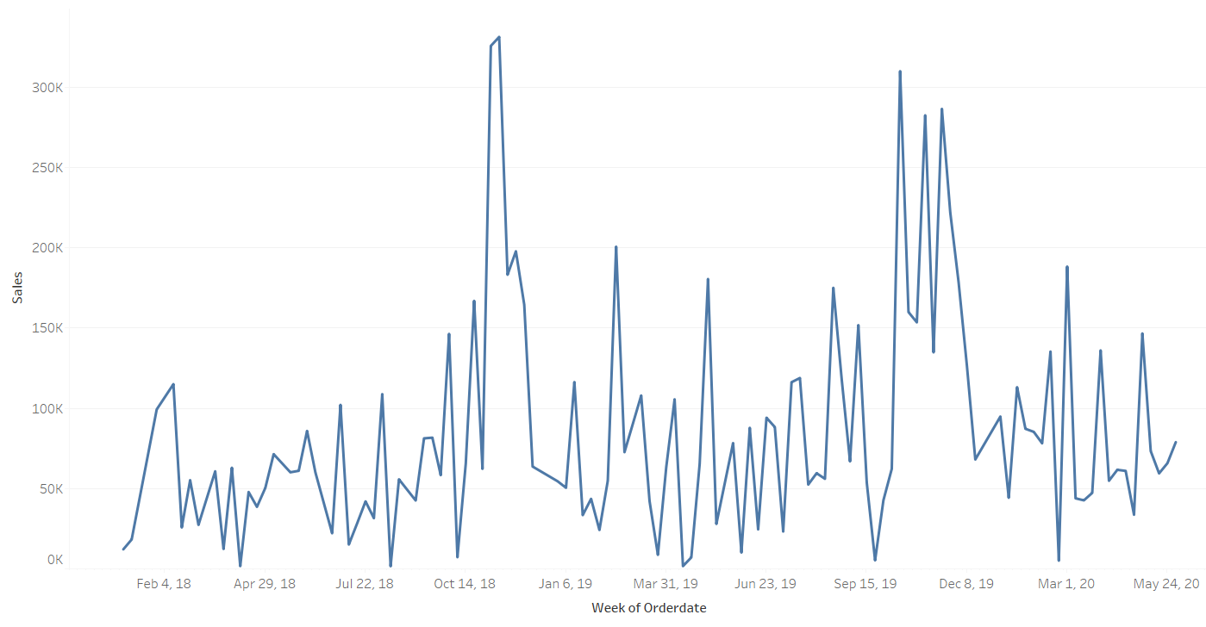
Weekly Trend - Sales

Slide 14
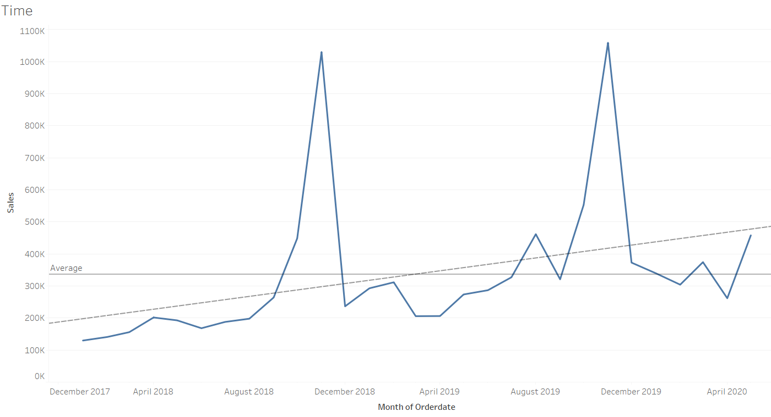
Time Series Analysis for Sales
Average Monthly sale for the provided data is about 336560.
Sales have an average upward trend with incremental sale of 330 per month.
The data has seasonality.
Highest sale is recorded in the month of November.

Slide 15
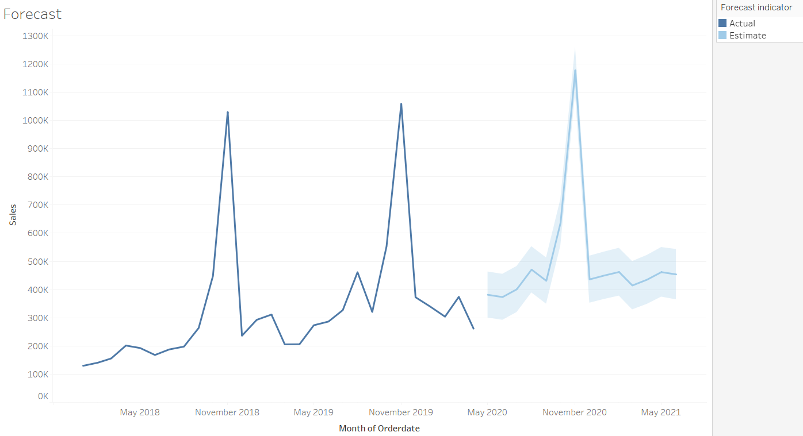
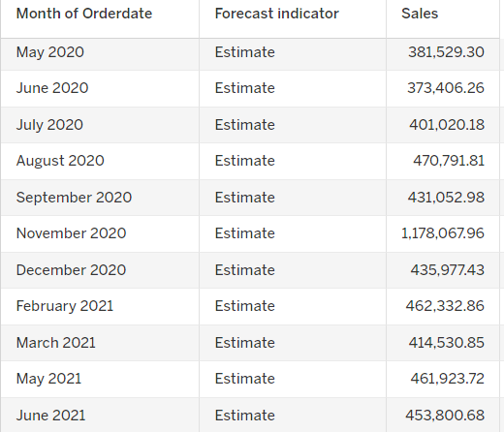
Sales Forecast
With the current trend, the average sales are forecasted
to increase in the next 11 months.

Slide 16
Summary
About 60% of the sales is saturated in USA, Spain and France.
Most important cities are San Rafael, NYC, New Bedford, Madrid, Paris and Nantes.
Most of the orders yield a sales of 500-8k. But there are some companies that have placed gigantic orders. Special care needs to be taken for their requirements.
Land of Toys Inc. and UK Collectables have canceled a lot of orders in comparison to the ones that were shipped to them. This needs to be looked at.
Car parts seem to contribute to about 58% of the sales.
Most of the high yielding products are classic car parts.
Average Monthly sale for the provided data is about 336560.
Sales have an average upward trend with incremental sale of 330 per month.
The data has seasonality.
Highest sale is recorded in the month of November.

Slide 17
RFM
RFM stands for Recency, Frequency and Monetary Analysis.
We used KNIME to perform RFM.
We used calculated field Last Order Date for Recency, Count of Number of Orders for Frequency and Sum of Sales for Monetary Analysis.
Each feature is divided into 4 segments, respectively L, ML, MH and H.
L symbolizing that the customer lies in 0-25th percentile.
ML symbolizing that the customer lies in the 25th-50th percentile.
MH symbolizing that the customer lies in the 50th-75th percentile.
H symbolizing that the customer lies in the 75th-100th percentile.

Slide 18
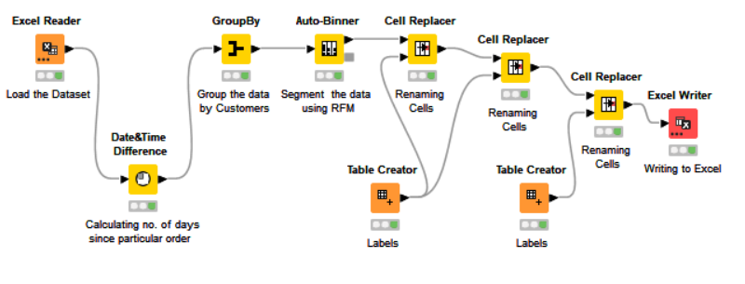
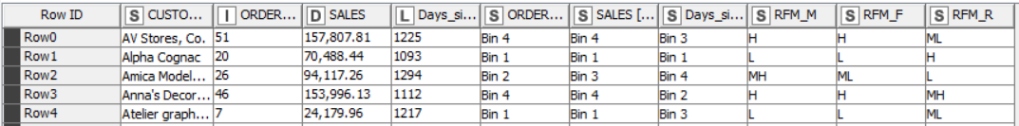
RFM Workflow and Output Table
Workflow
Output Table Head

Slide 19
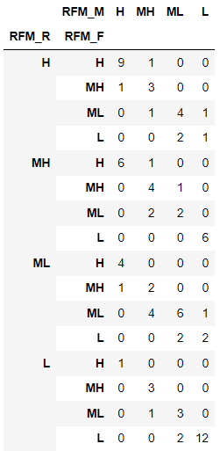
Segmentation
Active Customers
9 Gold customers
At Risk Customers
7 extremely significant customers at high risk of getting churned.
Inactive Customers
8 significant customers already churned.
Segmentation

Slide 20
Best Customers – Gold Customers
Most Loyal Customers – Top 5
Euro Shopping Channel
Mini Gifts Distributors Ltd.
La Rochelle Gifts
The Sharp Gifts Warehouse
Souveniers And Things Co.
Salzburg Collectables
Danish Wholesale Imports
L'ordine Souveniers
Reims Collectables
Euro Shopping Channel
Mini Gifts Distributors Ltd.
Australian Collectors, Co.
La Rochelle Gifts
Muscle Machine Inc
Churned Significant Customers
At Risk Good Customers
Amica Models & Co.
Collectable Mini Designs Co.
Herkku Gifts
Marta's Replicas Co.
Saveley & Henriot, Co.
Norway Gifts By Mail, Co.
Royal Canadian Collectables, Ltd.
Vida Sport, Ltd
Baane Mini Imports
Corrida Auto Replicas, Ltd
AV Stores, Co.
Land of Toys Inc.
Heintze Collectables
Rovelli Gifts
Online Diecast Creations Co.

Slide 21
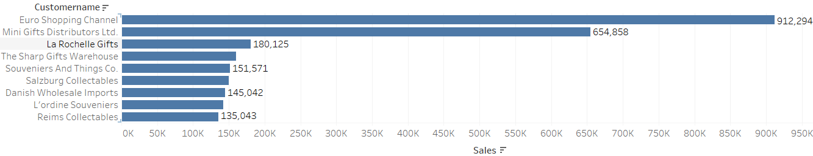
Best Customers
CUSTOMERNAME | RFM_M | RFM_F | RFM_R
Euro Shopping Channel | H | H | H
Mini Gifts Distributors Ltd. | H | H | H
La Rochelle Gifts | H | H | H
Souveniers And Things Co. | H | H | H
Reims Collectables | H | H | H
Salzburg Collectables | H | H | H
The Sharp Gifts Warehouse | H | H | H
L'ordine Souveniers | H | H | H
Danish Wholesale Imports | H | H | H

Slide 22
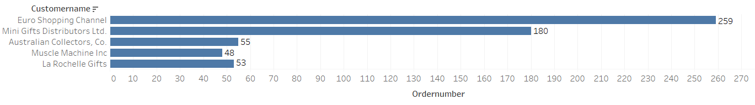
Most Loyal Customers
CUSTOMERNAME | RFM_M | RFM_F | RFM_R
Euro Shopping Channel | H | H | H
Mini Gifts Distributors Ltd. | H | H | H
Australian Collectors, Co. | H | H | MH
La Rochelle Gifts | H | H | H
Muscle Machine Inc | H | H | MH

Slide 23
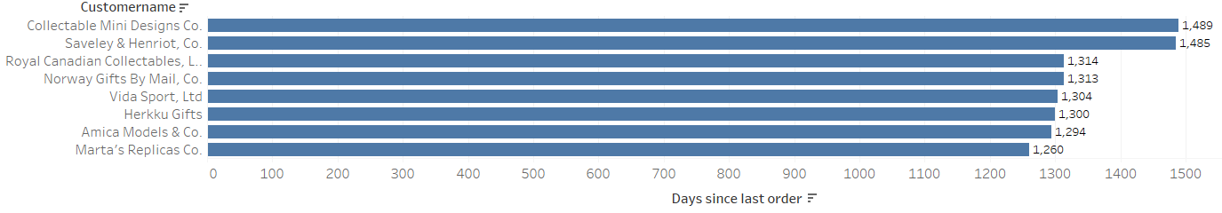
Churned Good Customers
CUSTOMERNAME | RFM_M | RFM_F | RFM_R
Amica Models & Co. | MH | ML | L
Collectable Mini Designs Co. | ML | ML | L
Herkku Gifts | MH | MH | L
Marta's Replicas Co. | MH | MH | L
Saveley & Henriot, Co. | H | H | L
Norway Gifts By Mail, Co. | ML | ML | L
Royal Canadian Collectables, Ltd. | ML | ML | L
Vida Sport, Ltd | MH | MH | L

Slide 24
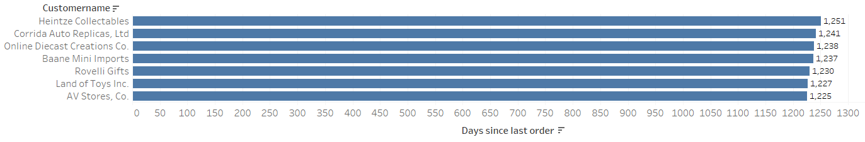
At Risk Good Customers
CUSTOMERNAME | RFM_M | RFM_F | RFM_R
Baane Mini Imports | MH | MH | ML
Corrida Auto Replicas, Ltd | H | MH | ML
AV Stores, Co. | H | H | ML
Land of Toys Inc. | H | H | ML
Heintze Collectables | MH | MH | ML
Rovelli Gifts | H | H | ML
Online Diecast Creations Co. | H | H | ML

Slide 25
Thank You!

