Slide 1
Diffpy-CMI,
Rob Koch
Brookhaven Lab
Notes:
Robert Koch
Brookhaven Lab
Collabs in Greece, Germany, SNS
arXiv link

Slide 2
Outline
Python? No silly walks here…
Diffpy-CMI
Beating a dead horse: fitting Nickel
Dead horse reprise: Nanocrystals
Some physics: the case of SrFe₂As₂

Slide 3
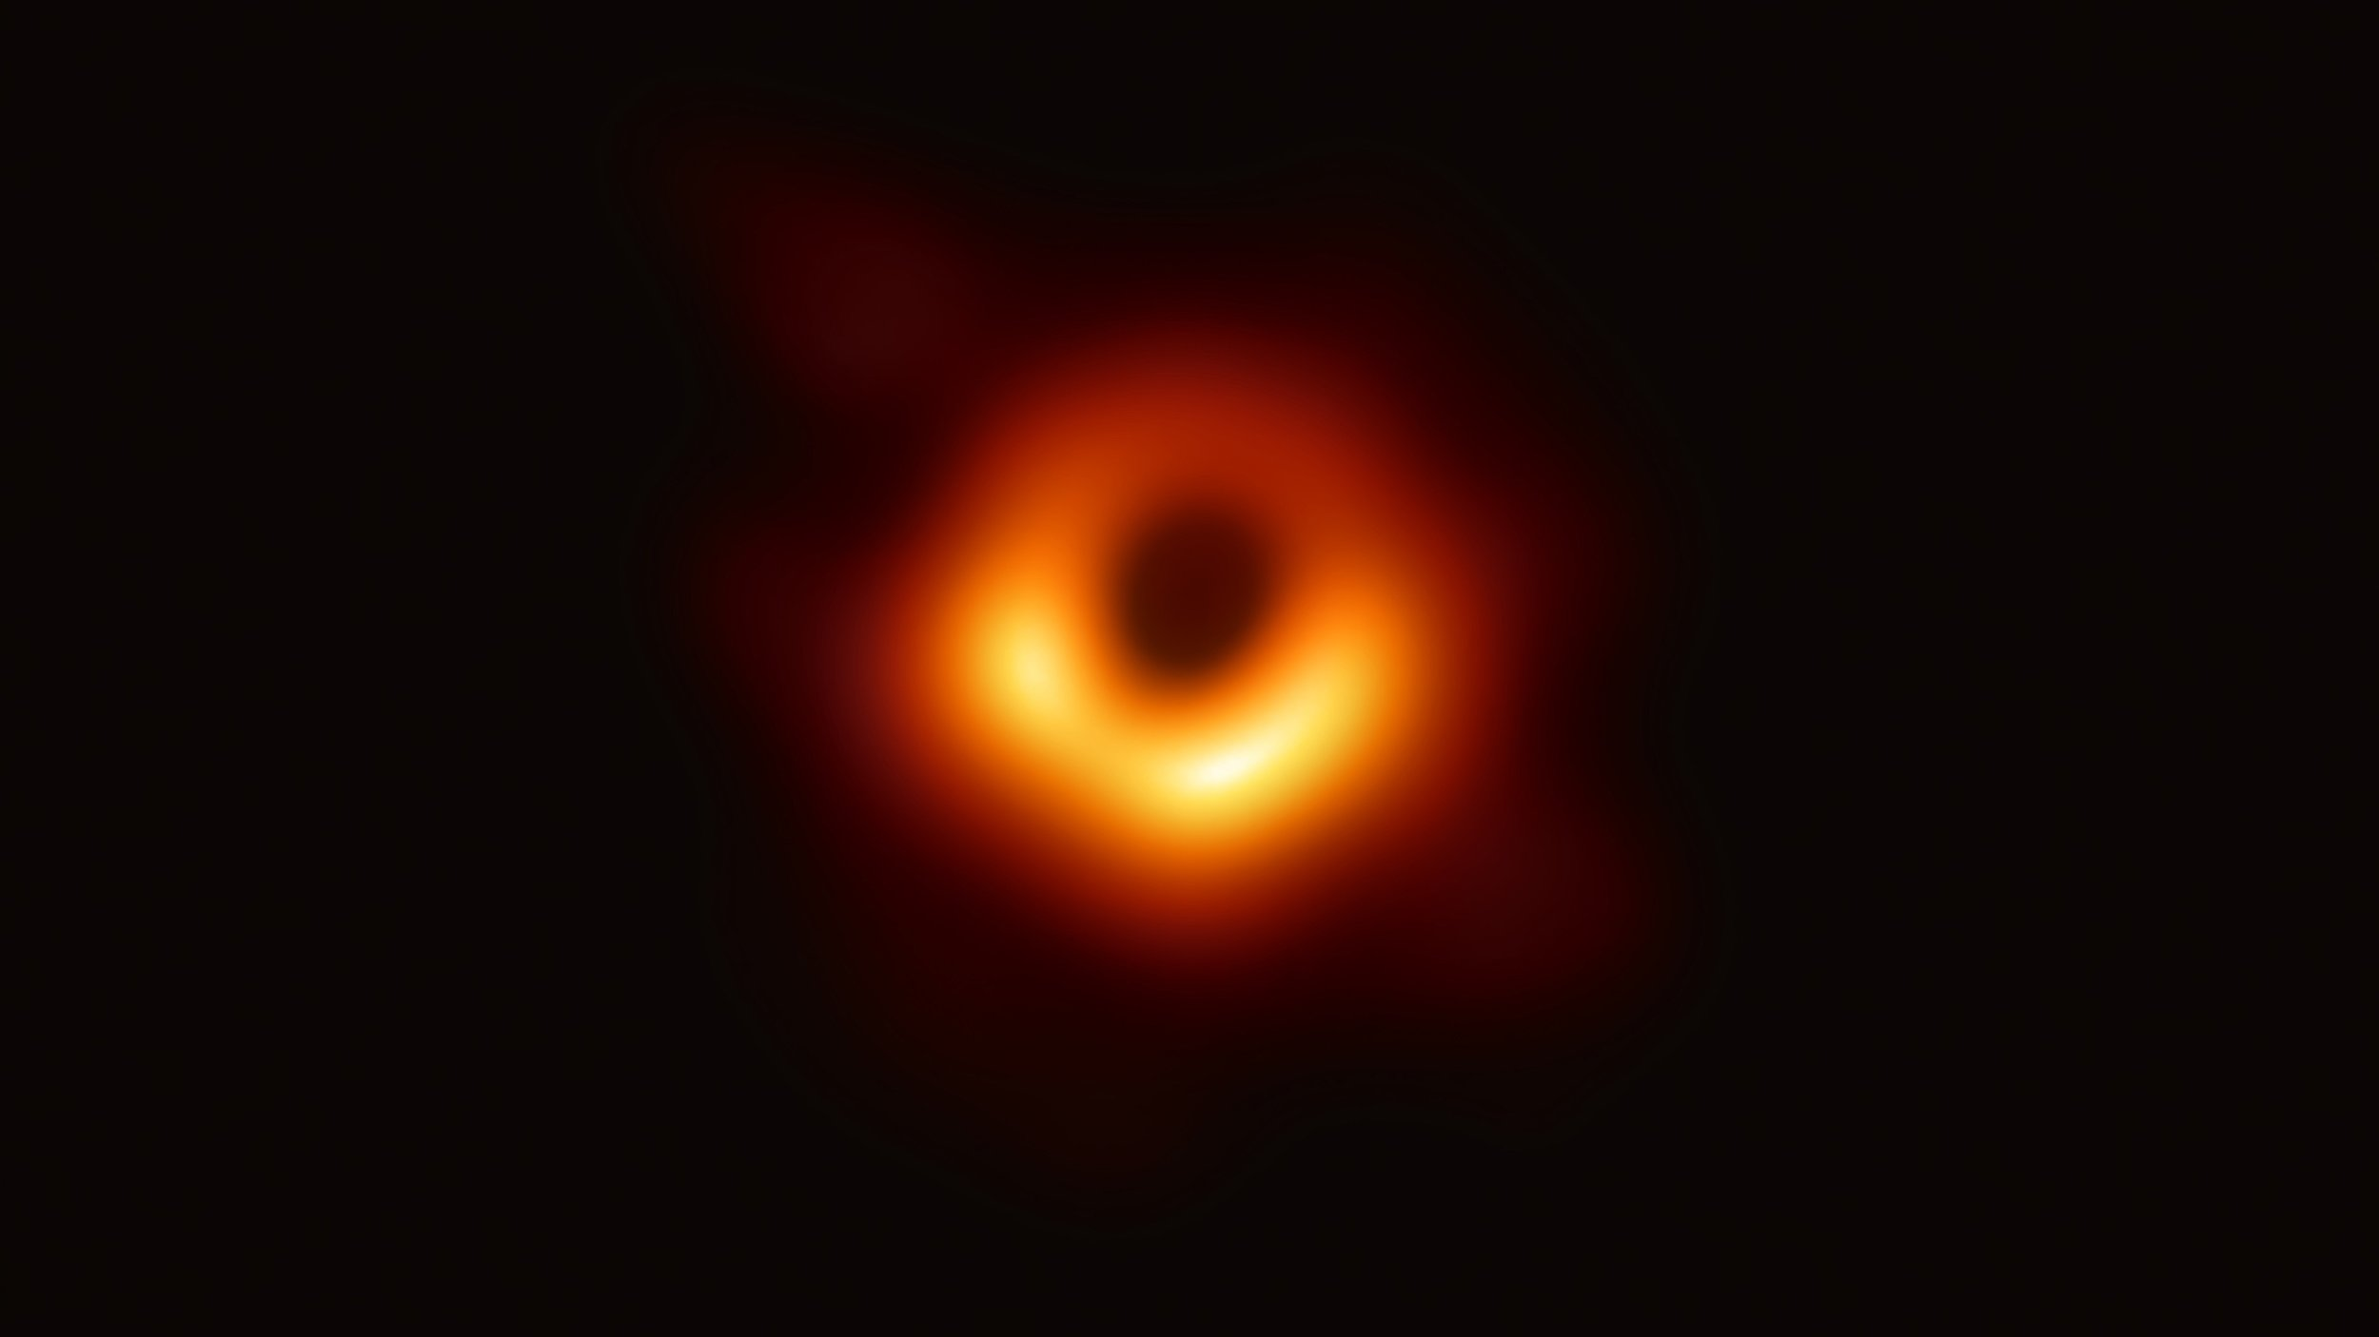
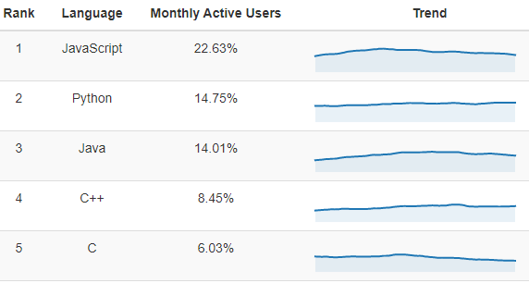
Python? No silly walks here…
Why use python?
It’s free!
It’s easy!
It’s open source!
It’s fast!*
*if you do things properly
https://youtu.be/BIvezCVcsYs
How can I use python?
First, install it:
https://www.anaconda.com/distribution/ (Windows)
https://docs.conda.io/en/latest/miniconda.html (Unix)
Next, apply it to your problems:
Read, plot your data (run away from MS Excel…)
Manipulate your data
Google
https://www.benfrederickson.com/ranking-programming-languages-by-github-users/
For your sake and ours, please use python 3 (not 2)…

Slide 4
Diffpy-CMI
Why would I use it?
PDFgui will only get you so far
A prerequisite of all advanced modelling is initial basic understanding
Python can streamline the handling and post processing of many datasets
Where can I get it? https://www.diffpy.org/products/diffpycmi/
What if I need help? https://groups.google.com/forum/#!forum/diffpy-users
What if I still need help? rkoch@bnl.gov
I can offer advice
I can help with minor debugging
What if I want to help? https://github.com/diffpy/
I cannot reduce your data
I cannot write your code
I cannot give you CPU cycles
Juhas, P., Farrow, C., Yang, X., Knox, K. & Billinge, S. (2015). Acta Cryst. A71, 562-568.
https://doi.org/10.1107/S2053273315014473

Slide 5
Let’s do some practical examples
You can have the source code: https://github.com/rjkoch/2019_ORNL_total_scattering
You can follow along: https://mybinder.org/v2/gh/rjkoch/2019_ORNL_total_scattering/master

Slide 6
Beating a dead horse: fitting Nickel
Let’s look at our prototype easy example
Fit PDF of nickel standard to get instrument parameters

Slide 7
Dead horse reprise: Nanocrystals
Let’s fit a nanocrystalline platinum system
We use our instrument parameters we refined in example 1

Slide 8
Some physics: the case of SrFe₂As₂
Iron-based superconductor
Phase transition (tetragonal to orthorhombic) at about 200 K
Some distortions persist….
B. A. Frandsen et al. Phys. Rev. Lett. 119, 187001 2017
https://doi.org/10.1103/PhysRevLett.119.187001

