Slide 1
Promotion & Credentialing
August 13, 2012

Slide 2
At GGC we have:
  1) the P&C Review Committees for each School
  and
  2) the College-wide P&C Standards Committee

Slide 3
Composition of P&C School Review Committees
  Three members (five members for schools with 75 or more full-time faculty) plus two alternates are elected by faculty in their respective schools for 2-year terms. Faculty are not eligible to serve on P&C Review Committees during their first year of service at GGC.
  SLA and S&T elect in odd-numbered years and SE and SB elect in even-numbered years.
  Each School Review Committee elects its chair from its members for a 2-year term.

Slide 4
Composition of the P&C Standards Committee
  The College-wide P&C Standards Committee is composed of the elected chairs of each P&C School Review Committee of the College.
  The Standards Committee elects its chair from its members every year.

Slide 5
Committee Membership
The committees will be comprised of Full Professors.
As an interim measure, if a School does not have a sufficient number of Full Professors, Associate Professors* may be elected to the vacant positions.
* Associate Professors wishing to apply for promotion are not eligible to serve on their respective P&C School Review Committees during that election cycle.

Slide 6
School of Business P&C Review Committee Membership, AY 2012-2013
Mei Miranda Zhang, Professor of Finance and Economics (Chair)
Spero C. Peppas, Professor of Marketing and International Business
James A. Weisel, Professor of Accounting
Alternates:
1. Atul Saxena, Professor of Finance
2. Vacant

Slide 7
School of Education P&C Review Committee Membership, AY 2012-2013
Rama Menon, Professor, Mathematics Education (Chair)
Gary Nelson, Professor, Mathematics Education
Julie Weisberg, Associate Professor, Curriculum & Instruction
Alternates:
1. Marquita Jackson-Minot, Associate Professor, Curriculum & Instruction
2. John Unger, Associate Professor, English for Academic Purposes

Slide 8
School of Liberal Arts P&C Review Committee Membership, AY 2012-2013
Ron Hunter, Professor of Criminal Justice/ Criminology (Chair)
Jill Jones, Professor of English
Herb Weaver, Professor of Art
David Cook, Associate Professor of Art
Ray Cook, Associate Professor of Psychology
Alternates:
1) Kay Heath, Associate Professor of English
2) Steve Platek, Associate Professor of Psychology

Slide 9
School of Science and Technology P&C Review Committee Membership, 2012-2013
Livinus Uko, Professor of Mathematics (Chair)
Alvina J. Atkinson, Associate Professor of Mathematics
Joseph Sloop, Associate Professor of Chemistry
Candace S. Timpte, Associate Professor of Biology
Vacant – to be filled by Fall 2012 election
Alternates:
Vacant – to be filled by Fall 2012 election
Vacant – to be filled by Fall 2012 election

Slide 10
Charges of the P&C School Review Committees
Each P&C School Review Committee is charged with reviewing credentialing* and promotion files and making the appropriate recommendations as laid forth in the P&C Policies and Procedures which appear on GGC’s web site.
* Confirming or not confirming Dean’s proposed rank for new hires

Slide 11
Charges of the P&C Standards Committee
  The P&C Standards Committee is charged with ensuring that P&C procedures and standards are maintained and applied consistently and equitably across all Schools.
  The P&C Standards Committee is also charged with reviewing P&C policies and procedures and making changes as needed.

Slide 12
Confidentiality
The members of the P&C Standards Committee and School P&C Review Committees are charged with adhering to a strict code of confidentiality. The official minutes of committee meetings shall constitute the only public communication regarding committee proceedings.

Slide 13
The Aim of GGC P&C Decisions
To award academic rank to faculty on the basis of:
Academic/Professional Qualifications
Quality of Teaching
Service
Student Engagement
Scholarship and Creative Activities
Collegiality

Slide 14
Minimum Years in Rank (Minimum Years at GGC)
From Instructor to Assistant Professor: 3 (3)
From Assistant Professor to Associate Professor: 6 (4)
From Associate Professor to Full Professor: 6 (5)

Slide 15
Minimum Years in Rank (Minimum Years at GGC)
Eligibility for Application for Promotion from Instructor to Assistant Professor
Applicant has faculty appointment @GGC at the rank of instructor?
yes
Applicant is beginning the 3rd year at the rank of instructor at GGC ?
yes
eligible to submit application

Slide 16
Minimum Years in Rank (Minimum Years at GGC)
Eligibility for Application for Promotion from Assistant to Associate Professor
Applicant has faculty appointment @GGC at the rank of assistant professor?
Applicant has had full-time experience @ another college/university at the rank of assistant professor or higher?
yes
no
2 or more years of such external experience, AND Applicant is beginning the 4th year at the rank of assistant professor at GGC ?
1 year of such external experience, AND Applicant is beginning the 5th year at the rank of assistant professor at GGC ?
Applicant is beginning the 6th year at the rank of assistant professor at GGC ?
OR
yes
no
yes
no
eligible to submit application
Application is early
eligible to submit application
Application is early

Slide 17
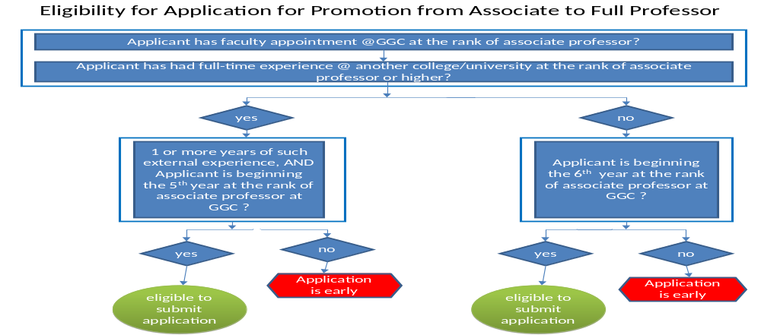
Minimum Years in Rank (Minimum Years at GGC)

Slide 18
Promotion Process
Faculty submit applications to chair of their P&C School Review Committee
Review is made by P&C School Review Committee and a written recommendation is submitted to Dean
Dean also makes a written recommendation which, along with School Review Committee’s written recommendation, is forwarded to VPASA
VPASA approves or denies promotion
VPASA forwards to President for final review and signature

Slide 20

Questions?

