Slide 1

CI/CD Implementation for UdaPeople
Raul Luzardo

Slide 2

Objective
Explain the benefits of CI/CD and the benefit that the implementation of such methodology will have for Udapeople

Slide 3
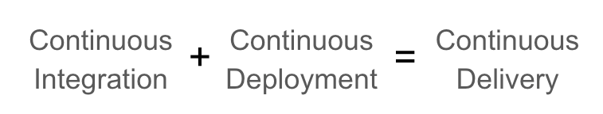
What is CI/CD
Continues Integration: merging all developers’ code working copies to a shared repository several times a day.
Continues Delivery: Implement the previous released features (code) in short cycles
Continues Deployment: Add value with the automated deployment of the previously created features.

Slide 4
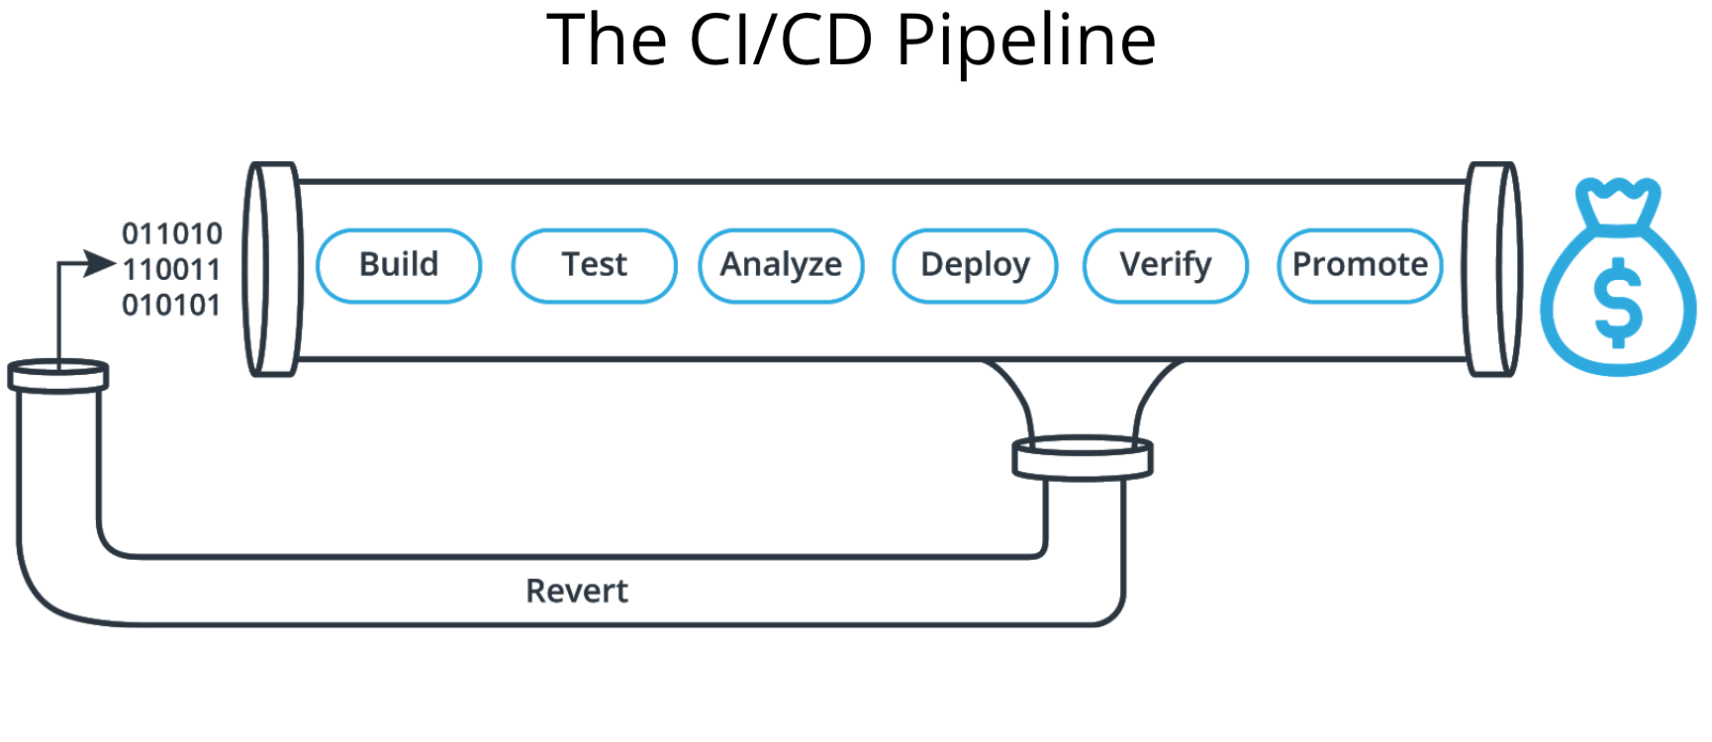
How CI/CD will help UdaPeople
Faster delivery of features
Reduce cost
Less human errors
Better software quality
Faster rollbacks in case of bugs
Continuous Improvement of our software
Happy Customers

Slide 5

How CI/CD is going to reduce cost
Less developer time resolving code issue
Prevent security holes
Decrease infrastructure investment
Reducing downtime from crash and bugs

