Slide 1
RENT A CAR PROJECT
CS 331-H02 Group 11;
Thomas Kataryniak, tnk6@njit.edu
Ryan McCusker, rjm8@njit.edu

Slide 2
ENTITIES
CUSTOMER
RESERVATION
RENTAL AGREEMENT
BRANCH
CAR
MODEL
CLASS

Slide 3
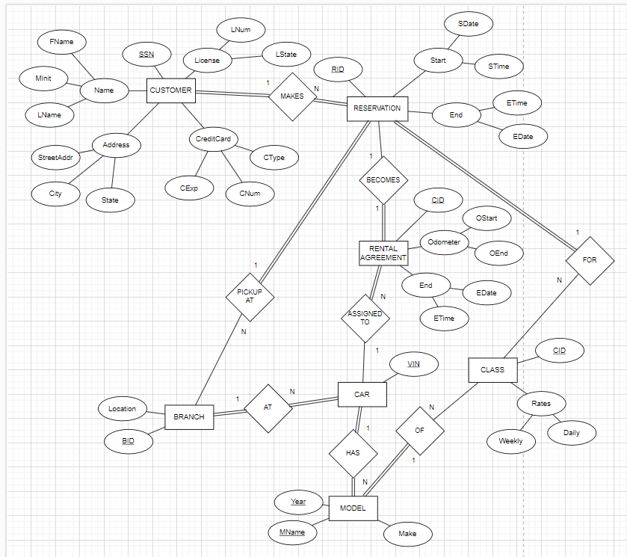
EER DIAGRAM

Slide 4
DESIGN DIRECTION
Collect customer information
Customer reserves time and class
Rental agreement is reached
Car to be rented
Model of car
Location of car
Class of car

Slide 5
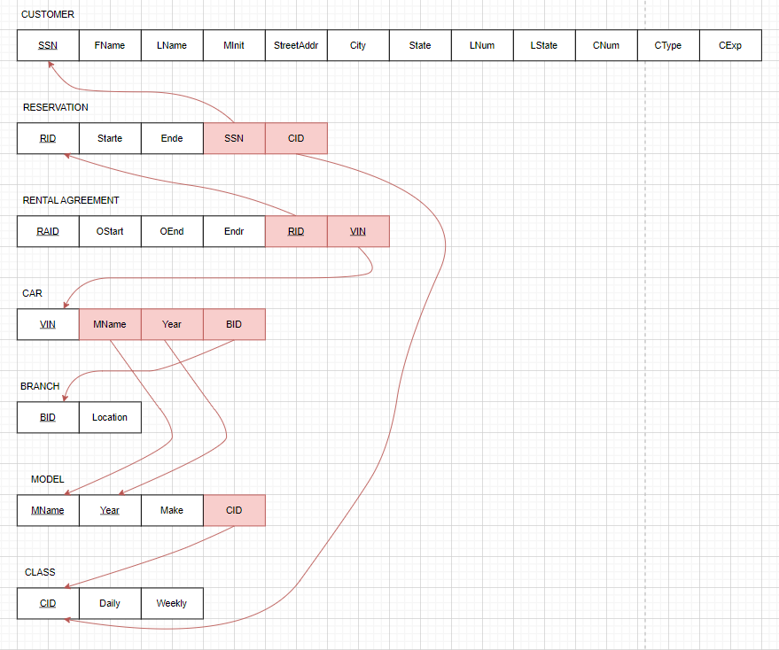
SCHEMA DIAGRAM

Slide 6




DATA EXAMPLE

