Slide 1
ADALM PLUTO
Julio Tena
EE504
4/21/20

Slide 2
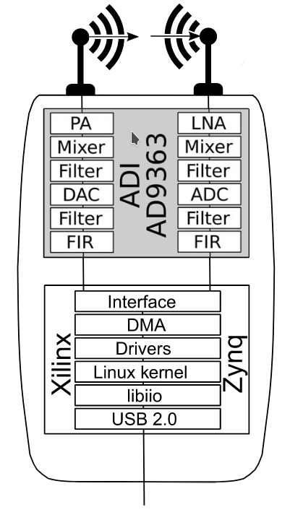
ADALM PLUTO
Full Duplex
AD9363 Integrated RF Agile Transceiver
Fixed halfband decimation & interpolation filters and programmable 128-tap FIR filters
Source: Software-Defined Radio for Engineers

Slide 3
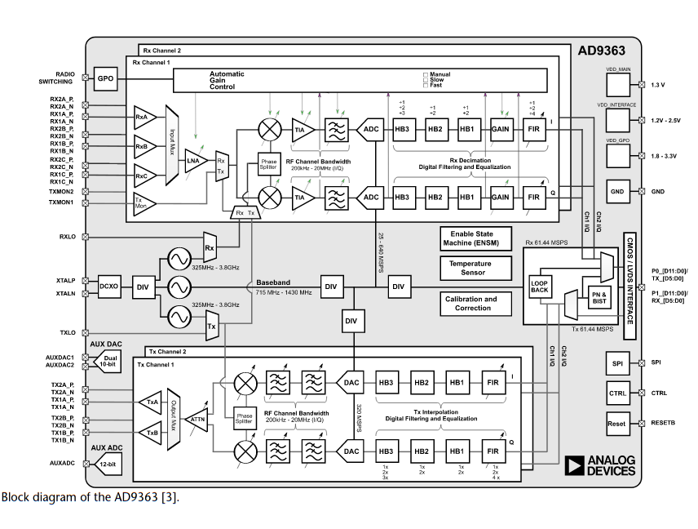
ADALM PLUTO
Source: Software-Defined Radio for Engineers

Slide 4
AD9363
Rx & Tx
300 MHz – 3.8 GHz, 200 kHz – 20 MHz channel bandwidth, 65.1 kSPS – 61.440 MSPS
2.4 Hz LO step size, 5 Hz sample rate step size
12-bit DACs
* Frequency range can be configured to 70 MHz – 6 GHz
Source: Software-Defined Radio for Engineers

Slide 5
AD9363
Rx & Tx
300 MHz – 3.8 GHz, 200 kHz – 20 MHz channel bandwidth, 65.1 kSPS – 61.440 MSPS
2.4 Hz LO step size, 5 Hz sample rate step size
12-bit DACs
* Frequency range can be configured to 70 MHz – 6 GHz

Slide 6
AD9363 - Rx
Signal acquisition
LNA
Splits off into two identical paths (IQ) components
Provide analog gain
Mixer (ZeroIF)
Phase rotation of mixer’s clock
Doubles effective bandwidth ( -fs/2, fs/2 )
Filters
Remove aliasing effects
Maintain desired analog bandwidth
Source: Software-Defined Radio for Engineers

Slide 7
AD9363 – Rx (continued)
Source: Software-Defined Radio for Engineers
Digital Conversion
ADC doesn’t provide all 12 bits (~ 4.5 bits of resolution)
Additional bits gained in halfband filter (HBF) stages
“Therefore, the best signal resolution is achieved through large oversampling of the input signal and then followed by several decimation stages”

