Slide 1
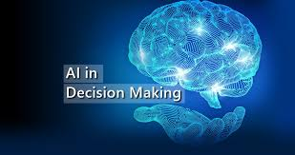
R. Joseph Manoj Ph.D.

Slide 2
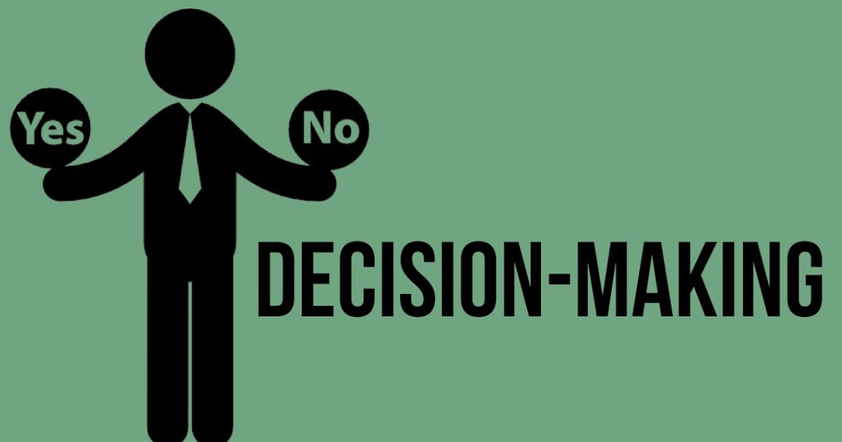

Slide 3
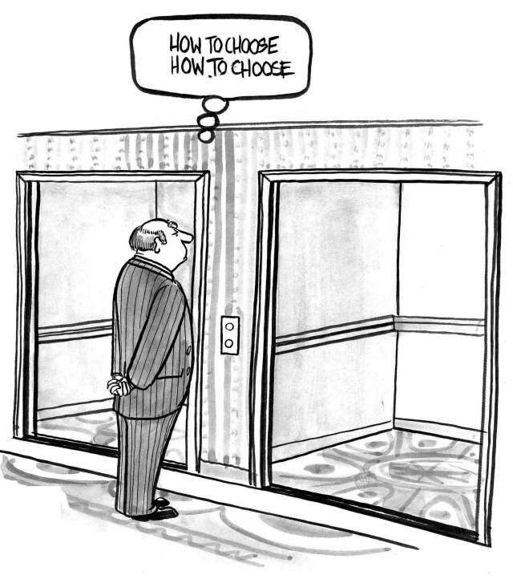

Slide 4
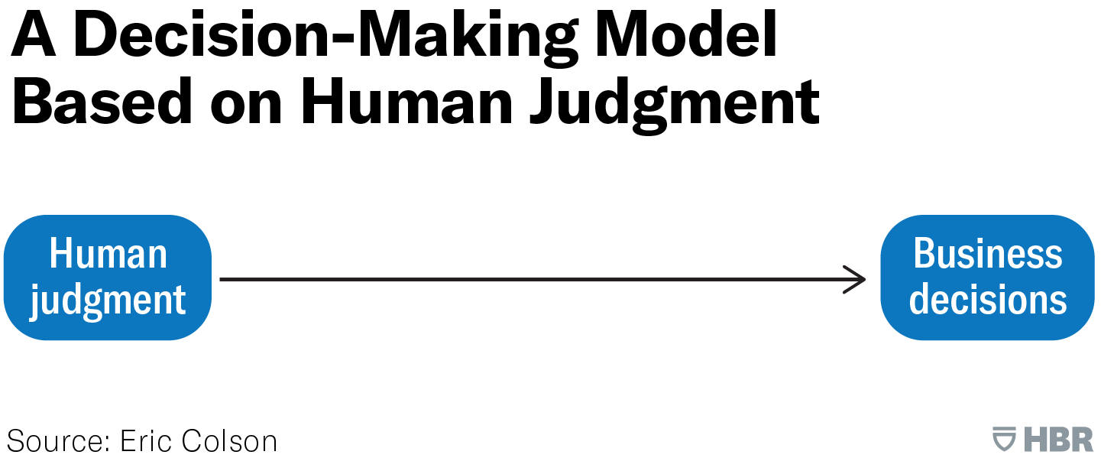


Slide 5
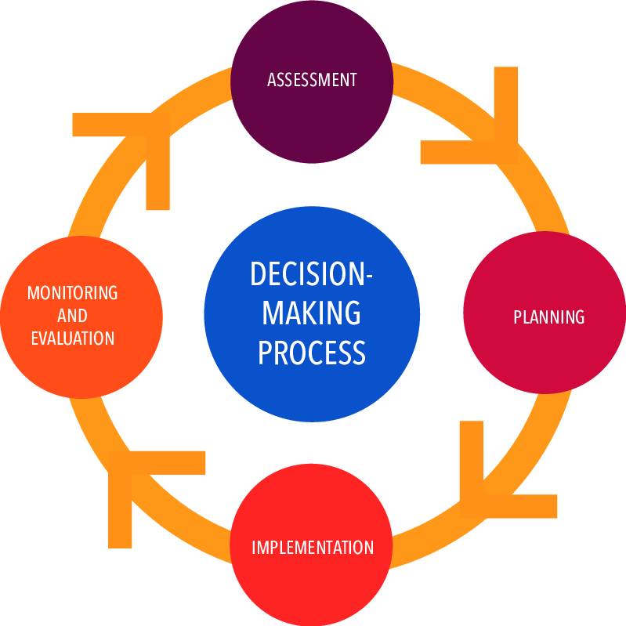

Slide 6
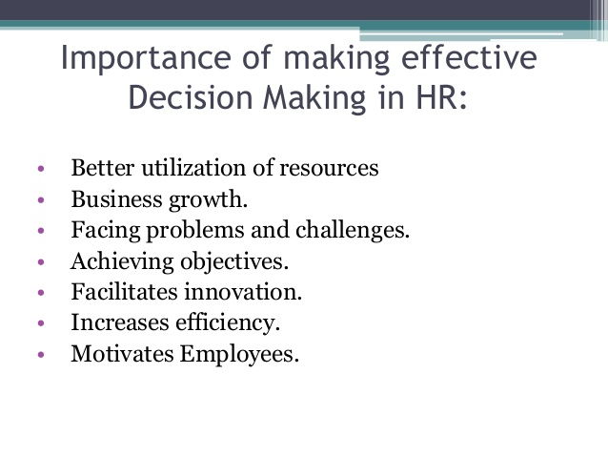

Slide 7
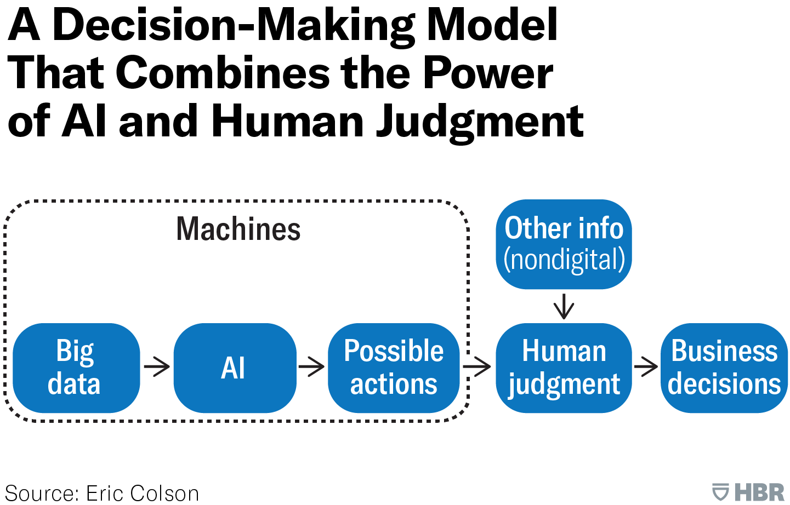


Slide 8
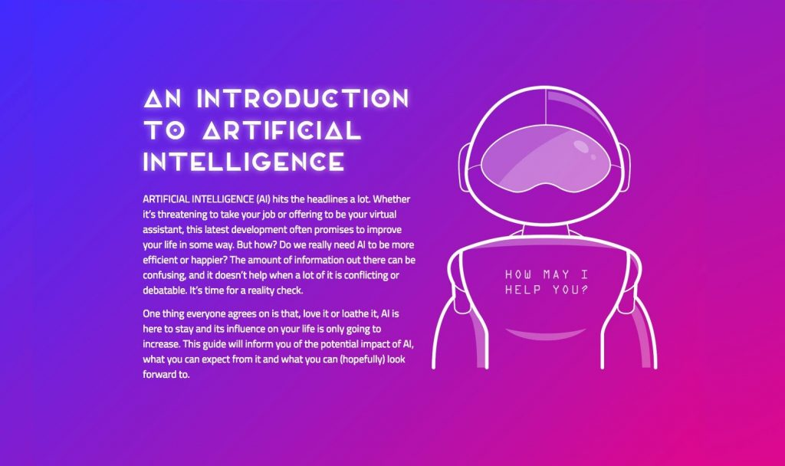
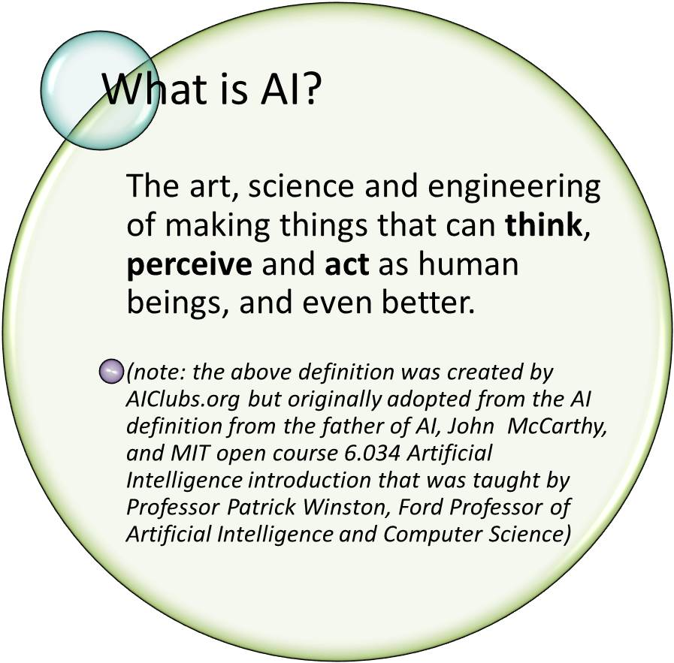

Slide 9
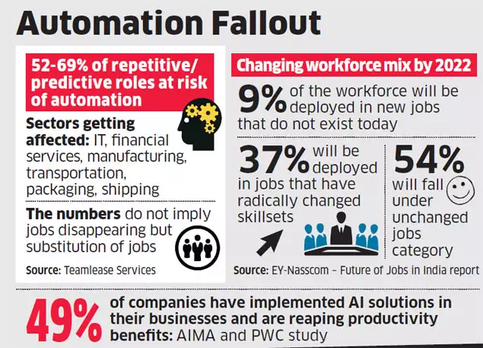

Slide 10
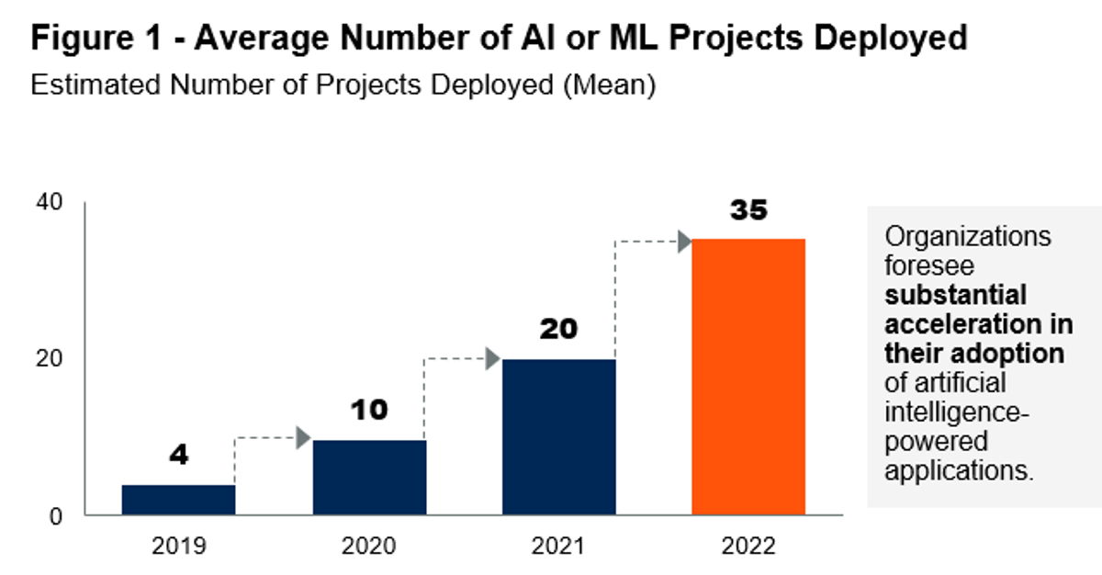


Slide 11
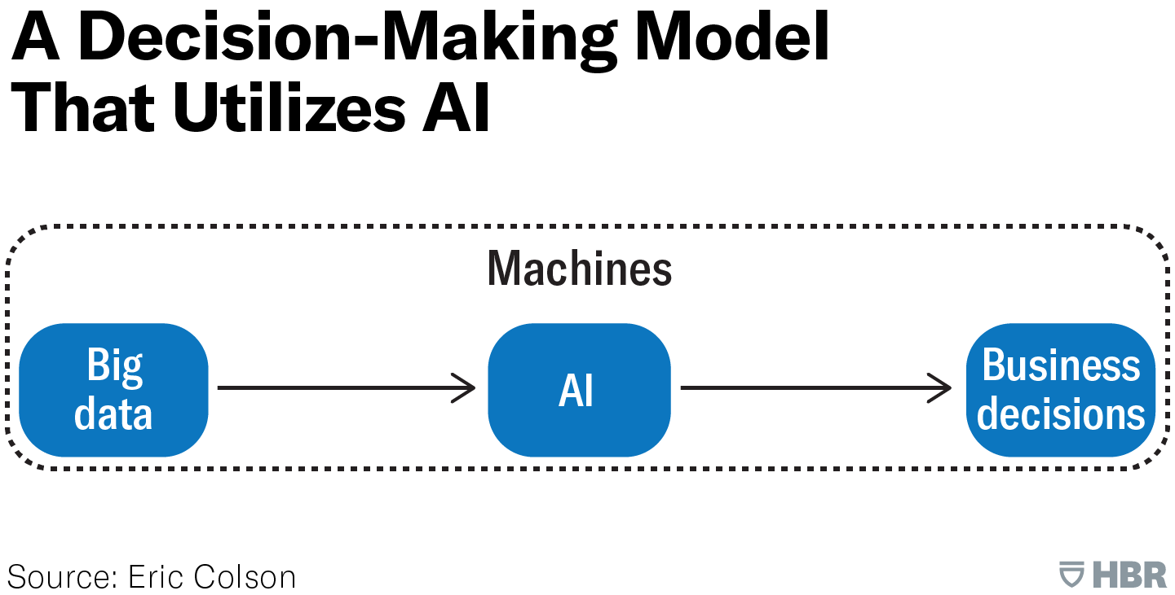

Slide 12
Advantages (Pros) of AI | Disadvantages (Cons) of AI
Reduce human errors | Job losses
Increase Productivity | Poses an existential risks
Brings speed to decision making processes | It can be wrong
Reduces cost of goods and services | Expensive to develop
Handles repetitive tasks excellently | Has no original creativity
Available 24/7 | It can’t currently handle highly intelligent tasks
Handles low level tasks excellently | Can do things but can’t explain
Open up money making opportunities | It increases war destructiveness
Transforms Healthcare for better | Results to loss of skills
Undertake dangerous explorations | Abilities are limited to it’s training datasets
Improves security roundabout
Transform learning
Foster communication
Creates new jobs
It learns

Slide 13
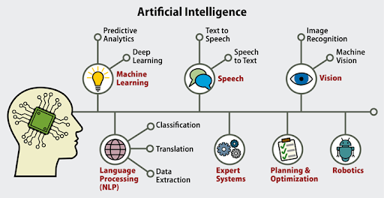

Slide 14
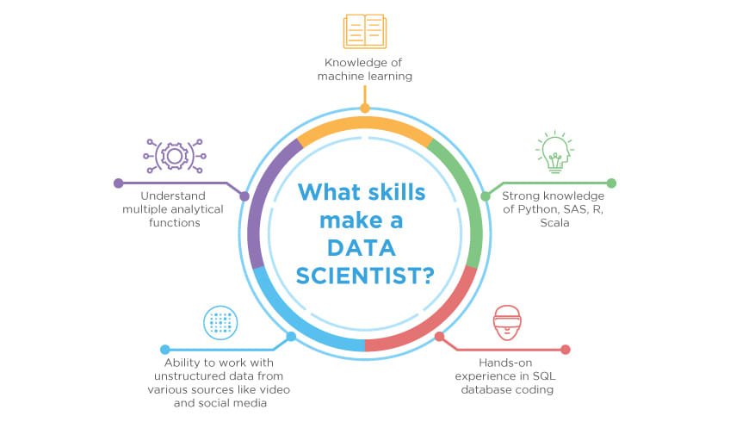
Data Science

Slide 15
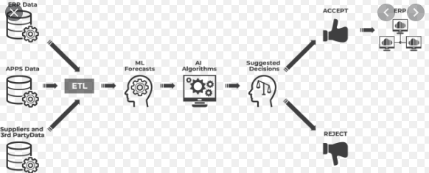

Slide 16
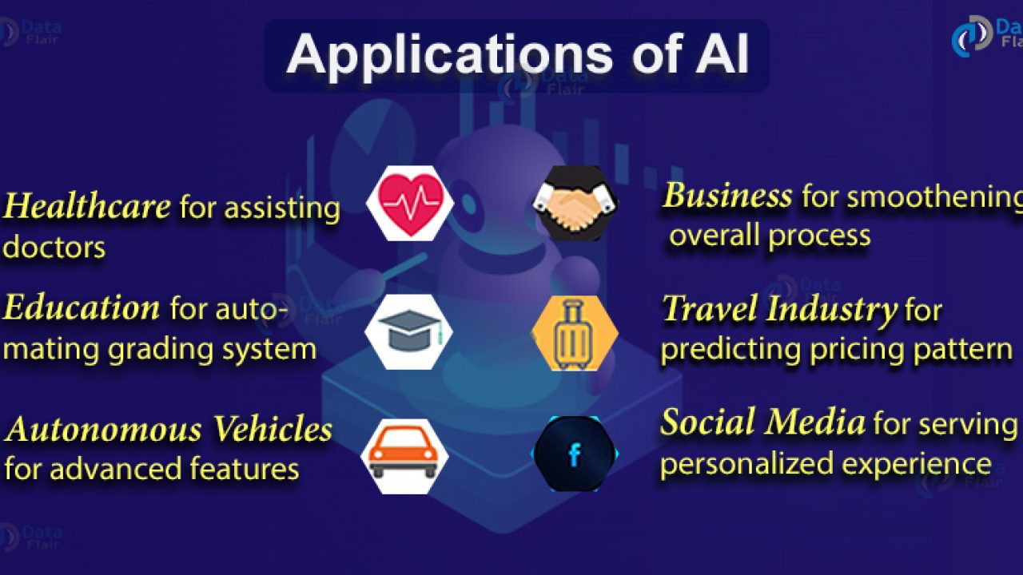

Slide 17


