Slide 1

Data Science Framework Report
Rob McLain – DA1018UT – C5T1

Slide 2
Agenda
Background
Scope
Analysis Plan
Data Collection
Insights
Recommendations

Slide 3
Background
Over the past year or so CreditOne has seen an increase in the number of customers who have defaulted on loans they have secured from various partners.
CreditOne could risk losing business if the problem is not
resolved.

Slide 4
Scope
Main Objective: Develop an empirically sound
method to forecast which customer is likely to default.
Reason: If CreditOne can identify accounts likely to
default, defensive measures can be taken to limit the
amount of financial exposure.
Benefit: Accounts with similar credit risk profiles can be moved / bundled into specialized products.

Slide 5
Analysis Plan
Determine if sufficient data is available to forecast
future defaults.
Use simpler analysis techniques to gather low-hanging
fruit; i.e. correlation analysis, trend analysis, estimation
and sizing, aggregate analysis.
Test data to determine which variable has the most
significance.
Consider if original question has been successfully
answered or if further analysis is required.

Slide 6
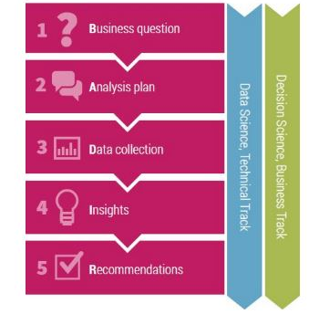
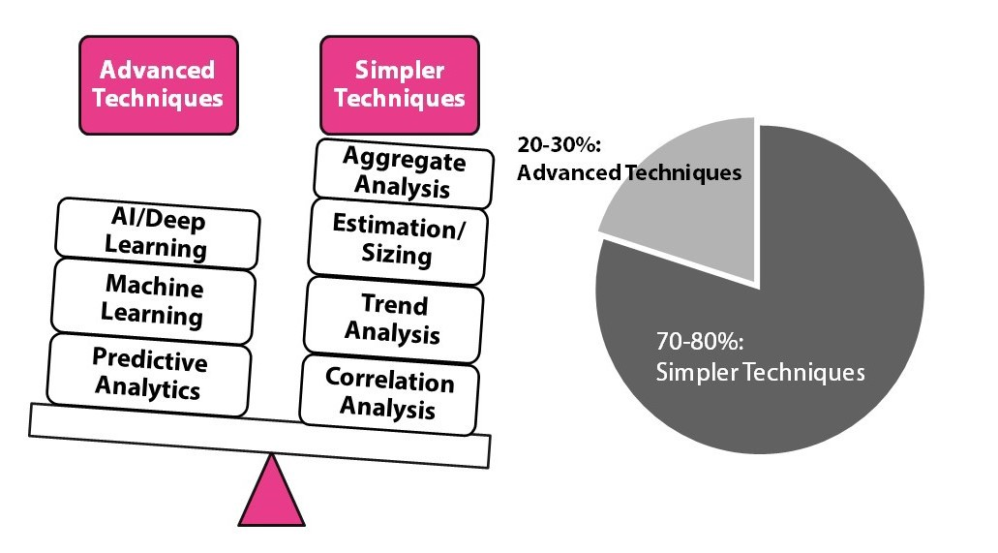

Slide 7
Data Collection
Data file “default of credit card clients.csv”, a collection of
30K credit records gathered from Taiwan in 2005, is to be
used as a testbed to develop a forecasting algorithm.
File consists of data which is available in our systems.
Data is comprised of Credit Limit, Gender, Education Level,
Marriage Status, Age, Credit Payment History (6 months),
Monthly Balance (6 months), Monthly Payment (6 months),
and Default Indicator.
File must be checked to determine missing, invalid, or
extreme values. Data with no significance will be removed
from the sample.

Slide 8
Insights
Using aggregate analysis, the data identifies a
population which is mostly women with a college
education, unmarried, under 30 years of age, who use
the card as a traditional revolving account with a credit limit of $50K.
Data is somewhat skewed due to individual accounts
with large credits (2% of file) or balances exceeding
$150K (9% of file).
This data may contain cultural nuance which may impact our findings. (Amounts are in Taiwanese New Dollar NT$)
Until further analysis has been conducted, these
findings should be treated as mere observations.

Slide 9
Recommendations
Further analysis will be required to be able to
determine what data is significant.

