Slide 1

CS551 Advanced Software Engineering UMKC
Tutorial 4
Android App Development using Android Studio

Slide 2
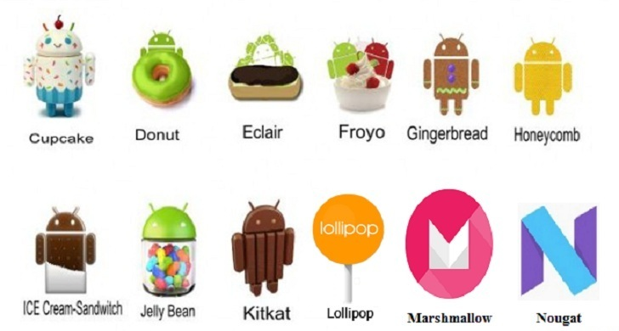
Android Versions

Slide 3
Topics
Creating Android Device Emulator
Understanding Android Directory structures
Android Programming Basics
Request/Response handling in Android App
Run Android App in emulator/device

Slide 4
Android Virtual Device Creation

Slide 5
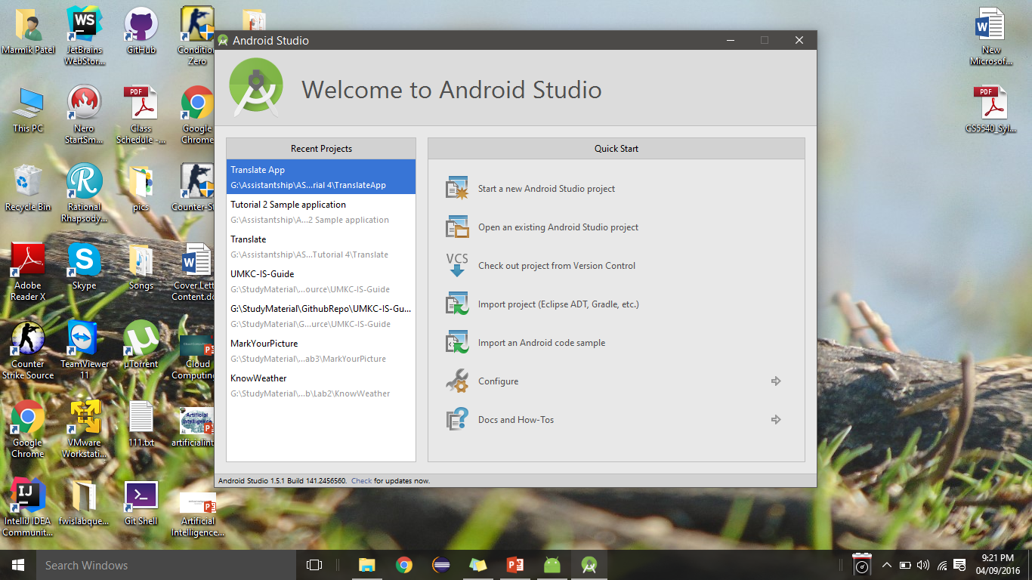
Open Android Studio
Click on the configure button

Slide 6
AVD Manager
Steps:
Open Android studio->Click Tools -> Android -> SDK Manager->AVD Manager
Click on Create Virtual Device.
Select a device that you intend to emulate and click Next.
Select the OS that you want the device to run on
You need to download and install OS versions in case they are not there
Finally name your AVD and configure it. Click Finish

Slide 7
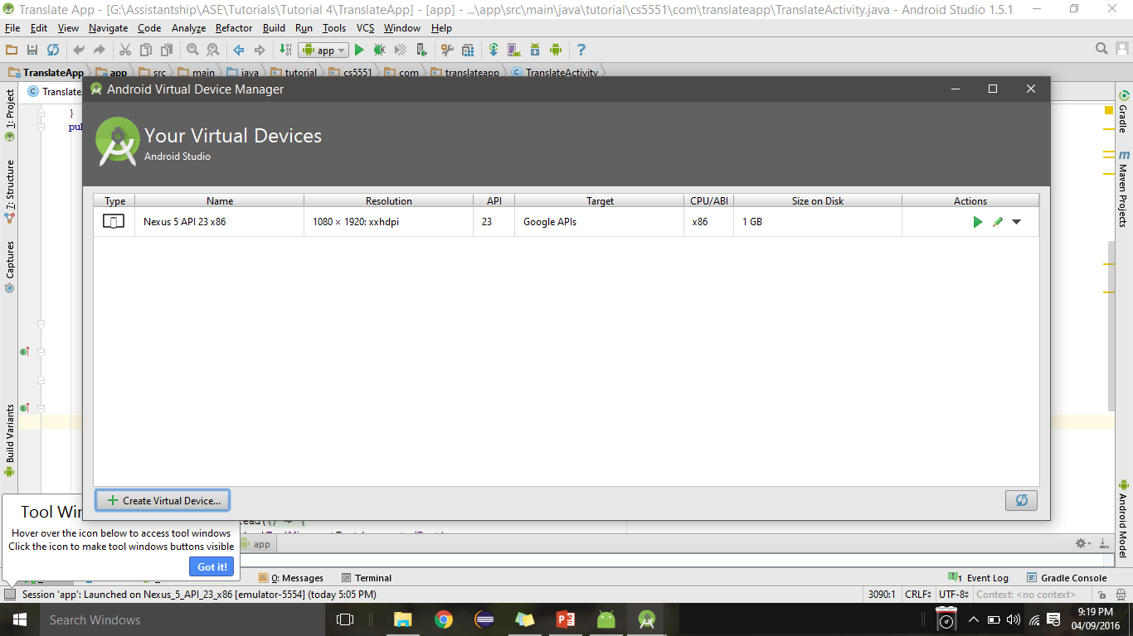
AVD Manager

Slide 8
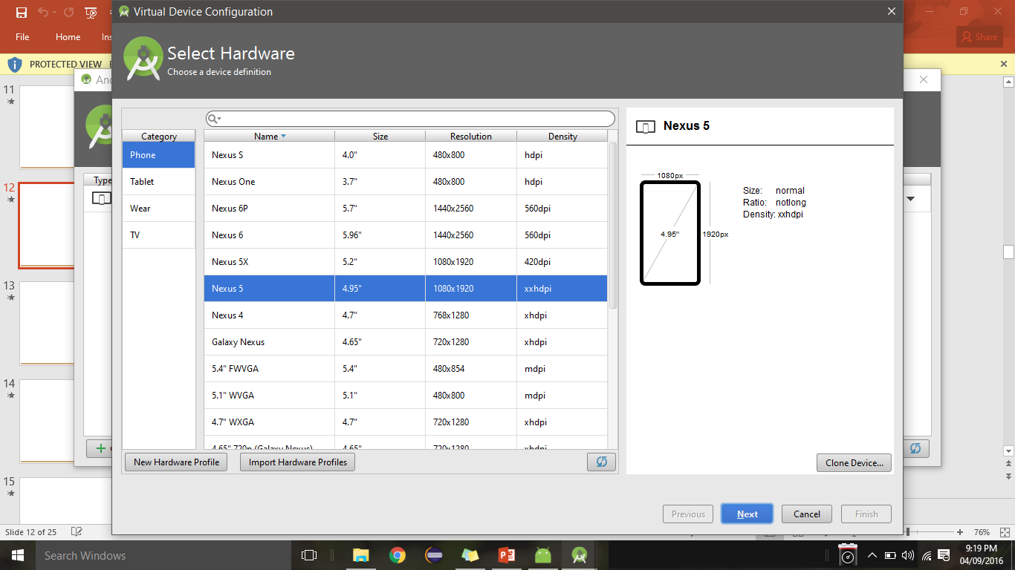
AVD Manager

Slide 9
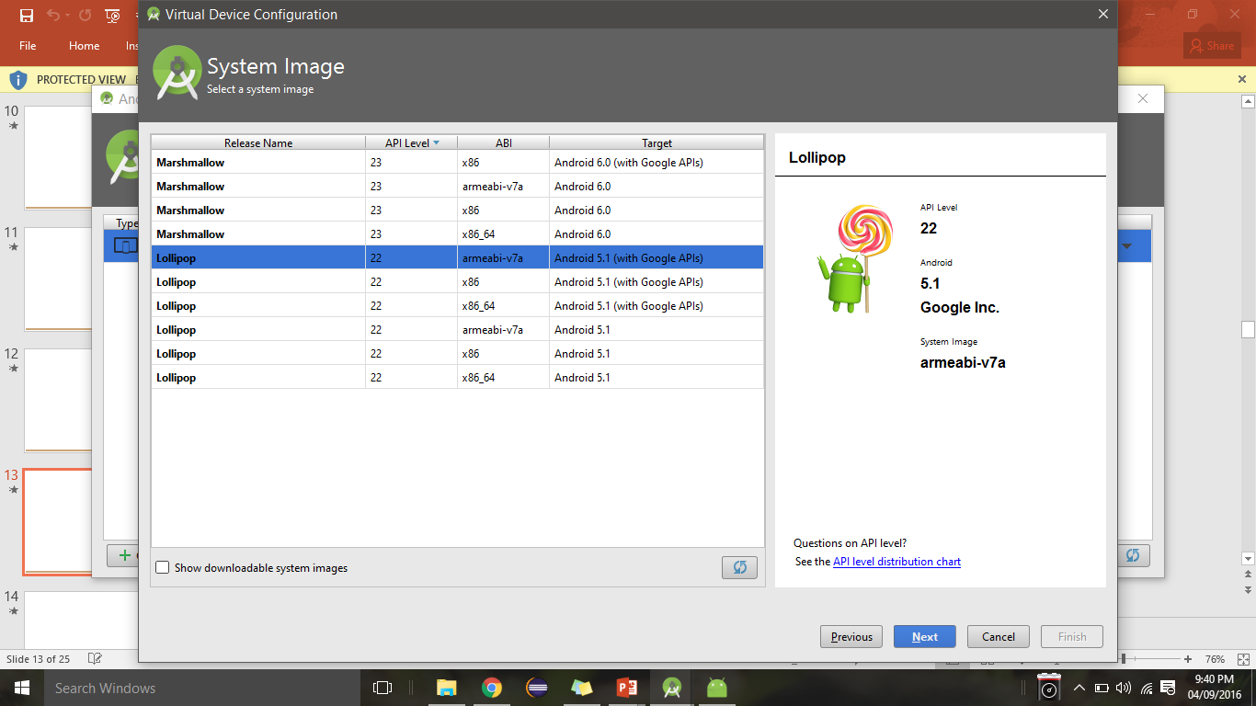
AVD Manager

Slide 10
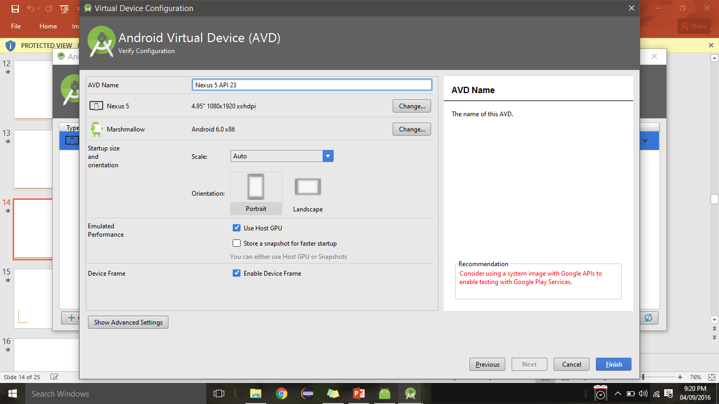
AVD Manager

Slide 11
Android App Development
https://alvinalexander.com/android/android-cheat-sheet-main-concepts
https://www.tutorialspoint.com/android/index.htm

Slide 12
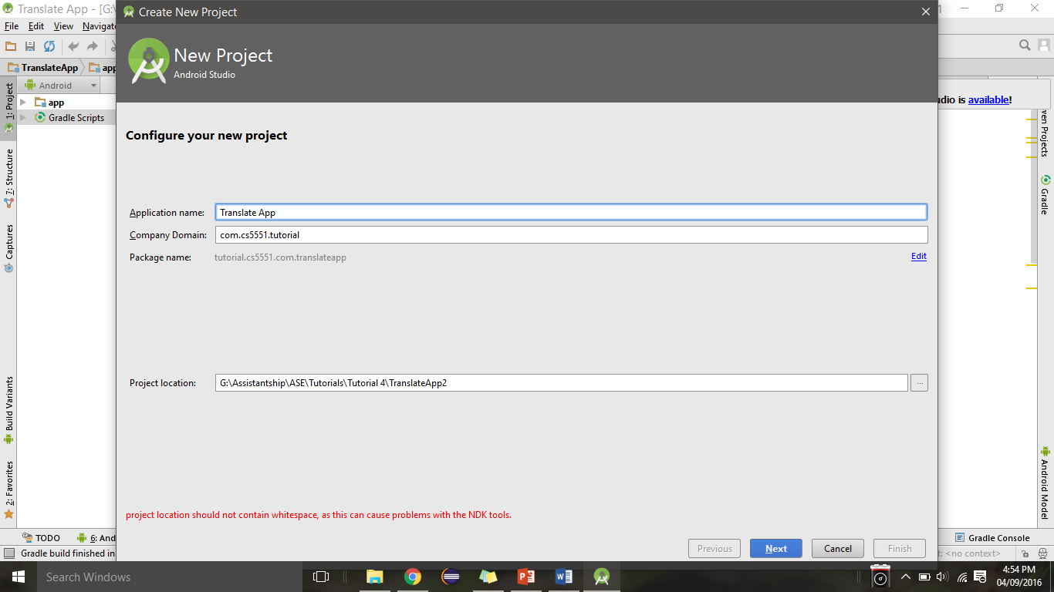
Creating a new Android application
Application name and domain

Slide 13
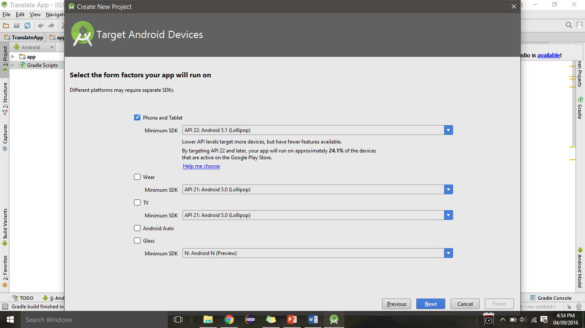
Selecting the SDK and Type of Target Device
1
2
The minimum SDK version that you want your app to run on. It is better to prefer a version that is stable and new
2. In case you want your app to deployed on smart watches and other wearable device.

Slide 14
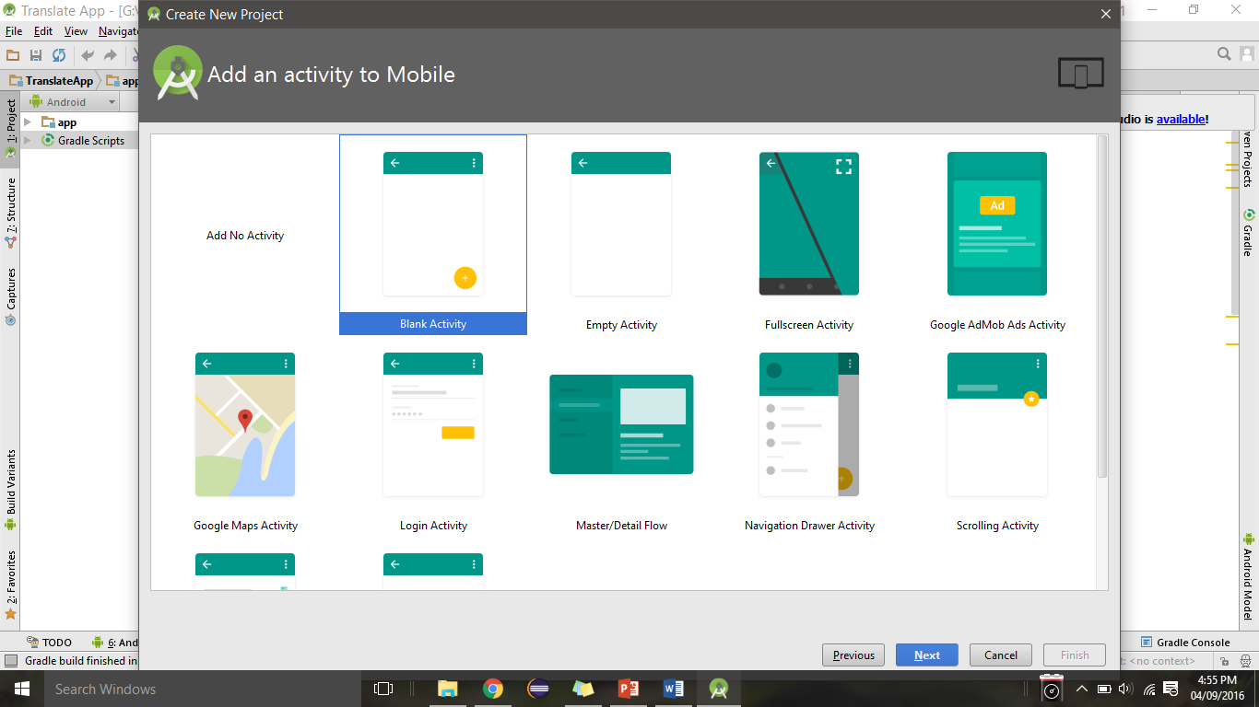
Selecting the Type of Activity for the Application
You can choose from various templates available to start off the application. It is better to choose a
Blank activity as you could add and manage the controls as you need.

Slide 15
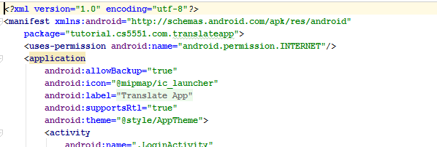
Android Manifest
Do not forget to add internet permission in AndroidManifest.xml file to enable internet access in device/emulator

Slide 16
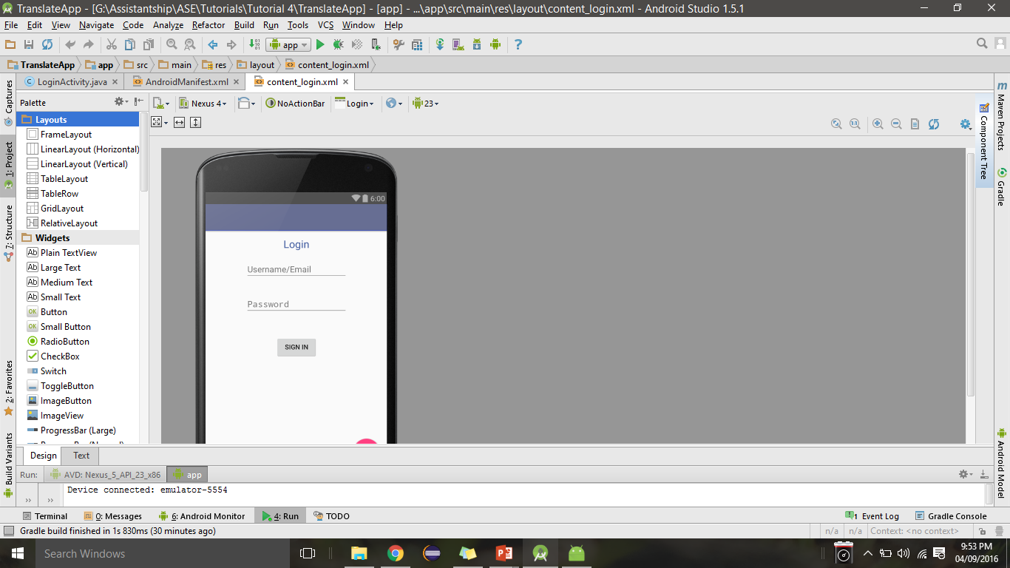
Controls in the Application provided in Tutorial
TextView Control
EditText Controls
Button Control
Explore the other controls present in the SDK in your lab exercises

Slide 17
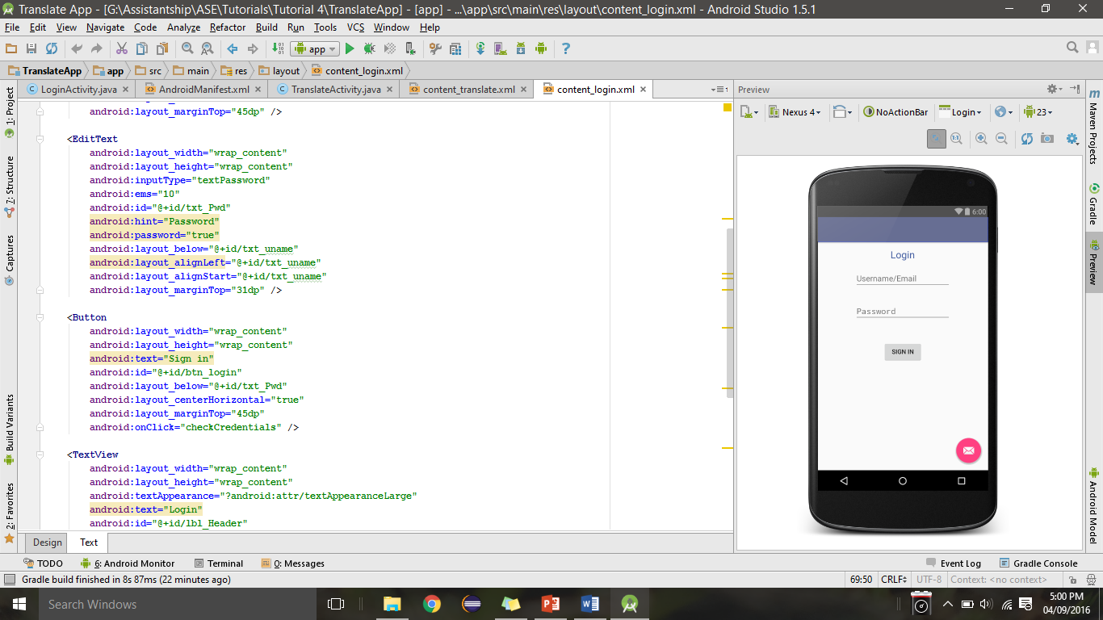
XXX.xml

Slide 18
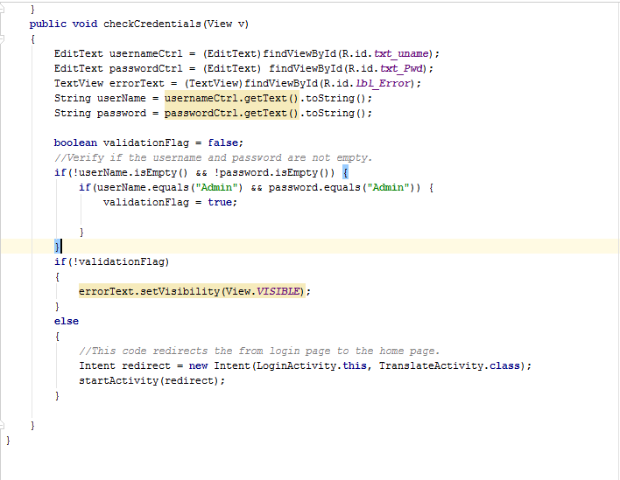
Code for login…...
Accessing the UI controls to get the username and password
Redirecting to the web service page on successful login.

Slide 19
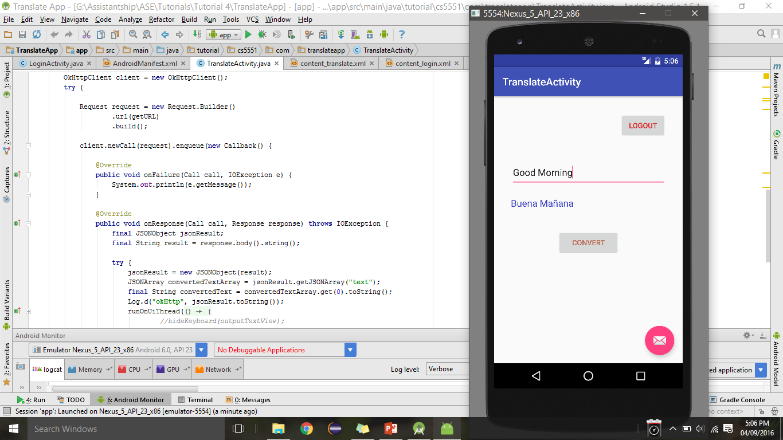
Snapshot of the Translate Activity for the Tutorial Application
Source text
Translated text

Slide 20
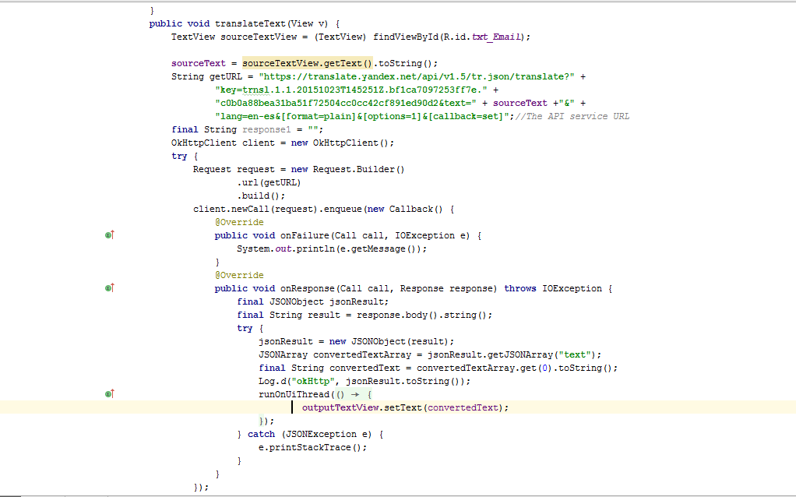
Translate web service code...
Accessing the UI controls
JSON web parsing of web service response
Populating the UI with the translated text

Slide 21
Run app on real device
Connect your device to your development machine with a USB cable. If you're developing on Windows, you might need to install the appropriate USB driver for your device. For help installing drivers, see the OEM USB Drivers document.
Enable USB debugging on your device by going to Settings > Developer options.
Note: On Android 4.2 and newer, Developer options is hidden by default. To make it available, go to Settings > About phone and tap Build number seven times. Return to the previous screen to find Developer options
In Android Studio, click the app module in the Project window and then select Run > Run
In the Select Deployment Target window, select your device, and click OK
Android Studio installs the app on your connected device and starts it

Slide 22
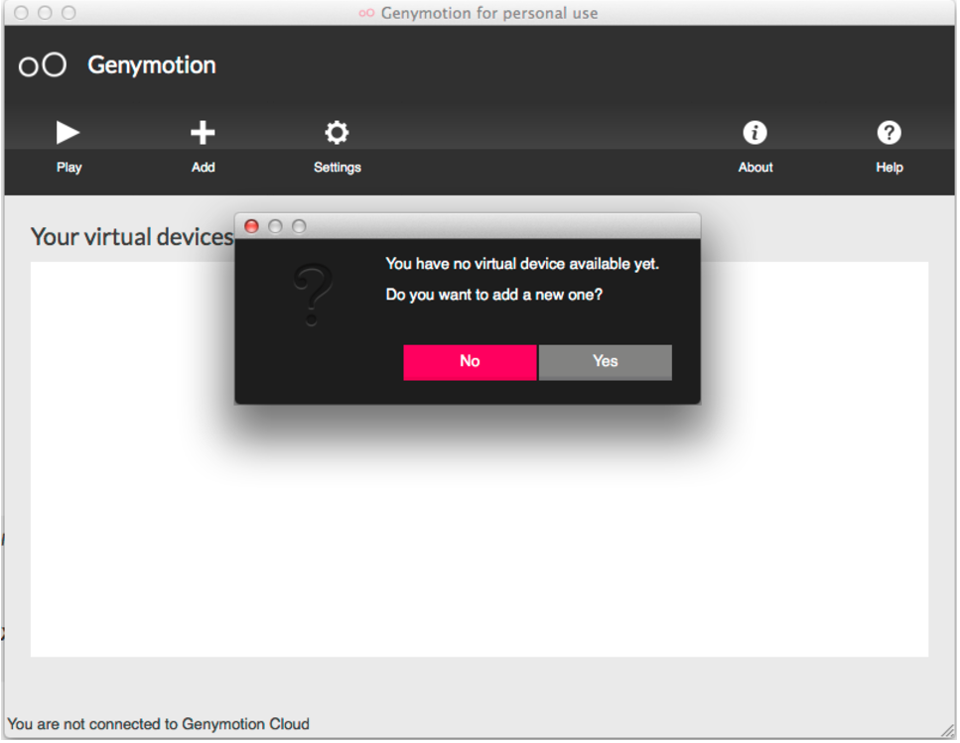
Android Studio + Genymotion Emulator
Download and Install VirtualBox https://www.virtualbox.org/wiki/Downloads
Signup with Genymotion + Download installer
Go to genymotion.com and signup
Click the “Get Genymotion” button and download the appropriate version for your OS.
Run the Genymotion application
It will install Genymotion and Genymotion shell — run the Genymotion application (not the shell)
http://tleyden.github.io/blog/2013/11/22/android-studio-plus-genymotion-emulator/

Slide 23
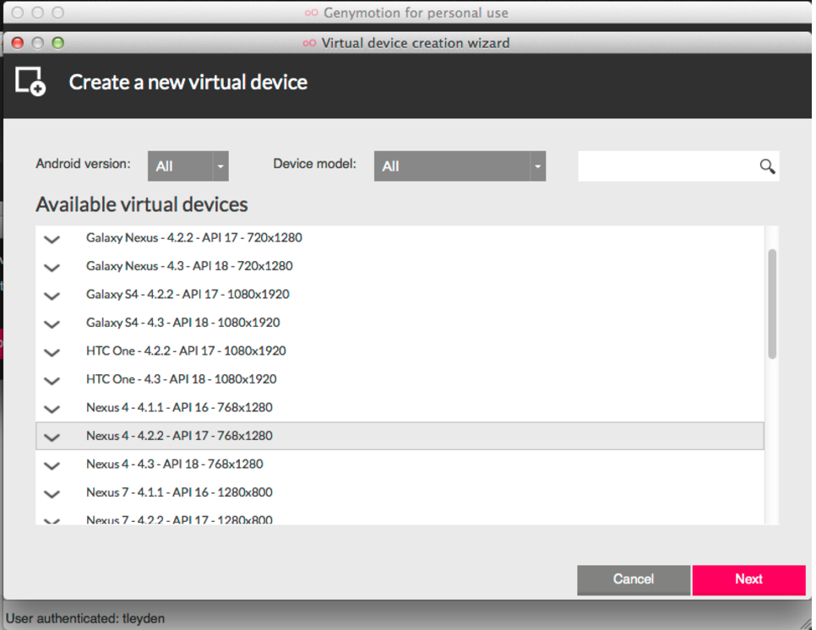
Click add new virtual device. It will ask you to login, then show you a list:
Pick the virtual device you want and it will download it.

Slide 24
Configure Android Studio plugin
Go to Preferences / Plugins and click “Browse Repositories”, then search for Genymotion. Right click and choose “Download and Install”.
Restart Android Studio and you should see a new icon in your IDE.
Click the icon and it will bring up Preferences, and choose the path to the Genymotion application.
Now if you click the Genymotion icon again, you will see the list of devices available
Click the Genymotion icon within Android studio, select a virtual device, and hit start.

Slide 25
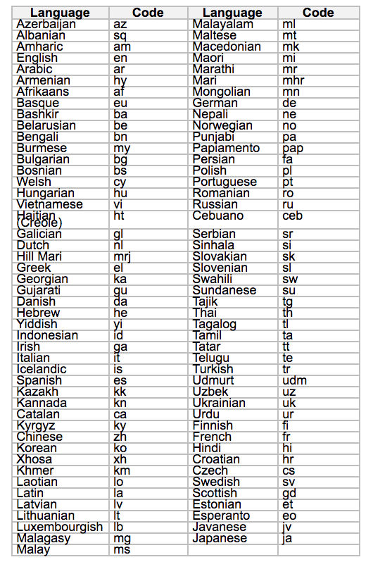
In Class Exercise
Change the login username and password validation to your name and password
Change the Translate activity so that the user will be able to select any two of the available languages one as his source and the other as the target language to be translated to
Create a logout button in translate page to take back the user to login page
Language codes

Slide 26
Thank You

