Slide 1
Tutorial 2
HTML5, Bootstrap, JSLint, Angular JS-1, AJAX
(8/30/2018)
CS551 Advanced Software Engineering
UMKC

Slide 2
Topics to be covered
Wireframe Design
HTML5/CSS3/JS
Bootstrap
JS Lint
Angular JS
AJAX

Slide 3
Wireframe

Slide 4
Wireframe
Wireframe is blueprint of the application/website that is being built.
This concentrates more on the structural and interaction part of the application.
Wireframes are used early in the development process to establish the basic structure of a page before visual design and content is added.

Slide 5
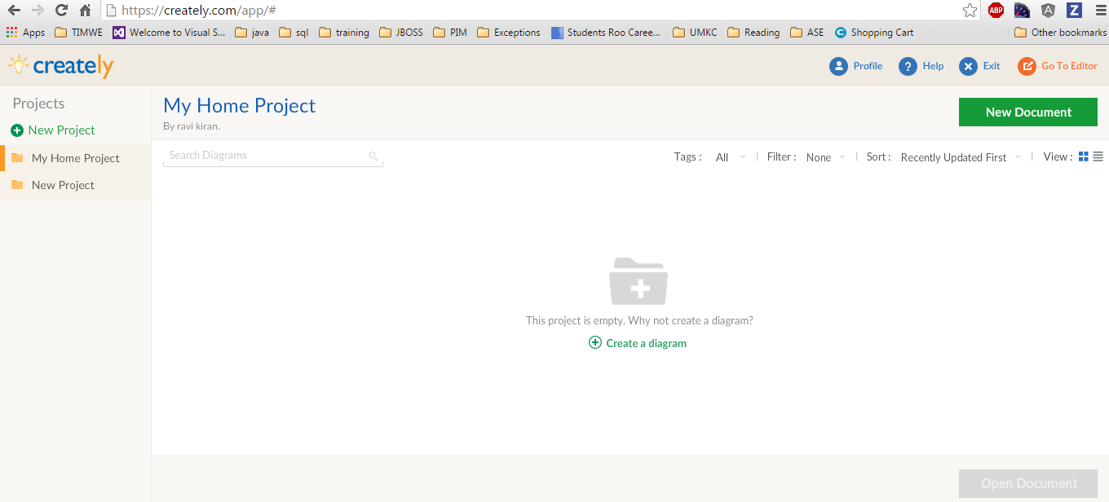
Using Creately

Slide 6
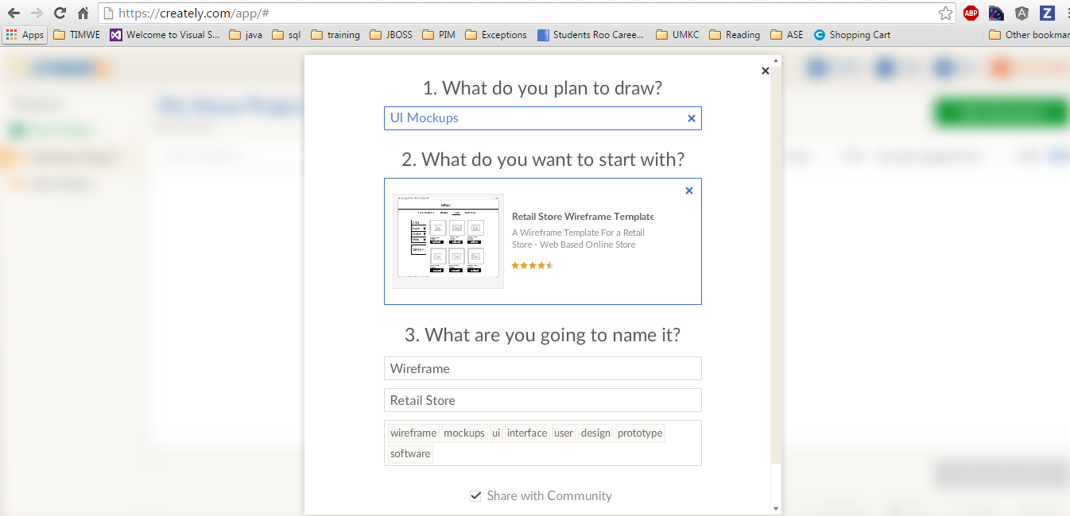
Creately Wireframes

Slide 7
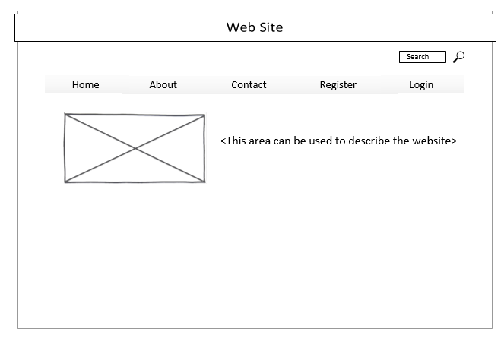
Example : Home Wireframe

Slide 8
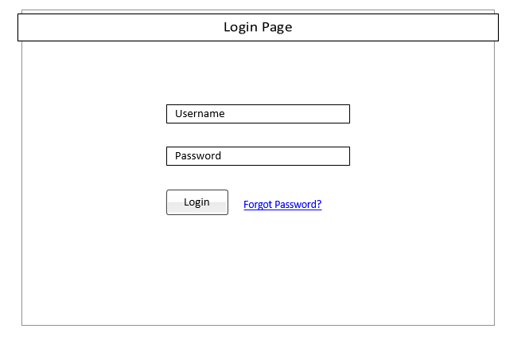
Login Wireframe

Slide 9
HTML5/CSS3/JS

Slide 10
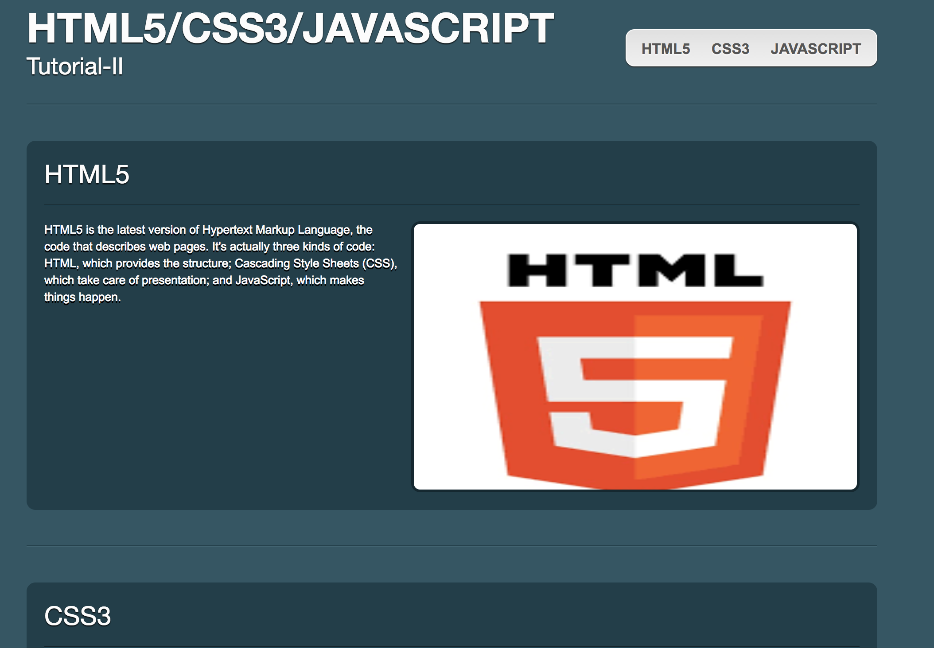
What is new ?
<video>
<audio>
<section>
<header>
<canvas>
<footer>
<output>
<figure>
<figcaption>
<progress>
<meter>
https://code.tutsplus.com/tutorials/28-html5-features-tips-and-techniques-you-must-know--net-13520
Notes:
http://code.tutsplus.com/tutorials/28-html5-features-tips-and-techniques-you-must-know--net-13520

Slide 11
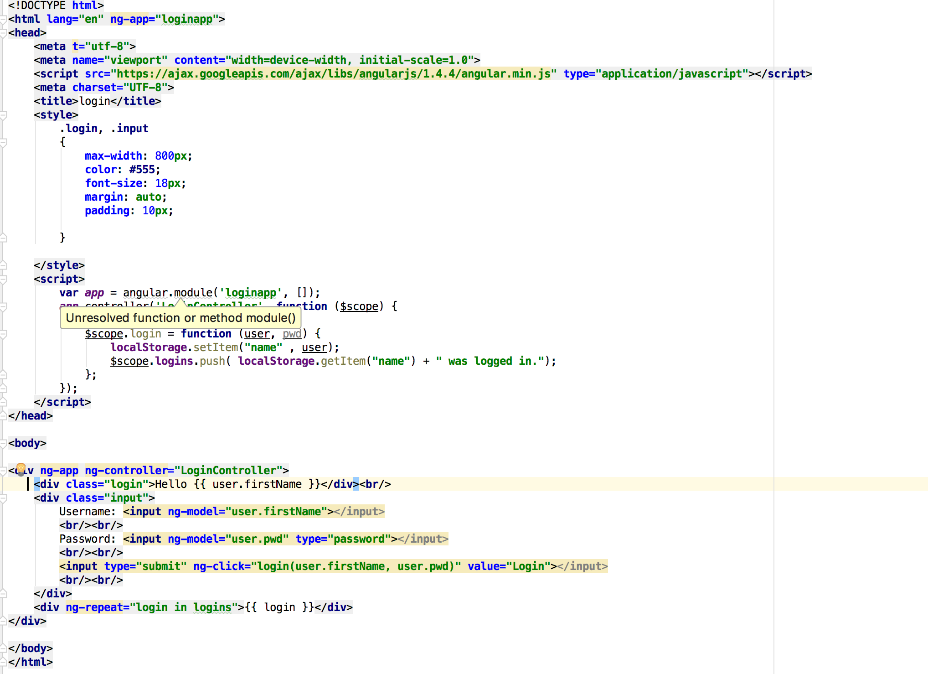
HTML5 (Local Storage)
Web applications can store data locally within the user's browser. Local storage is more secure, and large amounts of data can be stored locally, without affecting website performance.

Slide 12
Twitter Bootstrap
Bootstrap is the most popular HTML, CSS, and JavaScript framework for developing responsive, mobile-first web sites.
Download Twitter Bootstrap libraries
We can use the classes and functions defined in these libraries
in the HTML.
http://getbootstrap.com/getting-started/#download
Include these url’s in html to use Twitter Bootstrap
https://maxcdn.bootstrapcdn.com/bootstrap/3.3.1/css/bootstrap.min.css
https://maxcdn.bootstrapcdn.com/bootstrap/3.3.1/js/bootstrap.min.js

Slide 13
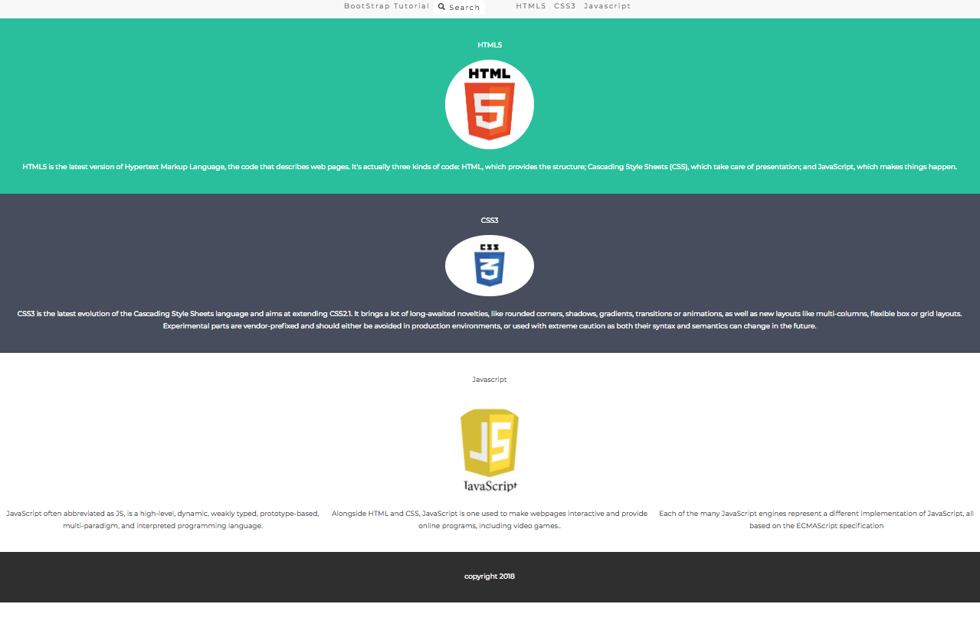
Bootstrap Page: Preview

Slide 14
Free Resources
http://startbootstrap.com/
http://bootsnipp.com/
https://codepen.io/pens/
https://bootstrapmade.com/

Slide 15
JS Lint
JSLint is a JavaScript program that looks for problems in JavaScript programs.
It is a code quality tool and JavaScript syntax checker and validator.
Working
JSLint takes a JavaScript source and scans it. If it finds a problem, it returns a message describing the problem and an approximate location within the source.
JSLint looks at some style conventions as well as structural problems. It does not prove that your program is correct. It just provides another set of eyes to help spot problems.

Slide 16
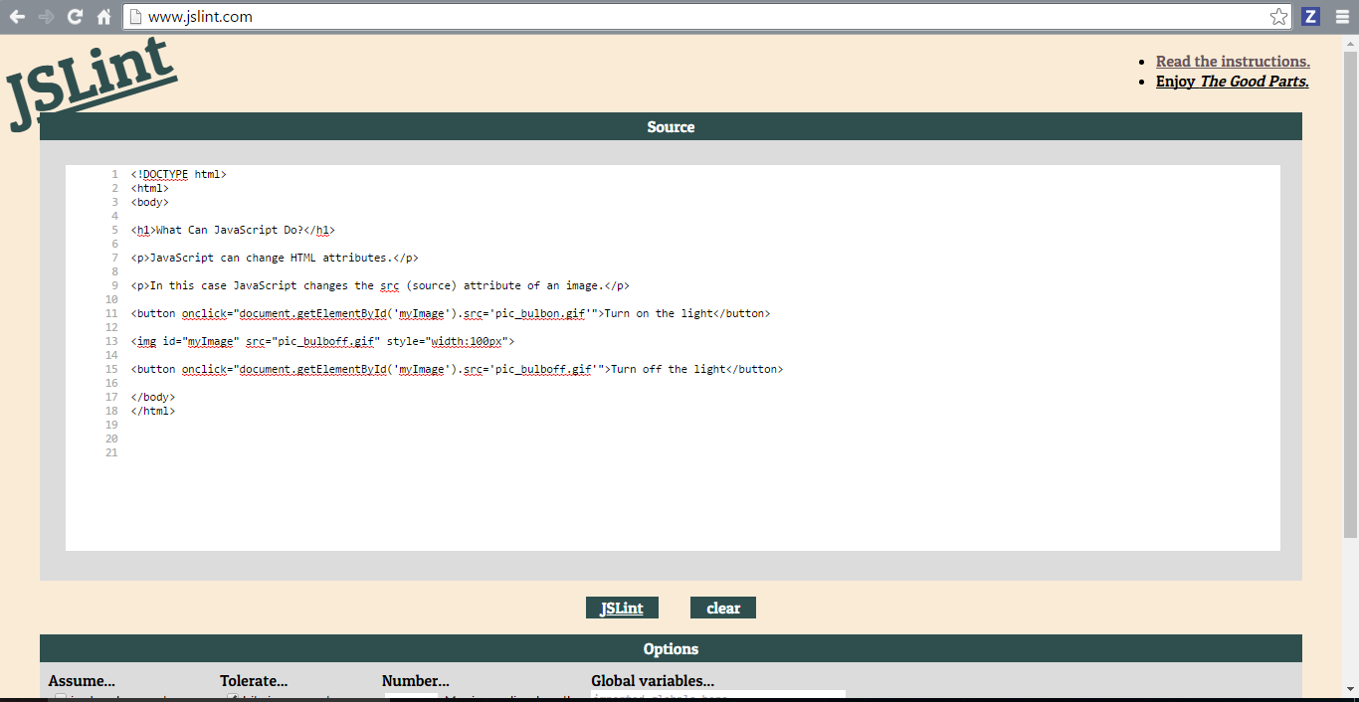
JS Lint (Web version)
http://www.jslint.com/

Slide 17
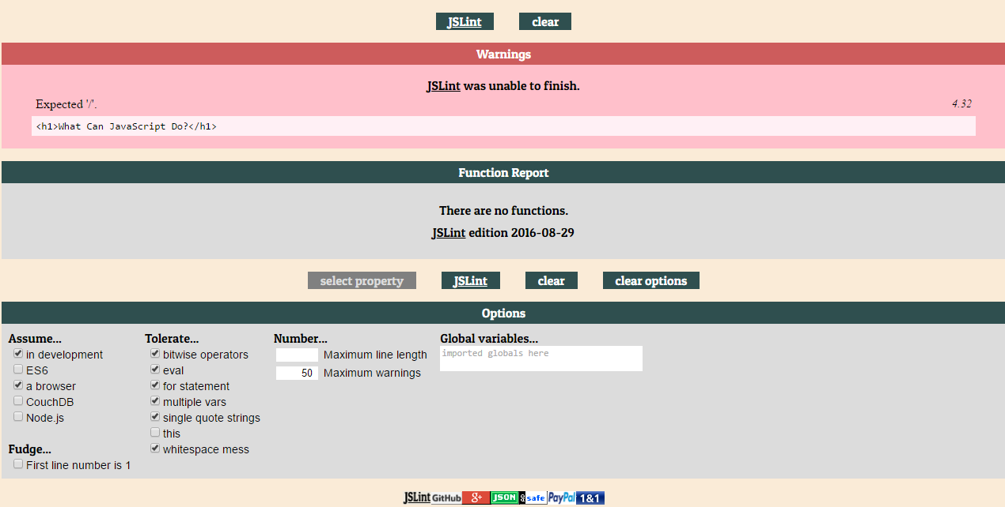
JS Lint Options

Slide 18
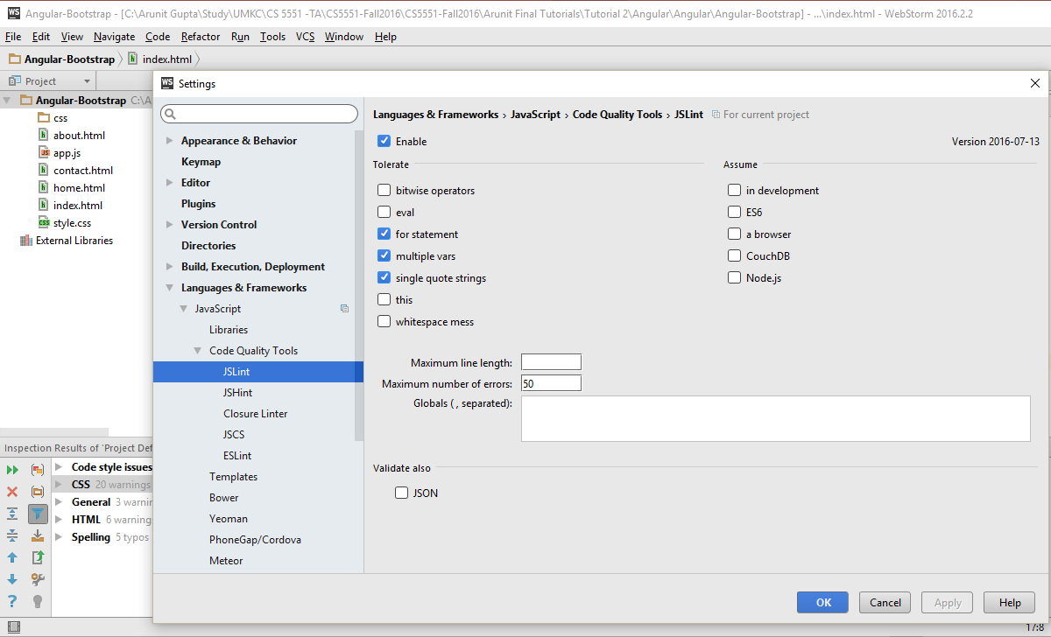
Integration with Web storm
File→ Settings (Ctrl+Alt+S)→ Enable JSLint

Slide 19


Slide 20
Angular JS
https://angularjs.org/
Angular JS is a structural framework for designing dynamic web applications. It binds your HTML(views) to JavaScript(models).
AngularJS extends HTML attributes with Directives, and binds data to HTML with Expressions.

Slide 21
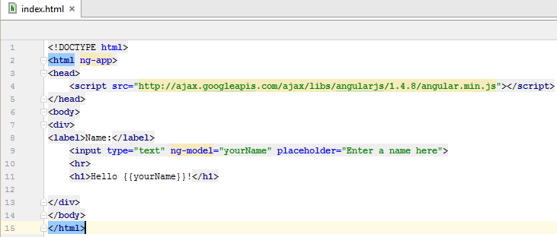
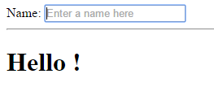
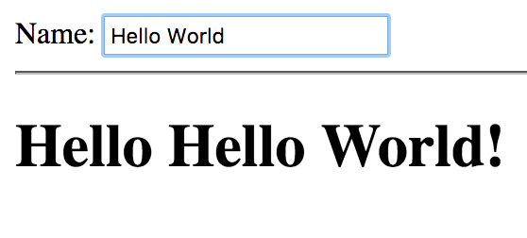
Basic Application
Tutorial for the above application : https://www.youtube.com/watch?v=uFTFsKmkQnQ

Slide 22
Directives in detail
The ng-app directive defines an AngularJS application.
The ng-model directive binds the value of HTML controls (input, select, textarea) to application data.
The ng-bind directive binds application data to the HTML view.
The ng-init directive initialize AngularJS application variables.

Slide 23
Expressions
AngularJS expressions are written inside double braces: {{ expression }}
AngularJS expressions binds data to HTML the same way as the ng-bind directive
AngularJS will "output" data exactly where the expression is written.

Slide 24
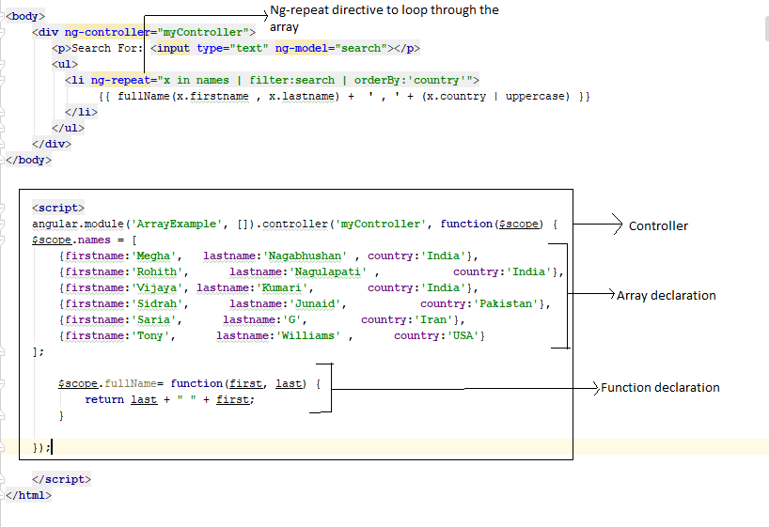
Example 2: Arrays, Filters, Controllers

Slide 25
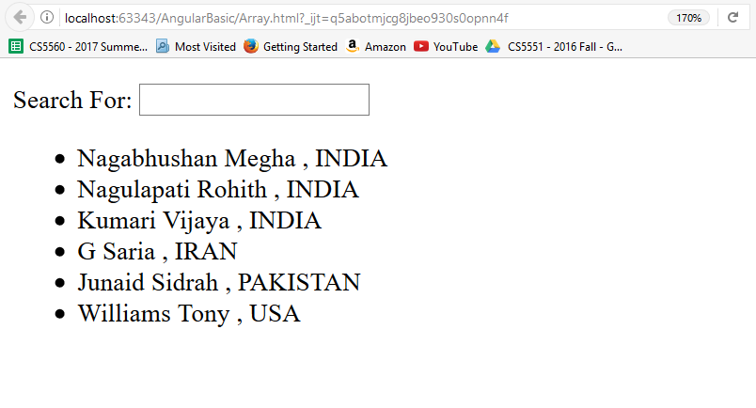
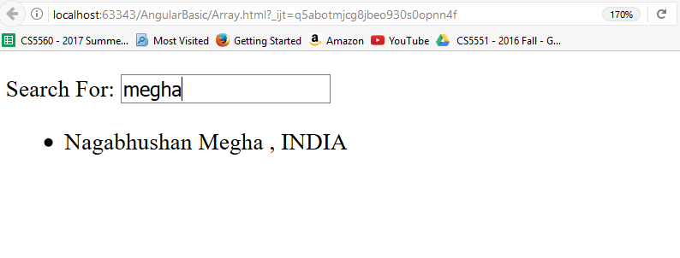
Example 2 Preview:

Slide 26
Angular JS AJAX
$http is an AngularJS service for reading data from remote servers.
The $http service has several functions you can use to send AJAX requests. These are:
$http.get(url, config)
$http.post(url, data, config)
$http.put(url, data, config)
$http.delete(url, config)
$http.head(url, config)

Slide 27
Syntax
$http({
url: “Url to request”,
method: "get/post/put/delete/head",
data: “The data needed to be sent to server”,
}).success(function(data, status, headers, config) {
“code to run if request succeeds: the response is passed to function”,
}).error(function(data, status, headers, config) {
“code to run if request fails”
});

Slide 28
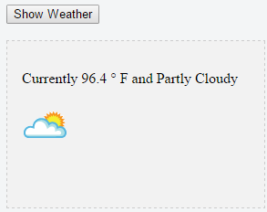
Example 6: Weather
https://jsfiddle.net/meghanagabhushan/t0fn3a6h/

Slide 29
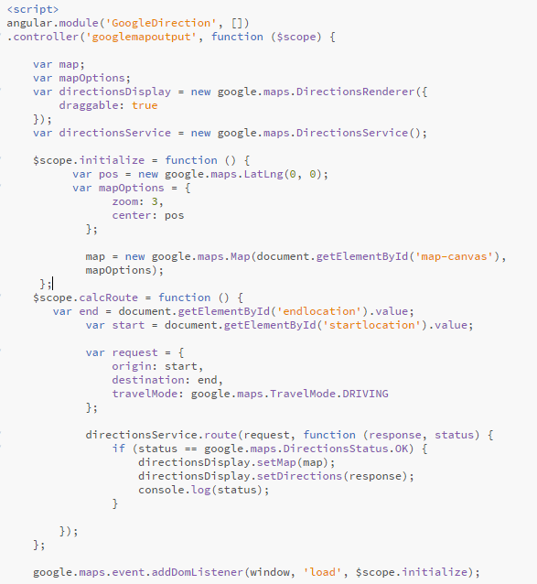
Example 5: Google Direction Service
Map initially
Rest call to update map

Slide 30
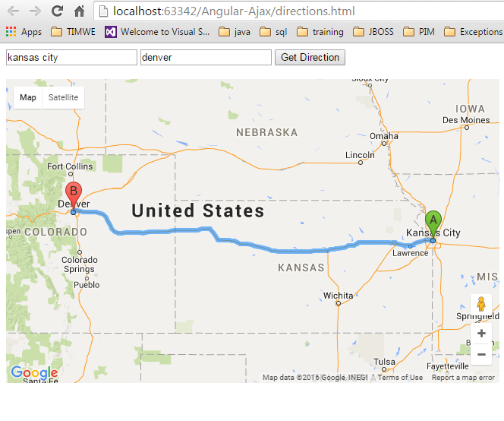
Direction App: Preview

Slide 31
In class Exercise
Create a single page application using bootstrap framework
1. The page should have two text fields that takes state code for example: MO and city name: Kansas city.
2. Pass those values and display weather details of the city like temperature and weather condition for next 5 hours.
For Reference:
http://api.wunderground.com/api/4bbbc25f4f5946dd/hourly/q/state code/cityname.json

Slide 32
Thank You

