Slide 1
Tutorial 3
Client-side Mashup
CS5551 Advanced Software Engineering
UMKC

Slide 2
Topics to Cover
REST
Four Square Service API
Edamam's Recipe Search API
Watson Text to Speech API

Slide 3
REST
Representational State Transfer
An Architectural style that specifies certain constraints for communication over web
An architecture similar to a client/server architecture designed to use a stateless communication protocol, typically HTTP
Clients and Servers exchange representations of resources by using a standardized interface and protocol
https://en.wikipedia.org/wiki/Representational_state_transfer

Slide 4
REST Operations
Get → Retrieves the current state of a resource
Post → Updates the state of an existing resource
Put → Creates a new resource
Delete → Deletes some info

Slide 5
Four Square Search API
https://foursquare.com/developers/
Search Venues
https://api.foursquare.com/v2/venues/search
Returns a list of venues near the current location, optionally matching a search term.
Parameters
All parameters are optional, unless otherwise indicated.
VENUE_ID : required ID of venue to retrieve.
Response fields
Venue :A complete venue.

Slide 6
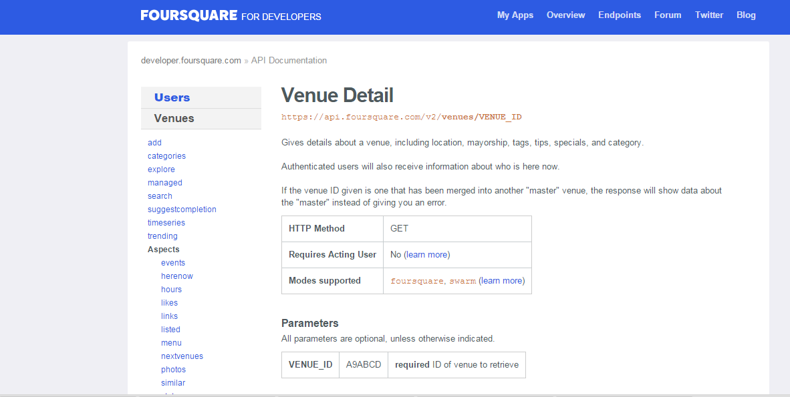
Four Square Search API
https://developer.foursquare.com/docs/venues/venus

Slide 7
Four Square Tips(Reviews) API
https://developer.foursquare.com/start/search
Get Reviews/Tips Venues
Tips from a Venue :Returns tips for a venue.
https://api.foursquare.com/v2/venues/VENUE_ID/tips
HTTP Method: GET
Parameters:
All parameters are optional, unless otherwise indicated.
VENUE_ID XXX123YYYY required The venue you want tips for.
sort recent One of friends, recent, or popular.
limit 100 Number of results to return, up to 500.
offset 100 Used to page through results.

Slide 8
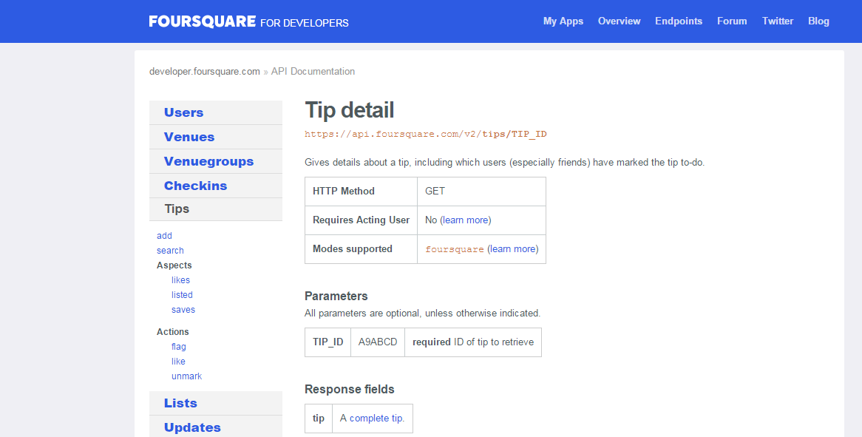
Four Square Tips(Reviews) API

Slide 9
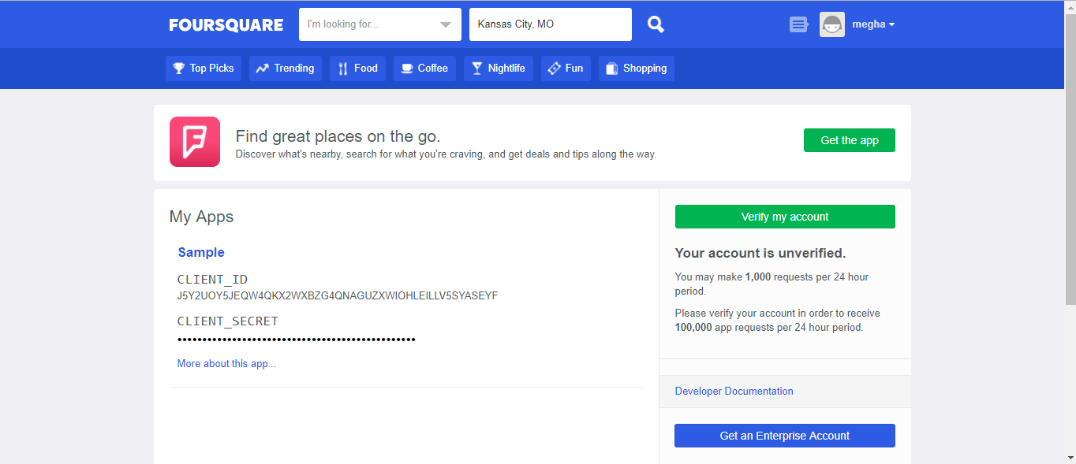
What is needed to Access API ?....
A Key !!!

Slide 10
Edamam's Recipe Search API
https://developer.edamam.com/edamam-recipe-api
Edamam's Recipe Search API lets you integrate recipes and faceted recipe search into your websites or mobile applications.

Slide 11
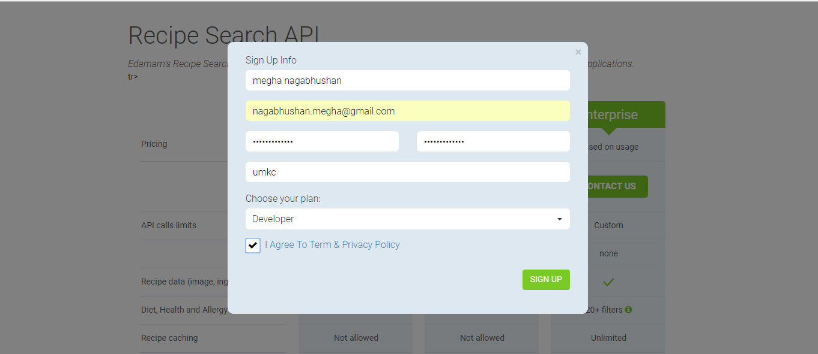
Edamam's Recipe Search API

Slide 12
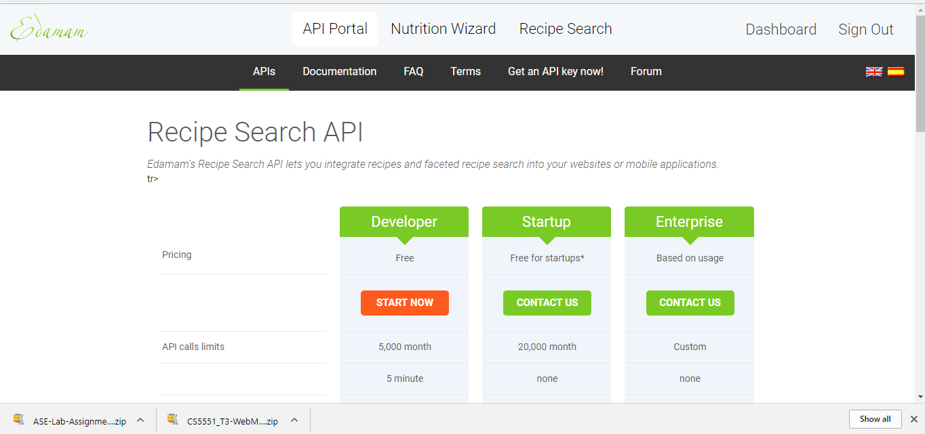
Edamam's Recipe Search API

Slide 13
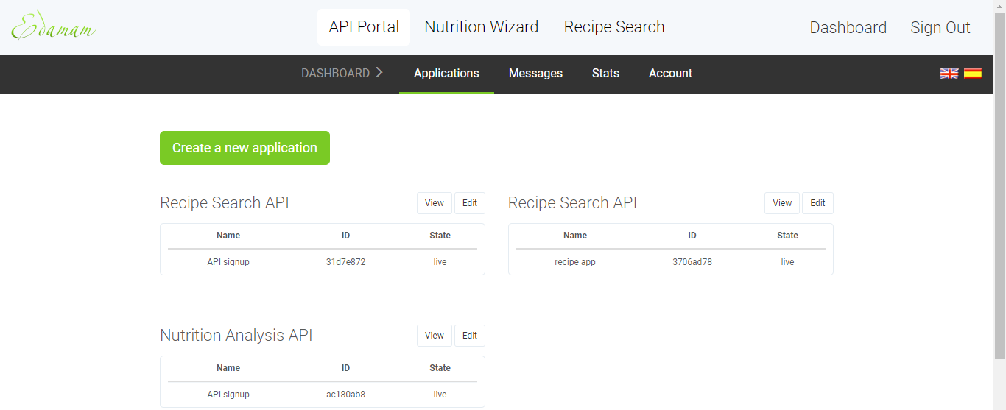
You can get a app-id and app-key by creating an application!

Slide 14
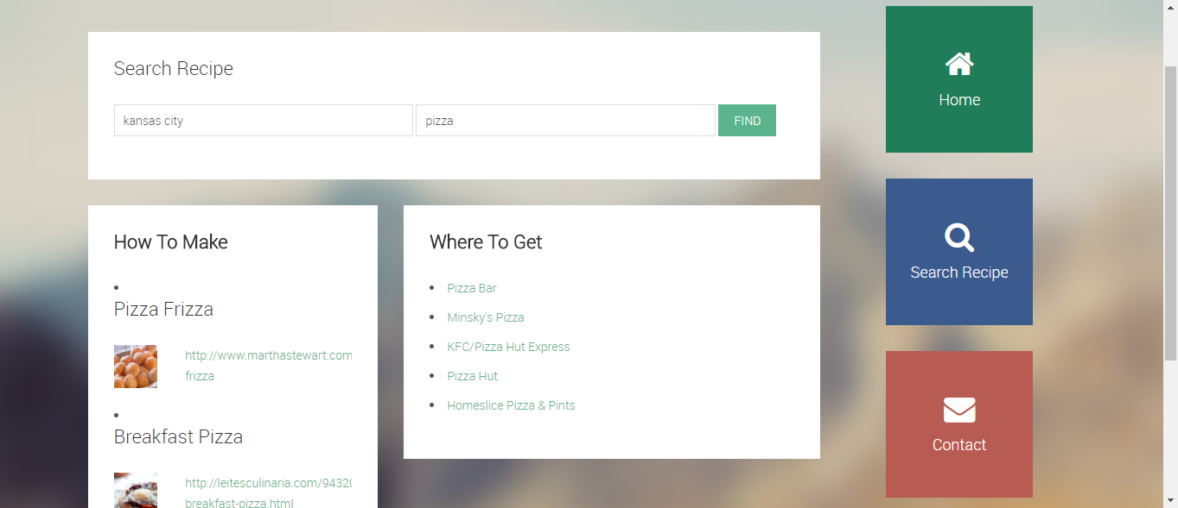
App Preview

Slide 15
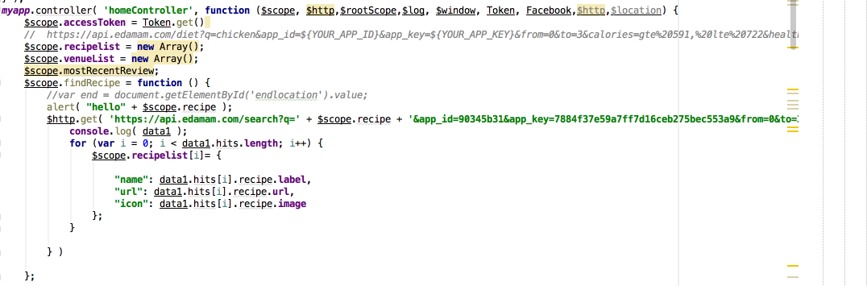
Edamam Request

Slide 16
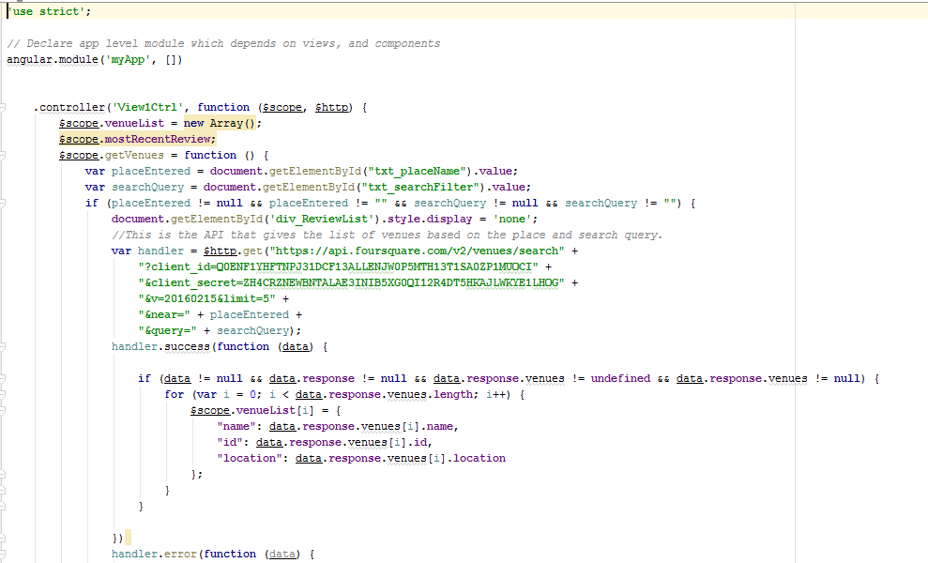
Four square Request

Slide 17
In Class Exercise
Make a Mashup application using url-1 to display following info : Calories and serving weight in grams, also use Watson Text to speech api using url-2 to speak out the searched keyword
Your search term = Whole chicken
url-1: https://api.nutritionix.com/v1_1/search/ “Your search term”?results=0:1&fields=*&appId=”Your app ID”&appKey=”Your API key”
url-2: https://stream.watsonplatform.net/text-to-speech/api/v1/synthesize?username=f61d1286-72ec-4d67-a0a2-16969a62acac&password=4AmGC8jSSy5G&text=”Your search term”
Notes:
https://api.edamam.com/api/nutrition-data?app_id=b14eeae1&app_key=dd733c0307965a1f70d18f6e4286026f&ingr=1%20large%20apple
'https://stream.watsonplatform.net/text-to-speech/api/v1/synthesize?username=b234d9a3-d86a-4476-9c56-07173e317489&password=0pmyS3pDPqUv&text='+text

Slide 18
Watson text to speech API
https://console.bluemix.net/registration/?target=%2Fcatalog%2Fservices%2Fapi-connect%3Fcm_mmc%3DEarned-_-IBM%2BCloud_API%2BEconomy-_-WW_WW-_-API%2BConnect%2BPDP%2BPricing%2BTab_ov49843%26cm_mmca1%3D000000WT%26cm_mmca2%3D10002833%26cm_mc_uid%3D06581119368715047921334%26cm_mc_sid_50200000%3D1504792133%26cm_mc_sid_52640000%3D1504792164
Convert written text into natural-sounding audio in a variety of languages and voices.

Slide 19
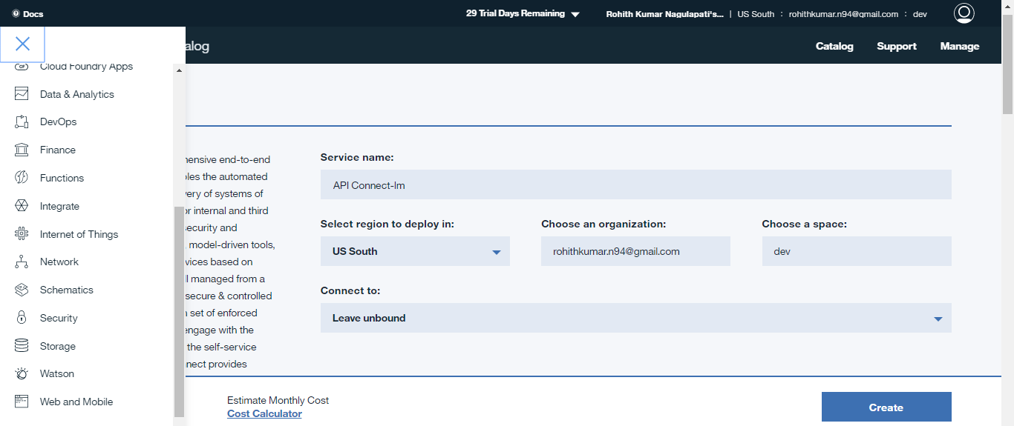
Watson text to speech API

Slide 20
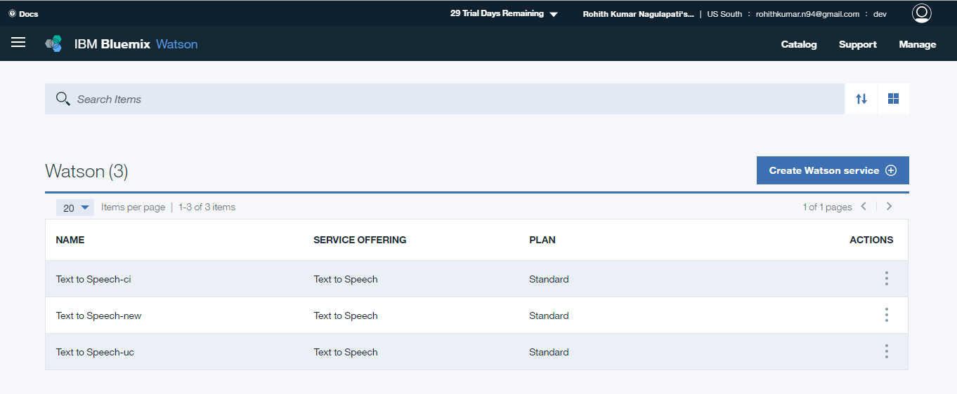
Watson text to speech API

Slide 21
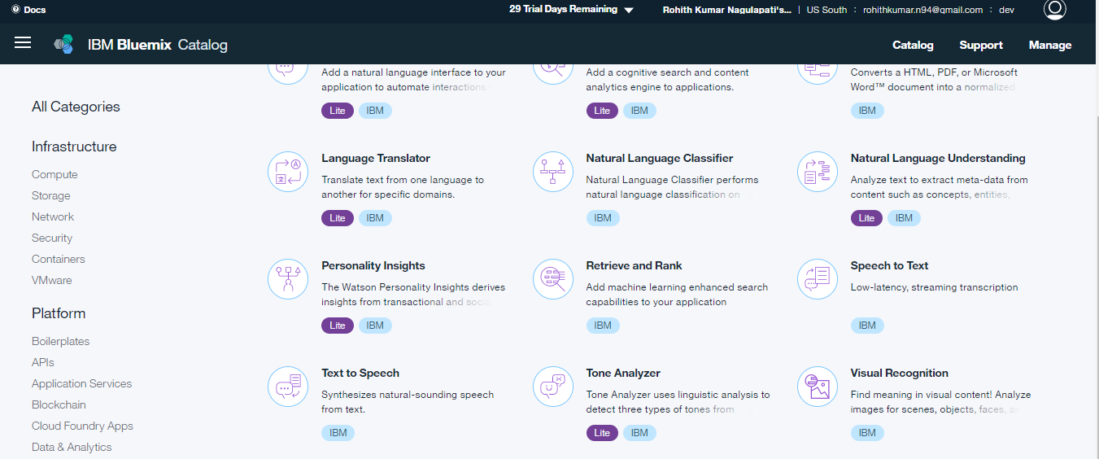
Watson text to speech API

Slide 22
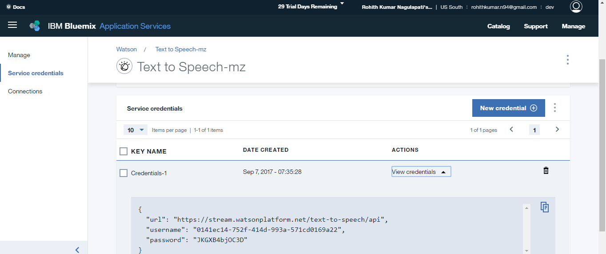
Watson text to speech API

Slide 23
Thank You

