Slide 1
Tutorial 5
Advanced Android App Development
CS551 Advanced Software Engineering
UMKC

Slide 2
Topics
Using Android Hardware like Camera
Using Google Maps

Slide 3
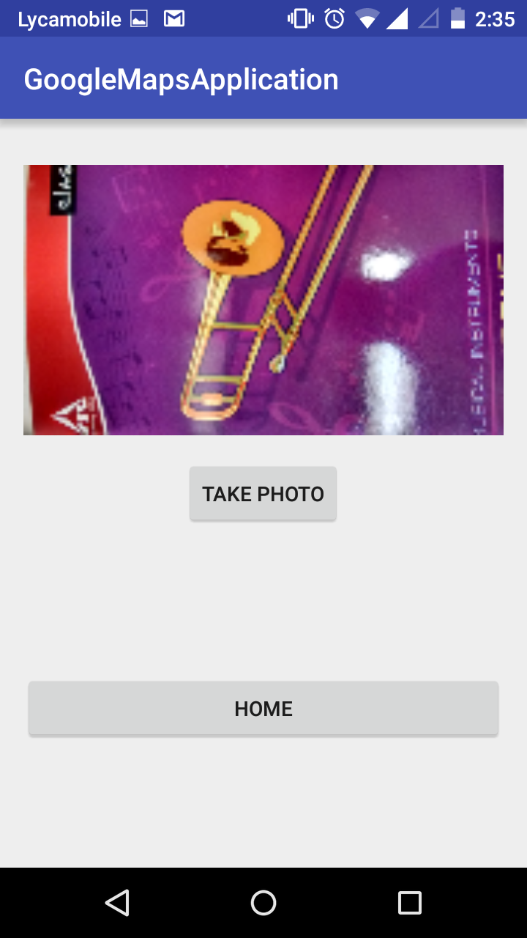
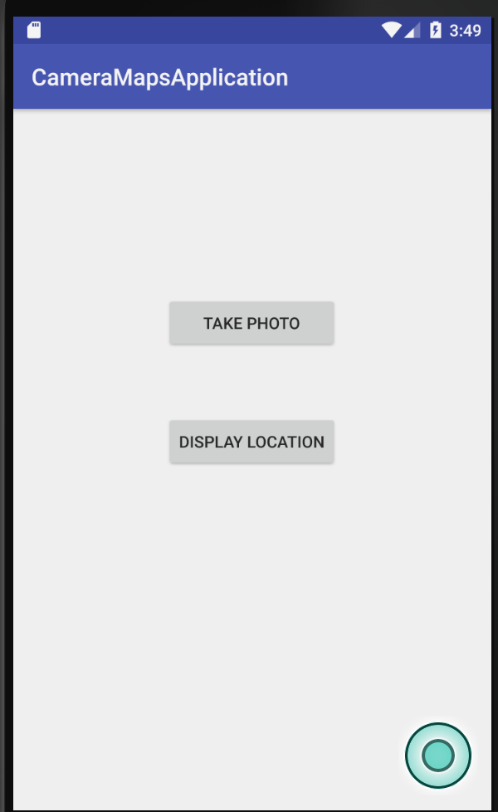
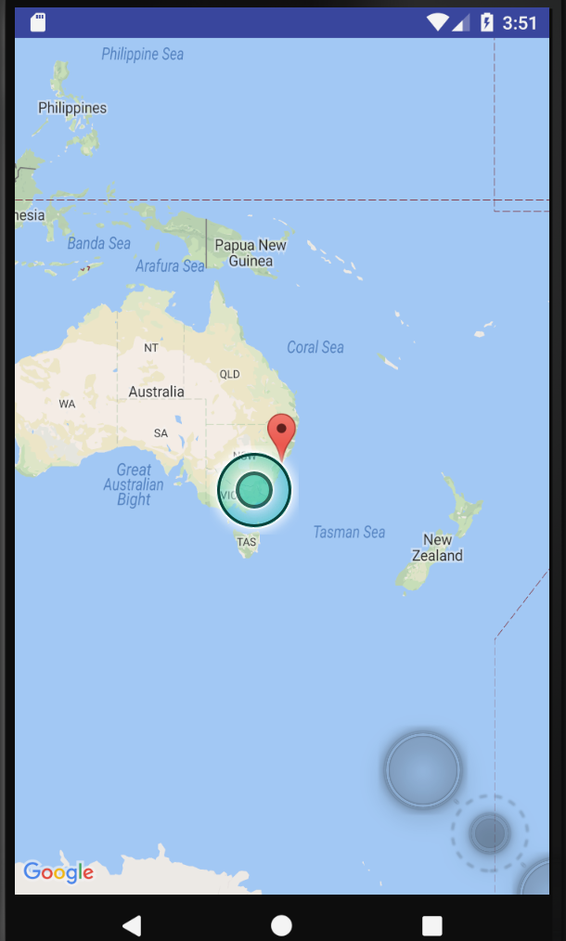
Outcome

Slide 4
Android Media and Camera
Several features present in Android that are accessible to the code.
Developers can add Audio, Video and image capabilities to their app using in built libraries in Android.
Eg: Camera Library
Camera can be accessed through
android.hardware.camera2
Camera Intent
http://developer.android.com/guide/topics/media/camera.html

Slide 5
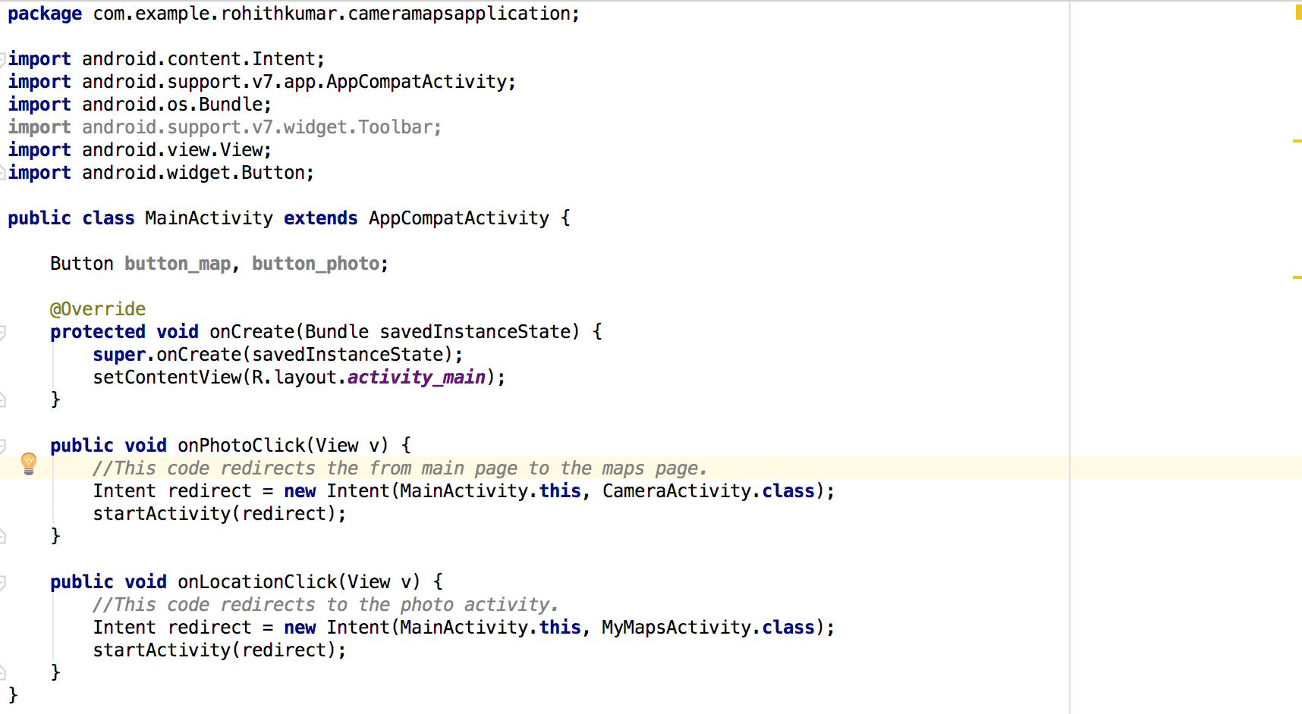
MainActivity.java code
Redirection to the selected button
activity.

Slide 6
Photo Activity code
Button capture = (Button) findViewById(R.id.btn_take_photo);
//Button click eventlistener. Initializes the camera.
capture.setOnClickListener(new View.OnClickListener() {
public void onClick(View v) {
Intent cameraIntent = new Intent(MediaStore.ACTION_IMAGE_CAPTURE);
startActivityForResult(cameraIntent, TAKE_PHOTO_CODE);
}
});
@Override
protected void onActivityResult(int requestCode, int resultCode, Intent data) {
super.onActivityResult(requestCode, resultCode, data);
if (requestCode == TAKE_PHOTO_CODE && resultCode == RESULT_OK) {
Bitmap photo = (Bitmap) data.getExtras().get("data");
userImage.setImageBitmap(photo);
Log.d("CameraDemo", "Pic saved");
Accessing the device camera and starting it.
If successful in capturing the image it redirects to OnActivityResult.
Inside OnActivityResult we set the image View with the image captured.

Slide 7
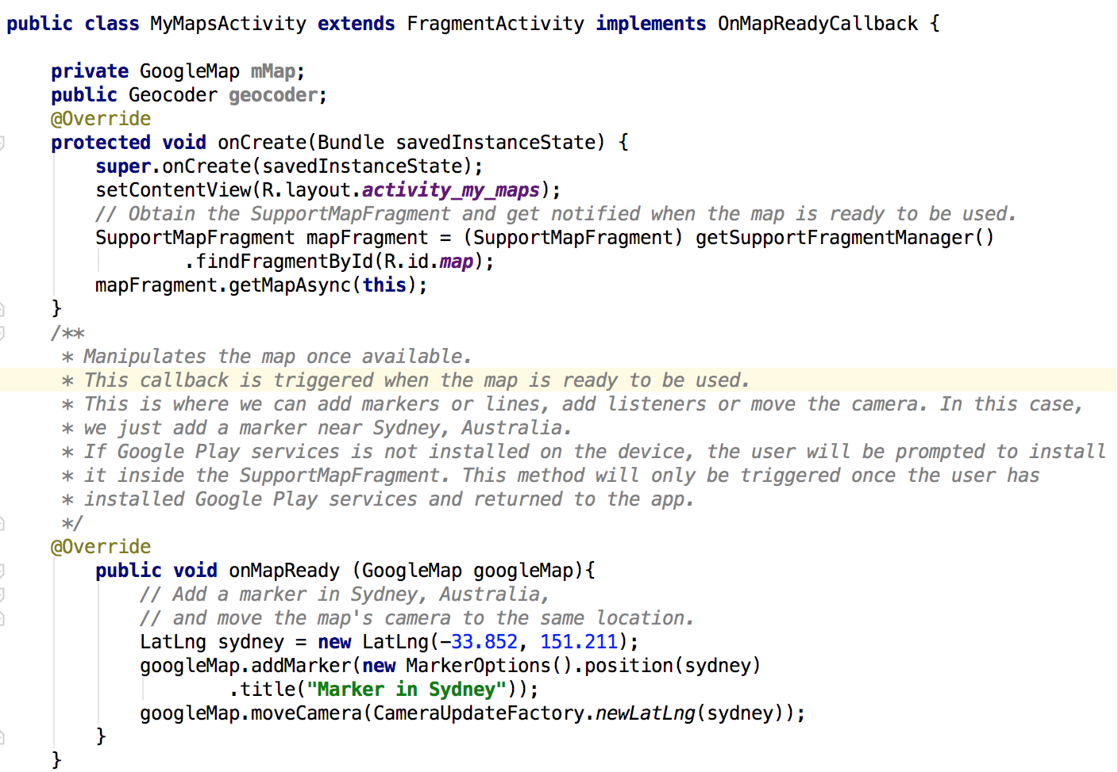
MyMapsActivity code

Slide 8
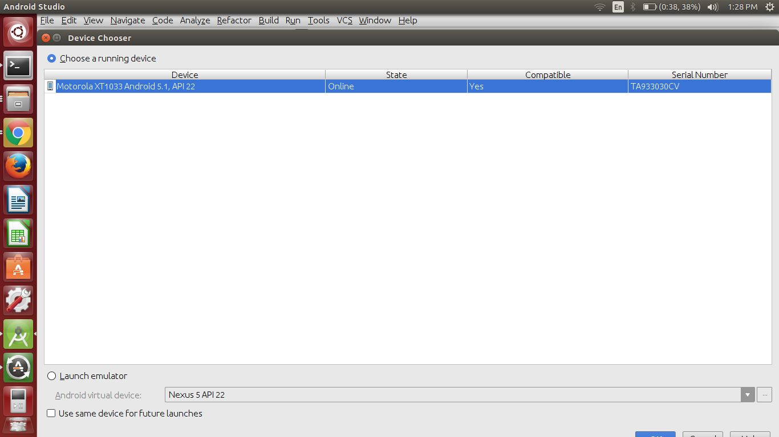
Running application on device
Enable USB Debugging on your device.
http://www.recovery-android.com/enable-usb-debugging-on-android.html
2. Connect your device through a USB cable.
3. Click Run button on Android studio.
4. Select your device from the list.
5. Click OK

Slide 9
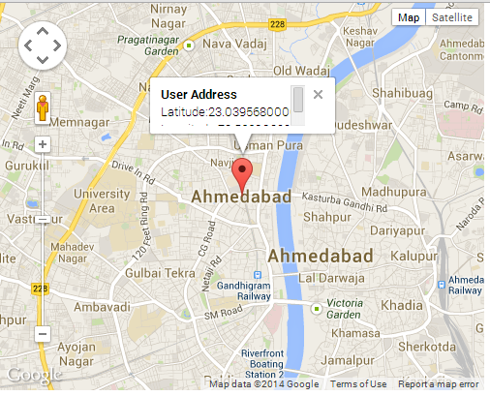
In Class Exercise
Modify the MyMapsActivity class to display user’s current location with a marker on the map along with the coordinate details
Hint: Use Location service and Geocoder classes to complete the task
https://developers.google.com/maps/documentation/android-api/current-place-tutorial

Slide 10
Thank you

