Slide 1
Introduction to
Web Server Architecture with AJAX
JavaScript, HTML5, CSS3, jQuery, Twitter Bootstrap, Angular.js
Sources:
www.csee.umbc.edu/~dondim1/104
www.csc.villanova.edu/~map/1020/javascript.ppt
cwo.ucsd.edu/_files/HTML5CSS3-ilin-final.ppt‎‎
csuf.kenytt.net/2012/spring

Slide 2
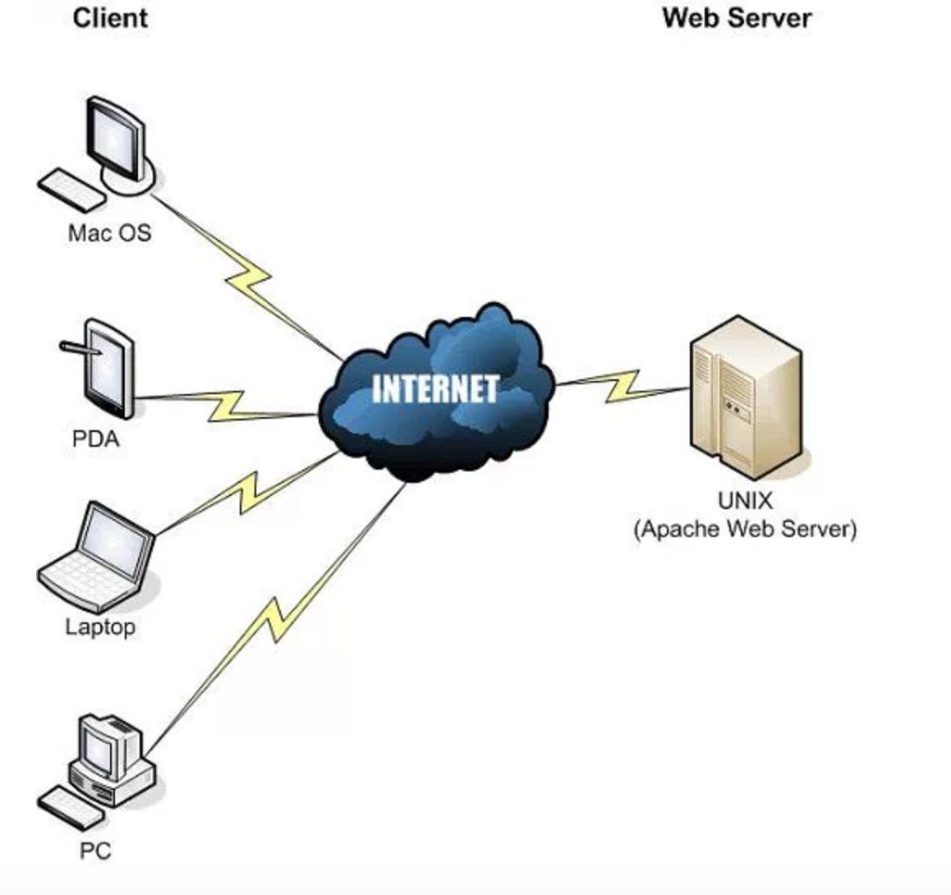
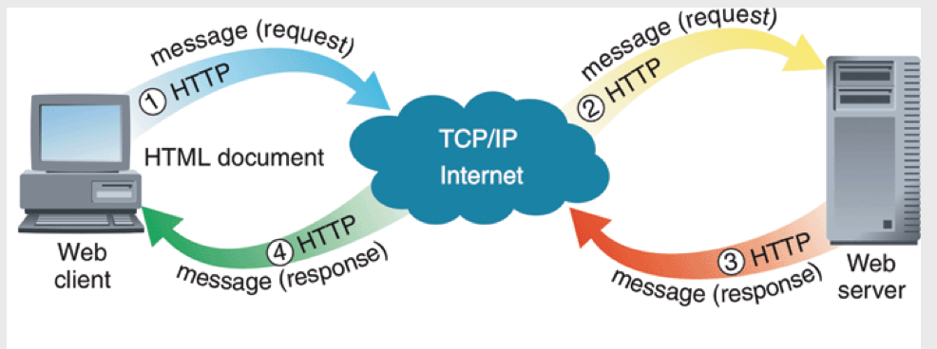
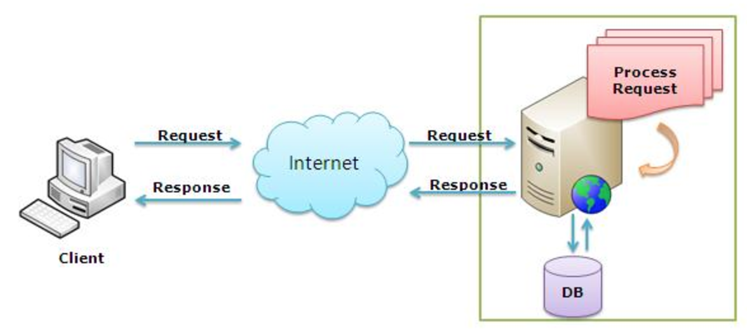
Web Server Architecture
Source: http://www.betterhostreview.com/quick-start-guide-website-hosting-beginners.html

Slide 3
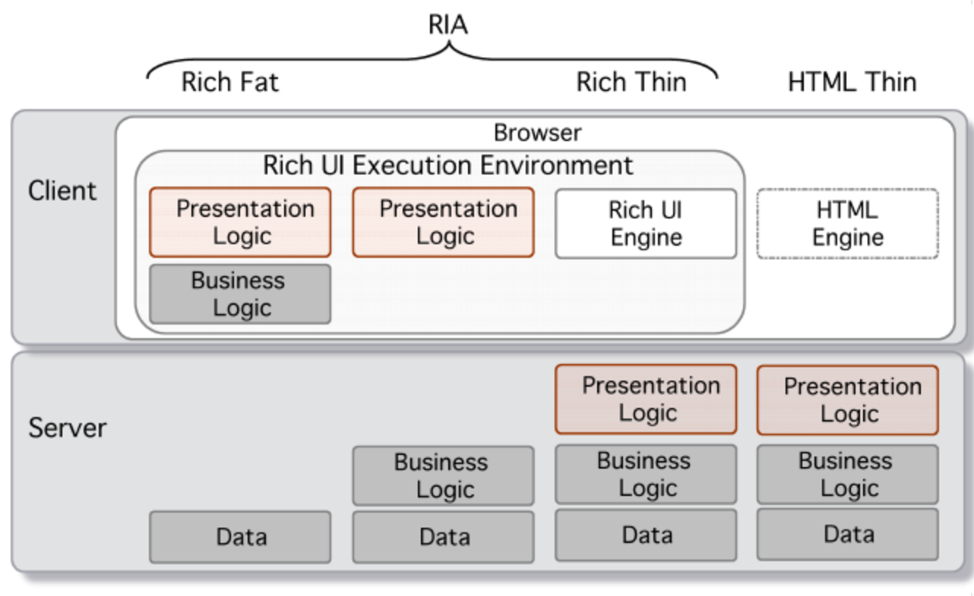
Web Server Architecture (AJAX)
(Rich Internet application)
Source: http://www.canoo.com/blog/2007/08/16/ajax-unforeseen-and-expensive-refactorings-in-lower-layers-part-2-of-3/

Slide 4
What is AJAX?
“Asynchronous JavaScript and XML”
Web development techniques used on the client-side to create asynchronous Web applications.
  Web applications can send data to/retrieve from a server asynchronously (in the background) without interfering with the display and behavior of the existing page.
  JavaScript and the XMLHttpRequest object provide a method for exchanging data asynchronously between browser and server to avoid full page reloads.
  Data can be retrieved using the XMLHttpRequest object.
http://en.wikipedia.org/wiki/Ajax_%28programming%29

Slide 5
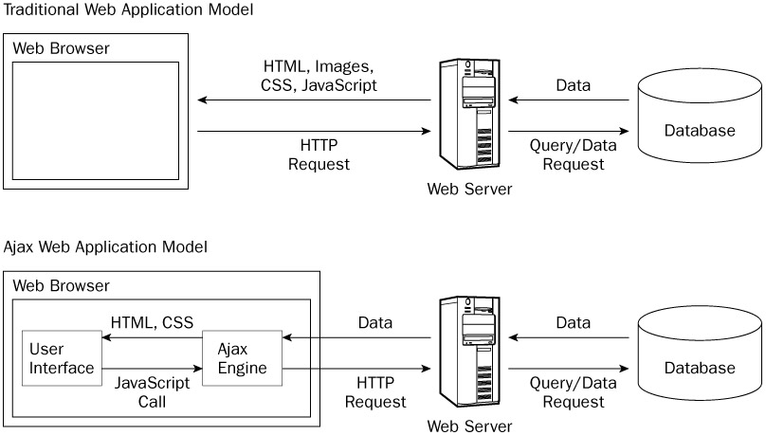
How AJAX Works
http://www.yaldex.com/ajax-tutorial-4/BBL0013.html

Slide 6
What is AJAX?
“Asynchronous JavaScript and XML”
Web development techniques used on the client-side to create asynchronous Web applications.
  The DOM is accessed with JavaScript to dynamically display – and allow the user to interact with – the information presented.
  HTML and CSS can be used in combination to mark up and style information.
http://en.wikipedia.org/wiki/Ajax_%28programming%29

Slide 7
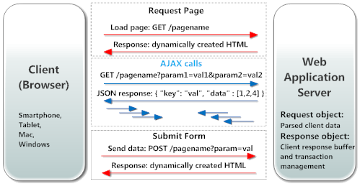
AJAX/JSON
Asynchronous Communication
AJAX and JSON are used by JavaScript code in modern web based user interfaces when querying the server in real time. JavaScript code may send URL-encoded data to the server, and the server may respond by sending back a JSON object.
https://realtimelogic.com/products/ajax/

Slide 8
HTML DOM
(Document Object Model)
The document itself is a document node
All HTML elements are element nodes
All HTML attributes are attribute nodes
Text inside HTML elements are text nodes
Comments are comment nodes
https://www.w3schools.com/jsref/dom_obj_document.asp

Slide 9
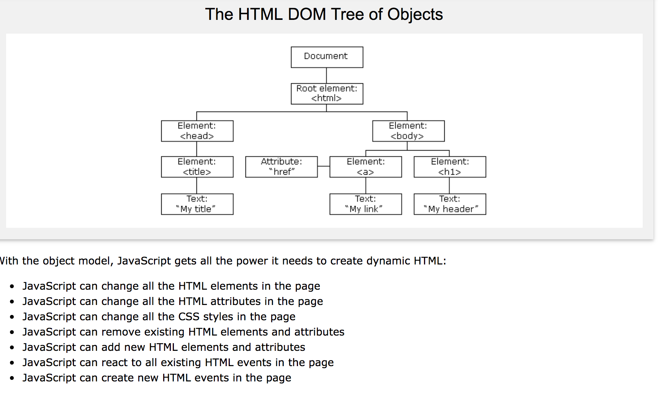
https://www.w3schools.com/js/js_htmldom.asp

Slide 10
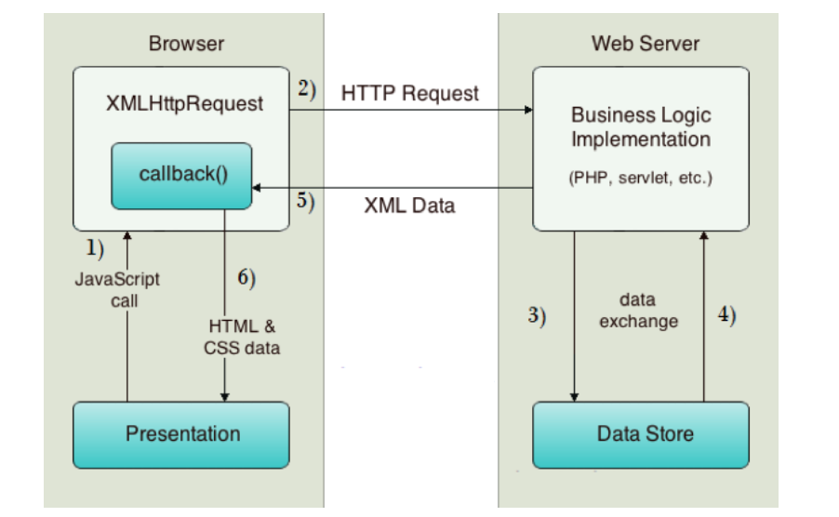
AJAX:
Web Client & Web Server
https://www.javatpoint.com/how-ajax-works

Slide 11
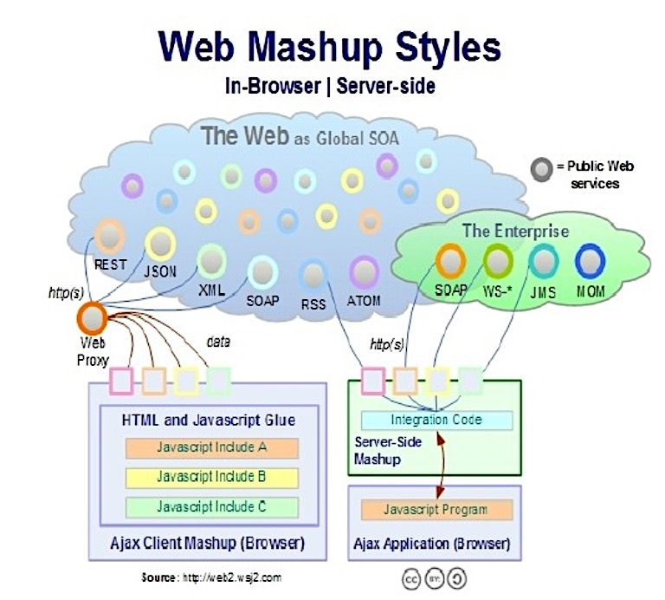
Source: https://www.slideshare.net/wso2.org/mashups-for-soa

Slide 12
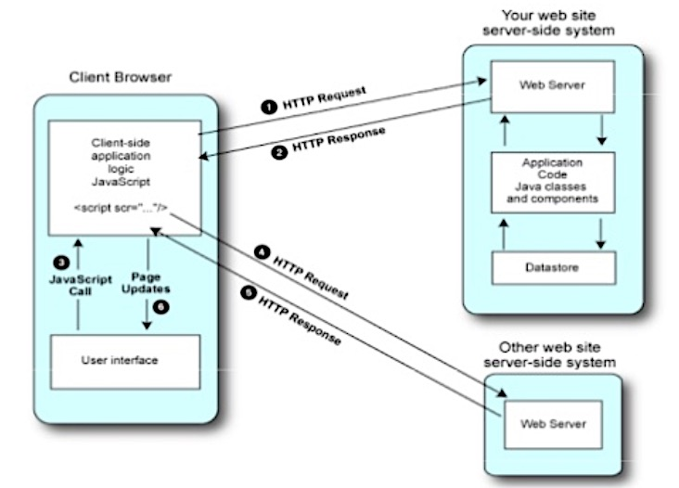
Client Side Mashup
Source: https://www.slideshare.net/achatti/modeldriven-mashup-personal-learning-environments

Slide 13
Client-Side Mashup: Limitations
Too much application logic on the client side.
Some data can be shared by more than one client.
Slow in responding
Limit access to some services (e.g., bandwidth).
Security risks would be hard to mitigate on the client.
Customization may not be provided by the mashup website.
Using Ajax (XMLHttpRequest) on the client to make requests is constrained by the browser Javascript security model (restricts access to the server of origin of the web page).
Server side mashup with protocols (SOAP) will be easier.
When multiple Ajax requests were on the client, but the maximum allowed concurrent Ajax requests are limited (only 2 or 3).

Slide 14
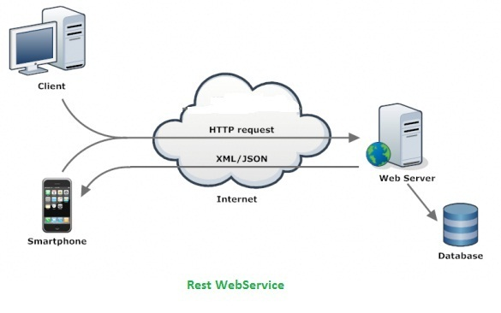
REST (Representational State Transfer)
Defined in 2000 by Roy Fielding as part of his thesis, “Architectural Styles and the Design of Network-based Software Architectures”, formalized as HTTP/1.1 (RFC2616)
An architectural style: client-server, stateless, cacheable, uniform representation, layered
Client transfers state with Web resource representation (URL)

Slide 15
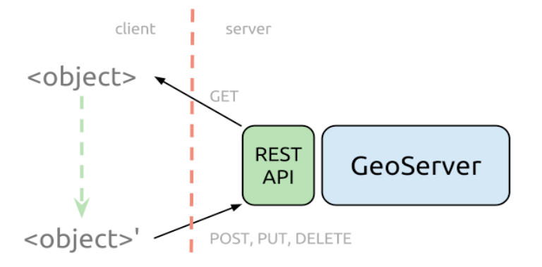
REST Operations, via the HTTP API
Web exchanges are done using this simple HTTP API:
  GET = "give me some info" (Retrieve)
  POST = "here's some update info" (Update)
  PUT = "here's some new info" (Create)
  DELETE = "delete some info" (Delete)
Messages are self-descriptive and stateless
  identify resources by uniform resource identifiers (URIs)
  manipulate resources through their representations
Source: http://blog.opengeo.org/2012/10/25/adding-layers-to-geoserver-using-the-rest-api/

Slide 16
Advantages
Better interactivity
AJAX allows easier and quicker interaction between user and website as pages are not reloaded for content to be displayed.
Easier navigation
allow easier navigation to users in comparison to using the traditional back and forward button on a browser.
Compact
several multi purpose applications and features can be handled using a single web page
Backed by reputed brands
several complex web applications are handled using AJAX (e.g., Google Maps, Google Mail)

Slide 17
Disadvantages
The back and refresh button are rendered useless
As all functions are loaded on a dynamic page without the page being reloaded or a URL being changed, clicking the back or refresh button would take you to an entirely different web page or to the beginning of what your dynamic web page was processing.
It is built on JavaScript A percentage of website surfers prefer to turn JavaScript functionality off on their browser rendering the AJAX application useless.
Development Time It usually requires more development time to build an application using AJAX than using other approaches.
Server Load Server load and bandwidth can be an issue when delivering AJAX-based solutions. The user may see fewer page reloads, but the server calls are still there.
Security data is sent as clear text. For this reason, no sensitive data should take a ride via HTTP using AJAX or any other technology.

Slide 18
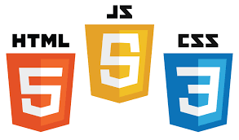
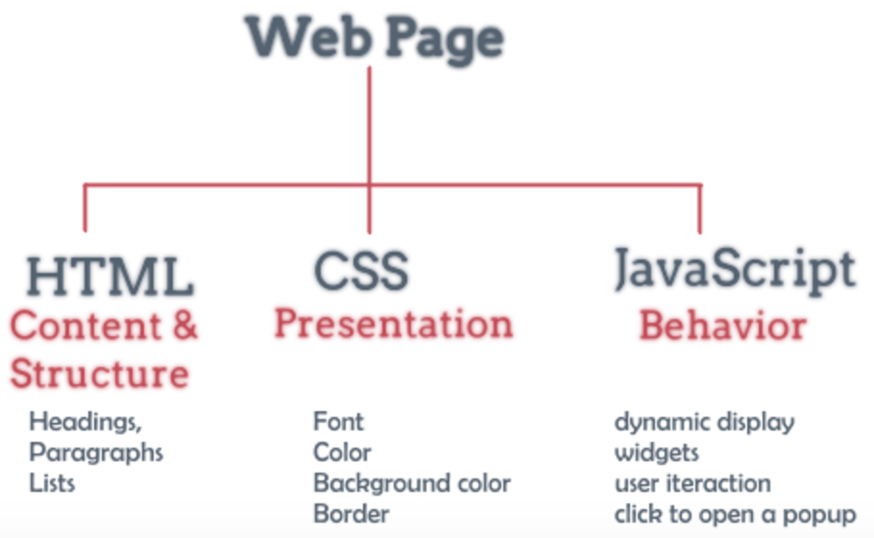

Slide 19
What is JavaScript?
Created by Netscape (~1995)
  Originally called LiveWire then LiveScript
A client-side scripting language
  Client-side refers to the fact that it is executed in the client (software) that the viewer is using. In the case of JavaScript, the client is the browser.
  A server-side language is one that runs on the Web server. E.g., PHP, Python, node.js/express.js (MEAN stack)
Interpreted on-the-fly by the client
  Each line is processed as it loads in the browser

Slide 20
JavaScript is not Java
Completely different types of languages that just happen to be similarly named
  JavaScript - programs are interpreted in the browser
  Java - programs are compiled and can be run as stand alone applications

Slide 21
Why JavaScript?
It’s easier to learn than most programming languages
It allows you to make interactive Web pages
It can be fun!

Slide 22
What does JavaScript support?
Adding dynamic features to Web pages
  validation of form data
  image rollovers
  time-sensitive or random page elements
Defining programs with Web interfaces
  utilize buttons, text boxes, clickable images, prompts, etc.
Event-driven programming
    specifying actions that are to occur in the page as a result of some event - reacts to events such as mouse clicks, buttons
    Most event-handling is associated with form elements (e.g., button, selection list, radio button, check box, password)

Slide 23
What are limitations of JavaScript?
limitations of client-side scripting
  since script code is embedded in the page, it is viewable to the world
  for security reasons, scripts are limited in what they can do
    e.g., can't access the client's hard drive
  since they are designed to run on any machine platform, scripts do not contain platform specific commands
  script languages are not full-featured
    e.g., JavaScript objects are very crude, not good for large project development

Slide 24
Including JavaScript in HTML
add JavaScript to Web pages
  Use the <script>…</script> tag
<!DOCTYPE html>
<html>
<head>
<title>Hello World Example</title>
</head>
<body>
<script type="text/javascript">
<!--
document.write("<h1>Hello, world!</h1>");
//-->
</script>
</body>
</html>

Slide 25
HTML5 is more than HTML5
HTML5 Spec
CSS3 Spec
Web Fonts
JavaScript to tie it all together

Slide 26
What’s New in HTML5 Spec?
Simplified and Loose Syntax
New Elements and Attributes
Embedded Media
Canvas
Offline Storage
Drag and Drop
Geo-Location
Local Database

Slide 27
Why Use HTML5 Today?
Pros
  Better semantics
  Lean code
  Improved user experience
Cons
  Some work is needed to accommodate older browsers

Slide 28
What’s New in CSS3 Spec?
New Selector (http://www.w3schools.com/cssref/css_selectors.asp)
Decorations (http://www.w3schools.com/cssref/pr_text_text-decoration.asp)
New Column Layout (http://dev.w3.org/csswg/css-multicol/Overview.src.html)
Transformation (Rotate, Resize… etc.) (http://www.w3schools.com/css3/css3_2dtransforms.asp)
Animation (Fade In/Fade Out) (http://www.w3schools.com/css3/css3_animations.asp)

Slide 29
Why Use CSS3 Today?
Pro
  Smaller download
  Less JavaScript
  Better user experience
Cons
  Some work is needed to accommodate older browsers

Slide 30
jQuery
jQuery is free, open source software (2006)
A cross-platform JavaScript library designed to simplify the client-side scripting of HTML.
the most popular JavaScript library in use today, with installation on 65% of the top 10 million highest-trafficked sites on the Web
jQuery is a lightweight JavaScript library that emphasizes interaction between JavaScript and HTML.
jQuery features:
  HTML element selections/manipulation
  CSS manipulation
  HTML event functions
  JavaScript effects and animations
  HTML DOM traversal and modification (Document Object Model)
  AJAX (Asynchronous JavaScript and XML)
  Utilities

Slide 31
Why jQuery?
jQuery is the defacto standard javascript library.
It works across most browser platforms.
  Rich Internet Applications (RIA)
  Dynamic HTML (DHTML)
Advantages over just JavaScript
  Much easier to use
  Eliminates cross-browser problems
helps compliment Bootstrap’s built-in functionality well.
  Datatables – to display tabular data
  jqPlot – to display graphs
  jQuery Validation – to validate form input

Slide 32
Twitter Bootstrap
Bootstrap is a front end framework, that is, an interface for creating websites and web applications.
It aims to ease the development of dynamic websites and web applications.
Very easy to use and based on latest Web Development Standards for screen and form design (contains HTML- and CSS-based design templates for typography, forms, buttons, navigation and other interface components, optional JavaScript extensions)
Very lightweight – it can be as little as just one CSS and one JS file.

Slide 33
Why Twitter Bootstrap?
Easy to create a layout – content only, left menu + content, right menu + content, etc.
Beautiful and functional built-in components which are easy to customise
Built-in Javascript to support components
Very low learning curve
Works well with jQuery and other javascript libraries

Slide 34
What is AngularJS?
Developed and maintained by Google
It is one of the top 3 JavaScript Frameworks.
It provides set of components to structure your app and organize the project.
Made for ambitious JavaScript Single Page Applications
easier by providing set of guidelines and architecture to application.

Slide 35
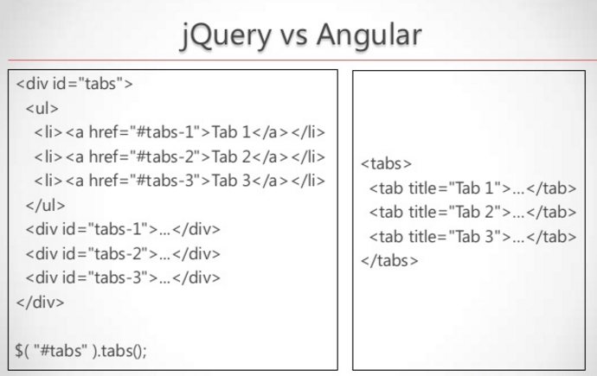

Slide 36
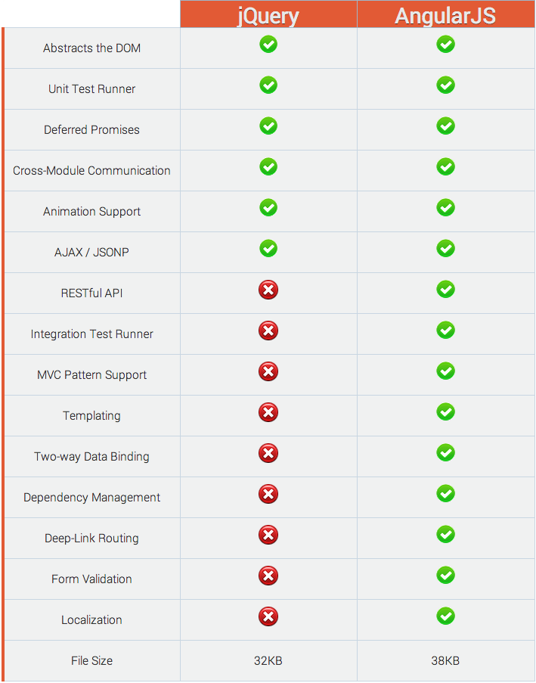
jQuery vs. AngularJS: A Comparison
https://www.airpair.com/angularjs/posts/jquery-angularjs-comparison-migration-walkthrough

Slide 37
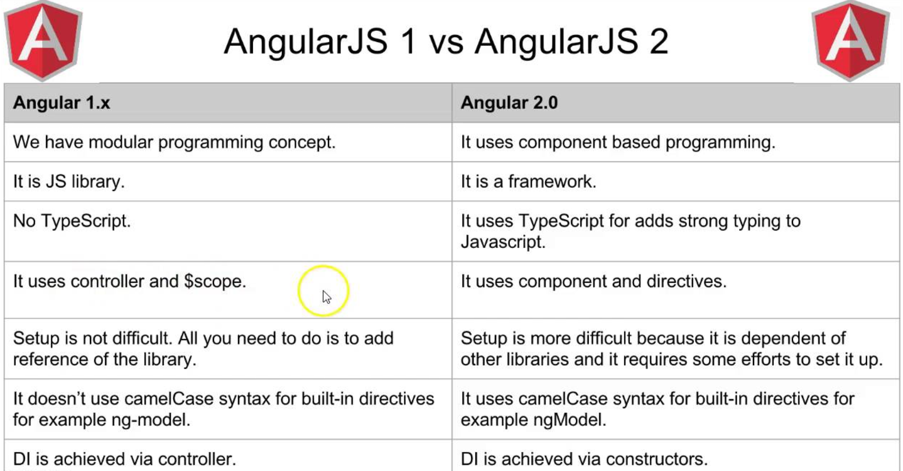
Angular.js 1, 2, 4
Difference between Angular.js 1 and 2
Angular.js 4 is now available
http://angularjs.blogspot.com/2017/03/angular-400-now-available.html

