Slide 1
Computer Chess
Richard Oates
April 2015

Slide 2
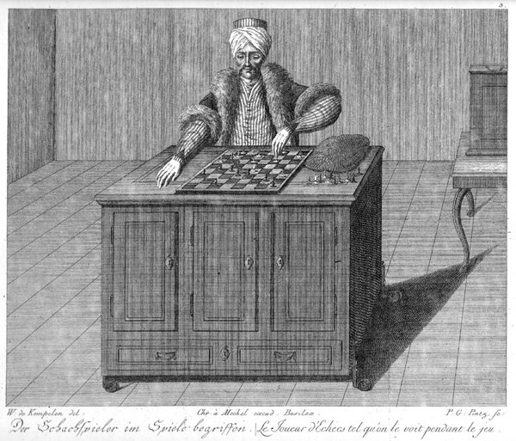
A brief History of computer chess
1770
“The Turk”
Wolfgang von Kempelen

Slide 3
A brief History of computer chess
1912
1950
1962
King + Rook vs King
“Programming a computer for playing chess” Claude Shannon
First serious program developed at MIT

Slide 4
A brief History of computer chess
1977
1978
1981
First microcomputer chess machines
First defeat of a chess master in a tournament
“Cray Blitz”
First computer to gain a master rating

Slide 5
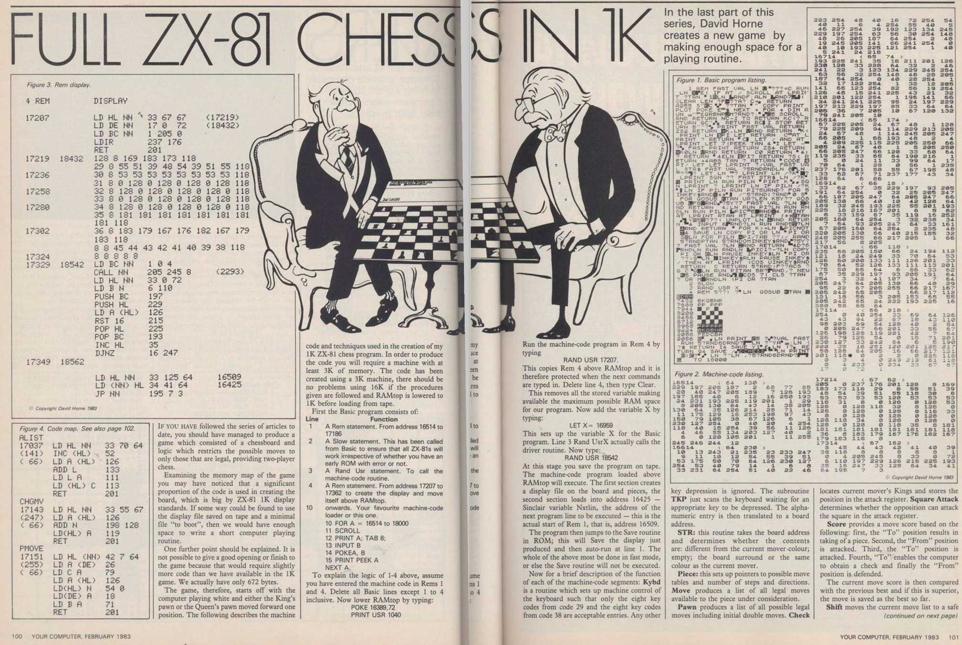
A brief History of computer chess
1983
“1K ZX Chess”
Chess in 672 bytes for the ZX81

Slide 6
A brief History of computer chess
1988
2015
1994
1997
“Deep Thought”
First defeat of a chess GM in a tournament
“ChessGenius”
First win of a game against the world champion (Kasparov)
“Deep Blue”
wins a 6-game match against Garry Kasparov

Slide 7
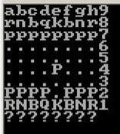
A brief History of computer chess
From 2005
2015
“Rybka”
Microcomputer chess above grandmaster level
“BootChess”
Only 487 bytes

Slide 8
Chess Software components
Board representation
Move generation
Search techniques
Position evaluation
User Interface

Slide 9
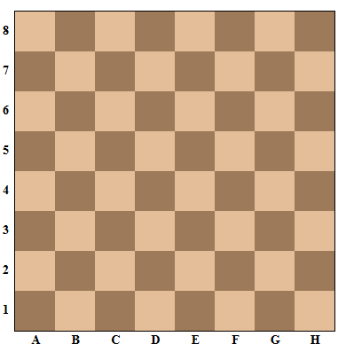

Board representation: bitboard
Each BitBoard has 64 bits
Allows use of bit operations for certain requirements
new BitBoard(
new byte[] {
(byte) 0b00000000,
(byte) 0b00000000,
(byte) 0b00000100,
(byte) 0b00000000,
(byte) 0b00001000,
(byte) 0b01000000,
(byte) 0b00100000,
(byte) 0b00000000 });

Slide 10






Board representation: bitboard
One BitBoard per piece-type and colour
Board state can be represented with 6 BitBoards per side
Optimizations: BitBoards for all pieces, empty squares, …
10000001 00000000
…… 00000000
01000010
00000000
…… 00000000
00100100
00000000
…… 00000000
00010000
00000000
…… 00000000
00001000
00000000
…… 00000000
00000000
11111111
00000000
…… 00000000

Slide 11
Move generation
Selective generation (human-style “best-move” generator) 1950s - 1970s
Incremental generation
Complete generation
Trade-offs:
effort for move generation and search
CPU and memory requirements

Slide 12


Rook move generation

Slide 13
Bishop move generation

Slide 14
Ray search
public static RayInfo findFirstPieceOnRay( Colour myColour, BitSet emptySquares, BitSet myPieces, Ray ray, int startSquare) {
...
Iterator<Integer> rayIter = ray.squaresFrom(startSquare);
while (rayIter.hasNext()) {
int sqIndex = rayIter.next();
distance++;
if (emptySquares.get(sqIndex)) { info.addEmptySquare(sqIndex); }
else if (myPieces.get(sqIndex)) {
info.storePiece(sqIndex, myColour, distance);
break;
}
else {
info.storePiece(sqIndex, Colour.oppositeColour(myColour), distance);
break;
}}}

Slide 15
Queen move generation

Slide 16

King move generation
Lookup table stores all possible moves for each square

Slide 17
King castling
Castling is possible if:
The king and rook have not yet moved
The squares between the king and rook are empty
The king is not in check
The king would not move over or land on a square that is attacked

Slide 18

Knight move generation
Lookup table stores all possible moves for each square

Slide 19
Pawn move generation
Pawns normally move 1 square forward
From their start position they can also move 2 squares forward
White and black pawns move in different directions

Slide 20

Pawn promotion
A pawn reaching the 8th rank gets promoted to a rook, bishop, knight or queen

Slide 21
Pawn move: One Square forward
Shift pawn BitBoard by 8 (shift left for white, shift right for black)
‘AND’ with empty square BitBoard
long lo = pawnBitSet.toLongArray()[0];
pawnBitSet = BitSet.valueOf(new long[] { (lo << 8) });
pawnBitSet.and(emptySquaresBitSet);
b3-b4
c2-c3

Slide 22
Pawn move: two Squares forward
Remove all pawns not on their start rank (2 for white, 7 for black)
Shift pawn BitBoard by 8 (shift left for white, shift right for black)
‘AND’ with empty square BitBoard
Shift pawn BitBoard again by 8 (shift left for white, shift right for black)
‘AND’ with empty square BitBoard
c2-c4

Slide 23
Pawn captures
Pawns capture diagonally
En-passant rule
b4xa3 e.p.

Slide 24
pawn capture algorithm
Shift pawn BitBoard appropriately (e.g. shift left 7 for white)
‘AND’ with BitBoard of opponent’s pieces
b2xa3

Slide 25
Checking for check
A legal move cannot leave the king in check
Therefore, need to check each move for validity
Optimization: If the king was not in check before the move, just check the ‘ray’ for an attacking piece (piece is ‘pinned’)
e5xf6 e.p.

Slide 26
Forsyth-Edwards notation
Describes the game state in a string with 6 fields (space-separated):
piece placement per rank
active colour
castling availability
en-passant square
halfmove clock
move number
Start position:
rnbqkbnr/pppppppp/8/8/8/8/PPPPPPPP/RNBQKBNR w KQkq – 0 1

Slide 27
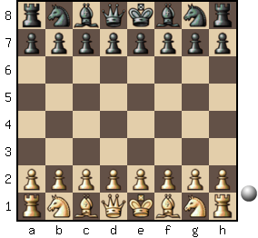
PERFT testS
PERFT (PERFormance Tests):
find all legal moves at a given depth
compare to predetermined value
Depth | Nodes
1 | 20
2 | 400
3 | 8 902
4 | 197 281
5 | 4 865 609
6 | 119 060 324
7 | 3 195 901 860
8 | 84 998 978 956
13 | 1 981 066 775 000 396 239

Slide 28
PERFT RESULTS

Slide 29

Further plans
Implement search
GUI
https://github.com/rjo67/chess

Slide 30
links
http://www.wordgames.com/2-player-chess.html

Slide 31
Reserve

