Slide 1
Towards Strehl-Optimal Adaptive Optics Control
Donald Gavel, Donald Wiberg,
Center for Adaptive Optics, U.C. Santa Cruz
Marcos Van Dam,
Lawrence Livermore National Laboaratory

Slide 2
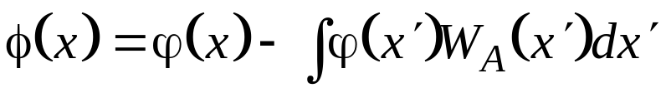

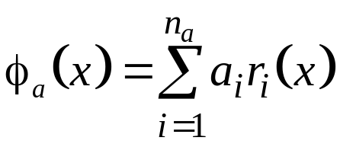

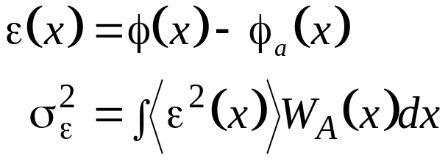

The goal of adaptive optics is to Maximize Strehl
Piston-removed atmospheric phase:
Phase correction by DM:
vector of actuator commands
vector of wavefront sensor readings
actuator response functions
Max Strehl ⇒ minimize residual wavefront variance (Marechal’s aproximation)
aperture averaged residual

Slide 3


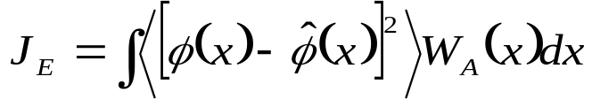
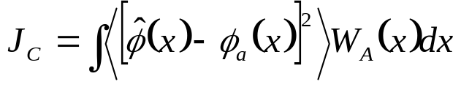

Strehl-optimizing adaptive optics
Define the cost function, J = mean square wavefront residual:
Wavefront estimation and control problems are separable (proven on subsequent pages):
where
J_{E} is the estimation part:
J_{C} is the control part:
and
is the conditional mean of the wavefront

Slide 4
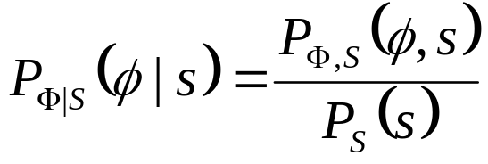
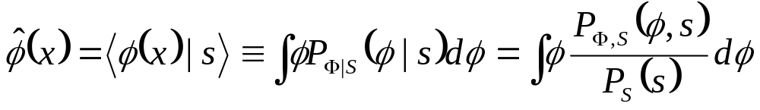
The Conditional Mean
The conditional probability distribution is defined via Bayes theorem:
The conditional mean is the expected value over the conditional distribution:

Slide 5
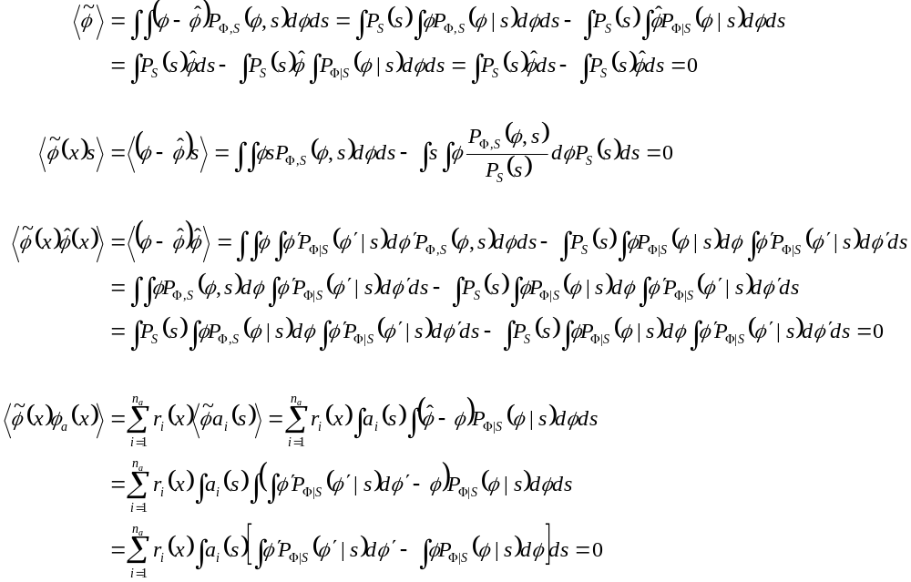
Properties of the conditional mean
1. The conditional mean is unbiased:
2. The error in the conditional mean is uncorrelated to the data it is conditioned on:
3. The error in the conditional mean is uncorrelated to the conditional mean:
4. The error in the conditional mean is uncorrelated to the actuator commands:

Slide 6
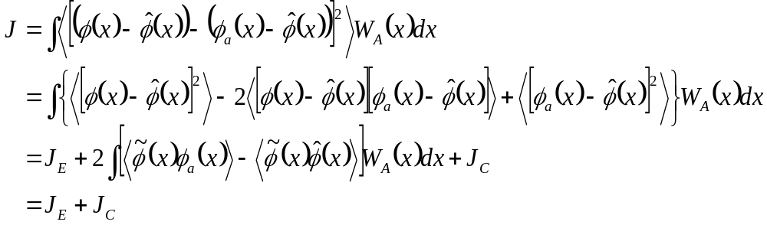
Proof that J = J_{E}+J_{C} (the estimation and control problems are separable)
0
0

Slide 7

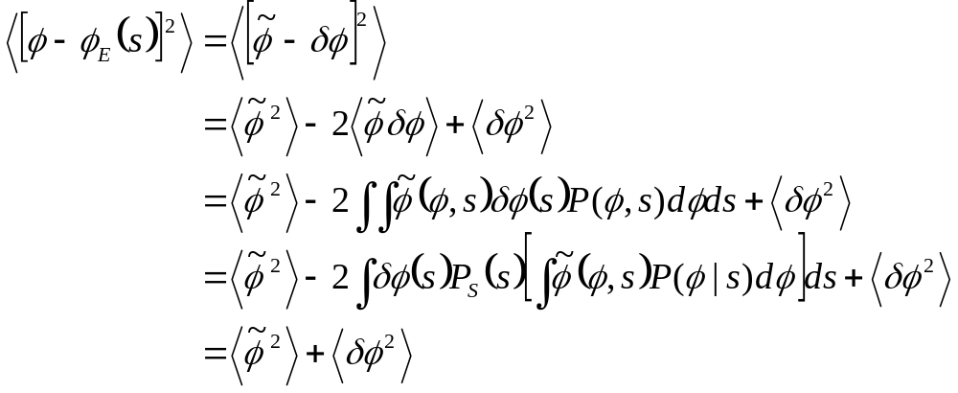
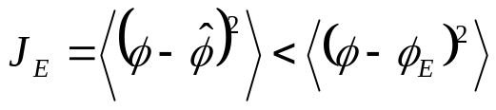


1) The conditional mean wavefront is the optimal estimate (minimizes J_{E})
Proof:
We show that any other wavefront estimate results in larger J_{E}
Let
0
for any
Therefore, minimizes J_{E}

Slide 8

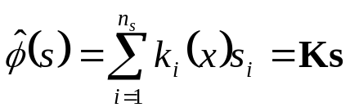
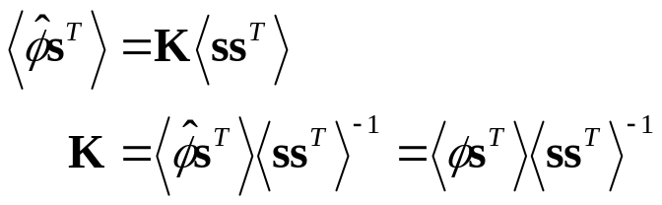


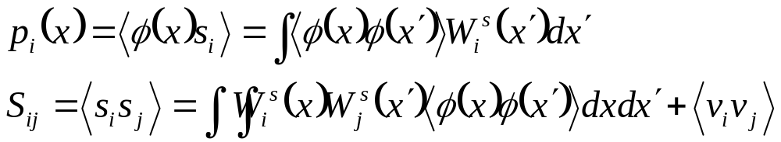
Calculating the conditional mean wavefront given wavefront sensor measurements
wavefront sensor operator: (average-gradient operator in the Hartmann slope sensor case)
The measurement equation
Measurement noise
For Gaussian distributed φ and ν, it is straightforward to show (see next page) that the conditional mean of φ must be a linear function of s:
Cross-correlate both sides with s and solve for K
(known as the “normal” equation)
since
so
where

Slide 9

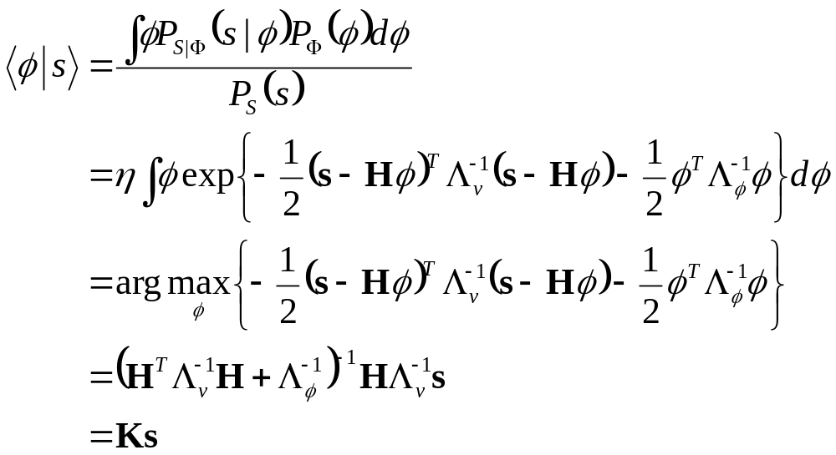
Aside: Proof that the conditional mean is a linear function of measurements if the wavefront and measurement noise are Gaussian
Measurement equation
Measurement is a linear function of wavefront
Bayesian conditional mean
Gaussian distribution
= maximum log-Likelihood of a-posteriori distribution
= a linear (least squares) solution

Slide 10
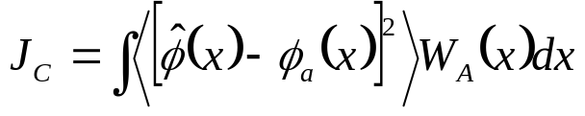
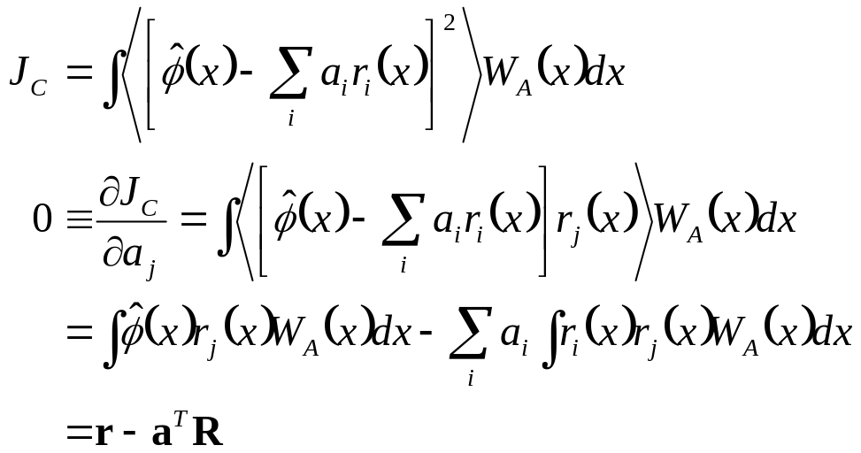



2) The best-fit of the DM response functions to the conditional mean wavefront minimizes J_{C}
where
and

Slide 11


Comparing to Wallner’s¹ solution
Combining the optimal estimator (1) and optimal controller (2) solutions gives Wallner’s “optimal correction” result:
where
The two methods give the same result, a set of Strehl-optimizing actuator commands
The conditional mean approach separates the problem into two independent problems:
  1) statistically optimal estimation of the wavefront given noisy data
  2) deterministic optimal control of the wavefront to its optimal estimate given the deformable mirror’s actuator influence functions
We exploit the separation principle to derive a Strehl-optimizing closed-loop controller
¹E. P. Wallner, Optimal wave-front correction using slope measurements, JOSA, 73, 1983.

Slide 12
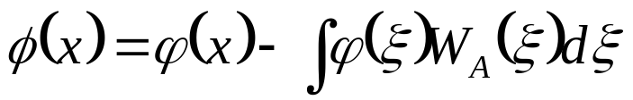
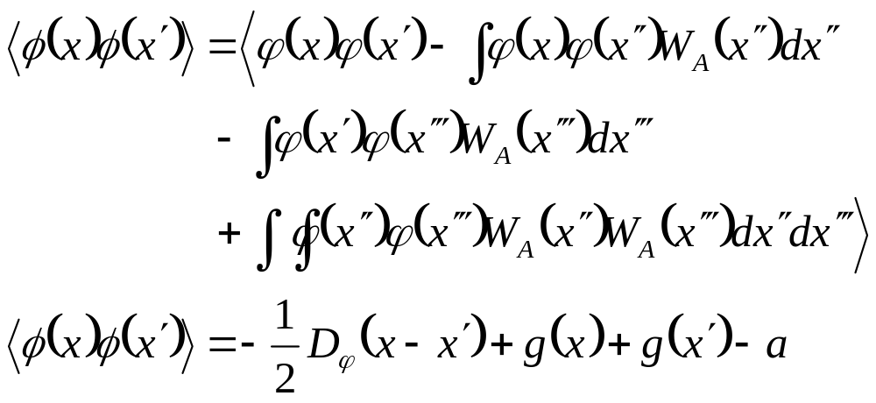
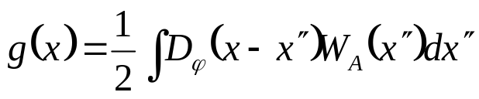
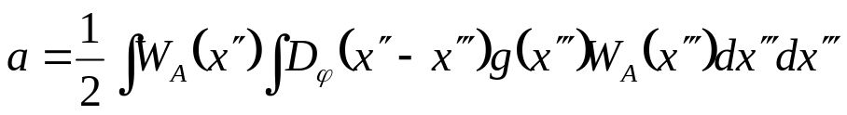
The covariance statistics of φ(x)
(piston-removed phase over an aperture A)
where

Slide 13
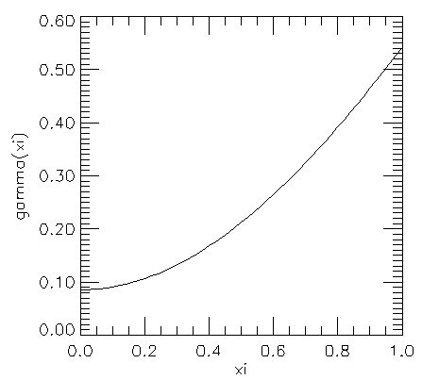
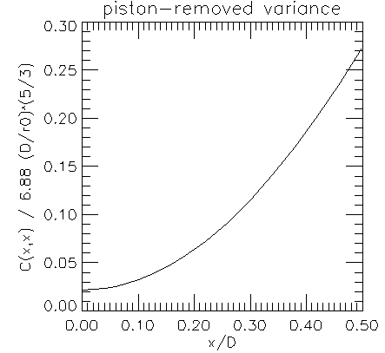
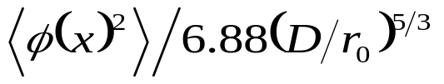


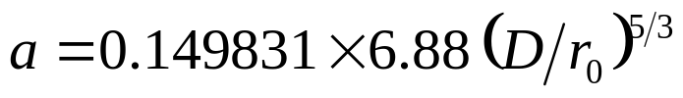
The g(x) function and a are “generic” under Kolmogorov statistics
D_{φ}(x) = 6.88(|x|/r₀)^{5/3}
Circular aperture, diameter D
Factor out parameters 6.88(D/r₀)^{5/3} and integrals are computable numerically

Slide 14
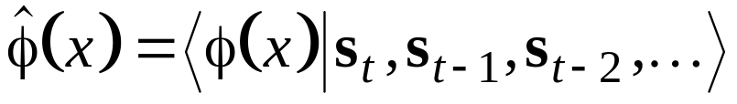
Towards a Strehl-optimizing control law for adaptive optics
Remember our goal is to maximize Strehl = minimize wavefront variance in an adaptive optics system
But adaptive optic systems measure and control the wavefront in closed loop at sample times that are short compared to the wavefront correlation time.
So the optimum controller uses the conditional mean, conditioned on all the previous data:

Slide 15
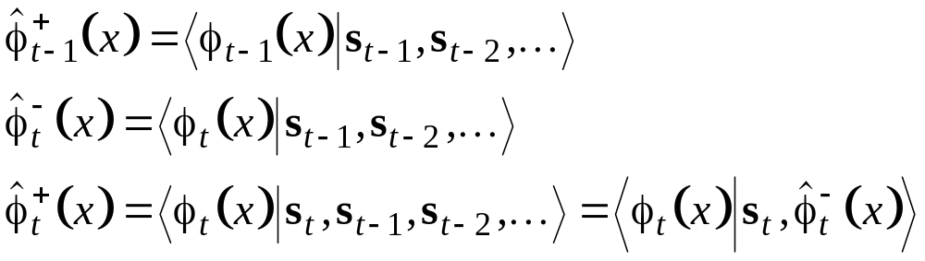
We need to progress the conditional mean through time (the Kalman filter² concept)
Take a conditional mean at time t-1 and progress it forward to time t
Take data at time t
Instantaneously update the conditional mean, incorporating the new data
Progress forward to time step t+1
etc.
²Kalman, R.E., A New Approach to Linear Filtering and Prediction Problems, J. Basic Eng., Trans. ASME, 82,1, 1960.

Slide 16


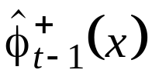
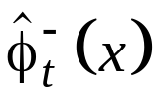
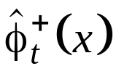
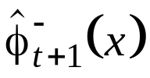
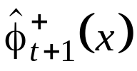
Kalman filtering
new data
new data
Time
progress
Update
Time
progress
Update
. . .
. . .

Slide 17
Problems with calculating and progressing the conditional mean of an atmospheric wavefront through time
The wavefront is defined on a Hilbert Space (continuous domain) at an infinite number of points, x ∈ A (A = the aperture).
The progression of wavefronts with time is not a well-defined process (Taylor’s frozen flow hypothesis, etc.)
In addition to the estimate, the estimate’s error covariance must be updated at each time step. In the Hilbert Space, these are covariance bi-functions: c_{t} (x,x’)=<φ_{t}(x),φ_{t} (x’)>, x ∈ A, x’ ∈ A.

Slide 18
Justifying the extra effort of the optimal estimator/optimal controller
If is interesting to compare “best possible” solutions to what we are getting now, with “non-optimal” controllers
  Determine if there is room for much improvement.
  Gain insights into the sensitivity of optimal solutions to modeling assumptions (e.g. knowledge of the wind, Cn2 profile, etc.)
Preliminary analysis of tomographic (MCAO) reconstructors suggest that Weiner (statistically optimal) filtering may be necessary to keep the noise propagation manageable

Slide 19



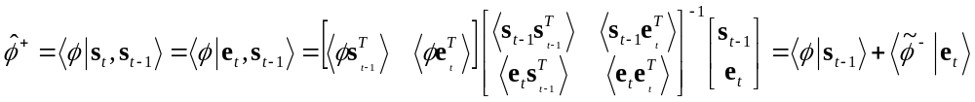


Updating a conditional mean given new data
Say we are given a conditional mean wavefront given previous wavefront measurements
And a measurement at time t
The residual
is uncorrelated to previous measurements,
Applying the normal equation on the two pieces of data e_{t} and s_{t-1}:
0
0
where
Summarizing:

Slide 20
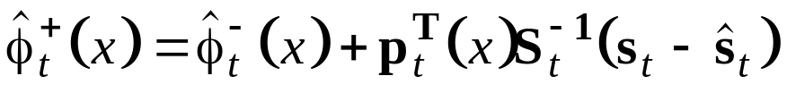

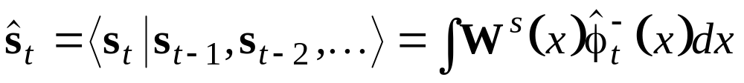
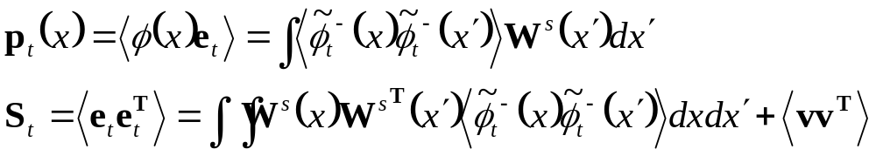
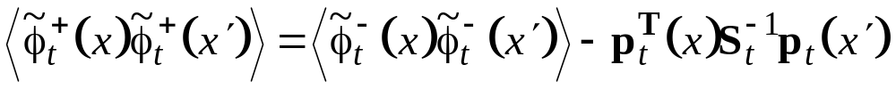
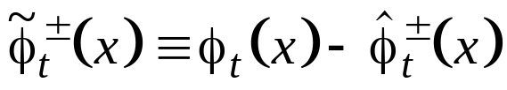
…written in Wallner’s notation
Estimate-update, given new data s_{t}:
Hartmann sensor applied to the wavefront estimate
Correlation of wavefront to measurement
Correlation of measurement to itself
Covariance-update:
where the estimate error is defined:

Slide 21
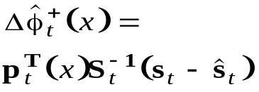







How it works in closed loop
+
Wavefront
sensor
Estimator
-
Best fit
to DM
+
Δ
Predictor

Slide 22
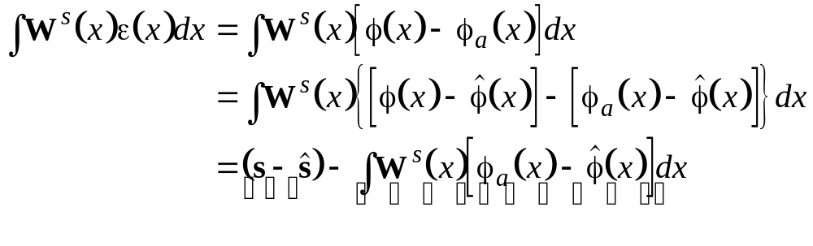
Closed-loop measurements need a correction term
^
…since what the wavefront sensor sees is not exactly the same as s - s, the wavefront measurement prediction error
Measurement prediction error
DM Fitting error
⇒
Measurement prediction error = Hartmann sensor residual + DM Fitting error
(measured data)
(can be computed from the wavefront estimate and knowledge of the DM)

Slide 23
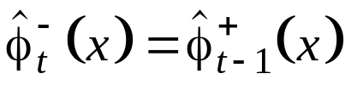
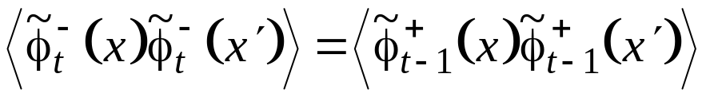
Time-progressing the conditional mean
Given
how do we determine
?
Example 1:
On a finite aperture, the phase screen is unchanging and frozen in place
Consequences:
Estimates corrections accrue (the integrator “has a pole at zero”)
If the noise covariance <vv^{T}> is non-zero, then the updates cause the estimate error covariance to decrease monotonically with t.

Slide 24

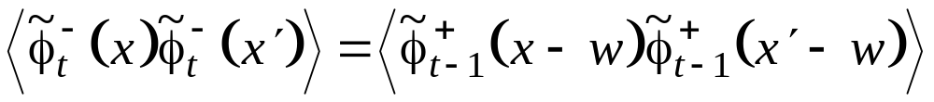
Time-progressing the conditional mean
Example 2:
The aperture A is infinite, and the phase screen is frozen flow, with wind velocity w
Consequence:
An infinite plane of phase estimates must be updated at each measurement

Slide 25

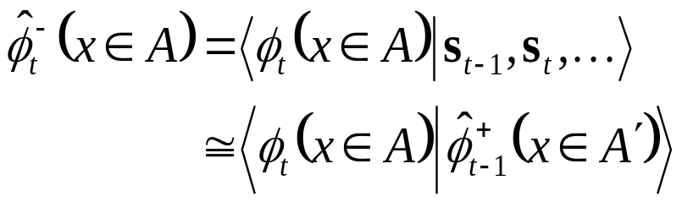
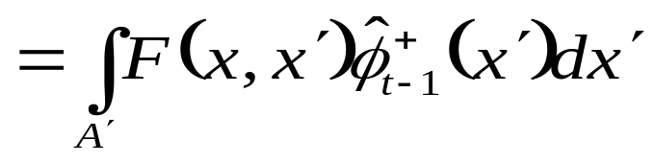

Time-progressing the conditional mean
Example 3:
The aperture A is finite, and the phase screen is frozen flow, with wind velocity w
more on this approximation later
A
A’
as we might expect
for x in the overlap region, A∧A’
The problem is to determine the progression operator, F(x,x’), for x in the newly blown in region, A − (A ∧ A’ )

Slide 26


“Near Markov” approximation
The property
where w is random noise uncorrelated to φ_{t-1}(x), is known as a Markov property.
We see that if φ obeyed a Markov property
that is, the conditional mean on a finite sized aperture retains all of the relevant statistical information from the growing history of prior measurements.
Phase φ over the aperture however is not Markov, since some information in the “tail” portion, A’’ - (A’’ ∧ A’ ), which correlated to s_{t-1}, is dropped off and ignored. The fractal nature of Kolmogorov statistics does not allow us to write a Markov difference equation governing φ on a finite aperture.
We will nevertheless proceed assuming the Markov property since the effect of neglecting φ in A’’ - (A’’ ∧ A’ ) to estimates of φ in A - (A ∧ A’ ) is very small
A
A’
A’’

Slide 27
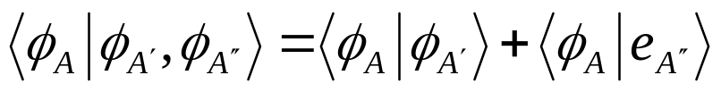
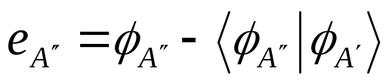
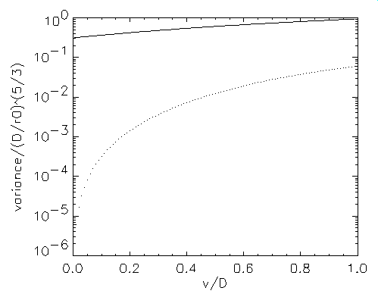


Validity of approximating wind-blown Kolmogorov turbulence as near-Markov
what is the effect of neglecting this point?
using the estimate at this point
To predict this point
contribution of point in A’
contribution of neglected point in A’’
A
A’
A’’
wind
Information contained in points neglected by the near-Markov approximation is negligible

Slide 28
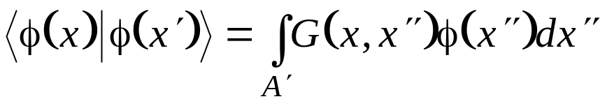

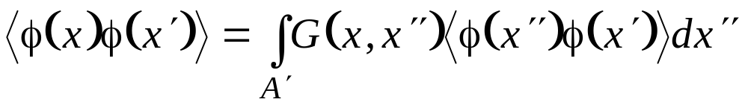





The progression operator from A’ to A
We write the conditional mean of the wavefront in A, conditioned on knowing it in A’
G(x,x’’) solves
A
A’
(a normal equation)
We can then say that
Note: q(x) = 0 and G(x,x’) = δ(x-x’-w) for x in the overlap A ∧ A’
where q(x) is the error in the conditional mean φ(x) - <φ(x)|φ(x’)>. q(x) is uncorrelated to the “data” (φ(x’))
Also true in the overlap since q(x) = 0 there
and, consequently
since the measurement at t-1 depends only on φ(x’) and random measurement noise.
Then
i.e.

Slide 29




In summary: The time-progression of the conditional mean is
A
A’
where F(x,x’) solves
If we assume the wavefront phase covariance function is constant or slowly varying with time, then the Green’s function F(x,x’) need only be computed infrequently (e.g. in slowly varying seeing conditions)
To solve this equation, we now need the cross-covariance statistics of the phase, piston-removed on two different apertures.

Slide 30


Cross-covariance of Kolmogorov phase, piston-removed on two different apertures
A
A’
Where c and c’ are the centers of the respective apertures, and
as before
and
also a “generic” function

Slide 31





The error covariance must also progress, since it is used in the update formulas
using
the error in the conditional mean is
and the error covariance is
where
Q is defined simply to preserve the Kolmogorov turbulence strength on the subsequent aperture

Slide 32
Simulations
Nominal parameters
  D = 3m, d = 43cm (D/d = 7)
  r₀(λ=0.5μ) = 10cm ( r₀(λ=2μ) ≅ d )
  w = 11m/s × 1 ms (w = D/300)
  Noise = 0.1 arcsec rms
Simulations
  Wallner’s equations strictly applied, even though the wind is blowing
  Strehl-optimal controller
  Optimal controller with update matrix, K, set at converged value (allows pre-computing error covariances)
  Sensitivity to assumed r0
  Sensitivity to assumed wind speed
  Sensitivity to assumed wind direction

Slide 33

Noise performance after convergence
Single-step (Wallner)
Strehl-optimal

Slide 34

Convergence time history
K matrix fixed at converged value
K matrix optimal at each time step

Slide 35

Sensitivity to r₀

Slide 36


Sensitivity to wind speed and direction

Slide 37
Conclusions
Kalman filtering techniques can be applied to better optimize the closed-loop Strehl of adaptive optics wavefront controllers
A-priori knowledge of r₀ and wind velocity is required
Simulations show
  Considerable improvement in performance over a single step optimized control law (Wallner)
  Insensitivity to the exact knowledge of the seeing parameters over reasonably practical variations in these parameters

