Slide 1
Docker & Ansible
Richard Kent Jordan
rjordan@pobox.com
@kentjordan

Slide 2
Traditional VMs
Load Balancer
  HAProxy
Backend
  X servers running RabbitMQ
App Servers
  X servers running your web app
Asset Server (possibly)
  X servers running nginx/apache to server static assets

Slide 3
What is Docker
What Docker ISN'T
  Docker is NOT a virtual machine
    Processes inside the container run on the HOST kernel
  Docker is NOT a security mechanism
    Applications and File systems are isolated, but it's not perfect

Slide 4
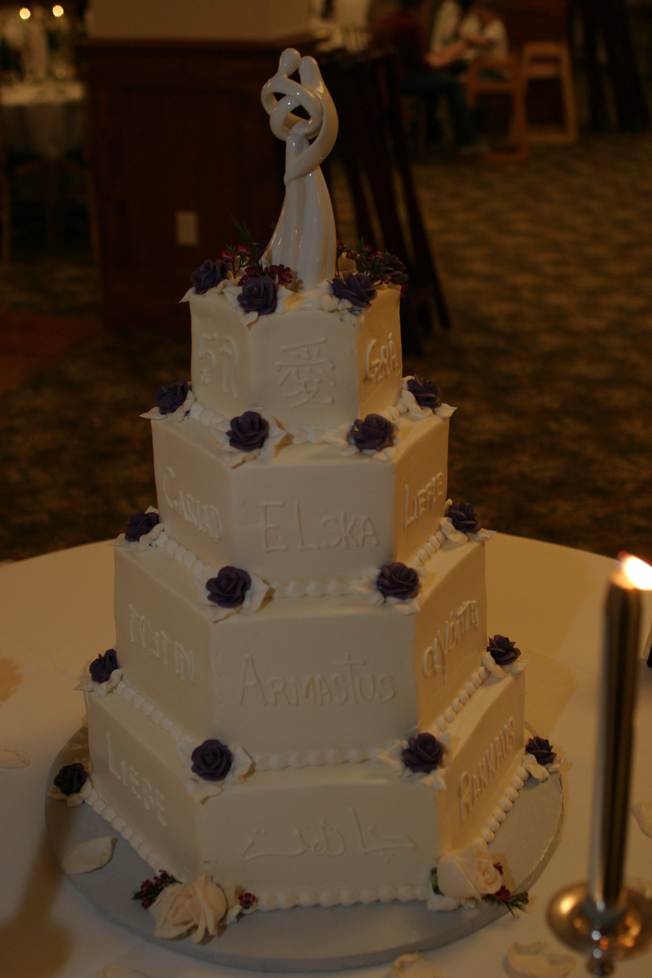
What is Docker
What Docker brings
  Layers
    Treat your containers file system like git
      Commit new layers
      Tagging layers
    The wedding cake
  Idempotence
    Container state should be throw away
    “Containers encourage treating application environments as transient, rather (than) static systems that exist for years and accumulate risk-inducing artifacts.” – source

Slide 5
Layer 1 - RailsBase
https://github.com/rjordan/dockerfiles/tree/master/railsbase
RailsBase forms the bottom layer of my cake
  RailsBase relies on ruby-2.2.2 which in turn relies on debian:jessie

Slide 6
Our App
Chatter
  https://github.com/rjordan/chatter
  Simple Sinatra application
    2 routes
      A simple web page with a form and minimal javascript
      A websocket that accepts/dispatches messages
    RabbitMQ
      Provides for queuing and delivering messages

Slide 7
Introducing Ansible
Ansible is an infrastructure automation
  Runs completely over SSH
  Requires no local agent
  Artifacts are YAML files

Slide 8
Basic Ansible
Can be used to execute simple shell cmd
  ansible deepspace9 -i hosts -m shell -a "echo Hello World"
Modules can be used to give Ansible new capabilities
Roles group related sets of tasks
Playbooks group related sets of tasks/roles together

