Slide 1


Slide 2
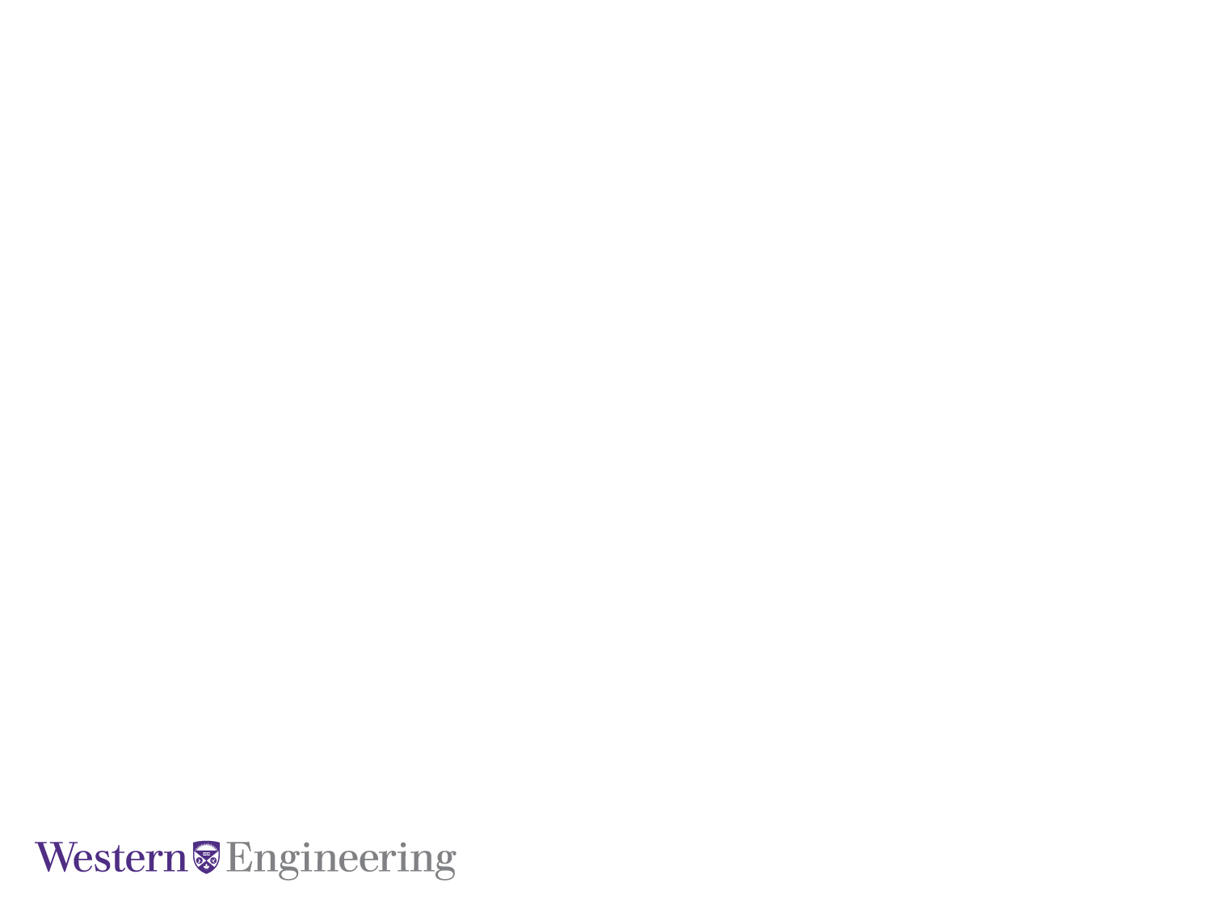
ECE 9017 – Advanced DBMS - Presentation
Sales History Trends Analysis
Group 10 Members:
Rinni Joshi - (rjoshi48@uwo.ca)
Electrical & Computer Engineering Department

Slide 3

Table of Contents:
Business Requirements
Operational Database ER Diagram
Datawarehouse ER Diagram
ETL Model Diagram
SSIS Process Diagrams
SSIS Implementation
SSAS Multidimensional Model
Dimension Hierarchy
Custom Calculated Measures
KPI
MDX Query
Electrical & Computer Engineering Department

Slide 4
Business Requirements
The sample company needs a data warehouse solution that can provide comprehensive reports on annual, quarterly, monthly sales figures by Product.
It also needs to analyze the impact of special Promotions on Sales and analyze sales by Geographical Area and distribution Channels.
It also analyzes that how Customer’s income level and marital status influence the Sales. The solution must be scalable to accommodate future growth in data volume and report complexity.
The Sales History (SH) schema must be designed to facilitate efficient querying and analysis of the data.
The solution should also provide robust security measures to ensure the confidentiality and integrity of the data.
Electrical & Computer Engineering Department ​
​

Slide 5
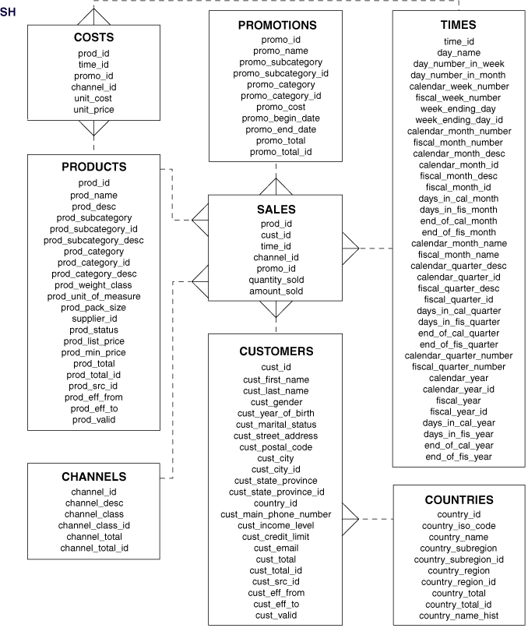
Operational Database ER Diagram:
Electrical & Computer Engineering Department ​
​

Slide 6
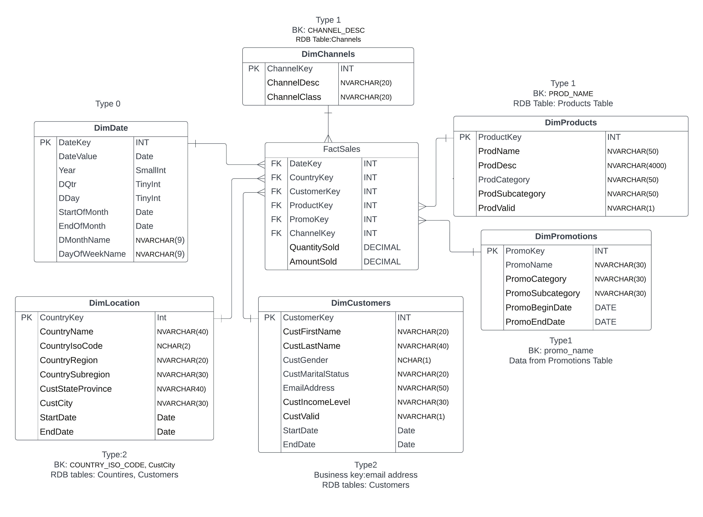
Datawarehouse Model
Electrical & Computer Engineering Department ​
​

Slide 7
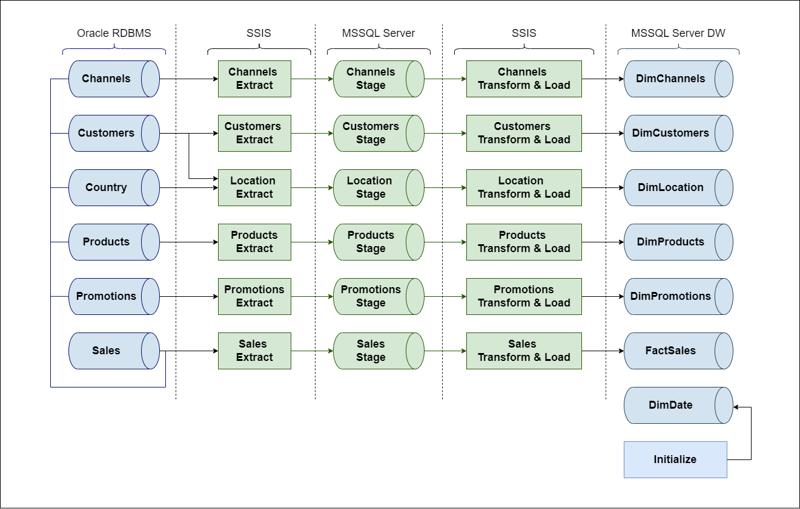
ETL Model Diagram:
Electrical & Computer Engineering Department ​
​

Slide 8
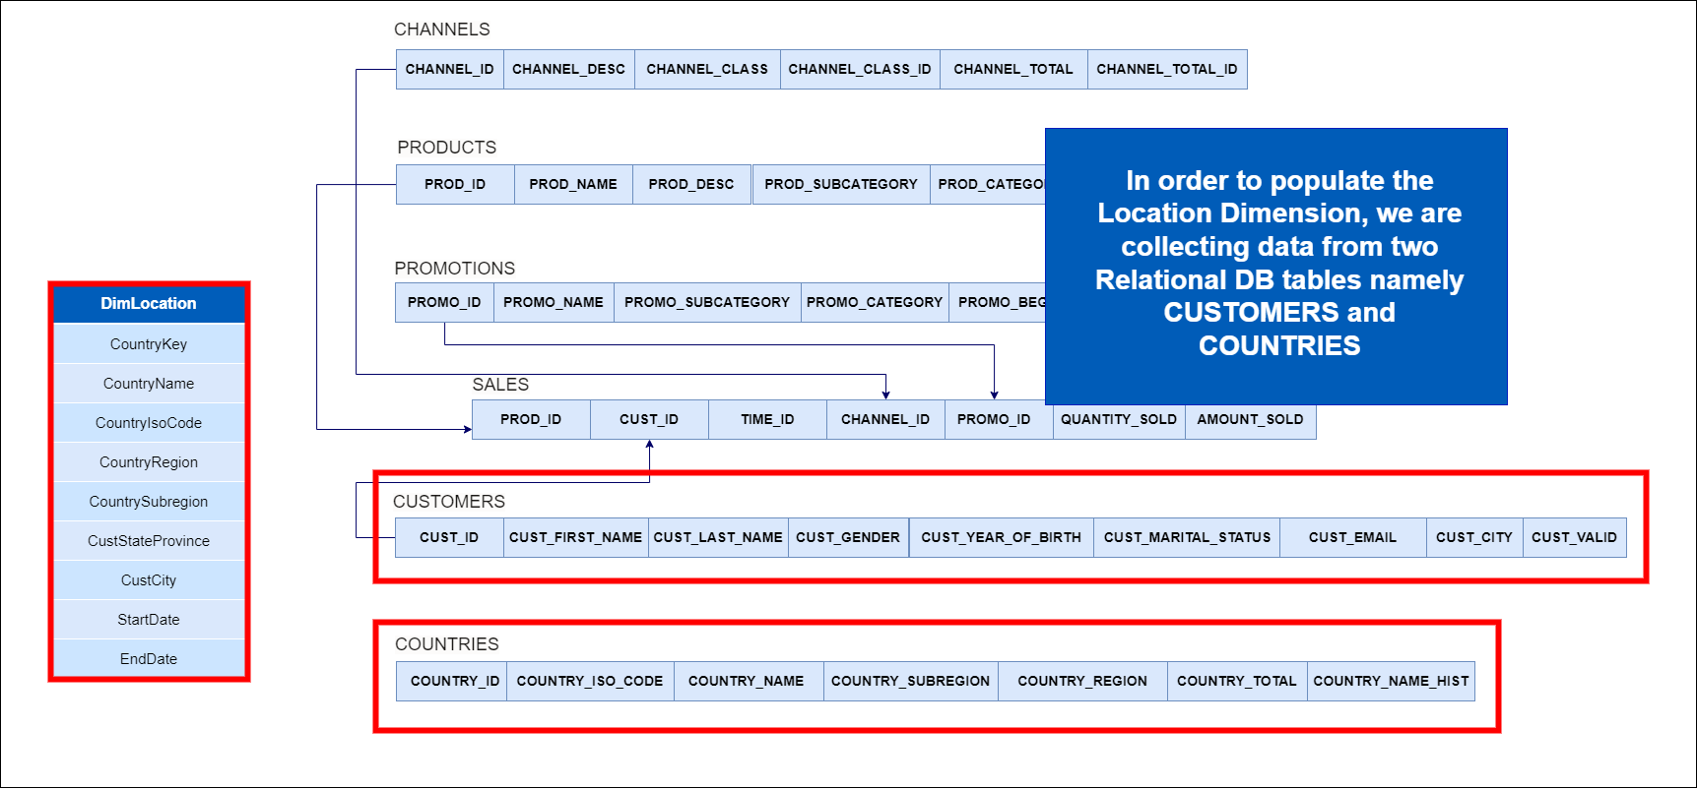
SSIS Process Diagrams:
Location Dimension:
Electrical & Computer Engineering Department ​
​

Slide 9
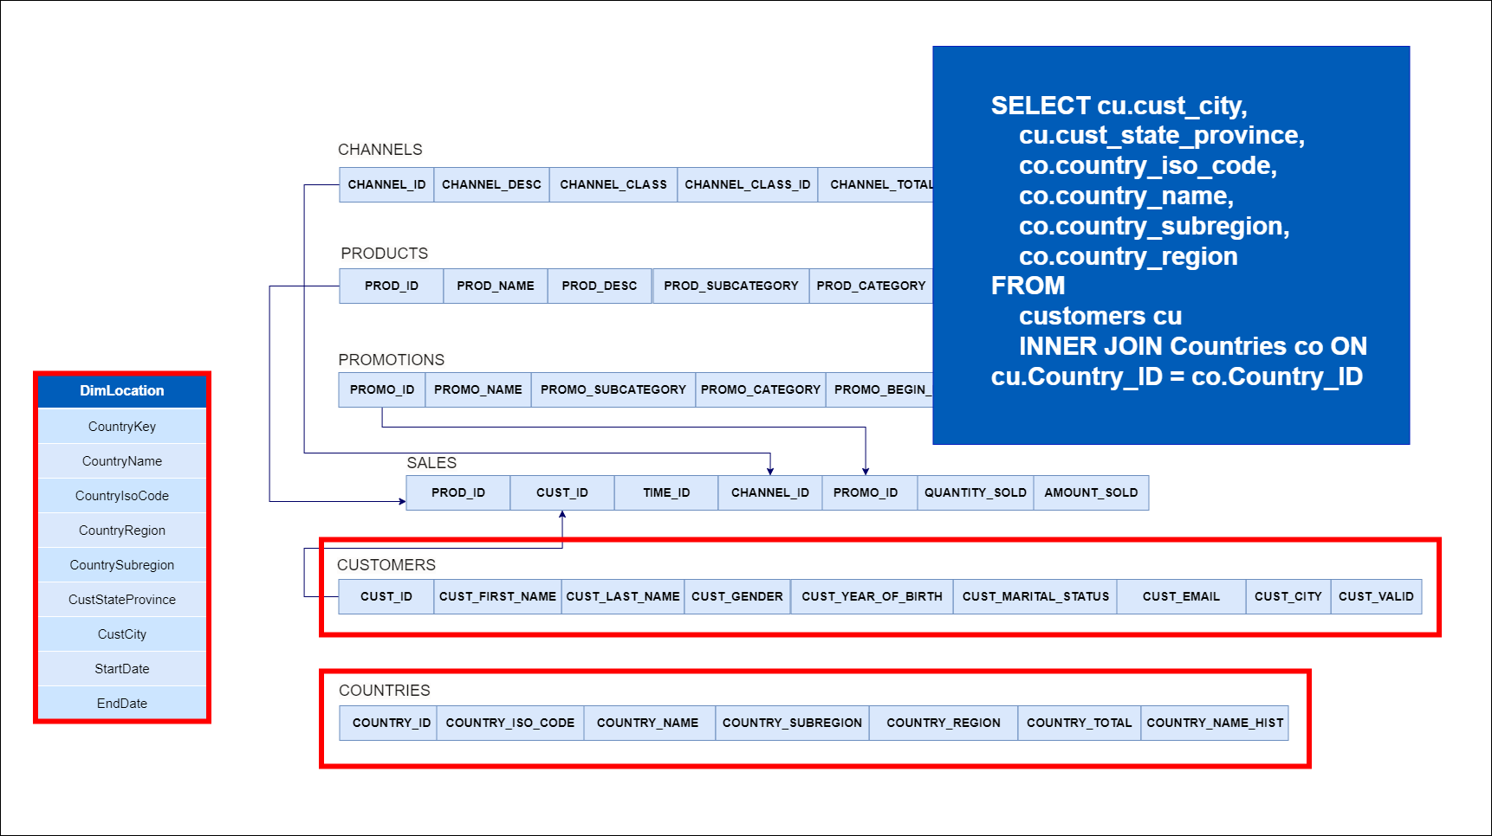
SSIS Process Diagrams:
Location Dimension:
Electrical & Computer Engineering Department ​
​

Slide 10
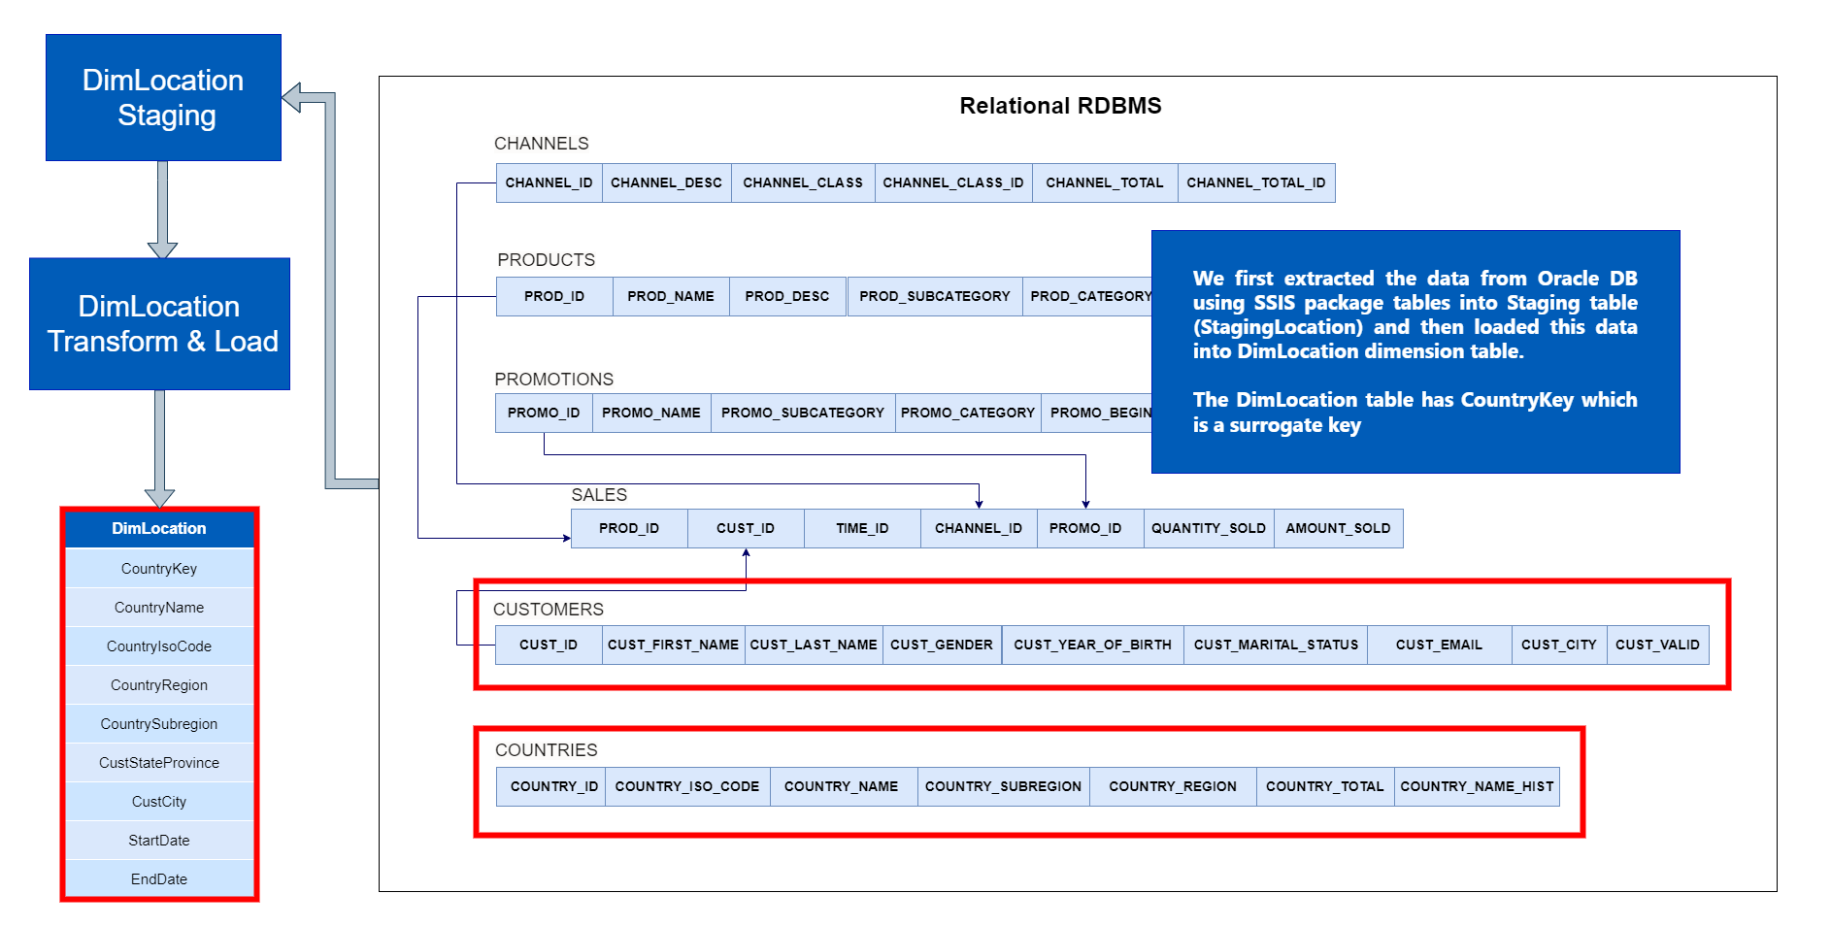
SSIS Process Diagrams:
Location Dimension:
Electrical & Computer Engineering Department ​
​

Slide 11
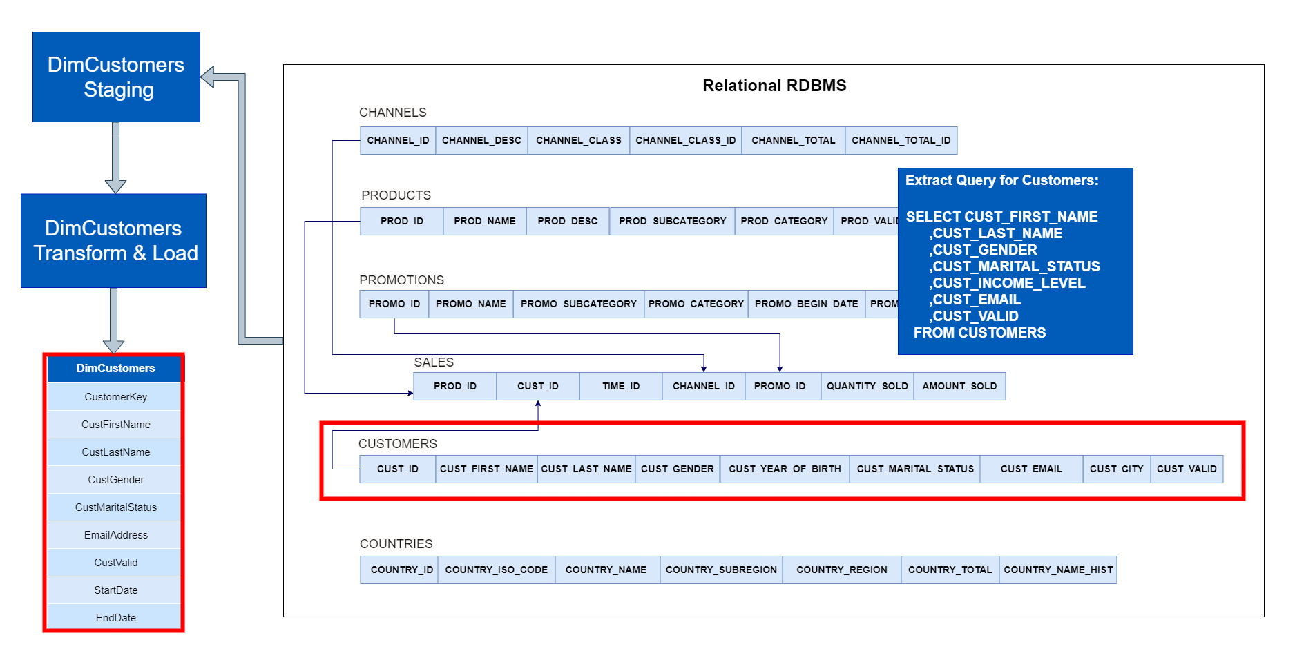
SSIS Process Diagrams:
Customers Dimension:
Electrical & Computer Engineering Department ​
​

Slide 12
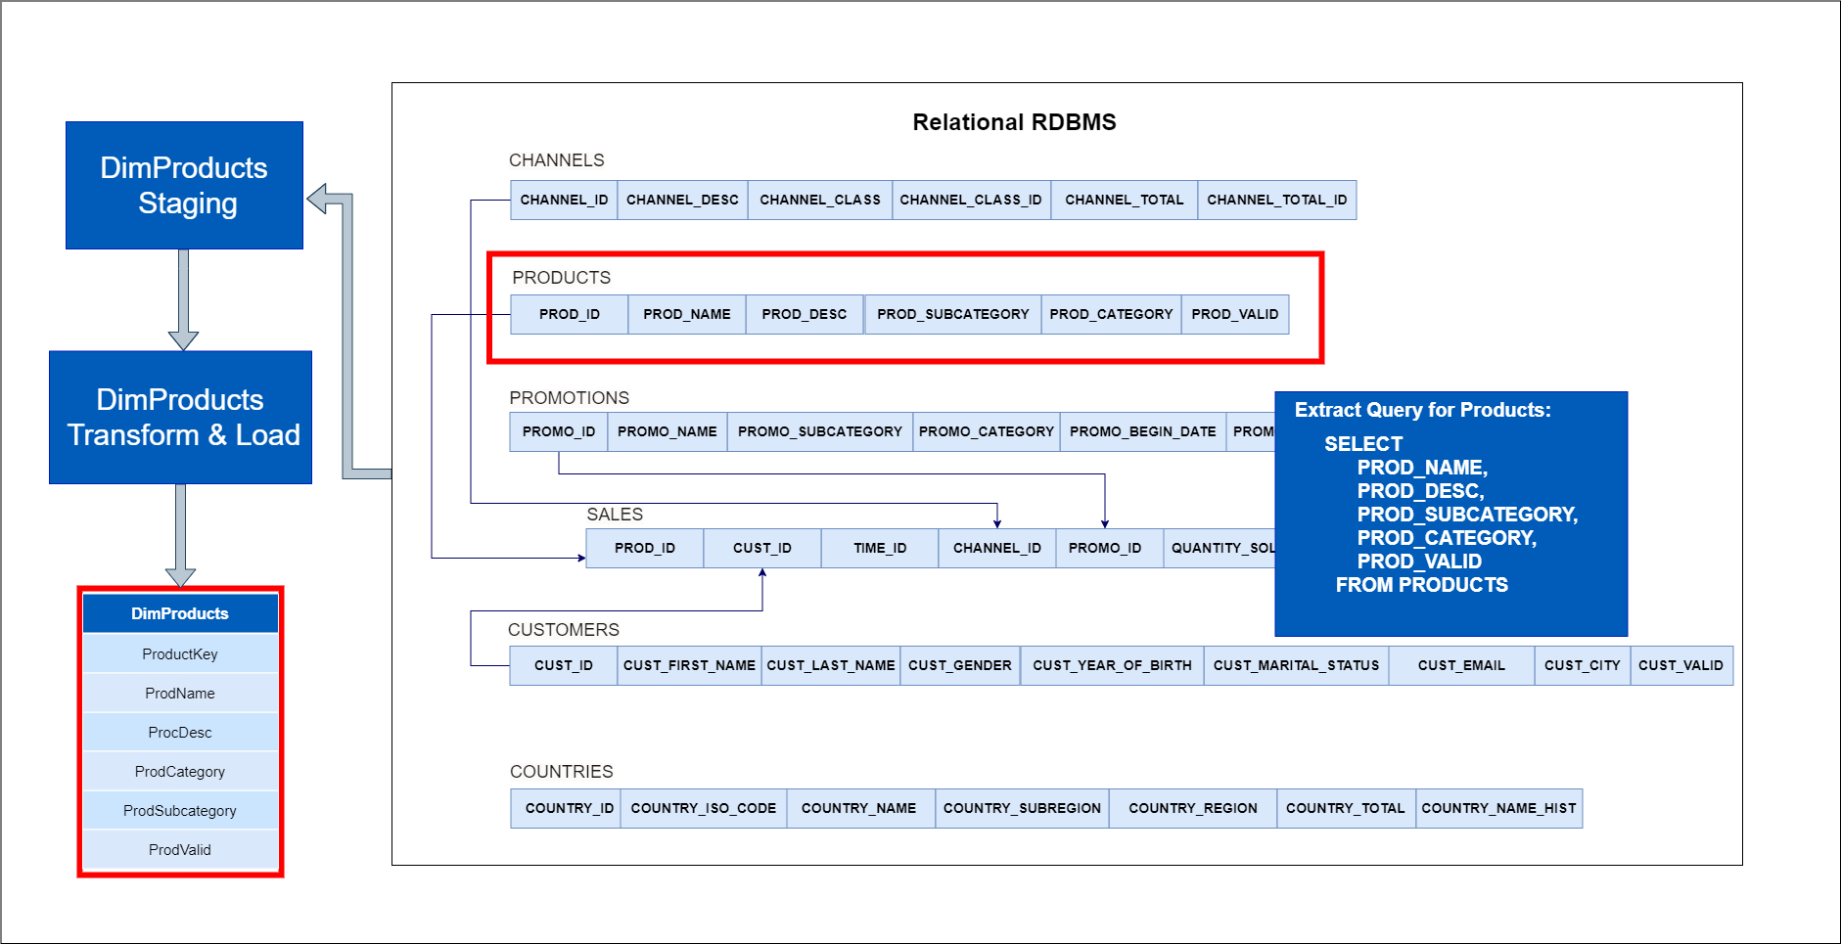
SSIS Process Diagrams:
Products Dimension:
Electrical & Computer Engineering Department ​
​

Slide 13
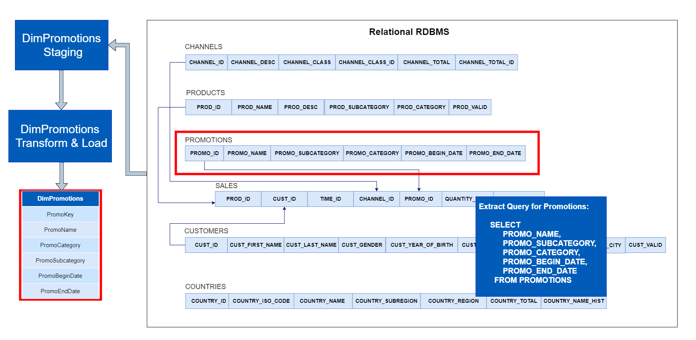
SSIS Process Diagrams:
Promotions Dimension:
Electrical & Computer Engineering Department ​
​

Slide 14
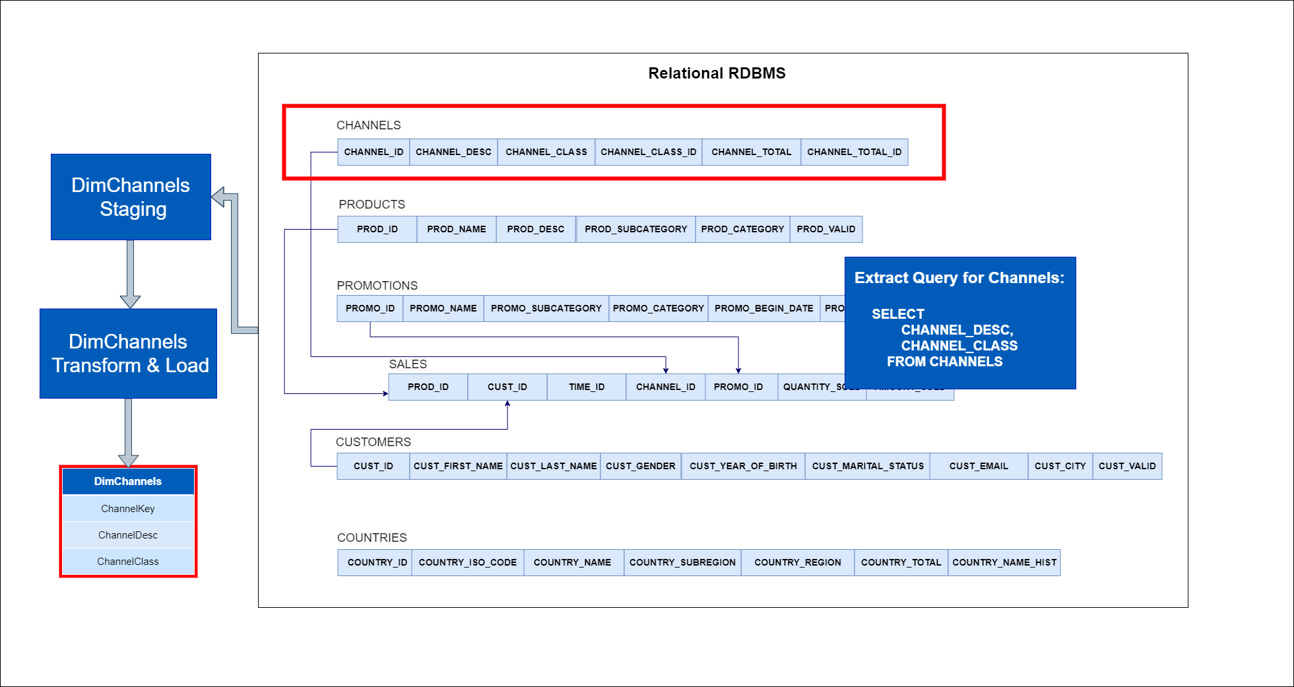
SSIS Process Diagrams:
Channels Dimension:
Electrical & Computer Engineering Department ​
​

Slide 15
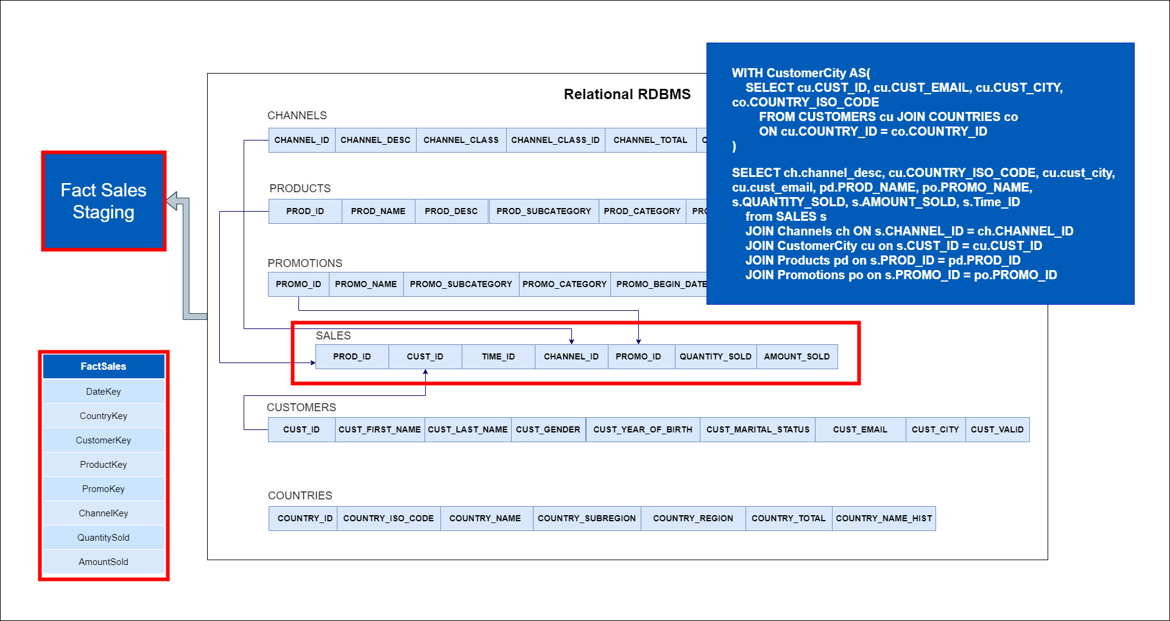
SSIS Process Diagrams:
Sales Facts:
Electrical & Computer Engineering Department ​
​

Slide 16
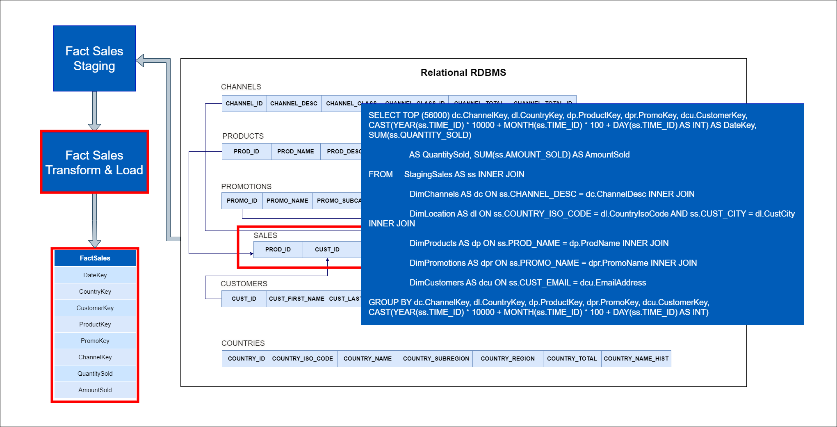
SSIS Process Diagrams:
Sales Facts:
Electrical & Computer Engineering Department ​
​

Slide 17
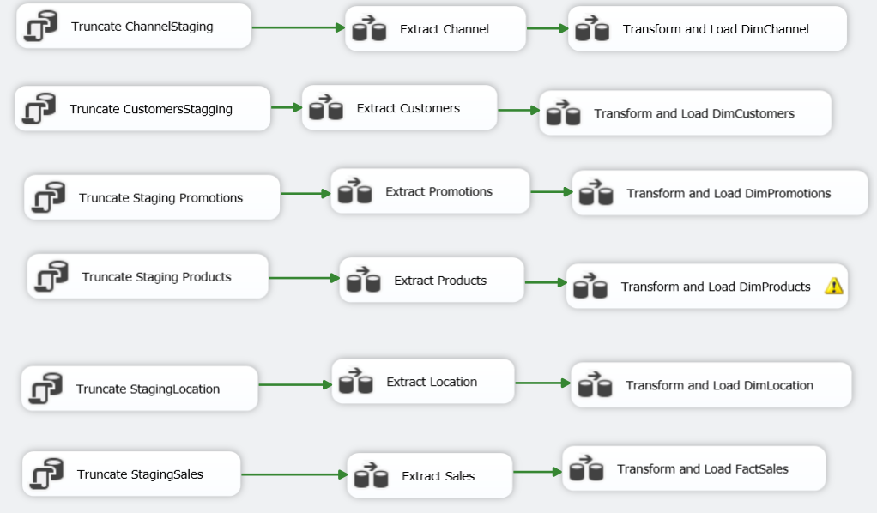
SSIS Implementation:
Electrical & Computer Engineering Department ​
​

Slide 18
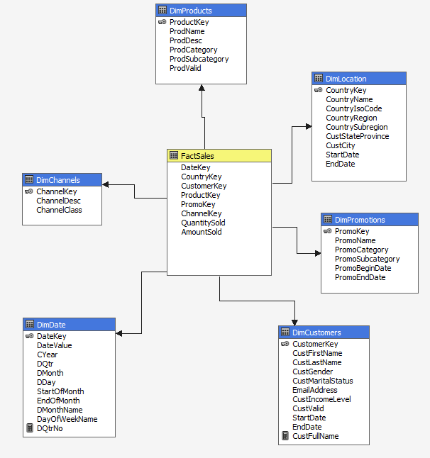
SSAS - Multidimensional Model:
Electrical & Computer Engineering Department ​
​

Slide 19
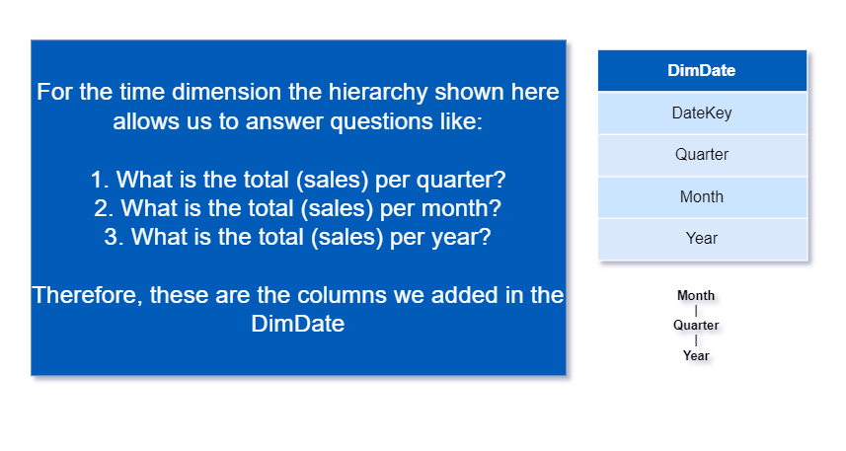
Dimension Hierarchy:
Electrical & Computer Engineering Department ​
​

Slide 20
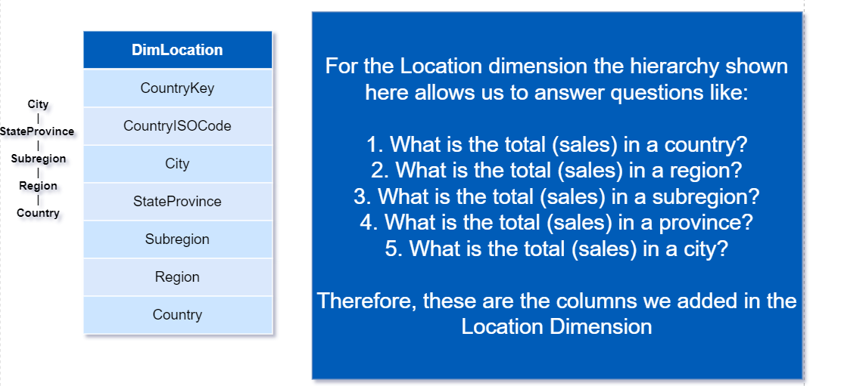
Dimension Hierarchy:
Electrical & Computer Engineering Department ​
​

Slide 21
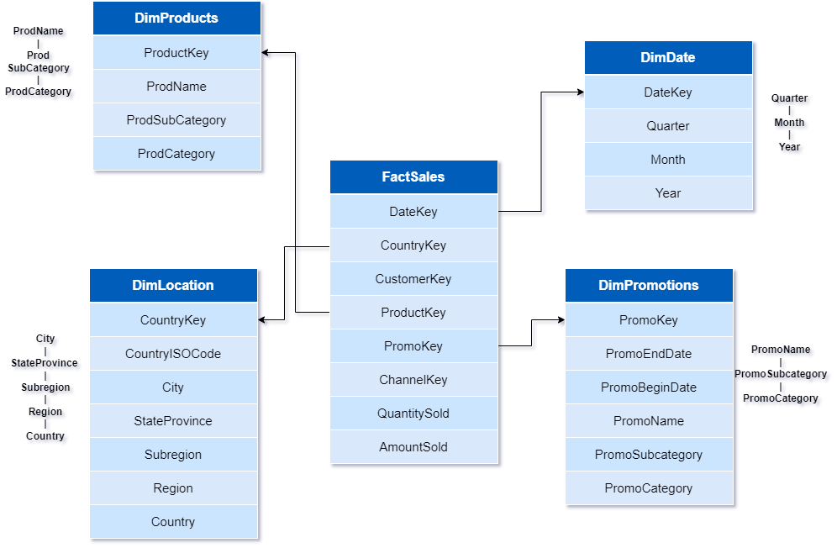
Dimension Hierarchy:
Electrical & Computer Engineering Department ​
​

Slide 22
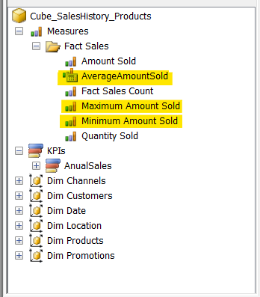
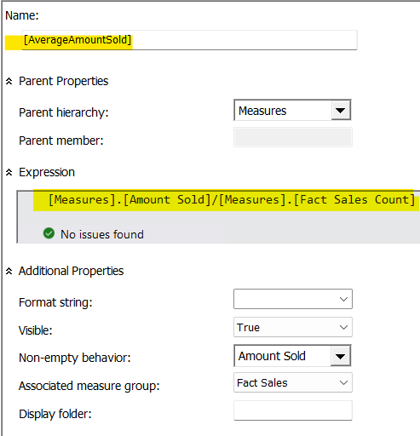
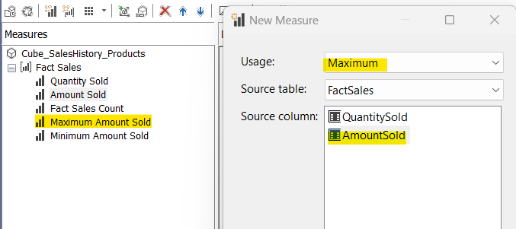
Custom Calculated Measures:
Measure created using Calculations
Measure created in Cube structure data view
Electrical & Computer Engineering Department ​
​

Slide 23
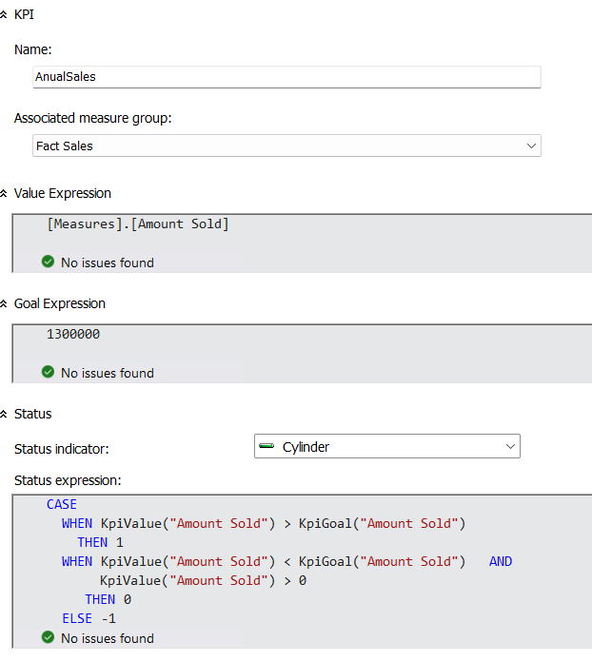
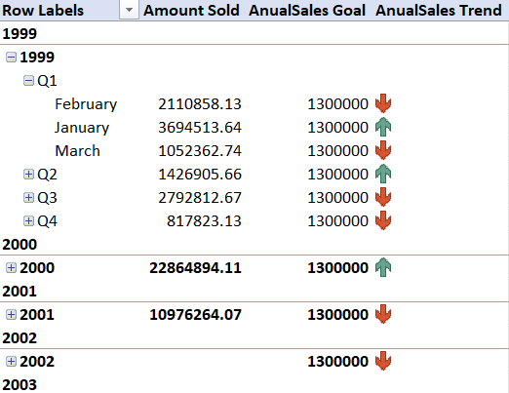
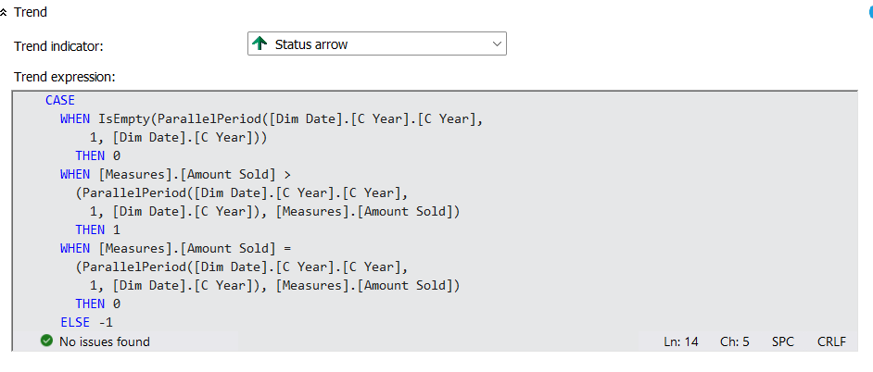
KPI:

Slide 24
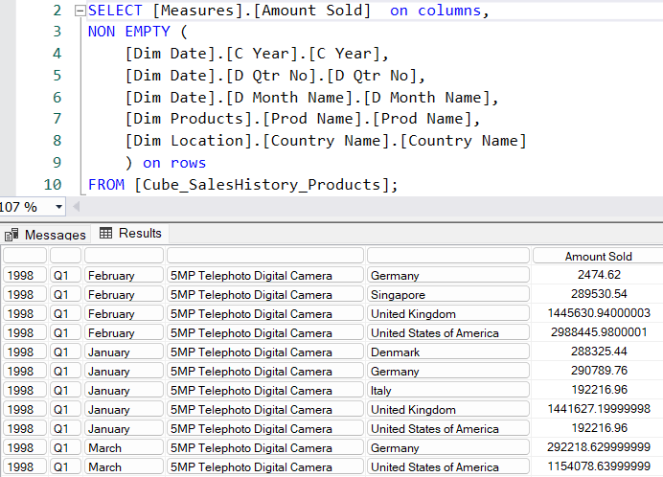
MDX Query:
Monthly, quarterly, and annual Sales of products worldwide.
Electrical & Computer Engineering Department ​
​

Slide 25
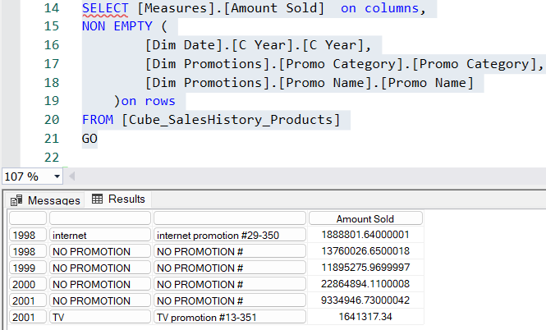
MDX Query:
2. Impact of promotions on annual sales
Electrical & Computer Engineering Department ​
​

Slide 26
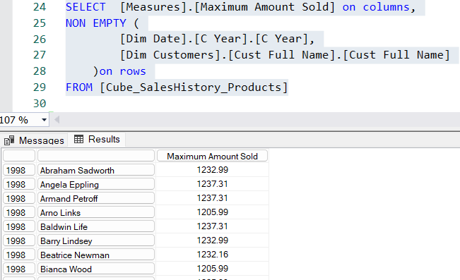
MDX Query:
3. Maximum sales a customer can make in a year.
Electrical & Computer Engineering Department ​
​

Slide 27
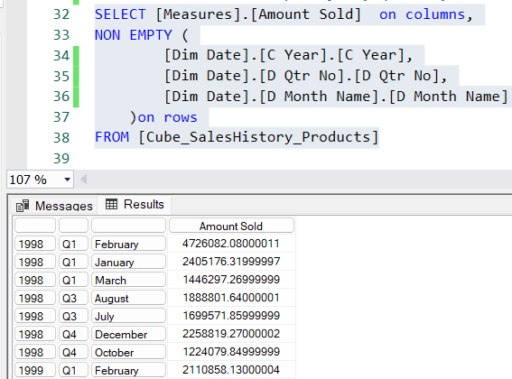
MDX Query:
4. Sales data over the past year, quarter, and month
Electrical & Computer Engineering Department ​
​

Slide 28
Thank You !
Electrical & Computer Engineering Department ​
​

