Slide 1
Prediction of Obesity Risk Level Among Youth
Mentor
Prof Jongwook Woo
GROUP 4 | CIS 5560 – Introduction to Big Data Science
Ritika Joshi
Ketki Vyas
Sanchita Gawand

Slide 2
Introduction
The YRBSS is a Surveillance System to monitor priority health risk behaviors that contribute markedly to the leading causes of death, disability, and social problems among youth and adults in the United States. As per their study, there are six categories of priority health behaviors among youth and young adults that contribute to unintentional health problems, injuries and violence:
1) Tobacco use
2) Alcohol and other drug use
3) Sexual behaviors
4) Obesity, Overweight and Weight Control
5) Physical inactivity
6) Dietary Behaviors
These behaviors are often established during childhood and early adolescence.

Slide 3
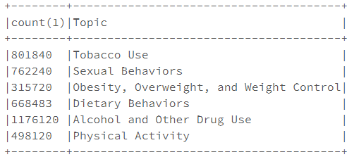
Why this topic?
The prevalence of obesity was 39.8% and affected about 93.3 millions of US adults in 2015~2016.
The estimated annual medical cost of obesity in the United States was $147 billion in 2008 US dollars.
The medical cost for people who have obesity was $1,429 higher than those of normal weight. ​
In this Project we have developed risk level prediction model for 'Obesity Overweight and Weight Control' using specific features to determine the prevalence of health risk behaviors which will help to predict risk.

Slide 4





About Dataset
URL https://www.kaggle.com/raylo168/dash-yrbss-hs-2017
Data size: 1.6 GB
Rows: 4,222,524
Columns: 35
File Type: CSV
Number of files: 1

Slide 5
Technical Specifications
 | Azure | Databricks | Oracle
Storage | 10 GB | Cluster 5.2 (includes Apache Spark 2.4.0, Scala 2.11) | 682GB, 12 OCPUs
Memory |  | 6GB Memory , 0.88 Cores, 1 DBU | 180GB
Node | 1 |  | 6
Python Version | 2.7.11 | 3.5.2 | 2.7.14
IP Address | https://studio.azureml.net | https://community.cloud.databricks.com/ | 129.150.127.176

Slide 6
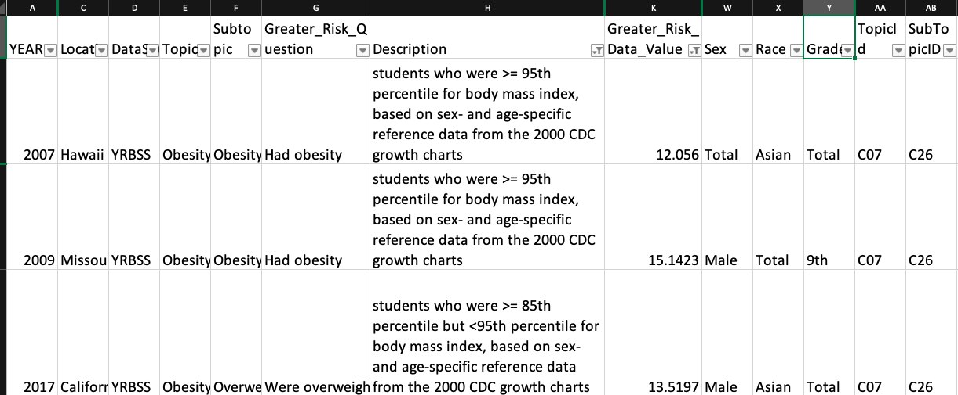
Dataset

Slide 7
Algorithms Used
AZURE | DATABRICKS/ ORACLE
Decision Forest regression | Decision Tree Regression
Linear Regression | Linear Regression
Boosted Decision Tree Regression

Slide 8







Flowchart
Gathering Data
Data Preparation
Data Transformation
Data Split
Train the Models
Test the Models
Evaluate prediction accuracy

Slide 9

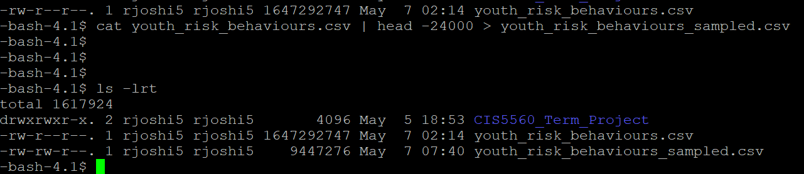
Sampled Data
Original Dataset: 1.65 GB
Sampled Dataset: 90 MB

Slide 10
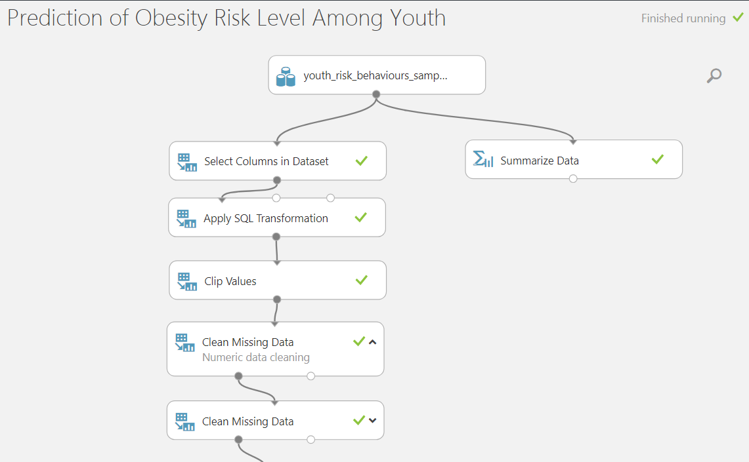
Data Cleaning

Slide 11
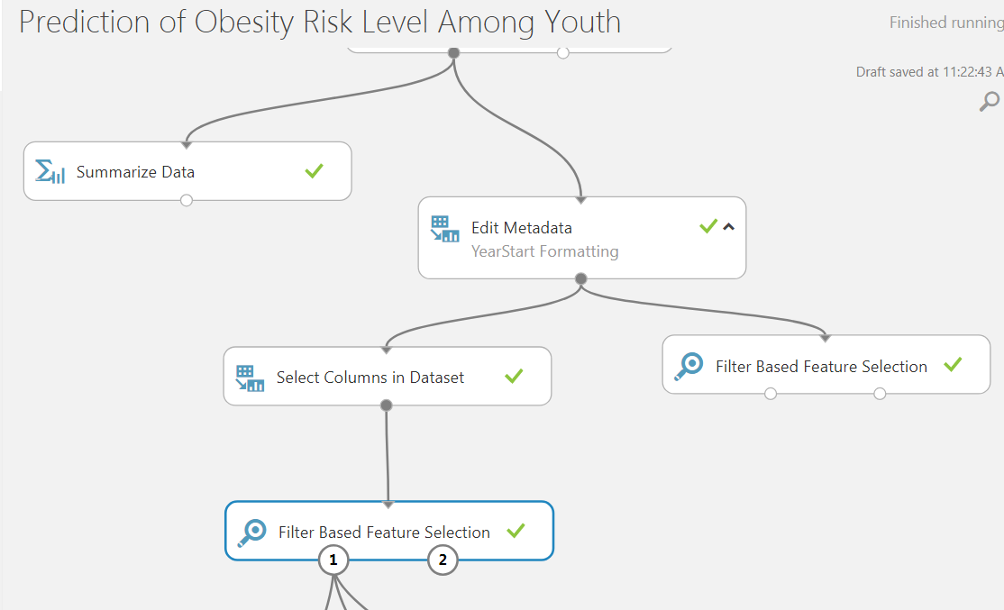
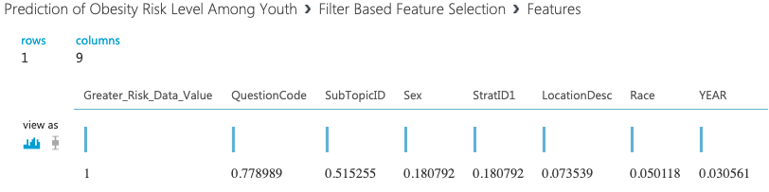
Feature Based Selection
In order to predict the level of obesity risk as precise as possible, 'Filter Based Feature Selection' is chosen.
Targeted eight best columns that had effect on 'Greater Risk Data Value'.

Slide 12
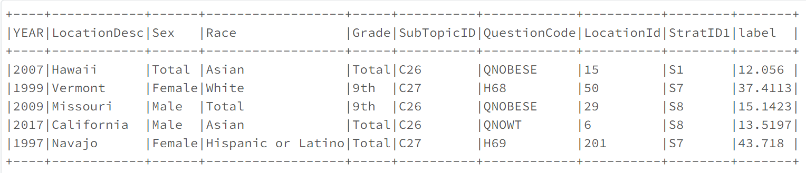
Features
Labelled Data: Greater Risk Data Value

Slide 13
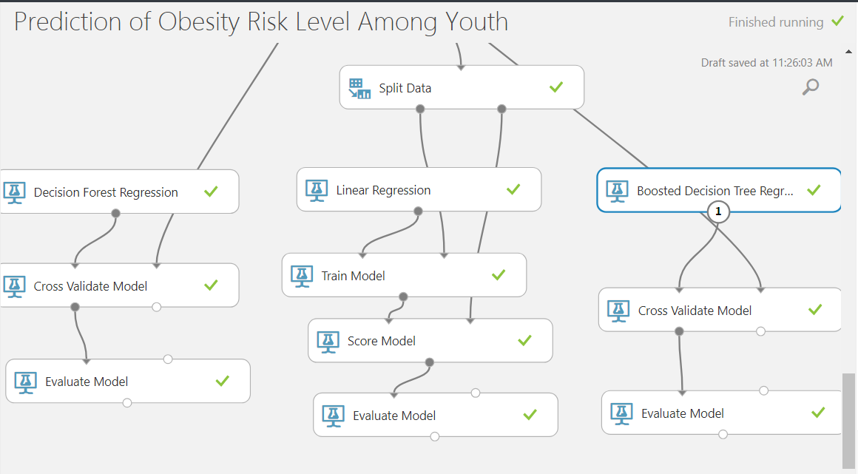
Azure Model
Time Taken: 4 min 45 sec

Slide 14
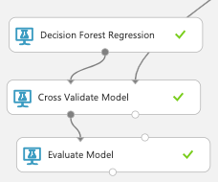
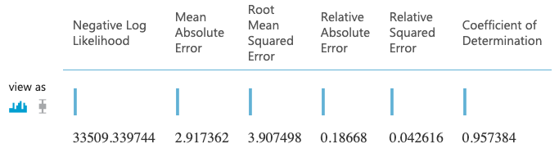
Decision Forest Regression
Train/test: 70/30
Random Seed: 12345

Slide 15
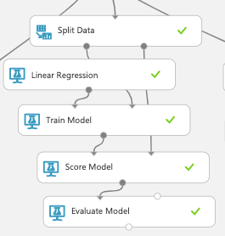
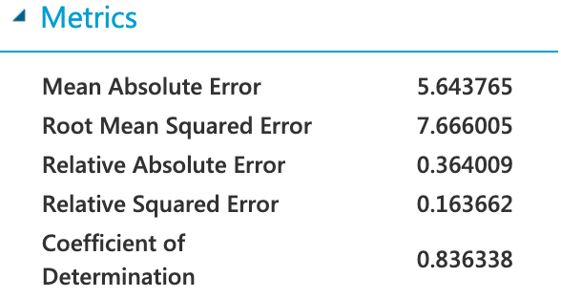
Linear Regression
Train/test: 70/30
Random Seed: 12345

Slide 16
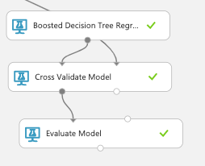
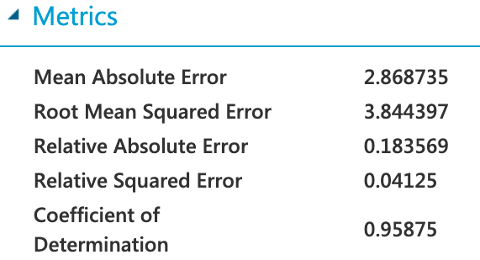
Boosted Decision Tree Regression
Train/test: 70/30
Random Seed:12345

Slide 17
Azure Model Comparison
 | Decision Forest Regression | Linear Regression | Boosted Decision Tree Regression
Mean Absolute Error | 2.91 | 5.64 | 2.86
RMSE | 3.90 | 7.66 | 3.84
Coefficient Of Determination | 0.95 | 0.83 | 0.95
Relative Absolute Error | 0.18 | 0.36 | 0.18
Relative Sqaured Error | 0.042 | 0.16 | 0.04

Slide 18
DATABRICKS
Execution Time: 15 min 22 sec

Slide 19
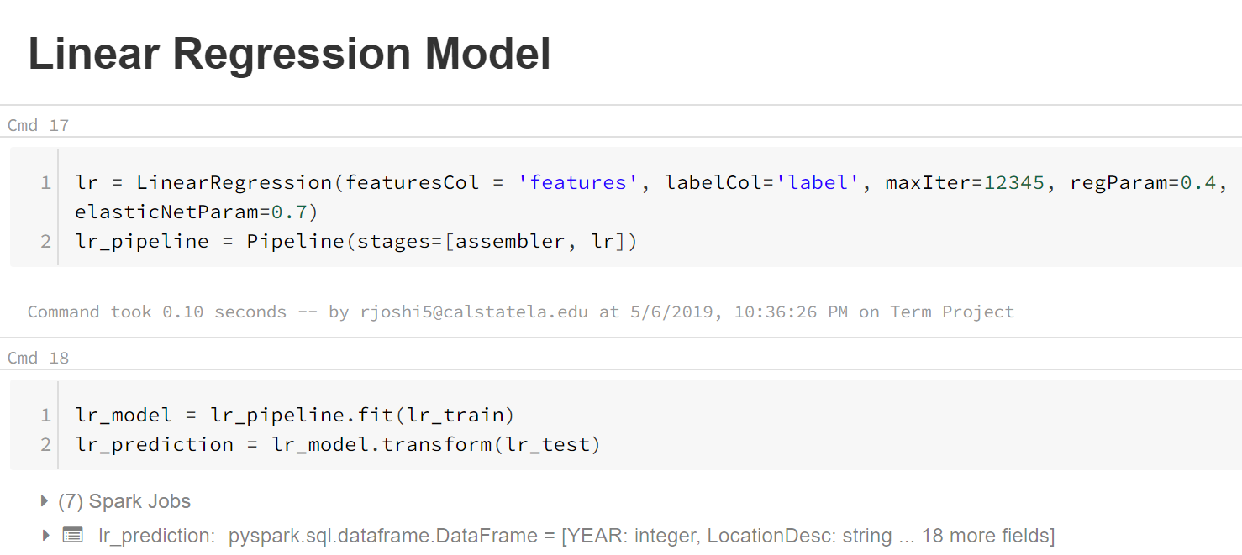
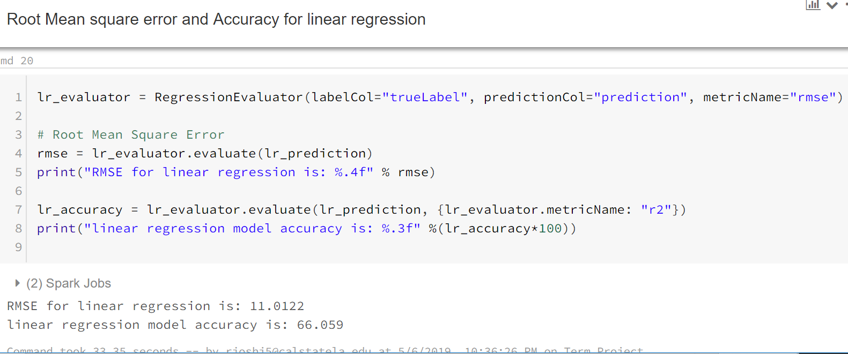
Databricks Linear Regression

Slide 20
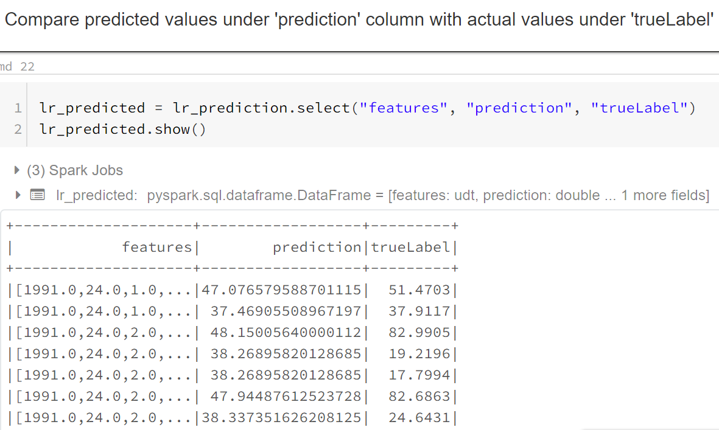
Databricks Linear Regression

Slide 21
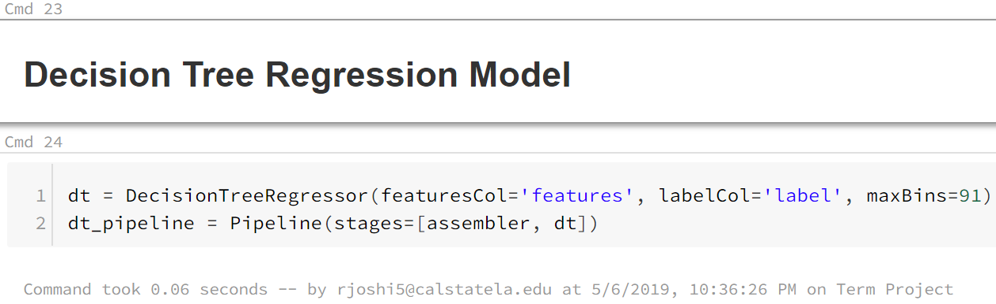
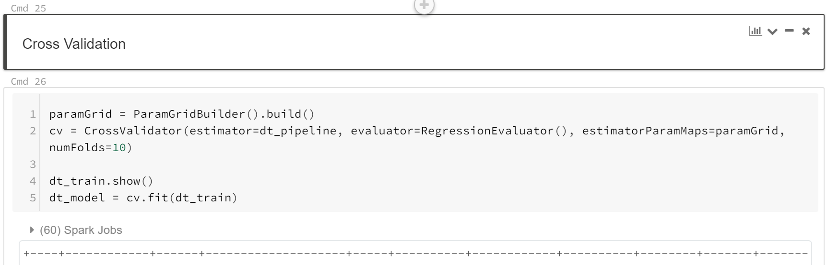
Databricks Decision Tree Regression

Slide 22
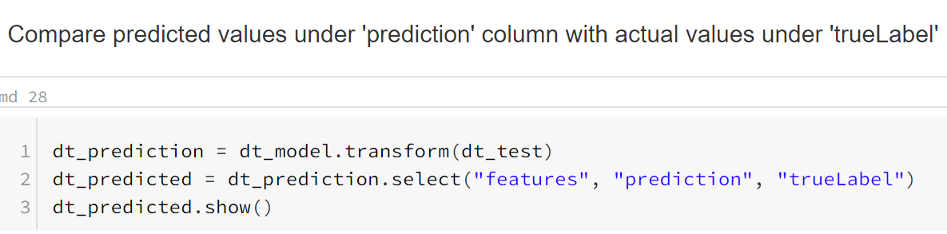
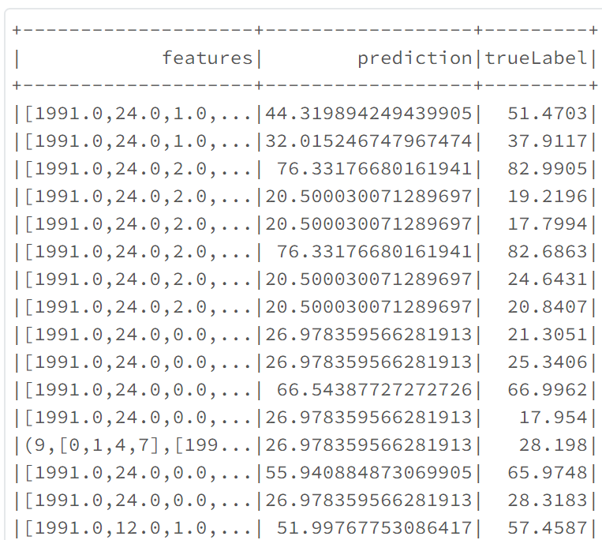
Databricks Decision Tree Regression

Slide 23
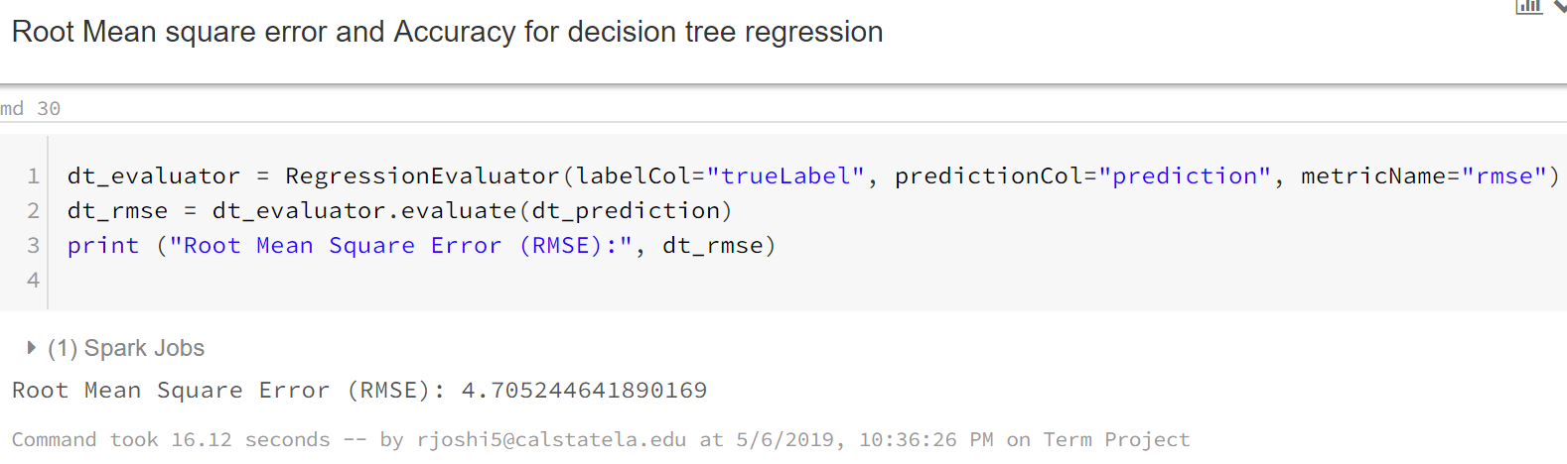
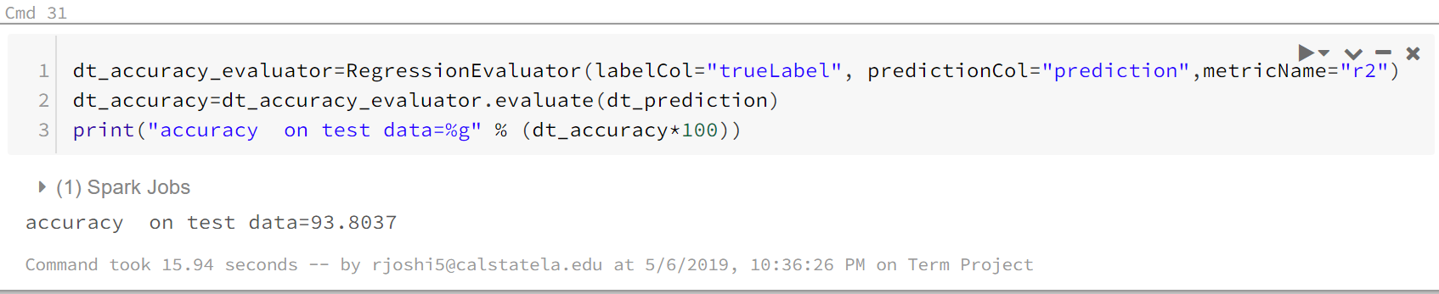
Databricks Decision Tree Regression

Slide 24
ORACLE
Execution time: 23 min

Slide 25
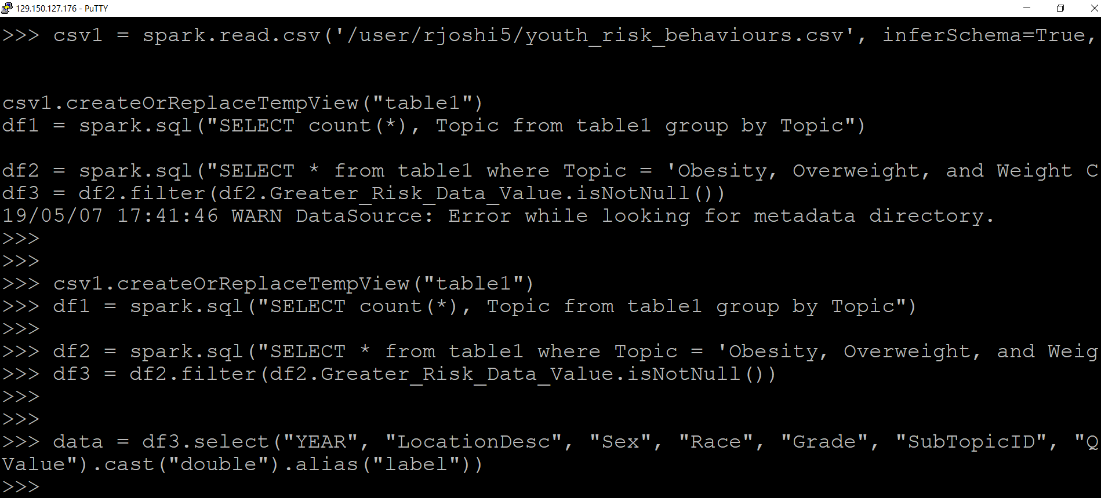

Oracle: File Load

Slide 26
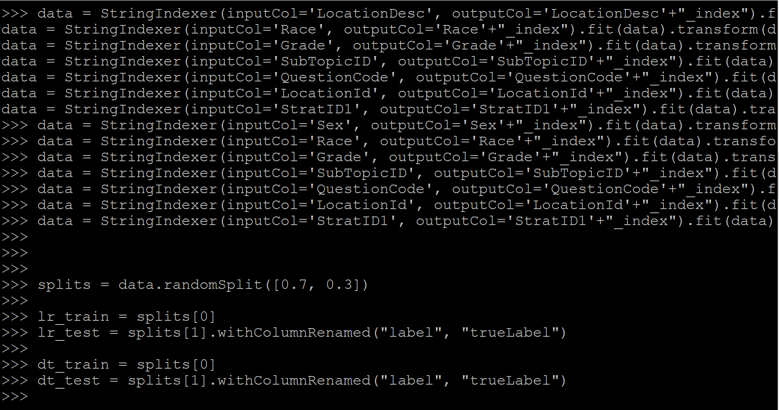
Oracle: Data preparing and splitting

Slide 27
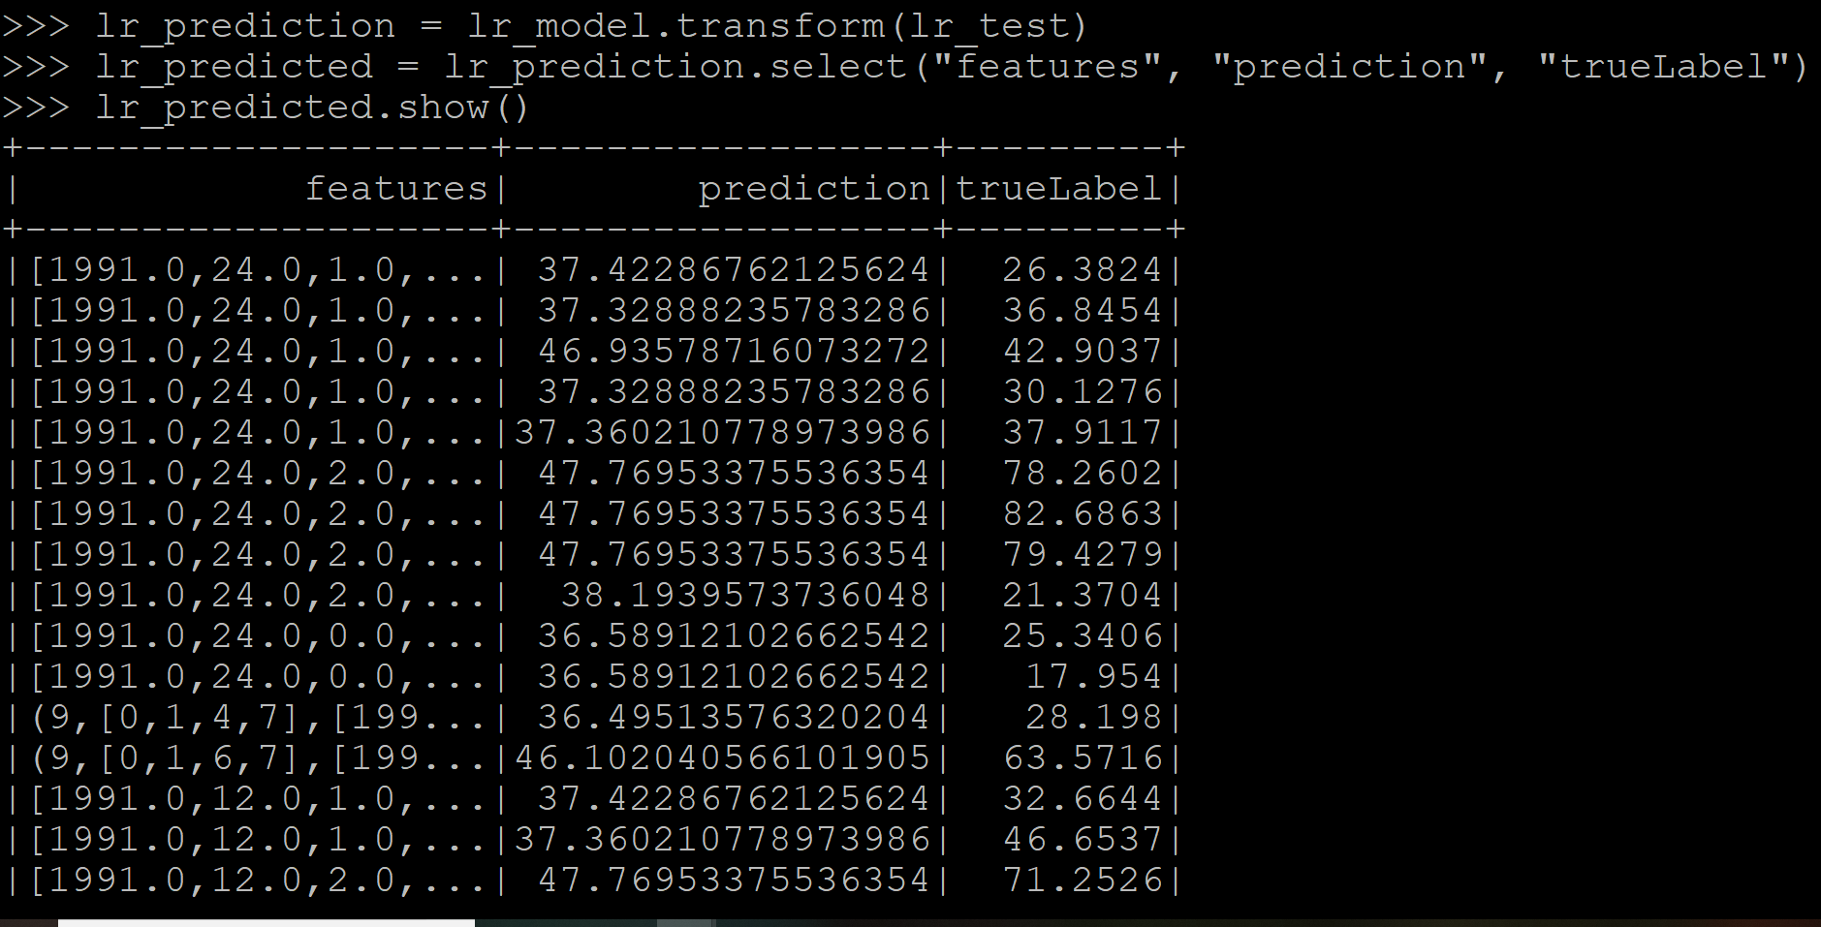
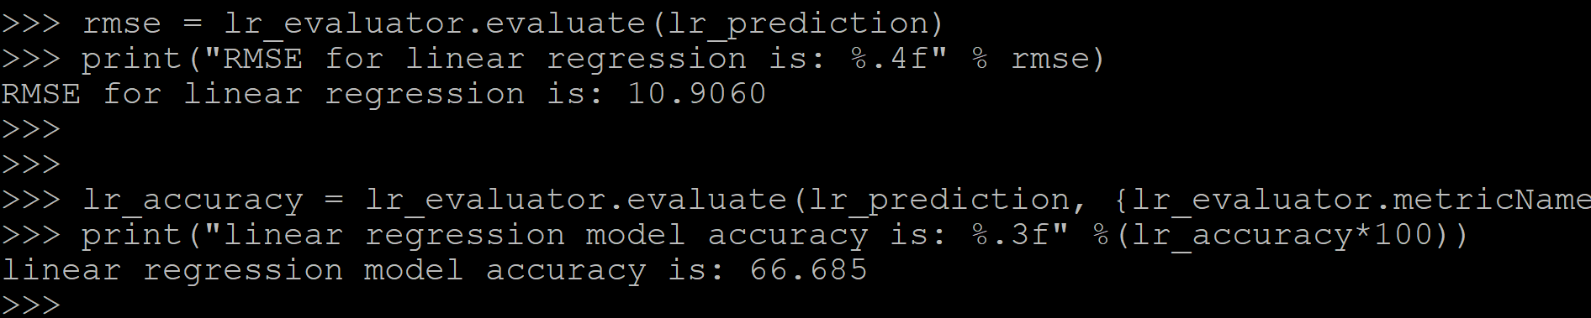
Oracle: Linear Regression

Slide 28
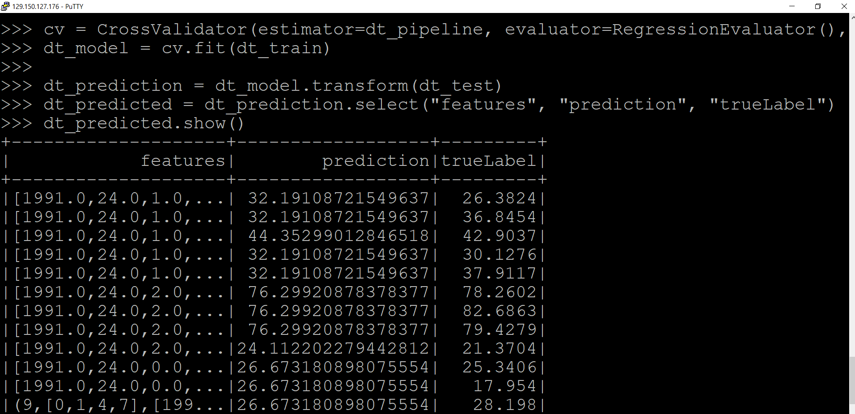
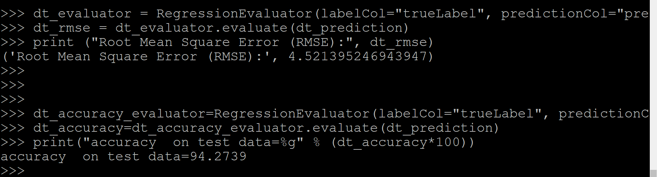
Oracle: Decision Tree Regression

Slide 29
Summary
​ | ​ | Linear Regression​ | Decision Tree Regression​
Azure​ ​ | RMSE​ | ​7.66 | ​3.90
Databricks​ | RMSE​ | ​11.07 | ​4.502
 | Accuracy​ | ​66.06 | ​94.403
Oracle​ | RMSE​ | ​10.90 | ​4.502
 | Accuracy​ | ​66.68 | ​94.27

Slide 30
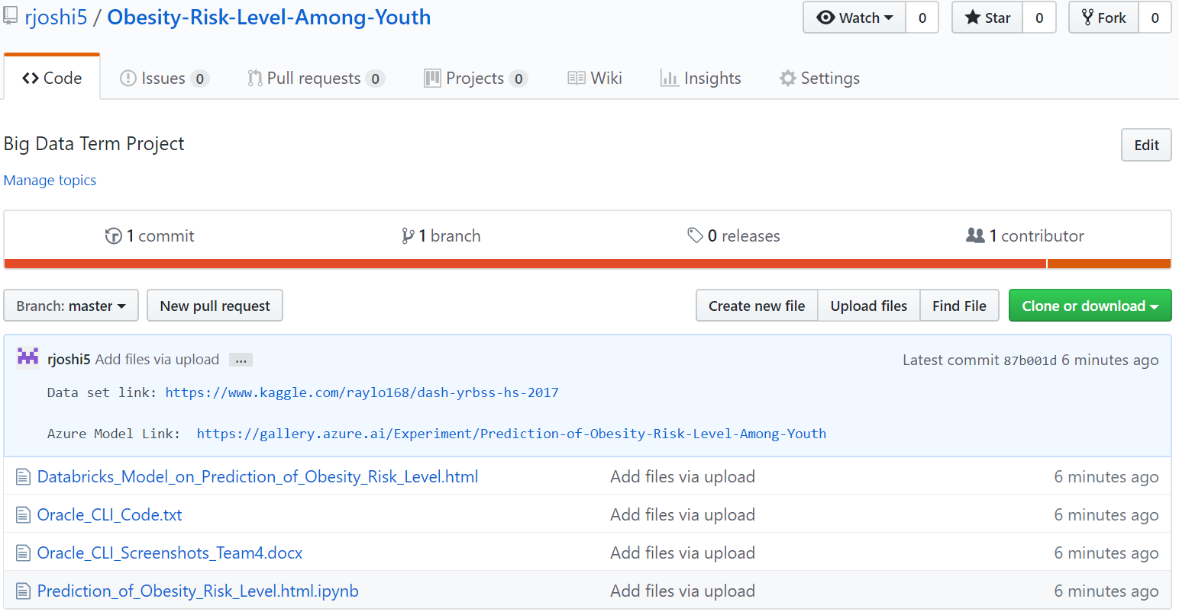
GitHub Link
https://github.com/rjoshi5/Obesity-Risk-Level-Among-Youth

Slide 31

Microsoft Azure Published Link
https://gallery.cortanaintelligence.com/Experiment/Prediction-of-Obesity-Risk-Level-Among-Youth

Slide 32
References
https://www.cdc.gov/healthyyouth/data/yrbs/overview.htm
https://spark.apache.org/docs/2.1.0/mllib-classification-regression.html
https://towardsdatascience.com/building-a-linear-regression-with-pyspark-and-mllib-d065c3ba246a
https://blog.epigno.systems/2018/02/18/machine-learning-with-pyspark-linear-regression/

Slide 33

Questions

