Slide 1
The bad luck generation and its choices
Rik Peters, October 2022

Slide 2
Did the transition from studiefinanciering to leenstelsel change the choices students made?

Slide 3
The important year: 2015
Nov. 6th, 2014 motion passes in parliament (dossier 34035)
→ After the beginning of the academic year
Sep. 1st, 2015 new system takes effect

Slide 4
The anticipated negative effects
Economic:
higher debts
unequal access to higher education
Administrative:
influence students in their choices

Slide 5
The change in 2015

Slide 6
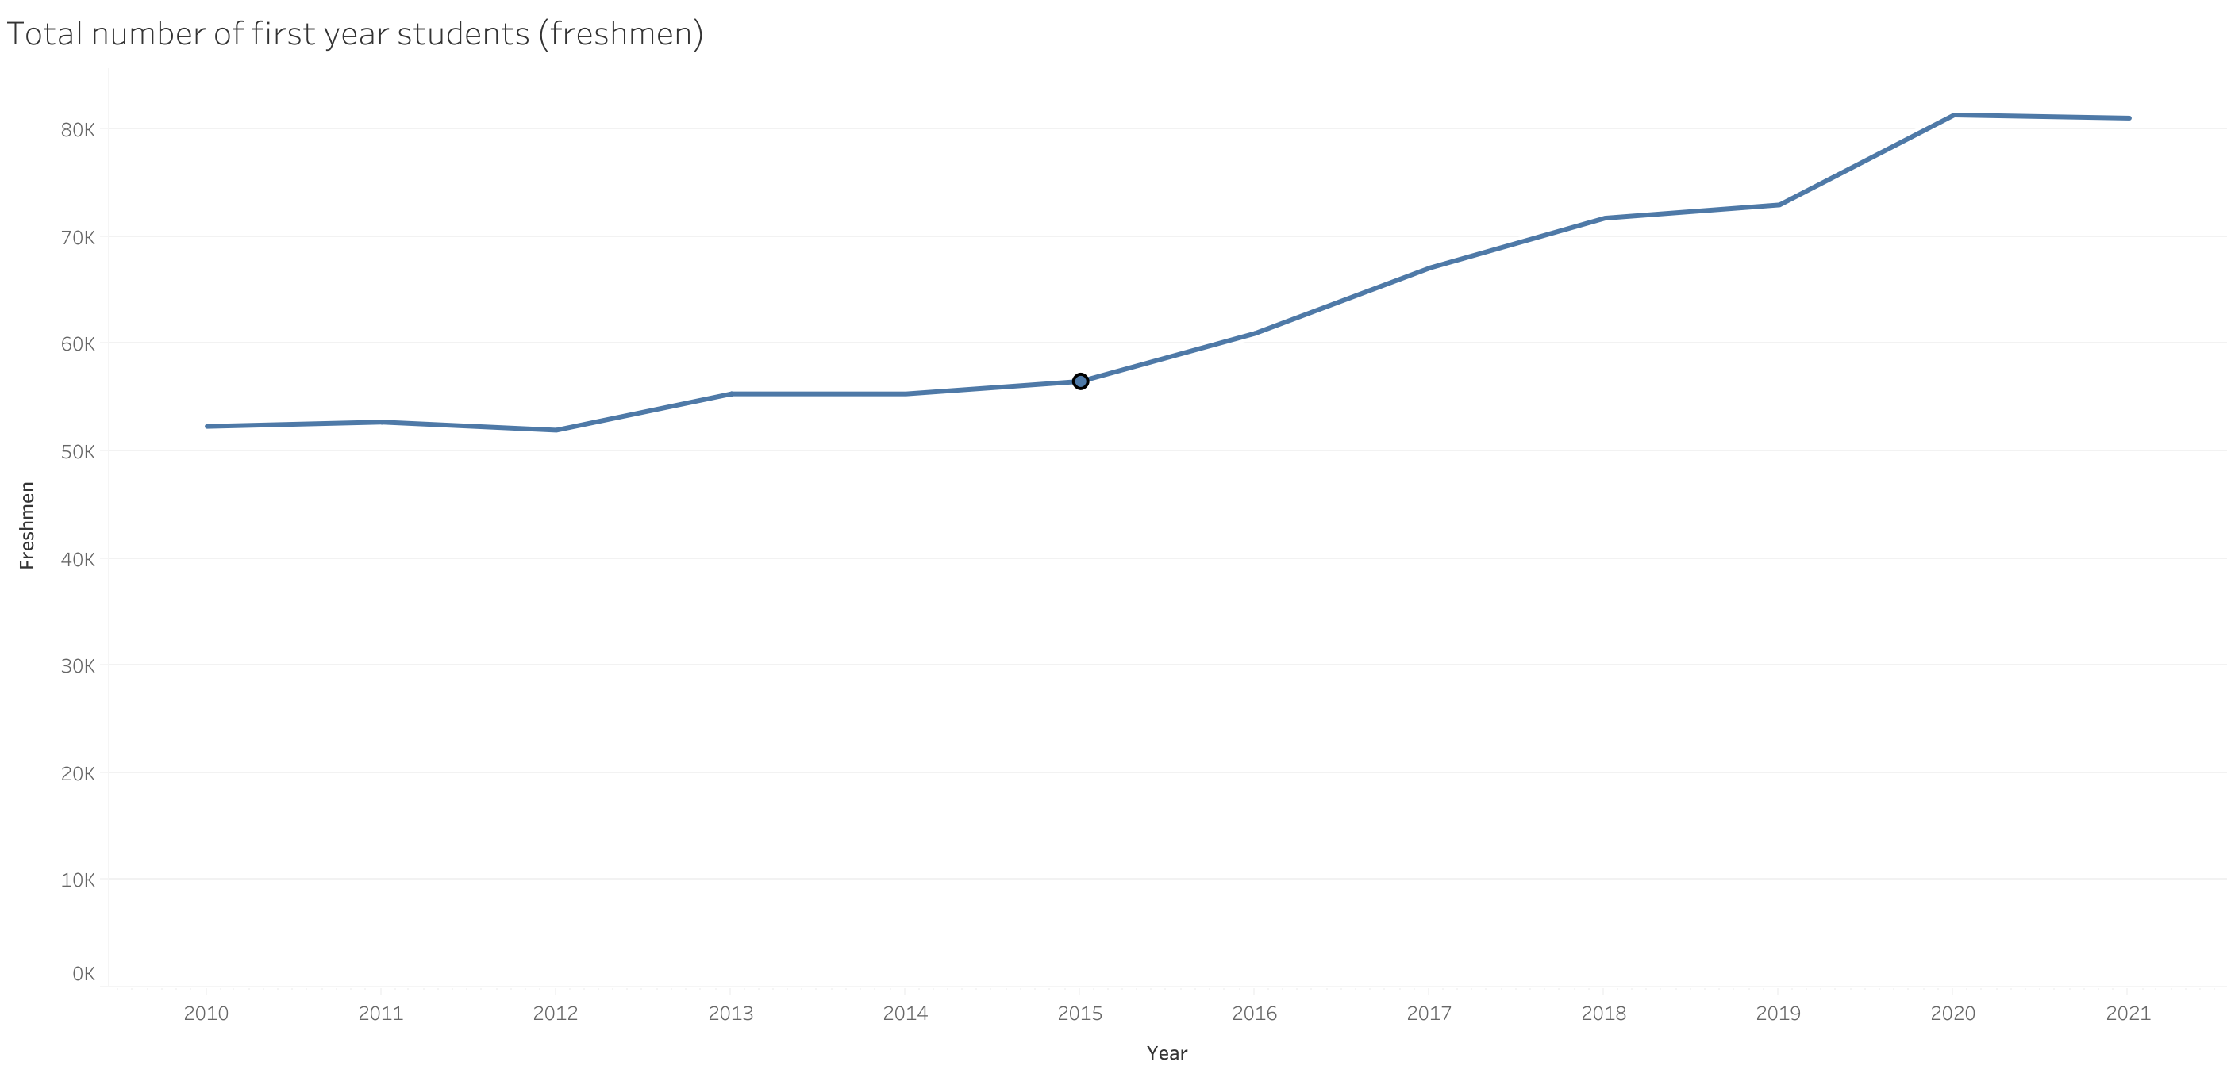

Slide 7
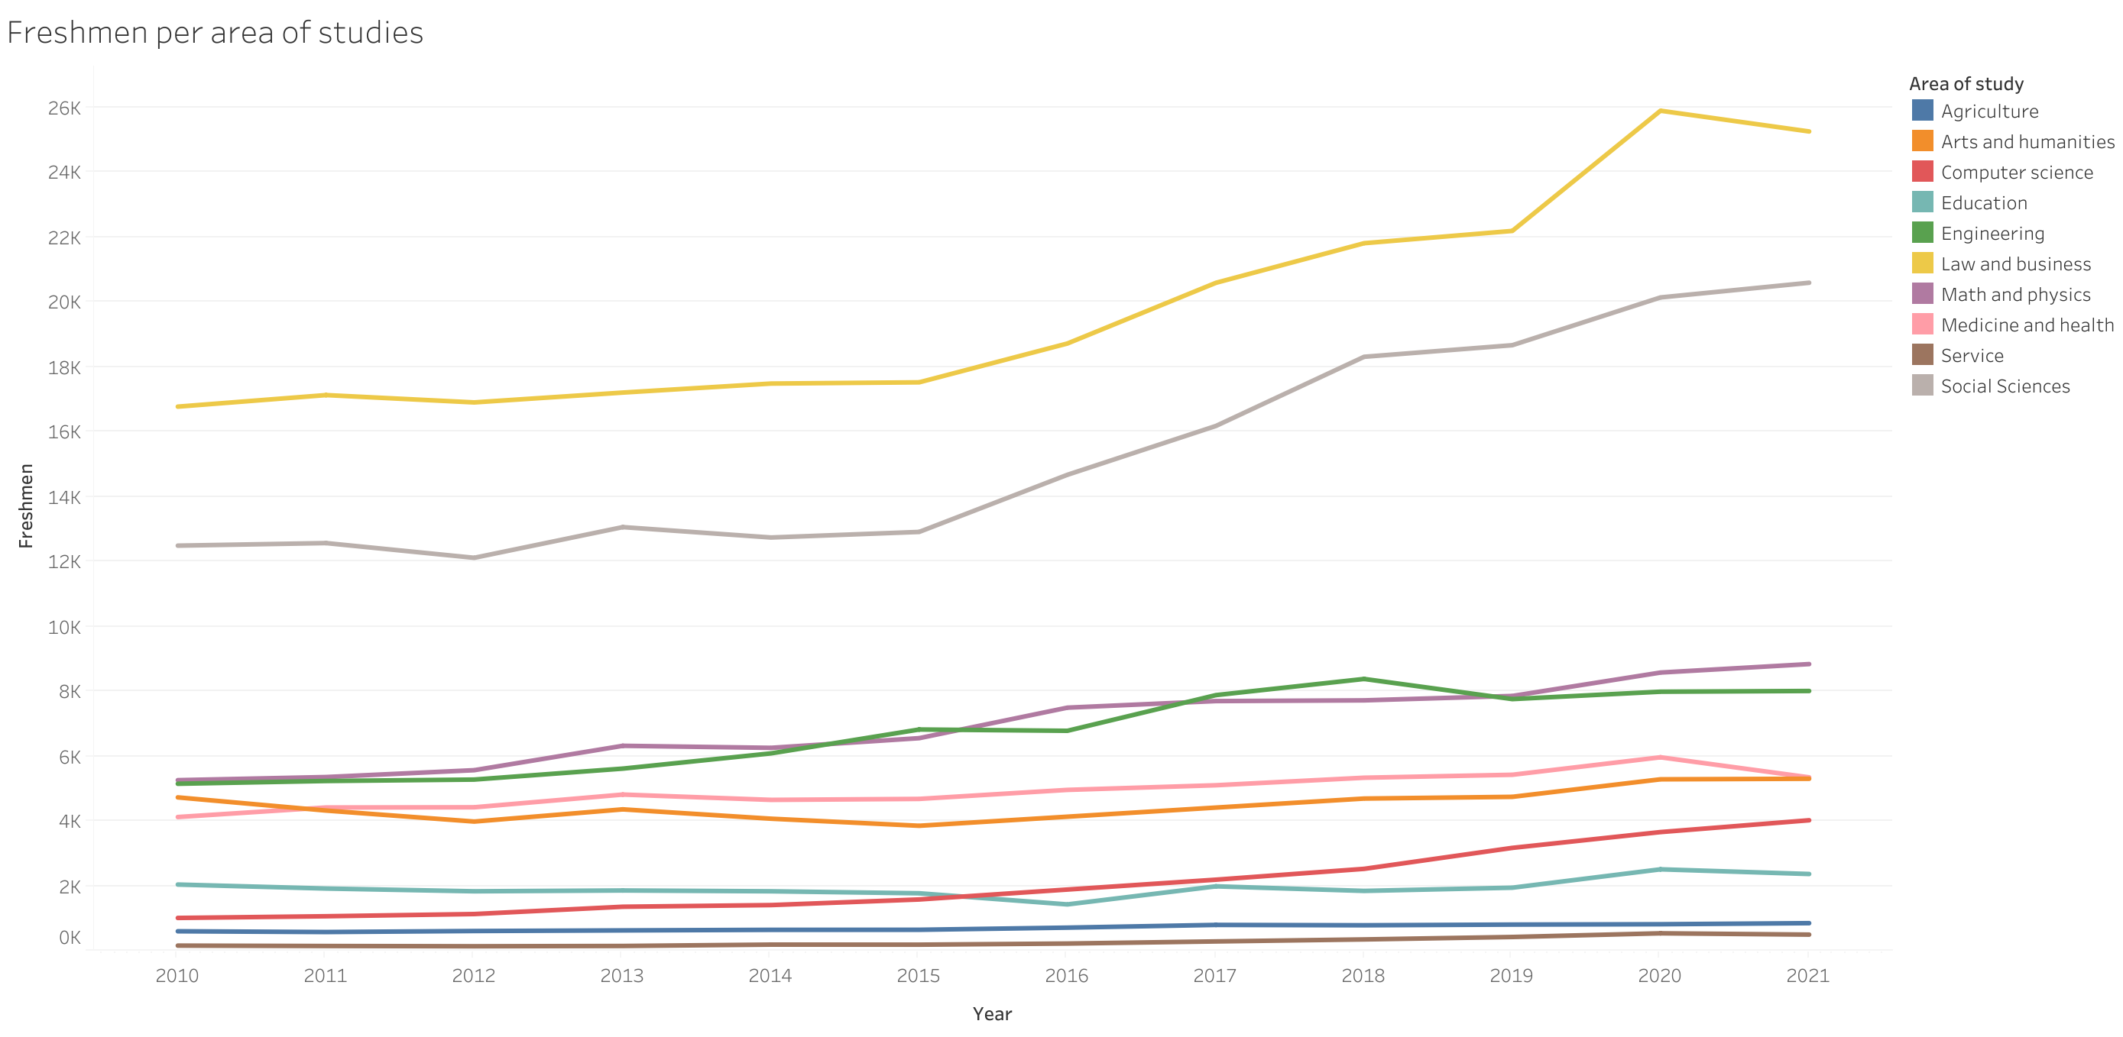

Slide 8
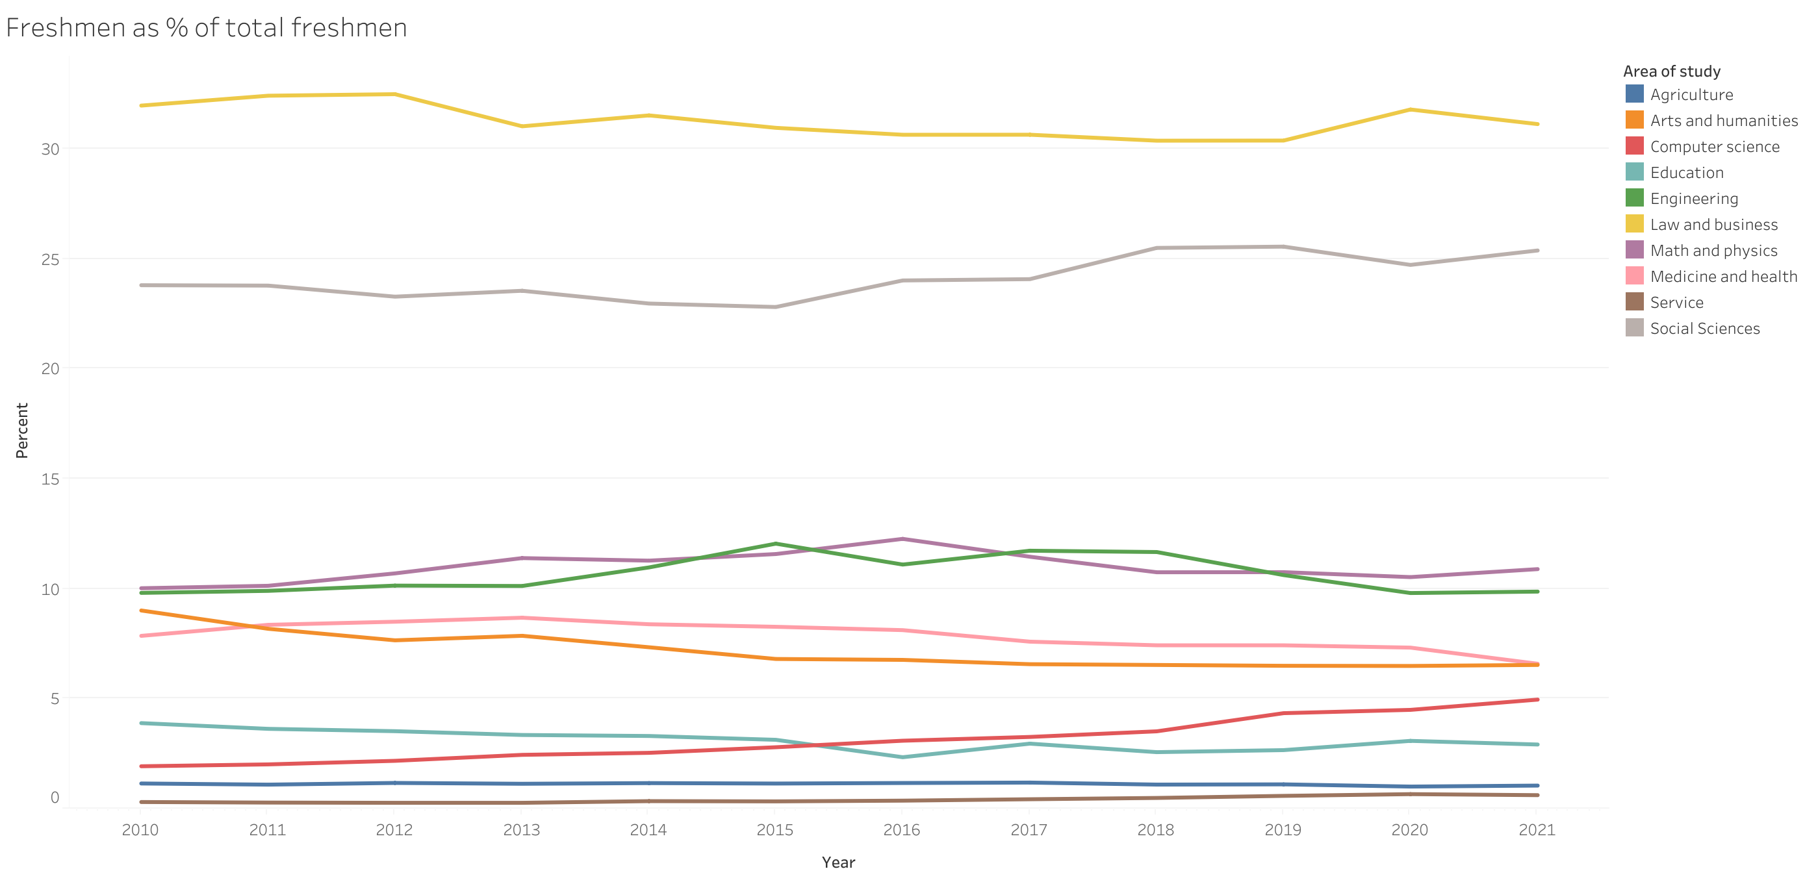

Slide 9
Another way to measure the change:
Rate of growth (in %) relative to the previous year.
Hypothesis test

Slide 10
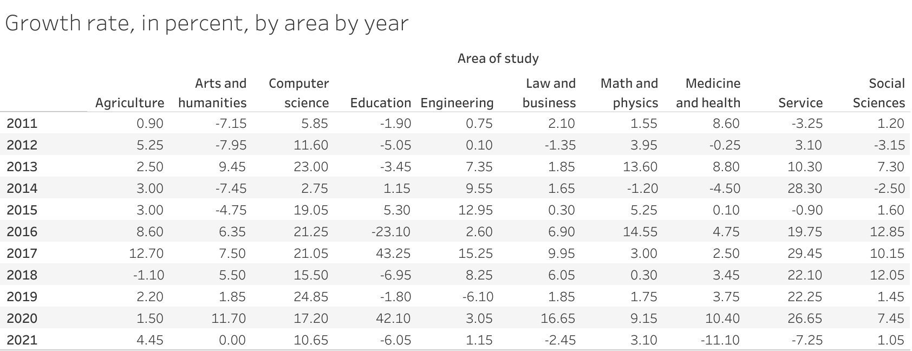

Slide 11
How special is 2015?
H0:
the mean change for all programs in 2015
=
the mean of all the changes over the whole period
H1
the mean change for all programs in 2015
≠
the mean of all the changes over the whole period

Slide 12
How special is 2015?
The p value for H0 is 0.0008
which is a reason to reject the null hypothesis: the mean rate of change in 2015 is not average
However – the mean rate of change in 2015 is lower than in other years

Slide 13
How special is 2015?
P values for similar hypothesis over other years:
2011 0.0000000007
2012 0.000000002
2013 0.005
2014 0.01
2015 0.0008
2016 0.01
2017 0.00000000000000002
2018 0.2
2019 0.7
2020 0.00000000000007
2021 0.000000002

Slide 14
Conclusions
Enrollments are turbulent
2015 was not significantly more or less turbulent than other years
University administrators can sleep soundly

Slide 15
Bonus
The most significant trend in the enrollment data:
computers and gender

Slide 16
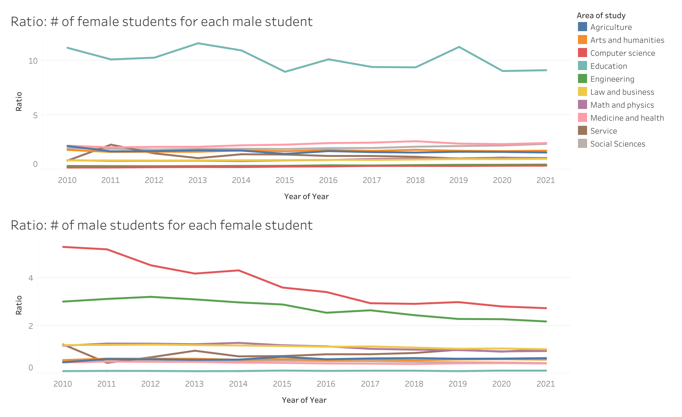

Slide 17
Significant changes do not come from short-term policy,
but from long-term societal processes.

