Slide 1


James O’Malley, 2018

Slide 2
CAPTCHA
Completely
Automated
Public
Turing test to tell
Computers and
Humans
Apart

Slide 3
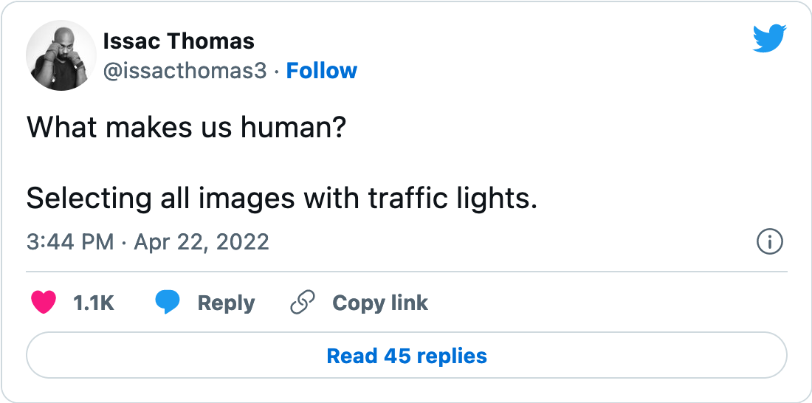
CAPTCHA
Completely
Automated
Public
Turing test to tell
Computers and
Humans
Apart

Slide 4

reCAPTCHA
Carnegie Mellon U, 2007
Google, 2009

Slide 5
reCAPTCHA
website
authentication
transcribing
data &
machine learning

Slide 6
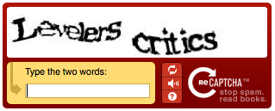
reCAPTCHA, generation 1

Slide 7

reCAPTCHA, generation 1
2011

Slide 8
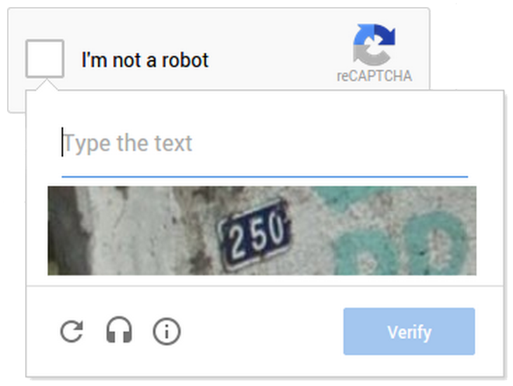
reCAPTCHA, generation 2

Slide 9
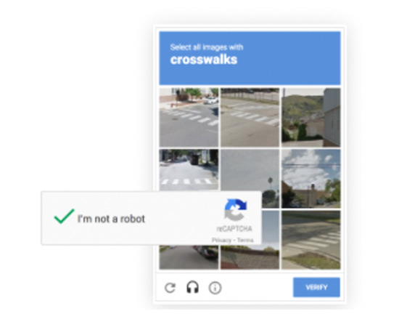
reCAPTCHA, generation 2

Slide 10
reCAPTCHA: beating the system
Computer against computer (proven successful in 2017)

Slide 11
reCAPTCHA, generation 3
(Launched in 2018, after the article)

Slide 12
