Slide 1
EVALUATING LANGUAGES FOR BIOINFORMATICS:
PERFORMANCE,
EXPRESSIVENESS, AND ENERGY
Thesis Defense
Randy J. Ray
December 2022
Notes:
Good Morning, I’m Randy Ray
Today I’m defending my Masters’ Thesis on Evaluating Languages for Bioinformatics,
with a focus on Performance, Expressiveness and Energy Efficiency

Slide 2
Evaluating Languages for Bioinformatics
One of the fastest growing concerns in the technology sector is the increased demand for power in the world’s data centers
As the data center industry continues to expand, so to will power usage, and therefore the need for increased energy efficiency in software development
A methodology that evaluates a set of programming languages based on three key metrics: performance, expressiveness, and energy use is needed
The framework presented takes a collection of string-matching algorithms used on DNA sequences to demonstrate the capabilities of each language, and draw out their distinctiveness
DNA sequencing was chosen due to its growing uses and applications as technology evolves and makes such sequencing faster and less expensive
The methodology presented here will show that using a newer language like Rust has advantages that help it balance speed, ease of use, and power consumption when used for advanced scientific computing
Notes:
When I began undertaking this research, several key points became readily apparent
DATA CENTER: Global data center electricity use in 2021 was estimated as between 220 and 320 terawatt-hours (TWh), as much as 1.3% of global electricity demand.
DNA SEQUENCING: This in turn has lead to a growing percentage of compute-time being spent on this field.
METHODOLOGY: The expectation is that this research will show how testing and evaluating via these metrics allows for rating and ranking programming languages in a consistent and reproducible manner.

Slide 3
Motivations & Real World Applications
Having started out with the BASIC language on a personal computer, the introduction of Pascal showed me that there were many other languages and that their syntax and structure could vary wildly
Pascal led to C, with academic diversions into Lisp and Fortran during my undergraduate study
Working in the software industry brought about experience with a long list of other languages, ranging from interpreted scripting languages (Perl, Python, Tcl, Ruby), to web-development (PHP, JavaScript), to Java and languages built on the Java Virtual Machine (Clojure, Scala)
Along the way, one constant remained: an interest in comparing languages not only on speed but also on readability, expressiveness, and capability
Notes:
I discovered Computer Programming as a 12 year old, and as with most programmers of my generation, I began with BASIC, which led to Pascal and C, which then advanced me through many new languages through my undergraduate studies and when I moved into software engineering in my career.
The evolution of languages has always been a strong personal interest of mine. So, creating a way to evaluate the strengths and weaknesses of languages is something I am particularly passionate about.
While a full treatment on the basis of programming language design was outside the scope of my thesis, issues of the more aesthetics-oriented language differences are addressed by examining some static aspects of code, aspects that are completely independent of the running of the programs themselves.

Slide 4
Real World Implications: Power Consumption
We are rapidly approaching an inflection point in computer science
We have been relying on being able to increase computing capacity and capability endlessly
Limits are going to be placed on our computing power purely from environmental concerns — which means efficiency has to extend beyond hardware into our software programming practices as well
Performance alone is not enough — we have to consider energy use and efficiency
Notes:
A couple of major aspects of software engineering have come to the forefront in recent conversations at work which tied directly to my research
This represents a definitive shift in the direction of software development within the industry

Slide 5
Real World Implications: Security Concerns
A large percentage of security vulnerabilities discovered in programs are traced back to memory related issues
Google & Microsoft software engineers are quoted as attributing roughly 70% of serious security bugs to memory management and safety
Even the NSA recommends developers switch to programming languages that feature greater memory safety
But in terms of evaluating memory safety, it is hard to quantify other than whether vulnerabilities have been fixed or not
Notes:
And, of course, Security has always been a core concern, but usually tends to be addressed “after the fact” when vulnerabilities have been discovered and exploited by bad actors
I was really hoping to add a metric that could measure memory safety, but I really could not quantify it
Instead, I ended up checking all my compiled code for memory errors with Valgrind, an open source memory checking tool, and refined and debugged until there were no detected memory-related errors

Slide 6
Evaluation Methodology
Evaluation of the languages was focused into three areas:
  Performance
  Expressiveness
  Energy Efficiency
Hypothesis was that these areas were distinct enough to provide a broad and fair assessment of each language
Performance & Energy Efficiency were evaluated with direct experiments
Expressiveness was evaluated by analysis of the code
A dedicated machine was set up and a harness application was developed
Notes:
With all of this in mind, I crafted my hypothesis to cover the aspects of performance, expressiveness and energy efficiency

Slide 7
Languages & Algorithms Selected
C & C++
  Foundational compiled languages in widespread use
Perl & Python
  Interpreted languages;
  Perl used early on in the Human Genome Project and Python is popular within Bioinformatics
Rust
  Newer compiled language focused on safety
Knuth, Morris, and Pratt
  Foundational to the development of string matching algorithms
Boyer and Moore
  Performance improvements on KMP and longevity in use
Bitap
  Treats both pattern and sequence as strings of bits and never actually does character comparisons
Aho and Corasick
  Introduces multiple pattern matching and uses a DFA approach
Notes:
I then selected the languages I wanted to test. I started with C, C++ and Rust, as they were all compiled languages and I was particularly interested in testing Rust against the foundational stalwarts of C and C++
I then added Perl & Python due to their widespread and popular use within the Bioinformatics field
After reviewing nearly a dozen algorithms, I selected the four displayed here due to their various approaches, the ease of writing them in each language, and the significance of their contribution to other exact matching algorithms

Slide 8
Implementation
Each algorithm was written as similarly as possible in each language
Implementation stressed readability as an important factor in software engineering
For C and C++ three different compilers were used to see how the performance compared to each other
Experiments did not produce as much source code as would have benefited expressiveness measurements, but provided a reasonable “apples to apples” comparison
Notes:
To create an even playing field for the evaluation of each language, I strived to write each algorithm as similarly as possible
As an experienced engineer, some things presented to me in a code review would be rejected even if they were more efficient
Some languages may have benefited from less readable code, but the same standard was applied to all languages

Slide 9
Creating the Novel Algorithm - DFA Gap
Much of DNA sequence alignment is approximate matching
Inspiration for the novel algorithm comes from a combination of regular expression experience and the Aho-Corasick algorithm
Used a Deterministic Finite Automaton (DFA) with extra states as an optimized regular expression
Created an approximate matching method with the ability to hold the gap between characters to a specific maximum
Notes:
After selecting the 4 primary exact-matching algorithms, I then created a new novel approach to approximate matching, both because this would further test the chosen languages, as well as take into account that much of DNA sequence alignment is done via approximate matching.
It will offer an alternative technique to other current approximate-matching algorithms and hopes to offer researchers another tool to consider for sequence-matching problems.

Slide 10
DFA Gap - How it works
DFA involves two stages-
  Building the DFA from the pattern
  Applying it to the target sequence
Building can be done in linear time with a predictable number of states
Applying it takes similar time complexity as other approximate matching algorithms
The DFA finds approximate matches in a non-greedy manner without backtracking
It provides the starting point and specific ending point of its matches with no further calculation
Notes:
How does it work?
The algorithm defines the gaps that it allows in terms of adjacent characters in the pattern instead of total gaps across the entire match (where the other algorithms could group a gap of 10 entirely between two letters, this algorithm restricts the gap)

Slide 11
Regular Expression Variation
Perl and Python performed extremely slowly in the DFA Gap
A regular expression variation was implemented to compare with the hand-crafted DFAs
This improved the interpreted languages performance
Surprisingly, the performance declined for all the compiled languages
Provided an important comparative performance test
Notes:
Once the DFA-Gap algorithm was created, and I ran preliminary experiments, it became clear that Perl and Python were running an order of magnitude slower than C, C++, and Rust
Frankly, no developer would program Perl and Python without taking advantage of regular expressions, so this provided an opportunity to write a regular expression variant for all five languages

Slide 12
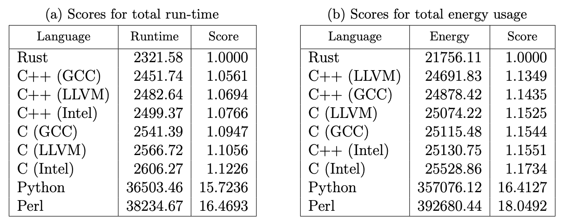
Evaluating Performance
Performance was measured by raw execution time
Two values were taken for each experiment
  The total execution time
  Time spent on the algorithm (shown)
A total of 14 experiments were run
DFA and Regular Expression Gap Algorithms were run with a k=1 to 5
Combined Runtimes of all Experiments
Runtime measured in seconds
Notes:
This all culminated in 14 unique experiments, 4 for the main algorithms and 5 each for the DFA and Regular Expression Gap algorithms for values of k (the gap) of 1 through 5.
Performance, of course, is the simplest and clearest of measurements — just how fast does it run?

Slide 13
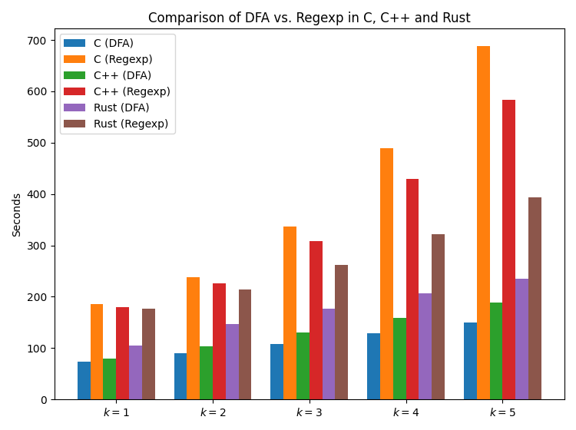
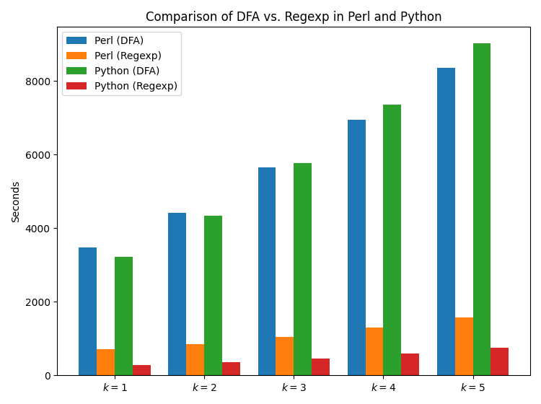
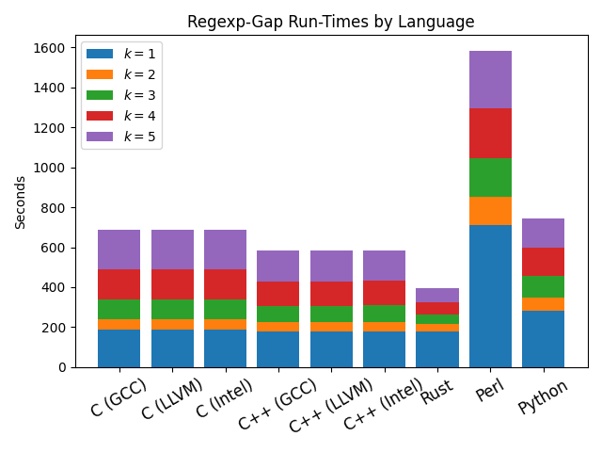
Regexp Performance Results
Reverse trend in performance between compiled and interpreted languages
Regular expression helped Python approach the compiled languages run times
In all the compiled languages, the DFAs outperformed the regular expressions
Notes:
Of particular note, the Regular Expression Gap results were the only ones that helped Perl and Python approach reasonable run times — with Python almost at the same speed as the compiled languages in their Regular Expression versions
However, for C, C++ and Rust the DFAs well outperformed their Regular Expression variants

Slide 14
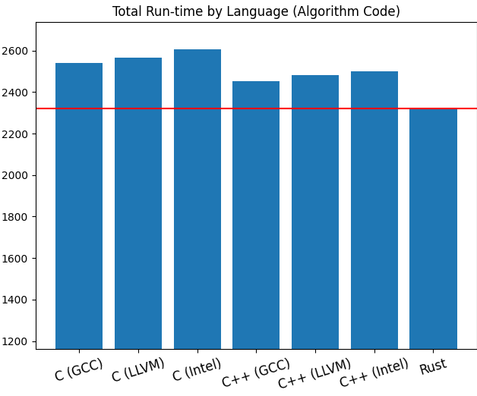
Performance Results
Rust was consistent across all experiments
Considerable variation in compilers used for C and C++
Interpreted languages were slower than their compiled counterparts by an order of magnitude
Notes:
It was interesting to see how much variation there was for C and C++ across the three compilers.
But, in the end, because Rust consistently performed well across all 14 experiments, it ended up with the lowest overall run-time.

Slide 15
Evaluating Expressiveness
Expressiveness was the most challenging of the metrics to measure and evaluate
Three comparison points:
  Source Lines of Code: Total SLOC values for each language’s files were combined. In the case of C and C++, this includes relevant lines from the header files for the runner and input modules.
  Complexity: Each file’s cyclomatic complexity values were computed on a per-function basis. Each module’s function scores were averaged, and all modules’ averages for a given language were summed together.
  Conciseness: Each source code file for a given language was stripped of comments and then merged into a sort of “archive” using the standard “cat” command available on Linux. Each such resulting file was then compressed with the “xz” compression utility and the compression ratio recorded.
Notes:
Expressiveness is challenging metric, and can be very subjective in nature. So I attempted to find metrics that were concrete, numerical measurements.
Complexity was derived from work done by McCabe
Conciseness came from the research of Bergmans
Much of what was measured for this metric was also dependent upon the skill shown in the writing of the programs
My familiarity with the different languages varied, from significant experience in C and Perl to relative newness with regards to Rust; It is not possible to say whether someone more expert in the Rust language, for example, could have implemented the chosen algorithms with more efficiency and better expressiveness metrics.
In these aspects of the research, measurement was taken through a range of open-source tools and the results tracked closely with expectation; the interpreted languages showed the strongest scores on the three expressiveness sub-metrics.

Slide 16
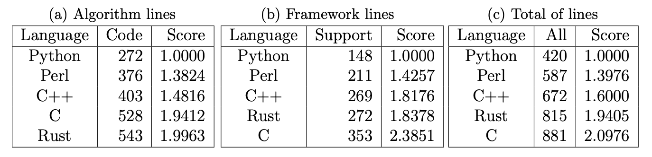
Source Lines of Code
Here Python is the clear leader, with Perl being 40% larger
C++ maintains the third-place ranking across all three sub-tables
Rust edges out C in both the framework measurement and the total lines measurement
Notes:
Rust’s score in the table likely suffered from the necessary mechanism that was used to pass and unpack pattern representation between a given algorithm’s initialization function and the algorithm function itself
In this area, C and C++ each needed only one line per element passed, while Rust required four
This is a 12-line difference in just the Aho-Corasick implementation, so it can be understood how this could propagate through the other algorithm implementations
By further comparison: both Python and Perl, having the native ability to pass arrays of differing types, needed only one line to unpack the pattern representations

Slide 17
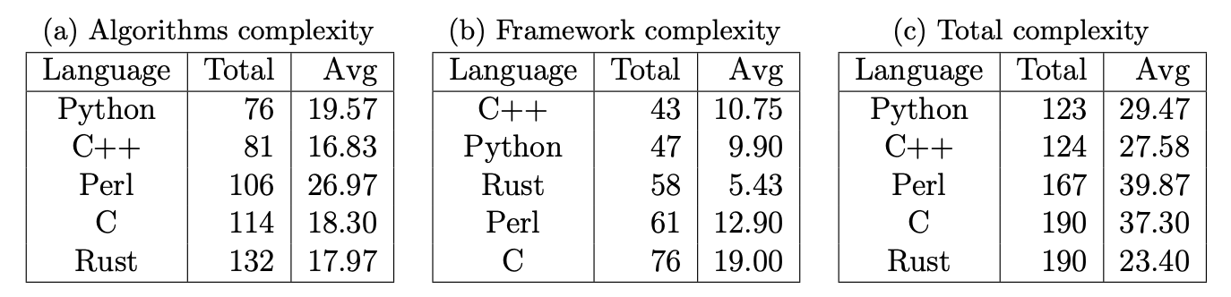
Cyclomatic Complexity
The value is based on measurement of control structures such as conditional statements, loops and similar means of changing the path of execution through the program or function being measured
Here the contest between the first and second rankings was between Python and C++
Notes:
This component of this metric had been cast in some doubt by the inability to use a single tool for all languages involved.
The lizard tool did not support Perl at all, and examination of the Rust results showed some bugs in the handling of Rust
Because of this, it is not possible to say with certainty that the relative comparisons of complexity between the five languages are completely sound

Slide 18

Conciseness: Comparison of Compressibility
The ranking of Python and Perl as the first two is expected
However, the placing of C ahead of both Rust and C++ came as a surprise given the presence of highly repetitive calls to library routines for the manual memory management
Notes:
Conciseness proved to be a difficult concept to quantify. The approach taken was designed around a significantly larger database of source code, but as the results from that paper were compelling, it led to the adaptation of a variation of that methodology here.
The steps for deriving this measurement were:
1. A clean copy of all source code was made into a series of directories named by language 2. All comments and blank lines were removed by the cloc tool
3. Each individual language directory had all text files concatenated into a single file
4. Each of these text files were compressed with xv and the compression ratio recorded
Bergmans and their team had removed most smaller examples of code for each language from the final measurements; this was not an option here given the limited size and number of the samples.
For this reason the decision was made to focus the compression on the text content only, by applying concatenation to the stripped versions of the source files and compressing the results of this process

Slide 19
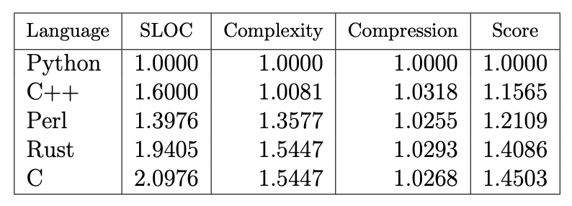
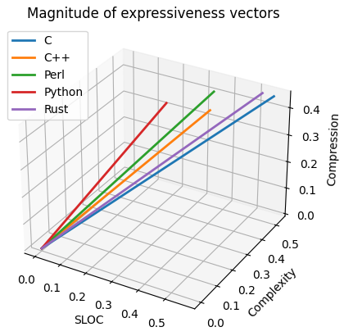
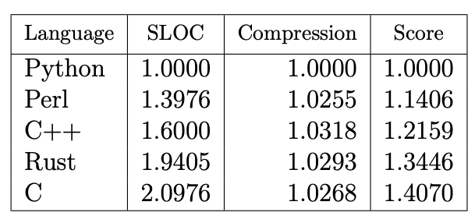
Overall Expressiveness
Notes:
So, in the end, while Python and Perl had the clear advantage in expressiveness, it was interesting to see that C++ and Perl swapped places when complexity was taken into account
Rust, as the newest and least developed language, was hindered by the way in which it was used

Slide 20
Evaluating Energy Efficiency
The Running Average Power Limit (RAPL) measurement system was used to measure power consumption
RAPL is a feature of select Intel CPUs
The only significant barrier to overcome was ensuring that the machine used to run the experiments would be sufficiently isolated so as to have the least amount of interference possible from other running processes
The RAPL system ended up proving robust-enough to handle measuring programs whose run-times ranged from a few seconds to nearly three hours
Combined Power Consumption of all Experiments
Runtime measured in Joules
Notes:
And finally, we move on to the Energy Efficiency evaluation; this was the most interesting aspect of all the experiments
RAPL is a feature of select Intel CPUs which is how I selected my dedicated machine
The nature of the RAPL system of measuring power consumption also required that the experiments be run with super-user access levels
This amplified the need for the code to be as safe as possible, even though the testing machine was not made accessible to the general internet

Slide 21
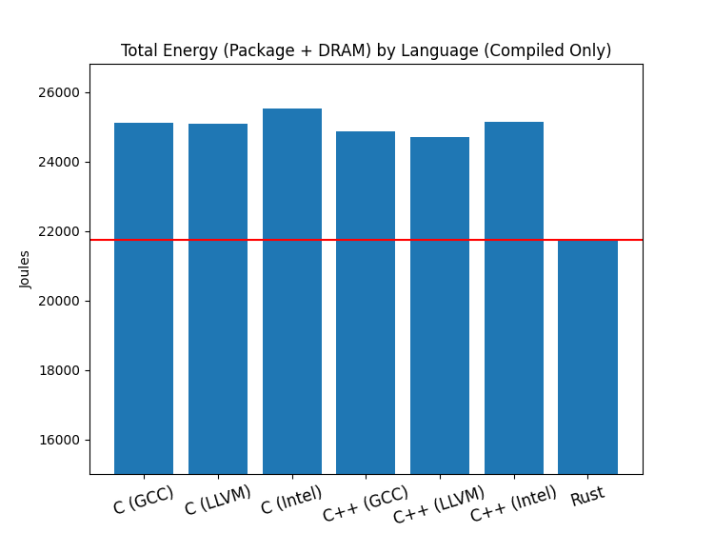
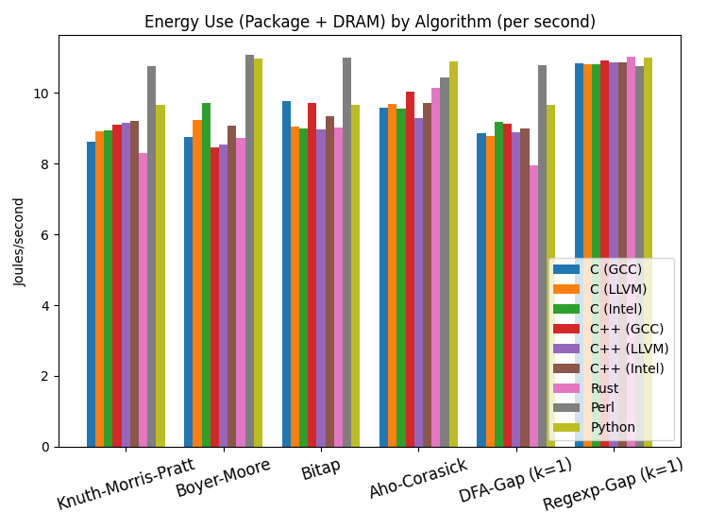
Energy Efficiency Results
Rust scored the lowest power consumption for all five variations of the DFA-Gap algorithm, making it the most-efficient language for 6 of the 14 distinct groups of experiments
Notes:
In the chart on the right, the total (mean) energy usage by all experiments in each language is shown
Here, the Perl and Python languages have been removed again due to the fact that their longer run-times lead to energy numbers well out of scale with respect to the compiled languages

Slide 22
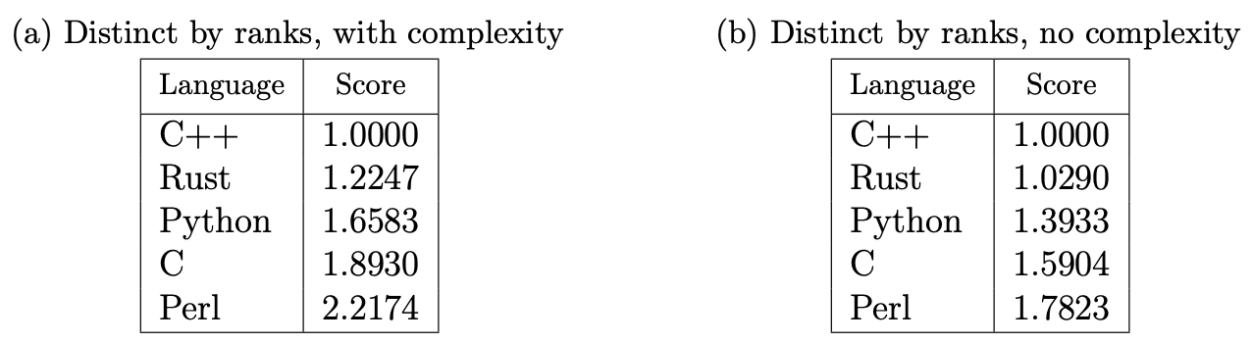
Final Rankings
Rank, with Complexity
The three metrics were combined, similar to how expressiveness was measured
Rust outperformed in performance and energy efficiency
Python outperformed in expressiveness
C++ outperformed Rust when expressiveness was added
Without complexity, Rust was only 2.9% behind C++ in the final ranking
Rank, without Complexity
Notes:
And so, in the end, with three distinct measurements available for combination and analysis, the first step was to derive a single set of scores for the run-time basis and the energy-used basis, combining the values from all 14 groups of experiments into single values

Slide 23
The End Result
The expectation was that this research would show how testing and evaluating via performance, expressiveness and energy could be done in a consistent and reproducible manner
Across three complete runs of the experiments, the difference between run times and energy readings were consistently within 1% from run to run
It is my hope that this methodology enables developers to make educated choices when selecting a language for a project
Everything described here would be applicable to other languages as well, given similar data to work with

Slide 24
Potential of Rust
Why Rust?
Performance and power consumption were concrete measurements; language expressiveness needs development
While memory security was not a metric used, Rust never had any memory errors when the code was checked with Valgrind
As the youngest language, Rust is still developing; increased usage and experience with the language will drive improvements
Rust shows great promise for scientific applications
Notes:
When I began researching topics for this thesis, my original focus was centered on figuring out the capabilities of Rust
My research led to broadening the experiments to focus on the larger concept of evaluating multiple languages across several bases
However, while Rust didn’t top the final ranking, it came as a pleasant surprise when it led in the performance and in the energy efficiency metrics
Rust performed well enough to recommend it for bioinformatics, scientific applications and other software development

Slide 25
Future Development of DFA Gap Algorithm
The DFA Gap Algorithm was shown to be effective at approximate-matching while also being simple to implement
Comparing it to other approximate matching algorithms would be an interesting exercise
Using the structure of Aho-Corasick, it could potentially be extended to include multiple-pattern matching
With the distinction of its approach to defining and constraining gaps, it can be further developed as an additional tool for researchers to use
Notes:
Writing the DFA Gap Algorithm and its Regular Expression variant was a great experience.
There is great potential in continuing its development
The DFA-Gap algorithm has shown that it can be applied in cases where an edit distance-based algorithm yields unsatisfactory results
Sequence alignments can be computed with more control over the gaps between nucleotides

Slide 26
Future Research Potential
Additional algorithms would tune the methodology
Larger source code examples would improve expressiveness measurements
Given larger datasets, run times and energy use could be more closely correlated
Examining the programs at the machine code level could give insights into energy usage patterns
Adding a memory security metric would impact the evaluation
Notes:
The whole endeavor was an eye-opening exercise in comparing the five languages
It would be very interesting to expand this to other new languages
Presented with a larger dataset, I wonder how would these metrics change?
A greater selection of source code files could lead to more precision in the expressiveness measurements, while more data points would have a similar effect on the scores for energy usage and performance.
Where memory safety was only briefly addressed here, additional work and research could add consideration of memory management and memory issues to the metrics.
This could take the form of an additional facet of expressiveness, or even become its own metric.
It could be possible to refine the methodology in ways that weigh the different metrics as opposed to treating them equally.
It might then be further refined in new ways that would allow someone to choose the weights of the various metrics based on their specific needs and goals.

Slide 27
Major Takeaways
Software engineers need to start planning for future energy budgets, environmental constraints, and challenges of scale
Small energy savings are significant at data center scale
By looking at performance, expressiveness and energy efficiency side by side, developers can consider the weights and balances of all three metrics to make decisions for future programming needs
When energy efficiency is as important as performance, this methodology has shown its ability to clearly evaluate the suitability of a programming language
Notes:
In conclusion

Slide 28
Q & A
Notes:
I now open this up to questions

Slide 29
Thank You
https://github.com/rjray/mscs-thesis-project

Slide 30
Appendices

Slide 31
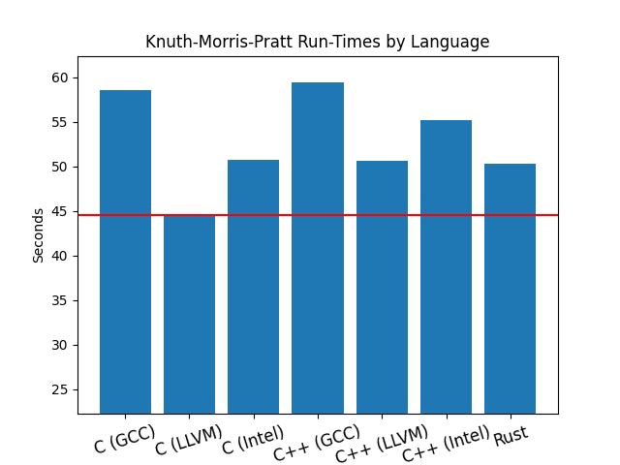
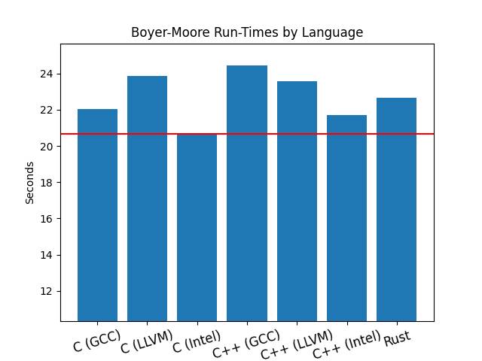
Exact Match Algorithm Run Times

Slide 32
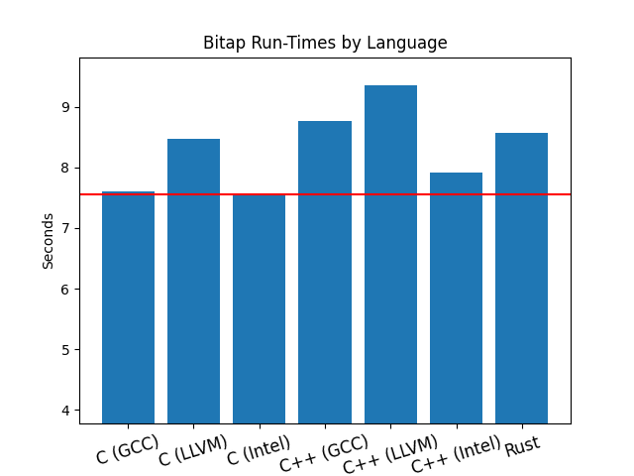
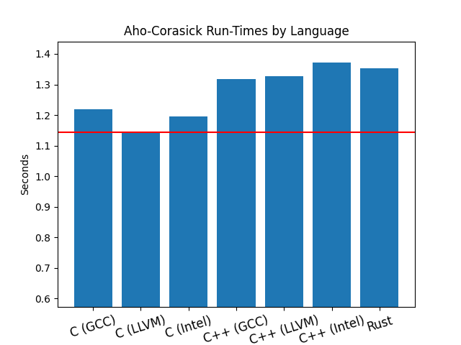
Exact Match Algorithm Run Times

Slide 33
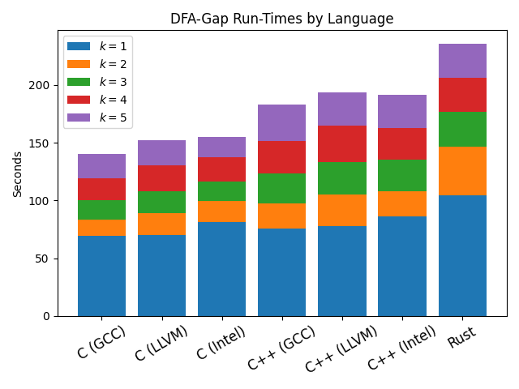
Novel Algorithm Run Times - DFA & Regexp

Slide 34
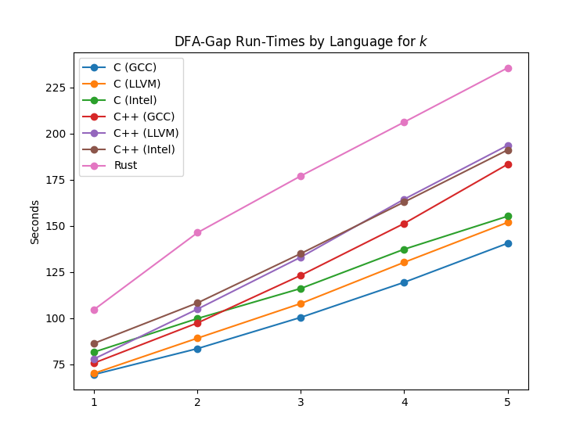
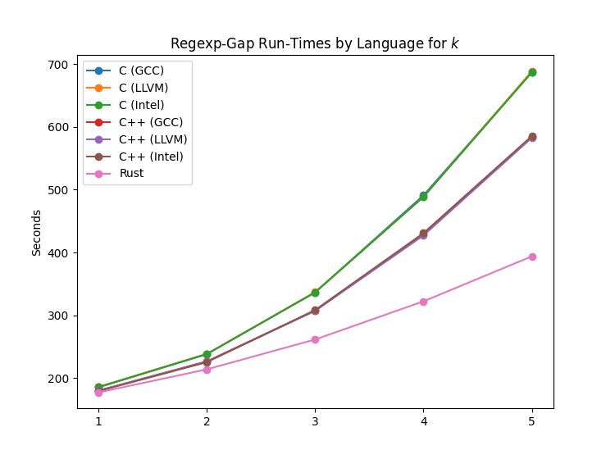
Novel Algorithm Run Times - DFA & Regexp

Slide 35
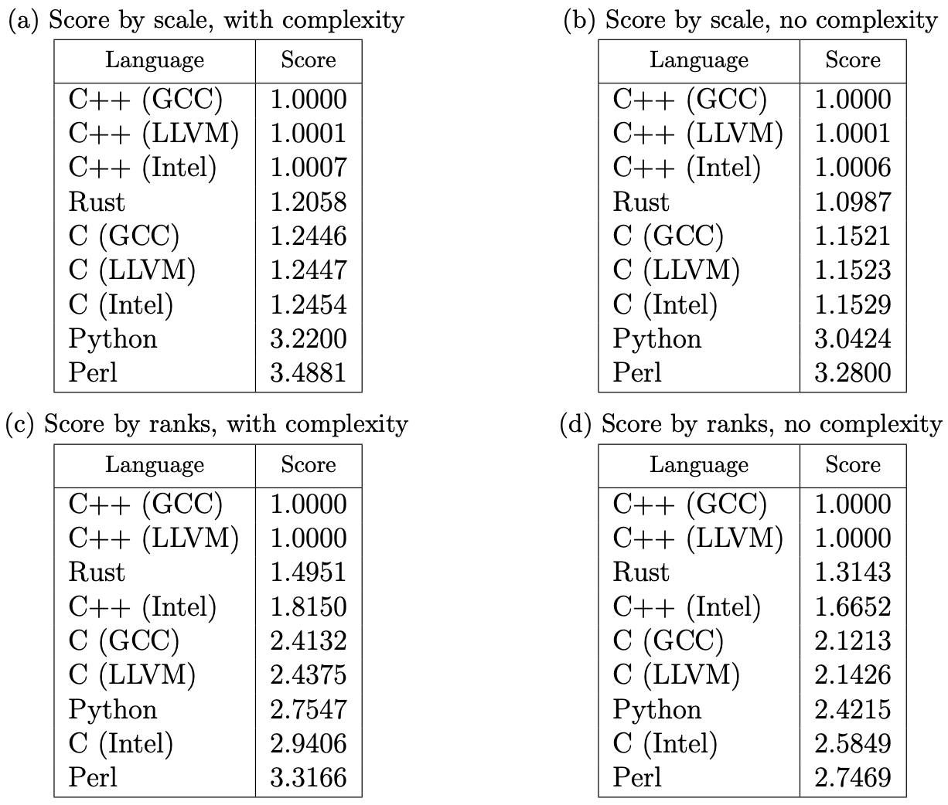
Final Rankings, with detail

Slide 36
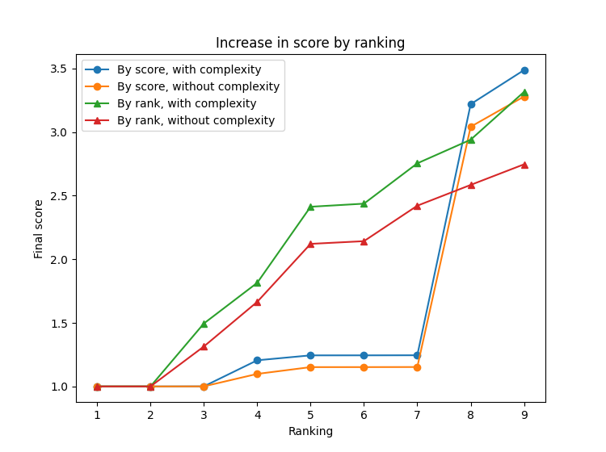
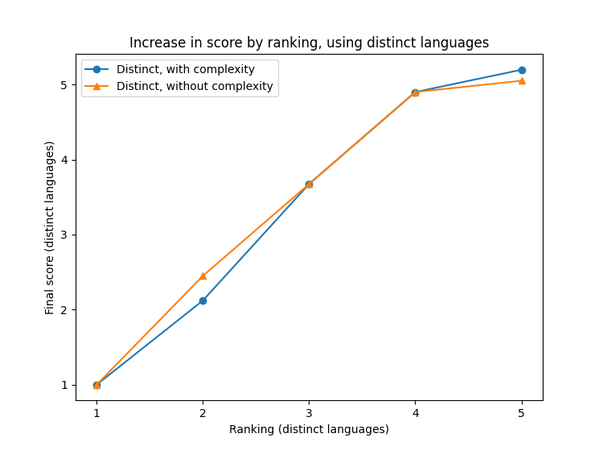
How Final Rankings Grew
Differences in score based ranking and placement ranking

