Slide 1
Probabilistic Timed Automata
Jeremy Sproston
Università di Torino
PaCo kick-off meeting, 23/10/2008

Slide 2
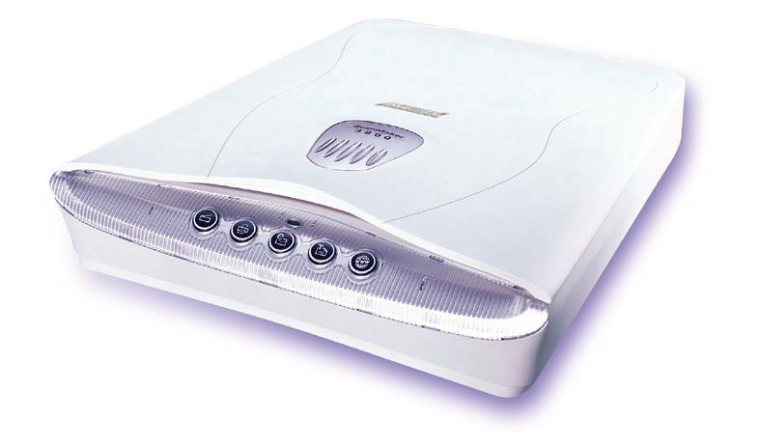



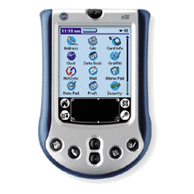


FireWire root contention protocol
Leader election: create a tree structure in a network of multimedia devices
Symmetric, distributed protocol
Uses electronic coin tossing (symmetry breaker) and timing delays

Slide 3
FireWire root contention protocol
If two nodes try to become root at the same time:
  Both nodes toss a coin
  If heads: node waits for a “long” time (≥1590ns, ≤1670ns)
  If tails: node waits for a “short” time (≥760ns, ≤850ns)
The first node to finish waiting tries to become the root:
  If the other contending node is not trying to become the root (different results for coin toss), then the first node to finish waiting becomes the root
  If the other contending node is trying to become the root (same result for coin toss), then repeat the probabilistic choice

Slide 4
FireWire root contention
Description of protocol:
  Time
  (Discrete) probability
  Nondeterminism:
    Exact time delays are not specified in the standard, only time intervals
Probabilistic timed automata - formalism featuring:
  Time
  (Discrete) probability
  Nondeterminism

Slide 5
PTA: other case studies
IEEE 802.11 backoff strategy [KNS02]
  Wireless Local Area Networks
IEEE 802.15.4 CSMA/CA protocol [Fru06]
IPv4 Zeroconf protocol [KNPS03]
  Dynamic self-configuration of network interfaces
Security applications [LMT04, LMT05]
PC-mobile downloading protocol [ZV06]
Publish-subscribe systems [HBGS07]

Slide 6
Probabilistic timed automata
Probabilistic timed automata:
  An extension of Markov decision processes with clocks and constraints on clocks
  An extension of timed automata with (discrete) probabilistic choice
Clocks, constraints on clocks
TA
PTA
LTS
MDP
(Discrete) probabilities

Slide 7
Timed automata
Timed automata [Alur & Dill’94]: formalism for timed + nondeterministic systems
  Finite graph, clocks (real-valued variables increasing at same rate as real-time), constraints on clocks

Slide 8
Markov decision processes
State-to-state transition:
Nondeterministic choice
over the outgoing probability
distributions of the source state
Probabilistic choice of target
state according to the
distribution chosen in step 1.
Markov decision process: MDP = (S,s₀,Steps):
  S is a set of states with the initial state s₀
  Steps: S → 2^{Dist(S)}\{∅} maps each state s to a set of probability distributions μ over S
1
fail
0.02
init
try
1
0.98
succ
1
1

Slide 9
Markov decision processes
State-to-state transition:
Nondeterministic choice
over the outgoing probability
distributions of the source state
Probabilistic choice of target
state according to the
distribution chosen in step 1.
The coexistence of nondeterministic and probabilistic choice means that there may be no unique probability of certain behaviours
For example, we obtain the minimum and maximum probabilities of reaching a set of states
1
fail
0.02
init
try
1
0.98
succ
1
1

Slide 10
Markov decision processes
State-to-state transition:
Nondeterministic choice
over the outgoing probability
distributions of the source state
Probabilistic choice of target
state according to the
distribution chosen in step 1.
Policy (or adversary): to resolve nondeterminism
  Mapping from every finite path to a nondeterministic choice available in the last state of the path
  I.e., a policy specifies the next step to take
1
fail
0.02
init
try
1
0.98
succ
1
1

Slide 11
Markov decision processes
Examples of policies:
Whenever in state s1, take the blue distribution
1
fail
0.02
init
try
1
0.98
succ
1
1

Slide 12
Markov decision processes
Examples of policies:
Whenever in state s1, take the blue distribution
Whenever in state s1, take the red distribution
1
fail
0.02
init
try
1
0.98
succ
1
1

Slide 13
Markov decision processes
Examples of policies:
Whenever in state s1, take the blue distribution
Whenever in state s1, take the red distribution
In state s1:
  take the blue transition if the last choice was of the red transition;
  otherwise take the red transition
1
fail
0.02
init
try
1
0.98
succ
1
1

Slide 14
Markov decision processes
Examples of policies:
Whenever in state s1, take the blue distribution
Whenever in state s1, take the red distribution
In state s1:
  take the blue transition if the last choice was of the red transition;
  otherwise take the red transition
1
fail
0.02
init
try
1
0.98
succ
1
1

Slide 15
Markov decision processes
Policy (denoted by A): a mapping from each finite path s₀ μ₀ s₁ μ₁…s_{n} to a distribution from Steps(s_{n})
  By resolving the nondeterminism of a Markov decision process, a policy induces a fully probabilistic system
  The probability measure Pr^{A}_{s} of a policy is obtained from the probability measure of its induced fully probabilistic system

Slide 16
Probabilistic timed automata
0.01
0.99
{x:=0}
{x:=0}
on
0.99
off
x≤3
0.01
x≥2
Recall clocks: real-valued variables which increase at the same rate as real-time
Clock constraints CC(X) over set X of clocks:
g ::= x ∼ c | g ∧ g
where
x ∈ X, ∼ ∈ {<, ≤, ≥, >} and c is a natural

Slide 17
Probabilistic timed automata
Formally, PTA = (Q, q₀, X, Inv, prob):
  Q finite set of locations with q₀ initial location
  X is a finite set of clocks
  Inv: Q → CC(X) maps locations q to invariant clock constraints
  prob ⊆ Q x CC(X) x Dist(2^{X} x Q) is a probabilistic edge relation: yields the probability of moving from q to q’, resetting specified clocks

Slide 18
Probabilistic timed automata
Discrete transition of timed automata:
(q,g,C,q’) ∈ Q x CC(X) x 2^{X} x Q
Discrete transition of probabilistic timed automata:
(q,g,p) ∈ Q x CC(X) x Dist(2^{X} x Q)
g,C
C₁
λ₁
λ₂
C₂
g
C₃
λ₃

Slide 19
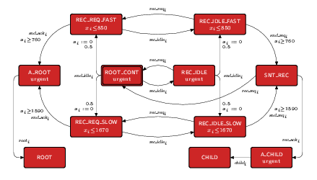
FireWire: node PTA
Modelling:
Four PTA (2 nodes, 2 wires)

Slide 20
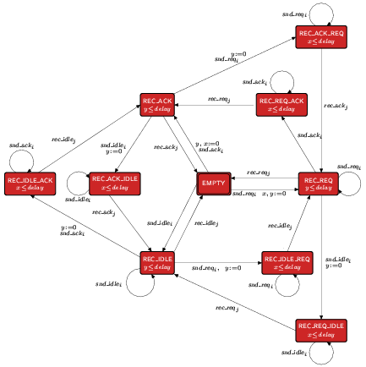
FireWire: wire PTA

Slide 21
PTA semantics
Formalism Semantics
Timed automata “Timed” transition systems
Probabilistic timed automata “Timed” Markov decision processes
States: location, clock valuation pairs (q,v) (v is in (R_{>=0})^{|X|})
  Real-valued clocks give infinitely-many states
Transitions: 2 classes
Time elapse
(v+d adds real value
d to the value of
all clocks given by v)
q,v
q₁,v₃
Edge
transitions
...
q,v+d
...
q,v+d’
q₁,v₁
q₂,v₂

Slide 22
PTA semantics
Formalism Semantics
Timed automata “Timed” transition systems
Probabilistic timed automata “Timed” Markov decision processes
States: location, clock valuation pairs (q,v) (v is in (R_{>=0})^{|X|})
  Real-valued clocks give infinitely-many states
Transitions: 2 classes
Time elapse
(v+d adds real value
d to the value of
all clocks given by v)
0.99
q₁,v₃
q,v
Probabilistic
edges
...
0.01
1
1
1
q,v+d
...
q,v+d’
q₁,v₁
q₂,v₂

Slide 23
Probabilistic Timed CTL
To express properties such as:
  “under any policy, with probability >0.98, the message is delivered within 5 ms”
Choices for the syntax:
  Time-bound (TCTL of [ACD93]):
  P_{>0.98}[ ◊_{≤5} delivered]
  Reset quantifier (TCTL of [HNSY94]):
  z.[P_{>0.98}[ ◊ (delivered ∧ z ≤ 5)]

Slide 24
Probabilistic Timed CTL
“Time-bound” syntax of PTCTL:
  φ ::= a | φ ∧ φ | ¬φ | P_{∼λ}[φ₁ U_{#c} φ₂]
  where:
  a are atomic propositions (labelling locations),
  c are natural numbers,
  ∼ ∈ {<, ≤, ≥, >}, # ∈ {≤, =, ≥} are comparison operators,
  λ ∈ [0,1] are probabilities
  Subclass with λ ∈ {0,1}: qualitative fragment

Slide 25
Probabilistic Timed CTL
Example: state s satisfies P_{>0.9}[safe U_{≤10} terminal]?
  A path satisfies [safe U_{≤10} terminal] iff:
    It reaches a terminal state within 10 time units
    Until that point, it is in a safe state
  State s satisfies P_{>0.9}[safe U_{≤10} terminal] iff all policies satisfy [safe U_{≤10} terminal] from s with probability more than 0.9
≤10
Probability of these paths > 0.9?
s
safe U terminal
Paths of a policy

Slide 26
Model checking for PTA
Common characteristics:
  Semantics of a PTA is an infinite-state MDP, so construct a finite-state MDP
    E.g., “region graph”
    E.g., discrete-time semantics (for certain classes of PTA/properties, equivalent to continuous-time semantics)
  Apply the algorithms for the computation of maximum/minimum reachability probabilities to the finite-state MDP

Slide 27
0.99
on
off
off
off
off
0.01
0.01
0.99
on
on
on
off
0.99
0.01
0.99
0.01
off
{y:=0}
x=1
{x,y:=0}
0.99
0.01
on
off
y<1
x≤1

Slide 28
Complexity of model checking PTA
Model checking for PTA:
  EXPTIME-algorithm [KNSS02]
  Construct finite-state MDP: exponential in the encoding of the PTA
  Run the polynomial time algorithm for model checking finite-state MDPs [BdA95]

Slide 29
Complexity of model checking PTA
Key sub-problem of model checking for PTAs: qualitative reachability
  Does there exist a policy such that, from the initial state, we can reach the location q_{Final} with probability 1?
  (Almost) the simplest question we can ask for PTAs
  EXPTIME-hard:
    Reduction from the acceptance problem for linearly bounded alternating Turing machines [LS07]
Qualititative reachability can be expressed in PTCTL
Therefore PTCTL model checking for PTAs is EXPTIME-complete

Slide 30
Complexity of model checking PTA
Comparison:
  TCTL model checking (and reachability) for timed automata is PSPACE-complete [ACD93, AD94]
  CTL model-checking problem for transition systems operating in parallel is PSPACE-complete [KVW00]
  TATL (and alternating reachability) for timed games is EXPTIME-complete [HK99,HP06]

Slide 31
TA with one or two clocks
Restricting the number of clocks in timed automata [LMS04]:
  Reachability for one-clock timed automata is NLOGSPACE-complete
  Reachability for two-clock timed automata is NP-hard
  Model checking “deadline” properties for one-clock timed automata is PTIME-complete

Slide 32
PTA with one or two clocks
Restricting the number of clocks in PTA [JLS08]:
  PCTL (no timed properties) for one-clock PTA is PTIME-complete
  Model checking qualitative “deadline” properties for one-clock PTA is PTIME-complete
  BUT qualitative reachability for two-clock PTA is EXPTIME-complete

Slide 33
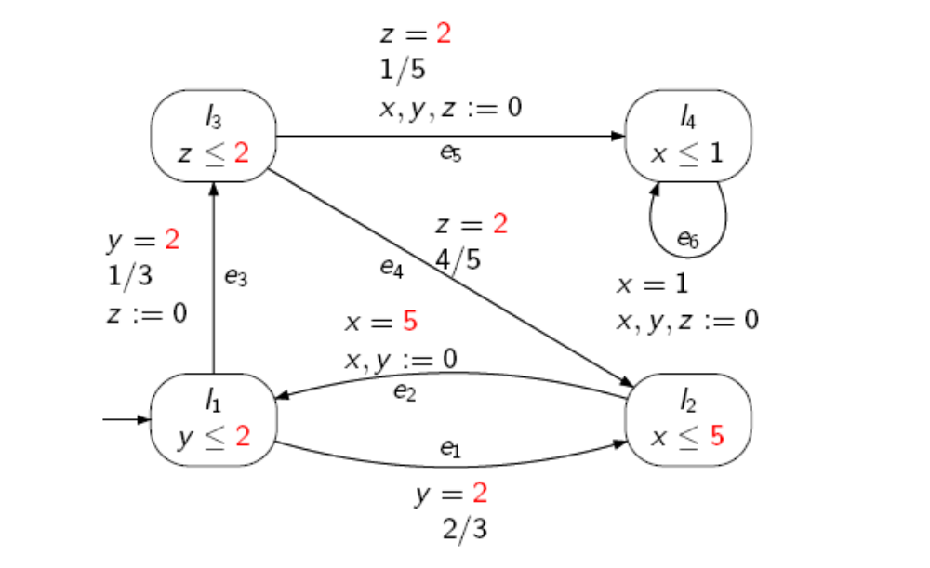
PTA without nondeterminism
E.g.:

Slide 34
PTA without nondeterminism
Require well-formedness assumption:
  On entry to a location, the guards of all outgoing edges can be enabled (possibly by letting time pass), whatever the values of clocks on entry
Polynomial algorithm for expected-time reachability properties [CDFPS08]:
  E.g., compute the expected time to reach location l₄
  Construct a graph of polynomial size in the encoding of the PTA
  Extract two linear equation solving problems from the graph

Slide 35
PaCo and PTA
Three main proposals:
  Subclasses: can we define more efficient model-checking algorithms for subclasses of PTA?
  Divergence: develop model-checking algorithms for PTA under more realistic assumptions
  Abstraction/refinement: algorithms for determining simulation-based preorders between PTA

