Slide 1
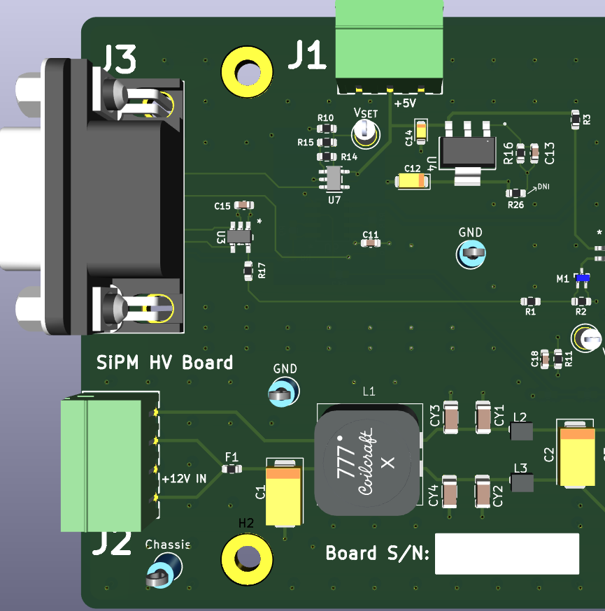
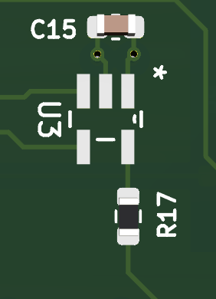
U3

Slide 2
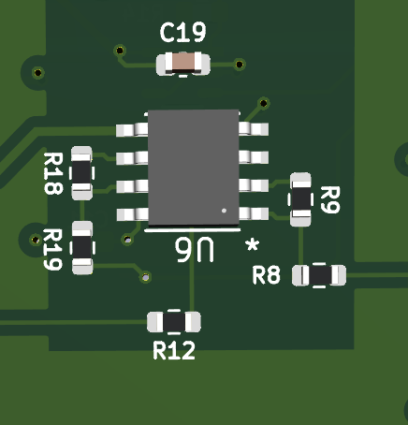
R12

Slide 3
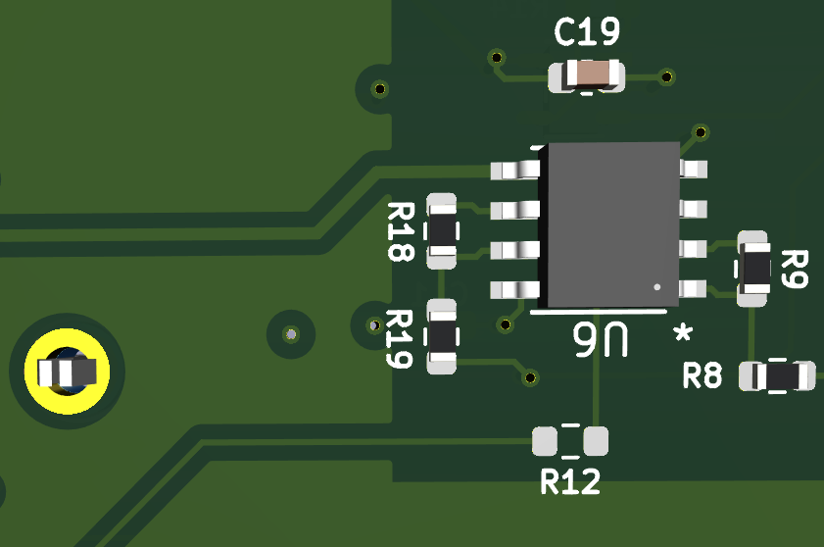

Slide 4
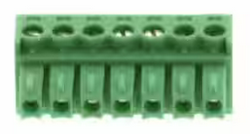
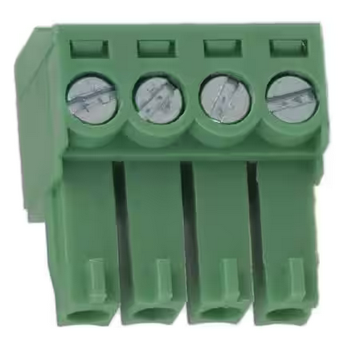
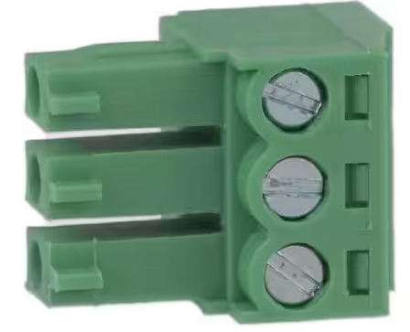
277-1166-ND
732-2753-ND
732-2077-ND
1
7
1
4
1
3
TP
2
1
4
3
732-2753-ND
1
2
3
4
5
6
7
277-1166-ND
TP
1
2
3
732-2077-ND
Please make this harness 1.5’ in length

