Slide 1
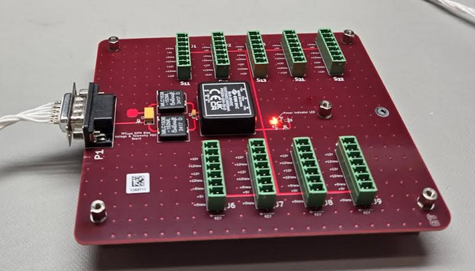
LED Indicator

Slide 2
J1
J2 – J7
+5V RTN
1
2
3
1
2
3
4
1
2
3
4
5
6
7
+5V IN
+5V RTN
+12V RTN
J2
+12V IN
+12V RTN
+12V IN

Slide 3
Rack Supply
Chassis
+12V
+12V_RTN
Telemetry Power Board
W1
J1
J2
W2
P_Out
J1
J2

Slide 4
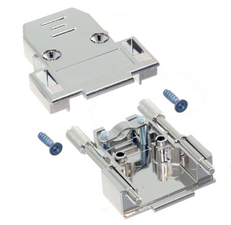
Shield
TP
1
6
2
7
4
8
5
9
Chassis
+12V_RTN
+12V IN
TP
+12V_RTN
Würth Electronik
9-Position Socketed D-Sub
Part Num: 61800924923
TP
+12V IN
Terminate all +12V lines into the same banana connector
Terminate all +12V_RTN lines into the same banana connector
Terminate the Chassis line into its own banana connector
+12V_RTN
+12V IN
TP
+12V_RTN
+12V IN
Chassis
Würth Elektronik
9-Position Backshell
Part Number: 260709

Slide 5
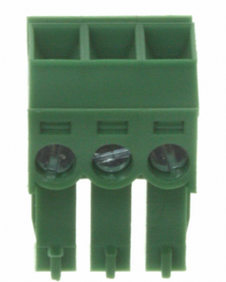
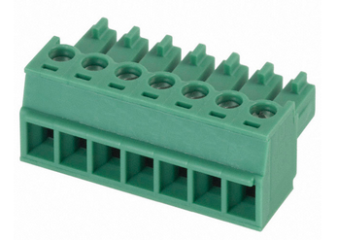
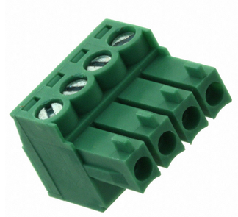
Würth Elektronik
3-Position Terminal Block
Part Number: 691361300003
Phoenix Contact
7-Position Terminal Block Part Number: 1803620
TP
Würth Elektronik
4-Position Terminal Block
Part Number: 691361100004
TP

Slide 6
Shield
TP
1
6
2
7
4
8
5
9
Chassis
HV Current Monitor
1
6
2
7
4
8
5
9
Chassis
Telemetry Return
TP
High Voltage Enable +
Würth Electronik
9-Position Pin D-Sub
Part Num: 61800924823
TP
High Voltage Enable -
Telemetry Return
High Voltage Monitor
TP
Telemetry Return
Set High Voltage
Chassis
Würth Elektronik
9-Position Backshell
Part Number: 260709

