Slide 1
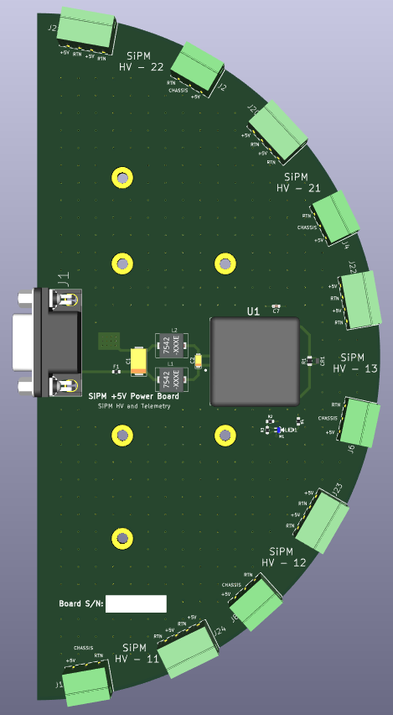
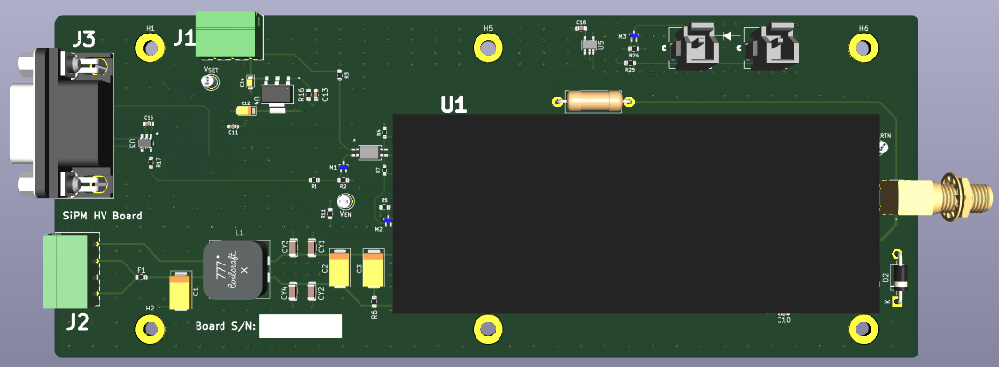
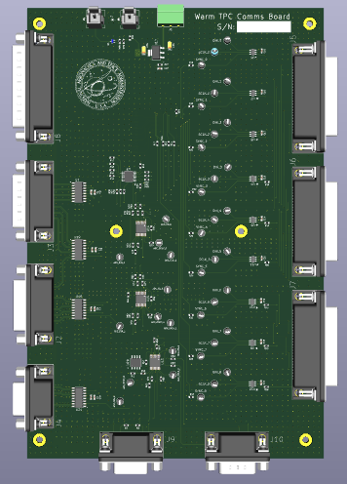
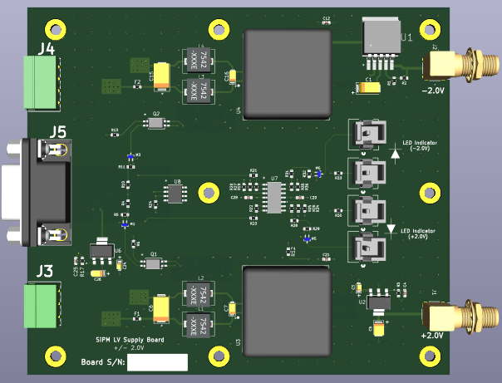
S33
S32
S33
Telemetry Power Board 2
S31
S23
Warm TPC Power (+/- 2V)
Warm TPC Comm Board
S22
S21
S13
Telemetry Power Board 1
S12
S11
S11

Slide 2
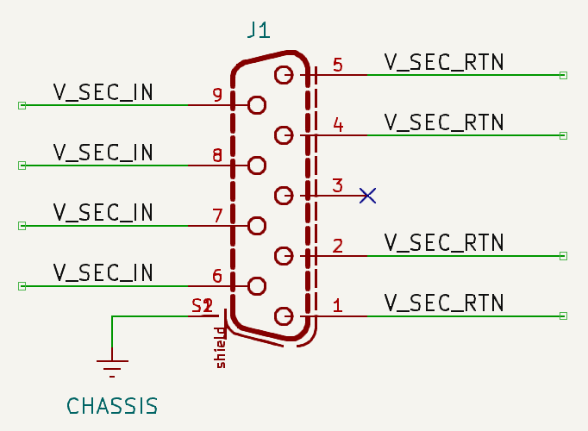
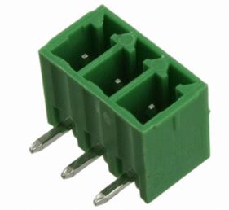
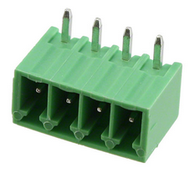
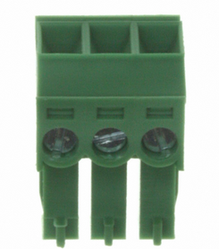
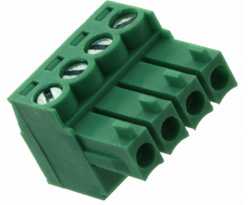
691322310003
691322110004
J1 is a 9-Socketed D-Sub Connector
U1 is the PDQ10-Q24-S5-D CUI DC-DC Converter
LED1 indicates when output voltage from converter is on
Terminal blocks (3 and 4 – Pos) headers
691361300003
691361100004

Slide 3
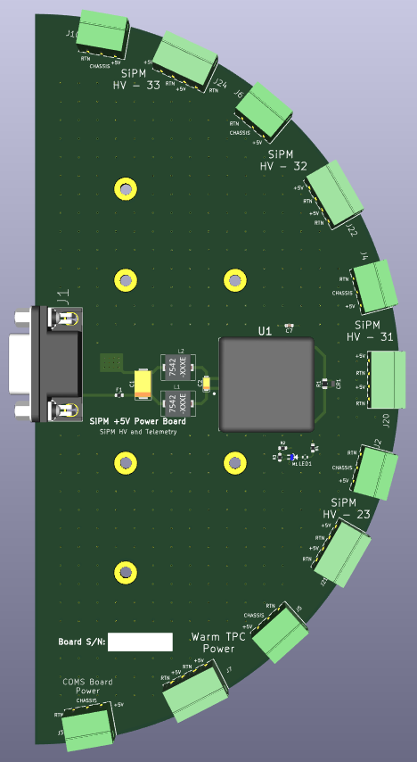
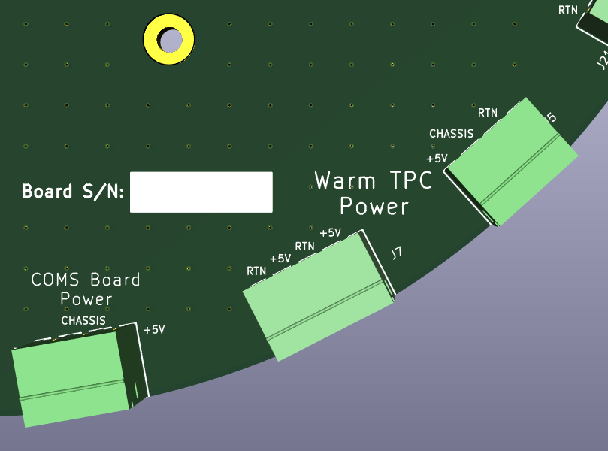

Slide 4
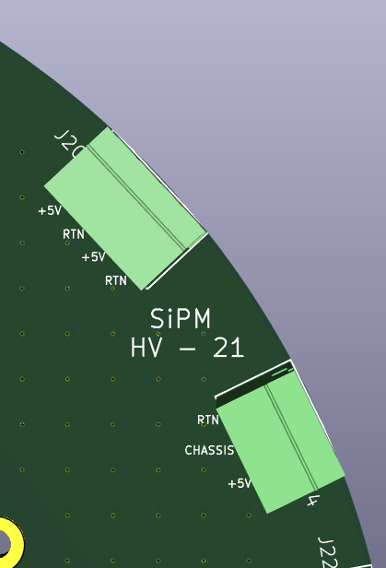
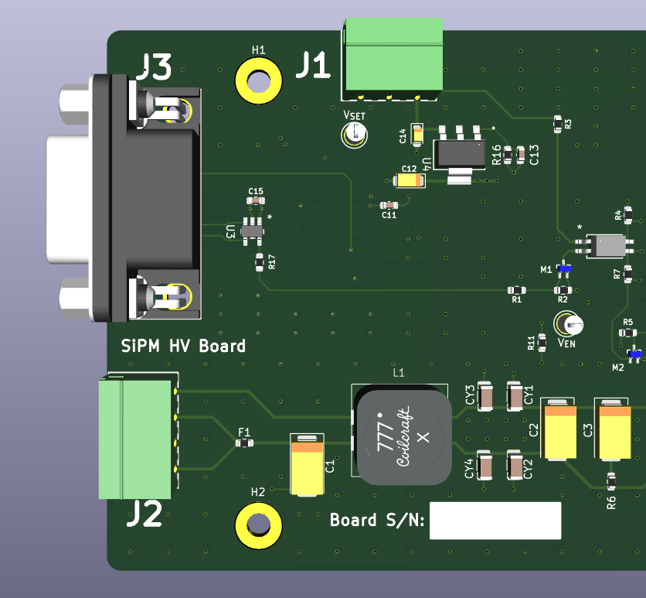
Power Board
SiPM HV Board

