Slide 1
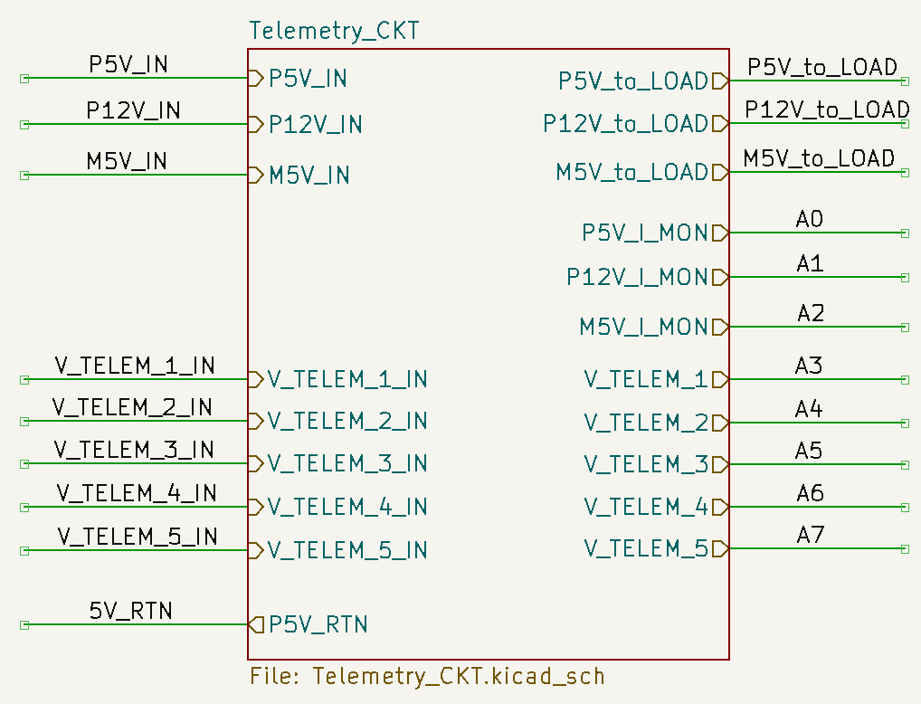
Power Rails. The P5V_IN is also powering the circuitry on this board, all of these rails are going out to the DUTs
These go out to the actual loads of the DUTs
These are all the inputs to the Arduino Analog Inputs
These are the various telemetry inputs from the DUTs
You always need a return!

