Slide 1
SiPM HV Board (Box Concept)

Slide 2
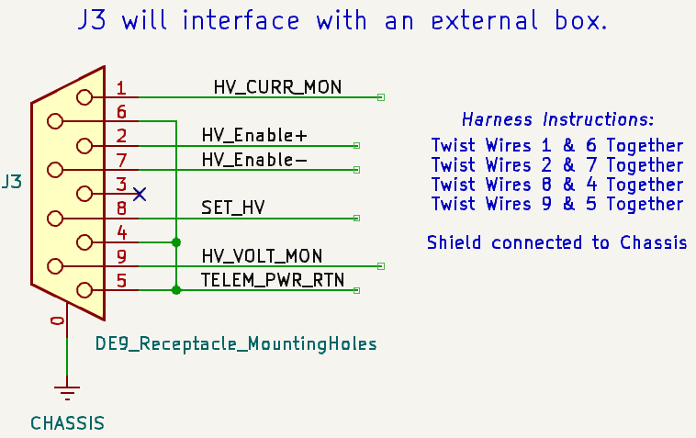

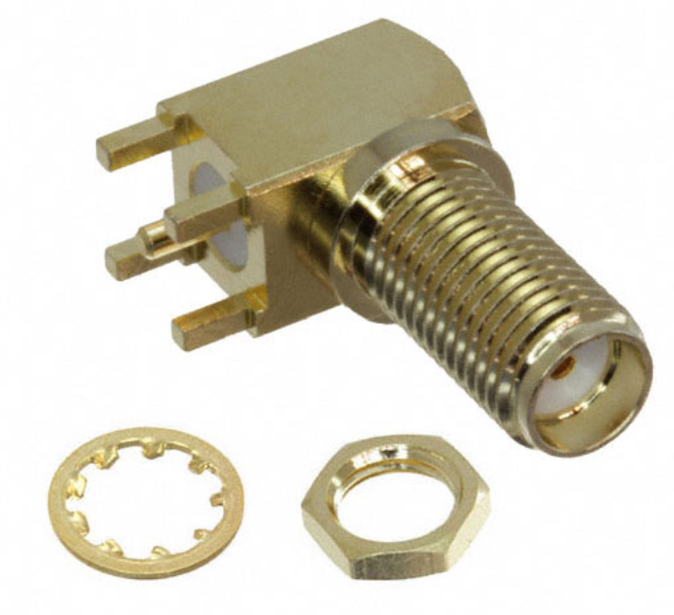
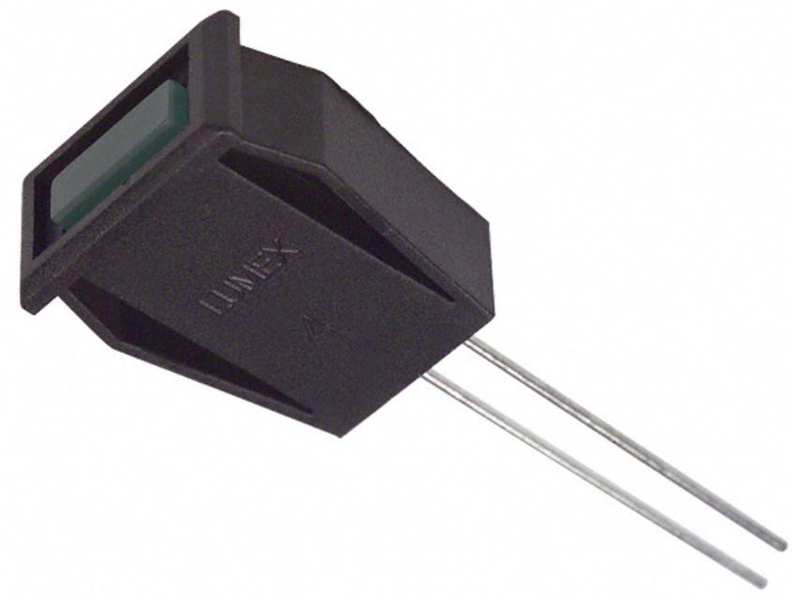
SiPM PDU BOX
+12V
SiPM HV Board
V_SEC
V_SEC_RTN
9-Pos D-Sub
1
+5V
Telem V+
SMA
Telem RTN
SiPM HV Board
V_SEC
V_SEC_RTN
9-Pos D-Sub
2
Telem V+
SMA
Telem RTN
V_SEC
+12V
V_SEC
V_SEC
Telemetry Supply (+5V)
V_SEC_RTN
V_SEC_RTN
V_SEC_RTN
Telem V+
Telem RTN
SiPM HV Board
V_SEC
V_SEC_RTN
9-Pos D-Sub
9
Indicator LED outside of box
Telem V+
SMA
Telem RTN
SiPM LV (+/- 2V Rails)
V_SEC
V_SEC_RTN
+2V
15-Pos D-Sub
RTN
Telem V+
-2V
Telem RTN

Slide 3
SiPM HV Board (Schematic Design)

Slide 4
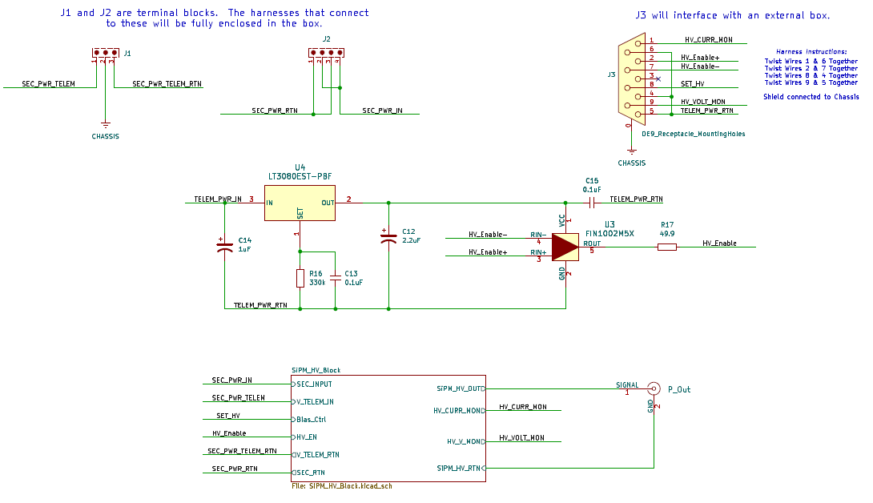
3.3V Logic for Enable Signal
LVDS Receiver

Slide 5
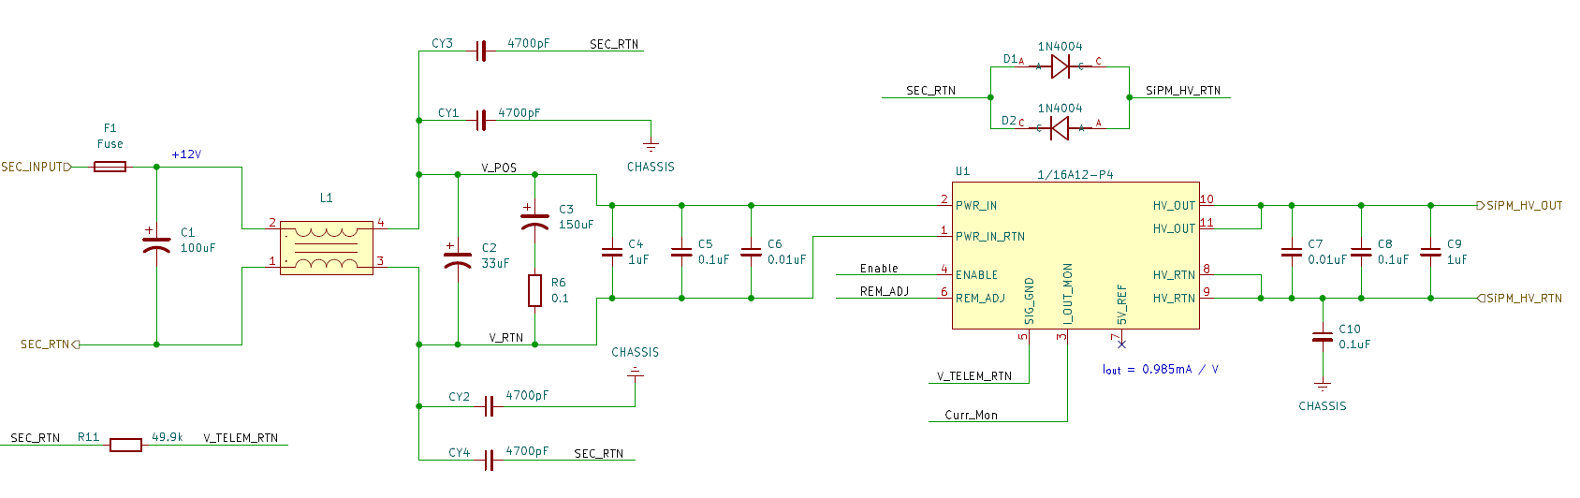
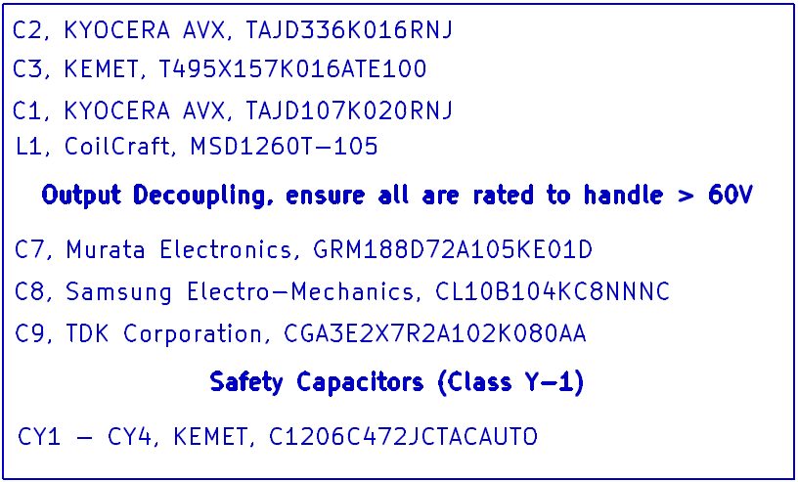
DC-DC Converter Supplying SiPM with HV
Zap Trap
Prevents any drift between HV and LV Returns
Safety Fuse
Keeps telemetry and secondary returns from drifting away from each other

Slide 6
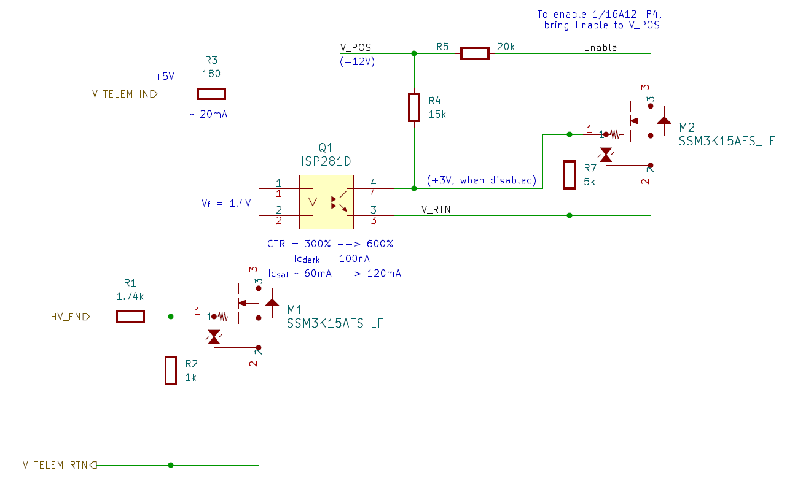
HV Enable Circuitry
(DNP)
Q1 Notes:
Pins 1 and 2 on Telemetry return plane
Pins 3 and 4 on the secondary return plane
R5 is a DNP, as Enable pin within 1/16A12-P4 converter should be tied to V_POS via 10k resistor. If not, install R5.

Slide 7
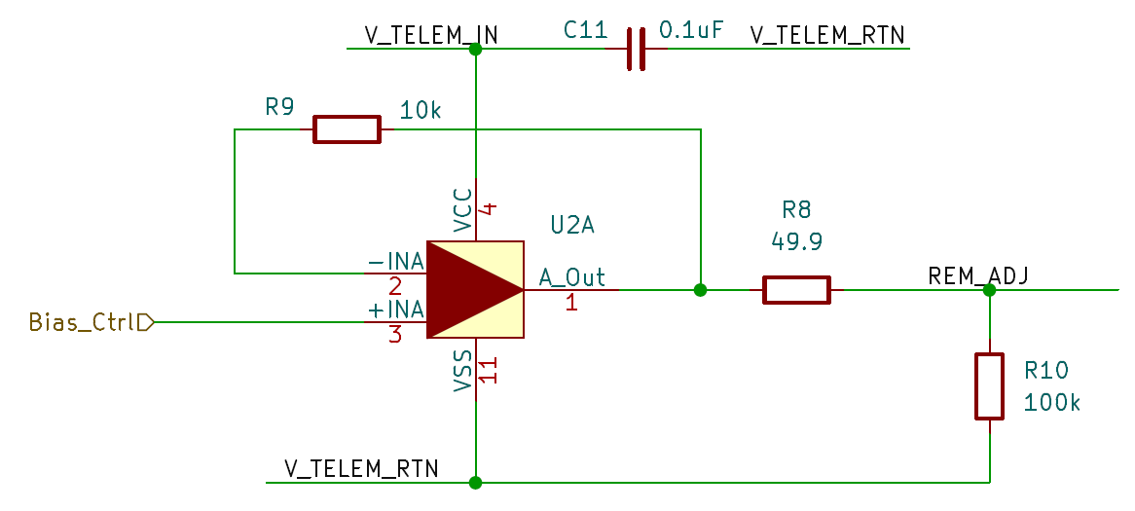
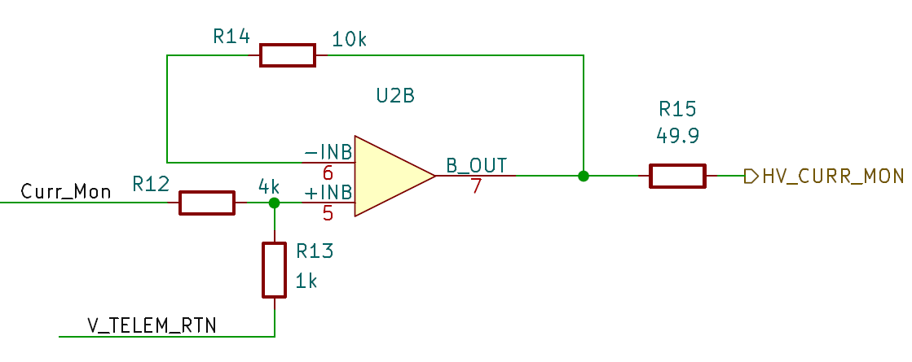
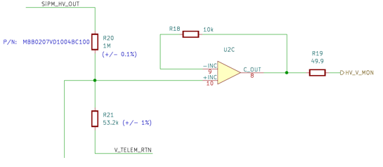
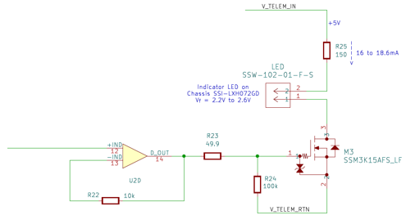





Telemetry Circuitry
Setting the HV Level
HV Current Monitor
Current Monitor is outputting a voltage
$$V_{HV}=13.33\left({HV}_{SET}\right)$$
$$i_{HV}=\frac{0.985mA}{HV_CURR_MON}$$
High Voltage Monitor
Indicator LED
R₂₄ keeps M3 off when not driven by U2D.
$${HV}_{MON}=V_{HV}\left(\frac{R_{21}}{R_{20}+R_{21}}\right)$$
Shares Input from High Voltage Mon circuit.
$$V_{HV}=0.05\left({HV}_{MON}\right)$$
$$V_{th}=1.5V$$

