Slide 1

Battle of the neighborhoods - CALIFORNIA STATE HOUSING PRICES

Slide 2
INTRODUCTION
California state is the most populous state in the United States and is a global hub of business and commerce and especially real estate
California, the golden state as it is called, is home to the most expensive and luxurious housing areas in the entire country
The real estate market is highly competitive and hence, investment in real estate bears its own challenges.
The analysis will be beneficial in the investment in real-estate and ensure better ROI and reduce risk

Slide 3
California housing – business environment
There are numerous factors which are required to be kept in mind before a fruitful investment in real estate is possible:
1. Location 5. Total number of bedrooms
2. Households 6. Income of investors
3. Housing Age 7. Ocean proximity
4. Total number of rooms 8. House Value

Slide 4
DATA DESCRIPTION
California state will be analyzed for the information on houses and other different factors. The data pertains to the houses found for a given California district and some summary stats about them based on the 1990 census data.
Link to the dataset is : https://www.kaggle.com/camnugent/california-housing-prices
Dimensions of the dataset are(20640, 10) which include the columns like: longitude, latitude, housing_median_age, total_rooms, total_bedrooms, population, households, median_income, median_house_value, ocean_proximity

Slide 5
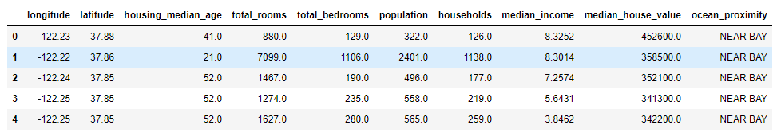
Data description
Dimensions include the columns like : longitude, latitude, housing_median_age, total_rooms, total_bedrooms, population, households, median_income, median_house_value, ocean_proximity

Slide 6
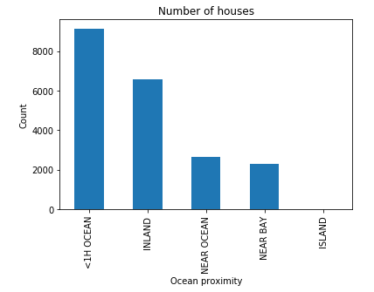
DATA formatting & Imputation of missing values
The data in the dataset has multiple incorrect format values which are difficult to analyze and to represent on the Maps. The dataset contains missing values which are handled and the entire data set is formatted removing unwanted rows and changing the type of data
Post formatting of the data set the data is filtered based on the ocean proximity and the following visualization is created

Slide 7
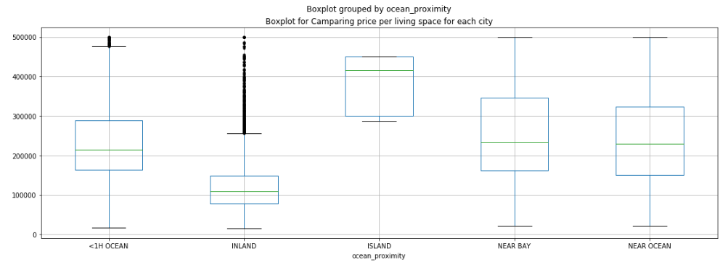
METHODOLOGY USING BOX PLOTS
The data after being filtered as per ocean proximity is represented as box plots for the various types of houses and median house value for each data entry

Slide 8
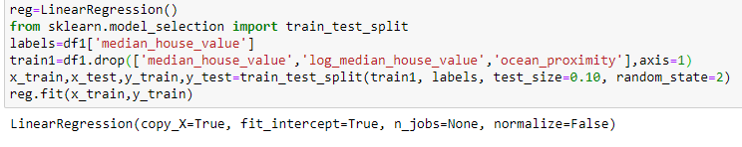


HOUSING PREDICTION
By Implementing a Linear Regression model, from sklearn.linear_model we predict the value of the houses by ocean proximity and below parameters

Slide 9
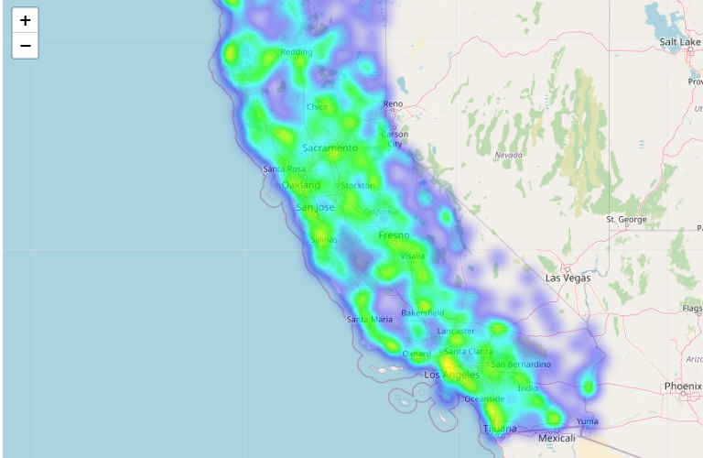
Folium representation
Based on the regression model implemented and then findings of the various houses based on ocean proximity, house median value and population the folium map is generated

Slide 10
CONCLUSION
From the maps and visualizations created it is evident that areas lying to the west coast of California and other cities including Los Angeles, Tijuana, San Jose, Oakland, Sacramento are densely populated.
However the count of houses situated at less than 1 hour from the ocean exceeds those which are near the bay or ocean.
The price of the houses also is directly linked the ocean proximity, with island houses costing the highest and other houses in the inland and further away from the ocean the lowest.

