Slide 1
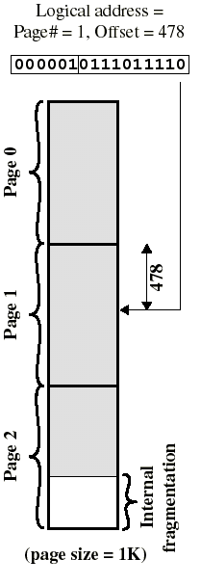
Logical Address in Paging
Page#=1, Displacement=478
Page size always chosen as a power of 2.
Example: if 16 bit addresses are used and page size = 1K, we need 10 bits for displacement and have 6 bits left for page number (64 pages)
Logical address (p,d) is translated to physical address (f,d) by indexing the page table by p and appending the page displacement d to the frame number f

Slide 2
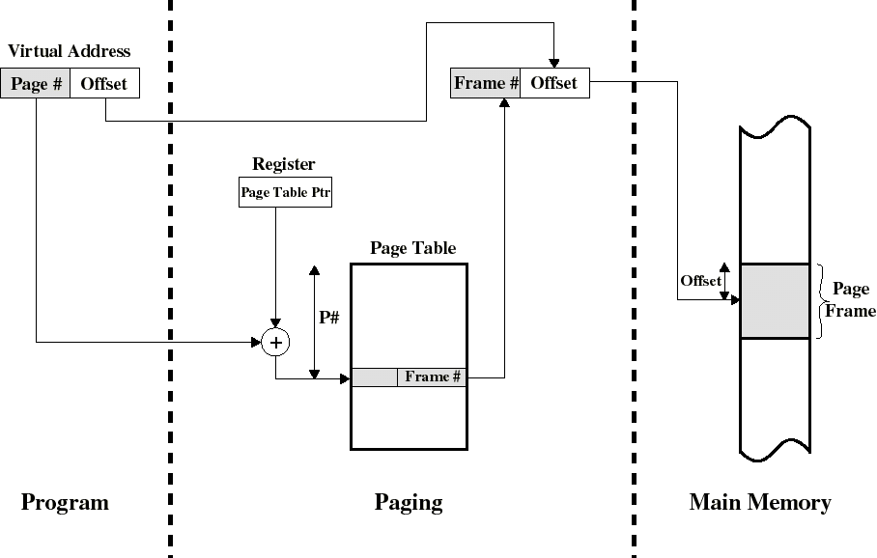
Address Translation in Paging (see also Fig 9.6)
Disp
Disp
Disp
CPU

Slide 3
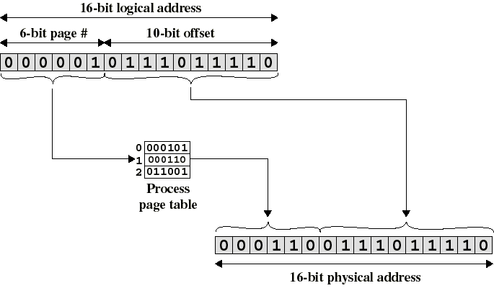
Logical-to-Physical Address Translation in Paging
(displacement)
translation
Page 1 is in memory frame 6

Slide 4
Translation Lookaside Buffer
Because the page table is in main memory, each paged memory reference causes two physical memory accesses:
  one to fetch the page table entry
  one to fetch the data
To overcome this problem a special cache is provided for page table entries
  Translation Lookaside Buffer (TLB)
    Contains page table entries that have been most recently used

Slide 5
Translation Lookaside Buffer
Given a logical address, the processor examines the TLB
If page table entry is present (a TLB hit), retrieve the frame number and the physical address is available immediately
If page table entry is not found in the TLB (a miss), use page number to index the page table in main memory (extra memory cycle)
  The TLB is updated to include the new page entry
  An older entry is “bumped” to make room

Slide 6
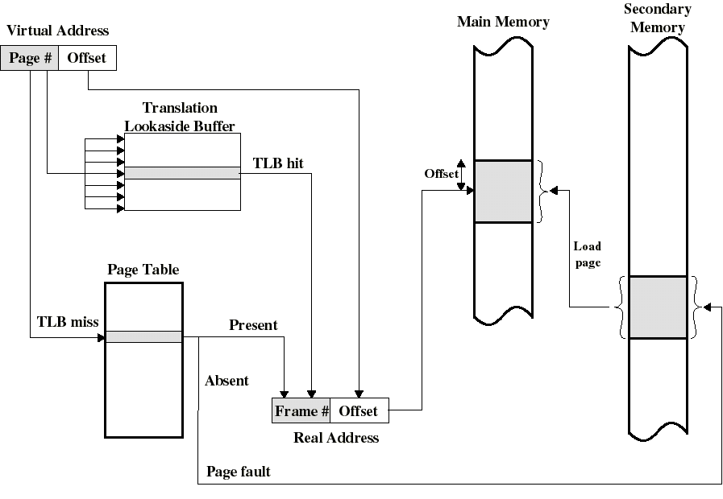
Use of Translation Lookaside Buffer
Frame
Frame
(described later with virtual memory)

Slide 7
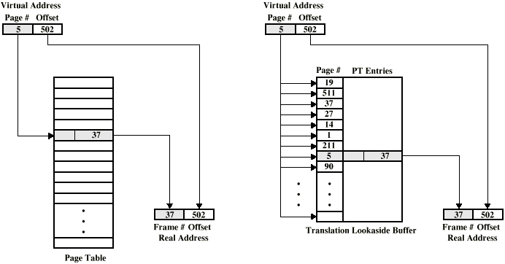
Direct vs. Associative Mapping

Slide 8
Page Tables and Virtual Memory
Page tables can be very large
  (32 - 64 bit logical addresses today)
  If (only) 32 bits are used (4GB) with 12 bit offset (4KB pages), a page table may have 2^{20} (1M) entries. Every entry will be at least several bytes.
The entire page table can take up a lot of main memory.
We may have to use a 2-level (or more) structure for the page table itself.

