Slide 1
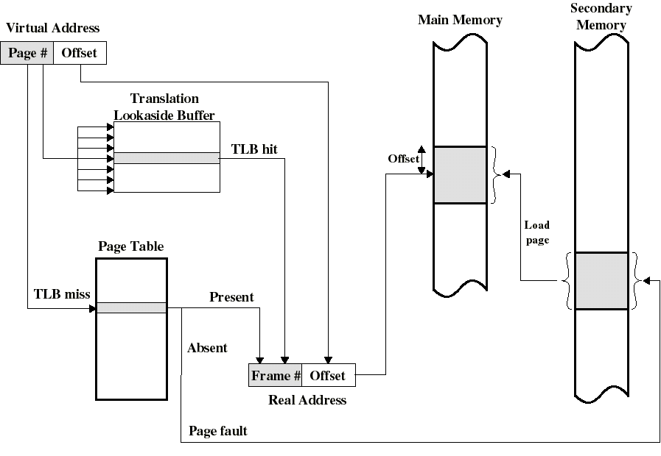
Translation Lookaside Buffer
Frame
Frame
(described later with virtual memory)

Slide 2
Page Tables and Virtual Memory
Page tables can be very large
  (32 - 64 bit logical addresses today)
  If (only) 32 bits are used (4GB) with 12 bit offset (4KB pages), a page table may have 2^{20} (1M) entries. Every entry will be at least several bytes.
The entire page table can take up a lot of main memory.
We may have to use a 2-level (or more) structure for the page table itself.

Slide 3
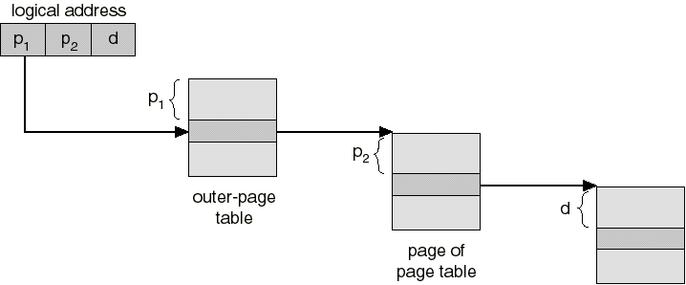
Multilevel Page Tables
With a 2 level page table (386, Pentium), the page number is split into two numbers p1 and p2
p1 indexes the outer page table (directory) in main memory whose entries point to a page containing page table entries for some range of virtual memory
The second level entry is indexed by p2.
Except for the directory (outer table), page tables entries can be swapped in and out as needed

Slide 4

Inverted Page Table
One entry per FRAME rather than one per PAGE
Search for matching page #

Slide 5
Sharing Pages
Several users can share one copy of the same program
Shared code must be reentrant (non self-modifying) so that more than one process can execute the same code
With paging, each process will have a page table with entries pointing to the same code frames
  only one copy of each page is actually in a frame in main memory
Each user also needs to have its own private data pages

Slide 6
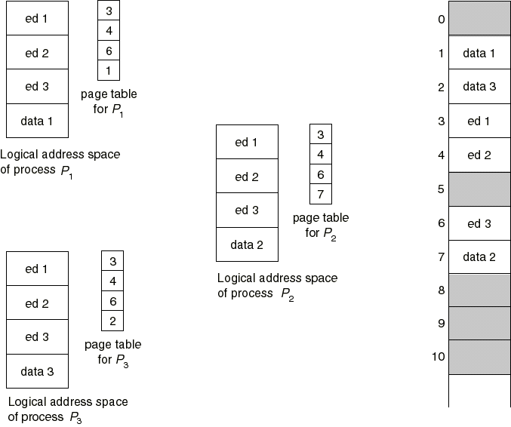
Sharing Pages: a Text Editor

Slide 7
Segmentation
Processes actually consist of logical parts (segments), such as:
  one or more executable segments
  one or more data segments
  stack segment
Another idea: make allocation more flexible by loading segments independently.

Slide 8
Segmentation
Divide each program into unequal size blocks called segments
When a process is loaded into main memory, its individual segments can be located anywhere
The methods for allocating memory to segments are those we have seen so far: just replace process by segment
Because segments are of unequal size, this is similar to dynamic partitioning (at the segment level).

Slide 9
Logical address used in simple segmentation with dynamic partitioning
We need a segment table for each process, containing:
  the starting physical address of that segment.
  the length of that segment (for protection)
A CPU register holds the starting address of the the segment table
Given a logical address (segment, offset) = (s,d), we access the s^{th} entry in the segment table to get base physical address k and the length l of that segment
The physical address is obtained by adding d to k
  the hardware also compares the offset d with the length l to determine if the address is valid

Slide 10
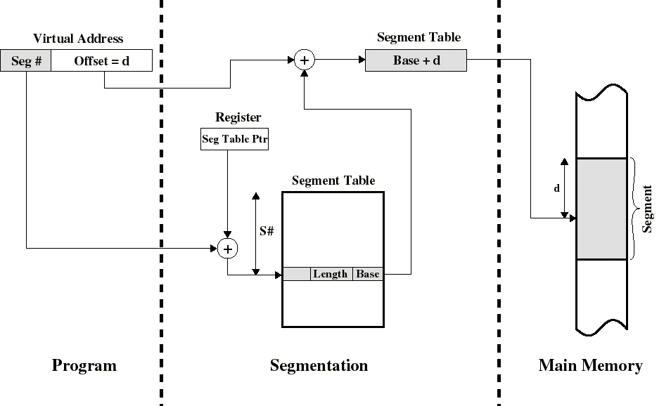
Address Translation in Segmentation
(See also Figure 9.18)
Disp = d

Slide 11
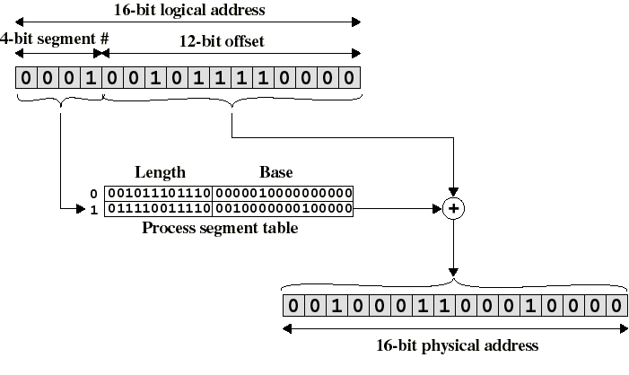
Logical-to-Physical Address Translation in Segmentation
displacement

Slide 12
Sharing in Segmentation Systems
The segment tables of 2 different processes can point to the same physical locations
Example: one shared copy of the the code segment for the text editor
Each user still needs its own private data segment
more logical than sharing pages

Slide 13
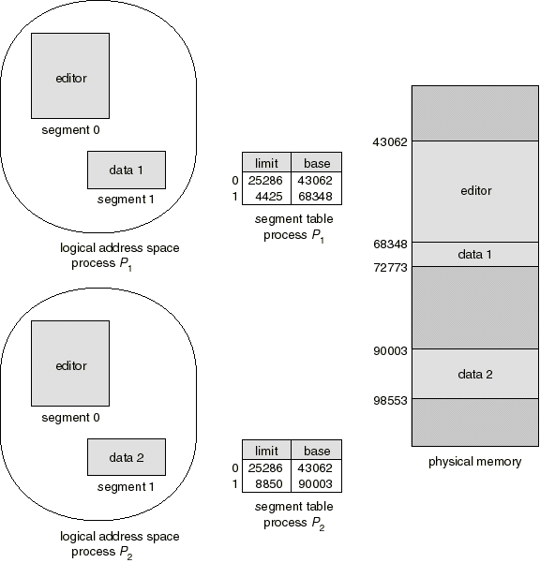
Segment Sharing: Text Editor Example

Slide 14
Evaluation of Simple Segmentation
Advantage: memory allocation unit is a logically natural view of program
  Segments can be loaded individually on demand (dynamic linking).
  Natural unit for protection purposes
  No internal fragmentation
Disadvantage: same problems as dynamic partitioning.
  External fragmentation
  Unlike paging, it is not transparent to programmer
  No simple relationship between logical and physical address

Slide 15
Combined Segmentation and Paging
Combines advantages of both
Several combinations exist. Example:
  Each process has:
    one segment table
    one page table per segment
  Virtual address consists of:
    segment number: index the segment table to get starting address of the page table for that segment
    page number: index that page table to obtain the physical frame number
    offset: to locate the word within the frame
Segment and page tables can themselves be paged

Slide 16
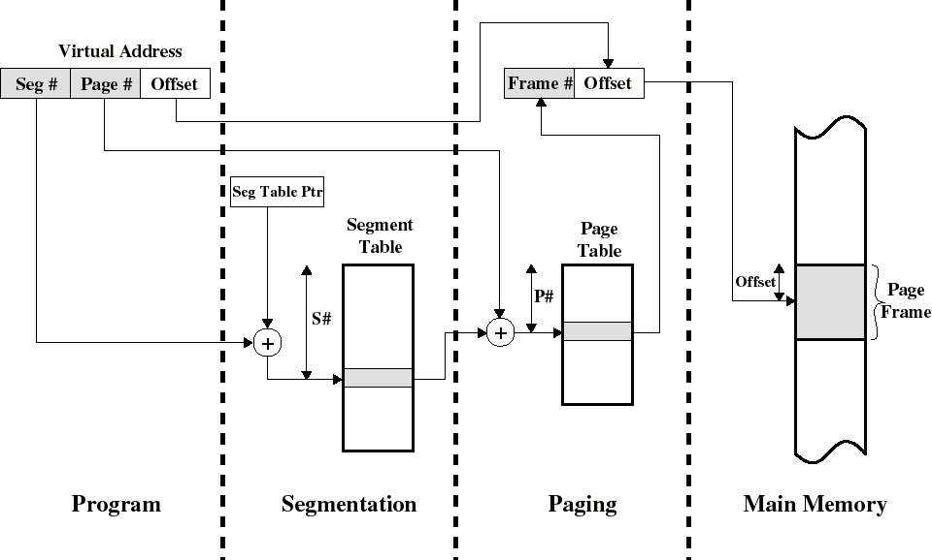
Address Translation in Combined Segmentation/Paging System(see also Fig 9.21)

Slide 17
Advantages of Segmentation + Paging
Solves problems of both loading and linking.
  Linking a new segment amounts to adding a new entry to a segment table
Segments can grow without having to be moved in physical memory (just map more pages!)
Protection and sharing can be done at the ‘logical’ segment level.

