Slide 1
Virtual Memory
Chapter 10
Sections 10.1 - 10.3.1
and 10.4 - 10.6
plus 10.8.1
(Skip: 10.3.2, 10.7, rest of 10.8)

Slide 2
Observations on Paging and Segmentation
Memory references are dynamically translated into physical addresses at run time
A program may be broken up into small pieces (pages or segments) that do not need to be located contiguously in main memory
Provided that the portion of a program currently being executed is in memory, it is possible for execution to proceed, at least for a time.
So it is possible to execute a program that is not entirely loaded in memory.
  computation may proceed for some time if enough of the program is in main memory

Slide 3
Locality of Reference and Memory Hierarchy
" A program spends 90% of its execution time in 10% of its code."
Temporal Locality: Recently accessed items in memory are
likely to be accessed again soon.
Spatial Locality: Items with addresses that are close are
likely to be accessed at about the same
time.
You could keep that critical 10% of the code in memory and the other 90% on disk, and most of the time the code the CPU needs would be in memory
CPU
Disk
Memory

Slide 4
Locality and Virtual Memory
Memory references within a process tend to cluster.
So only a few pieces of a process are actually needed in memory at a particular time.
  the rest can be kept on disk
We just need to be able to deal with the case when the program tries to access a page that is not resident in memory.
Now, since only a portion of a process needs to be resident in memory at a time, it is no longer necessary for the entire process to fit in main memory.

Slide 5
Program Execution with Virtual Memory
At process startup, the loader only brings into memory the page that contains the entry point
Each page table entry has a present bit that is set only if the corresponding piece is in main memory
A special interrupt (page fault) is generated if the processor references a memory page that is not in main memory
Whenever we reference a page not in memory, the OS responds to the page fault and brings in the missing page from disk
This is “demand paging”
We call that portion of the process’ address space that is in main memory the resident set

Slide 6
New Format of Page Table
present bit:
1 if in main memory,
0 if not in main memory
If page in main memory,
this is a main memory address
otherwise it is a secondary memory address
Address
Present
Bit

Slide 7
Page Fault Handling
OS places the faulted process in a Blocked state
OS issues an I/O Read request to bring the needed page into main memory
  (another process can be dispatched to run while the read takes place)
an I/O interrupt is generated when the Read completes
  the OS updates the page table and places the faulted process in the ready state

Slide 8

Handling a Page Fault

Slide 9
Advantages of Partial Loading
More processes can be in execution
  Only load portions of each process
  With more processes in memory, it is less likely for them all to be blocked at once
A process can now execute even if its logical address space is much larger than the main memory size
  one of the most fundamental restrictions in programming is lifted.

Slide 10
Support for Virtual Memory
We need memory management hardware that must support paging and/or segmentation
And the OS must manage the movement of pages between secondary storage and main memory
We’ll look at the hardware issues first

Slide 11
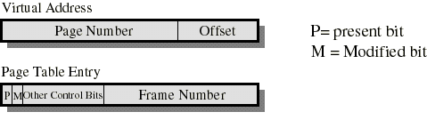
Page Table Entries
Typically, each process has its own page table
Present bit already described.
Modified bit: Indicates if the page has been altered since it was last loaded
  If it has not been changed, it does not have to be written to secondary memory if it is swapped out
Other control bits:
  read-only/read-write bit
  protection level bit: kernel page or user page, etc.

Slide 12
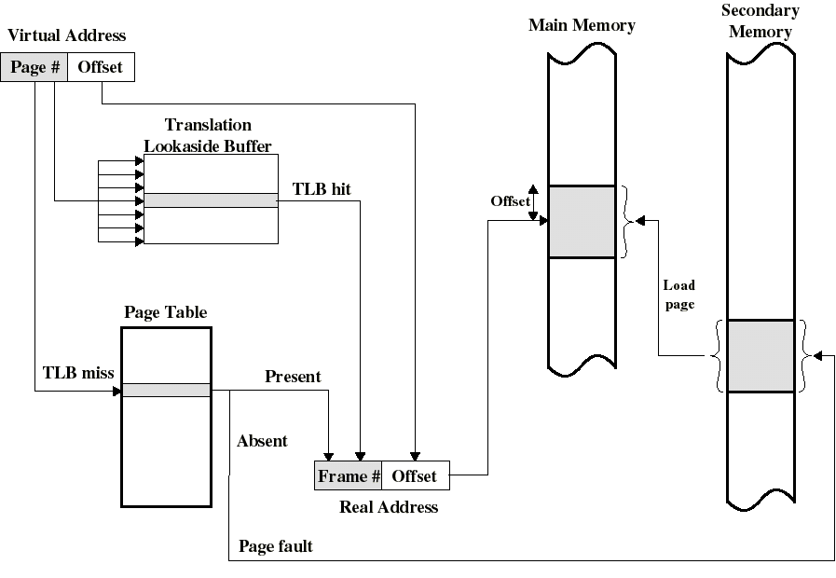
Paging With Translation Lookaside Buffer
Frame
Frame

Slide 13
Support for Virtual Memory
The OS must manage the movement of pages between secondary storage and main memory
Need algorithms to decide how many frames to allocate per process,
to decide when to bring new pages in (Fetch Policy)
and to decide which frames to “bump” when we bring in new pages (Replacement Policy)

Slide 14
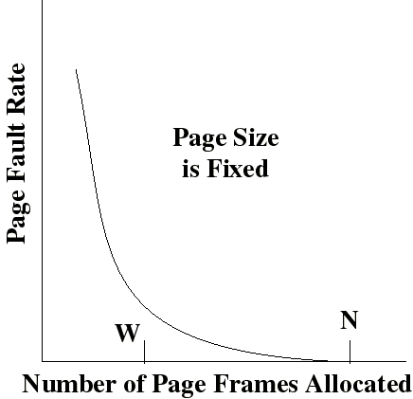
Page Fault Rate and Resident Set Size
Page Fault Rate depends on the number of frames (W) allocated for process
High if too few pages available
Page fault rate drops as W increases
Page fault rate is zero when working set holds entire process is in memory
W = Resident Set
N = Frames in process

Slide 15

Belady’s anomaly
For some page replacement algorithms, the page-fault rate may increase as the number of allocated frames increases.

Slide 16
Replacement Policy
When memory frames are occupied, and a new page must be brought in to satisfy a page fault:
  Which other page gets bumped to make room?
Not all pages in main memory can be selected for replacement
Some frames are locked (cannot be paged out):
  much of the kernel is held in locked frames as well as key control structures and I/O buffers

Slide 17
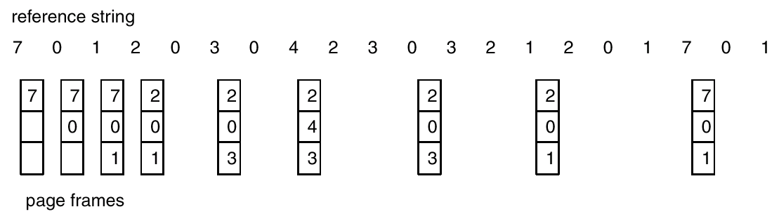
Optimal Page Replacement Algorithm
Replace page that will not be used for longest period of time.
Reference string:
  70120304230321201701
6 page faults

Slide 18
Is it really optimal?
Results in the fewest page faults
No problem with Belady’s anomaly
But…
  Wickedly hard to implement (need to know the future)
Serves as a standard to compare with other algorithms:
    Least Recently Used (LRU)
    First-In, First-Out (FIFO)
    LRU Approximations such as Clock (“Second Chance”)

Slide 19
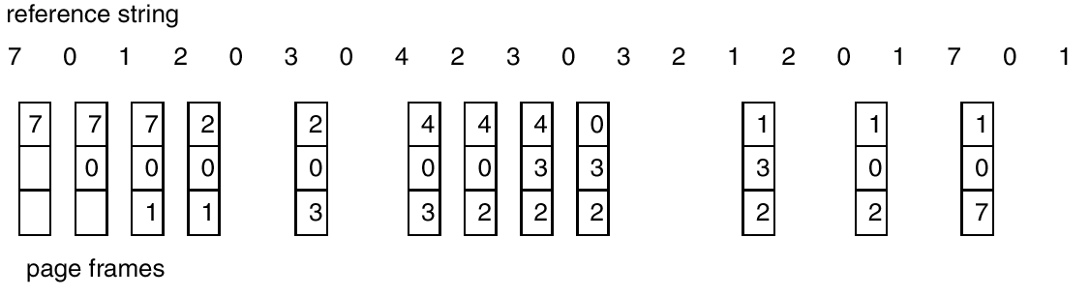
The LRU Policy
Replaces the page that has not been referenced for the longest time in the past
  By the principle of locality, this would be the page least likely to be referenced in the near future
9 Page faults

