Slide 1
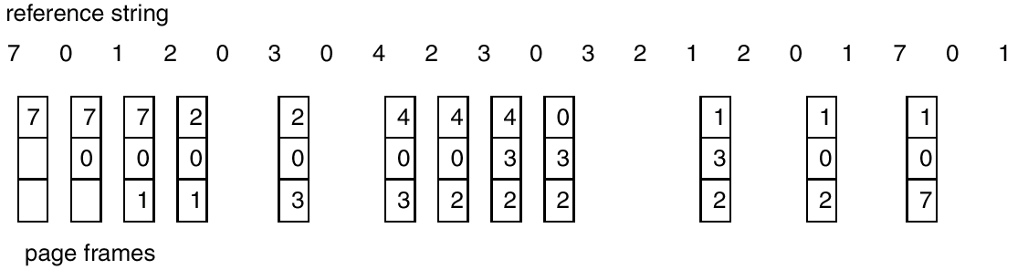
The LRU Policy
Replaces the page that has not been referenced for the longest time in the past
  By the principle of locality, this would be the page least likely to be referenced in the near future
9 Page faults

Slide 2
LRU Algorithm (Cont.)
Counter implementation
  Every page entry has a counter; every time page is referenced through this entry, copy the clock into the counter.
  When a page needs to be changed, look at the counters to determine which should be the victim.
Stack implementation – keep a stack of page numbers in a double link form:
  Page referenced:
    move it to the top
    requires 6 pointers to be changed
  No search for replacement

Slide 3
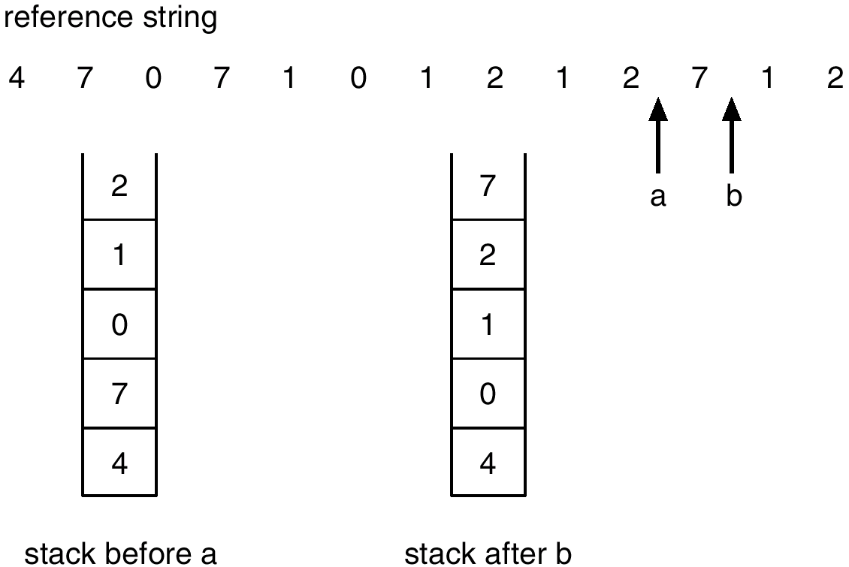
Use Of A Stack to Record The Most Recent Page References

Slide 4
Evaluation of LRU
Performs nearly as well as the optimal policy
But..
  Requires expensive hardware and table updates/lookups (at every memory reference):
  page replacement algorithms must be fast.
So true LRU replacement policy is seldom if ever used.
Approximation algorithms are used instead.

Slide 5
The FIFO Policy
Treats page frames allocated to a process as a circular buffer
  When the buffer is full, the oldest page is replaced. Hence: first-in, first-out
    Not necessarily the same as the LRU page

Slide 6
Evaluation of FIFO
Simple to implement
  requires only a pointer that circles through the page frames of the process as they are loaded
But…
    A frequently used page is often the oldest, so it will be repeatedly paged out by FIFO
    Suffers from Belady’s anomaly – increasing number of frames available doesn’t guarantee fewer page faults

Slide 7
Second Chance – LRU Approximation
Modified FIFO (circular queue with rotating pointer) but gives frames a “second chance”
A use bit for each frame is set to 1 whenever:
  a page is first loaded into the frame
  the corresponding page is referenced
When it is time to replace a page, replace the first frame encountered with a use bit of 0.
  During the search, frames with use bit=1 are skipped
  but we change the use bit to 0

Slide 8

Second-Chance Page-Replacement Algorithm

Slide 9
Comparison of 2nd Chance with LRU
Performance of 2nd Chance is close to that of LRU
Results depend on how many frames are allocated to each process
  If few (6 to 8) frames allocated per process, there is almost a factor of 2 of page faults between LRU and FIFO
  This factor reduces considerably when more than 12 frames are allocated. (But more main memory is needed)
Variation of Clock Algorithm on Macintosh uses multi-pass search giving priority to replacing pages which have not been modified: “Enhanced Second-Chance Algorithm”
  no need to write them back to disk before bumping)

Slide 10
Skip the Following Replacement Policies
10.4.5.1: Additional reference-bits
10.4.6: Counting-Based Replacement

