Slide 1
Cleaning Policy
When should a modified page be written out to disk?
Demand cleaning
  write page out only when its frame has been selected for replacement (the process that page faulted has to wait for 2 page transfers)
Precleaning
  modified pages are written in batches before their frames are needed
    but some of these pages get modified a second time before their frames are needed.
Page Buffering turns out to be a better approach

Slide 2
Page Buffering
Use simple replacement algorithm such as FIFO, but pages to be replaced are kept in main memory for a while
Two lists of pointers to frames selected for replacement:
  free page list of frames not modified since brought in (no need to swap out)
  modified page list for frames that have been modified (will need to write them out)
A frame to be replaced has its pointer added to the tail of one of the lists and the present bit is cleared in the corresponding page table entry
  but the page remains in the same memory frame

Slide 3
Page Buffering (cont.)
On a page fault the two lists are examined to see if the needed page is still in main memory
  If it is, we just need to set the present bit in its page table entry (and remove it from the replacement list)
  If it is not, then the needed page is brought in and overwrites the frame pointed to by the head of the free frame list (and then removed from the free frame list)
When the free list becomes empty, pages on the modified page list are written out to disk in clusters to save I/O time, and then added to the free page list

Slide 4
Resident Set Management
(Allocation of Frames, 10.5)
The OS must decide how many frames to allocate to each process
  allocating small number permits many processes in memory at once
  too few frames results in high page fault rate
  too many frames/process gives low multiprogramming level
  beyond some minimum level, adding more frames has little effect on page fault rate

Slide 5
Resident Set Size
Fixed-allocation policy
  allocates a fixed number of frames to a process at load time by some criteria
    e.g. Equal allocation or proportional allocation
    on a page fault, must bump a page from the same process
Variable-allocation policy
  the number of frames for a process may vary over time
    increase if page fault rate is high
    decrease if page fault rate is very low
  requires OS overhead to assess behavior of active processes

Slide 6
Replacement Scope
The set of frames to be considered for replacement when a page fault occurs
Local replacement policy
  choose only among frames allocated to the process that faulted
Global replacement policy
  Any unlocked frame in memory is candidate for replacement
  High priority process might be able to select frames among its own frames or those of lower priority processes

Slide 7
Comparison
Local:
  Might slow a process unnecessarily as less used memory not available for replacement
Global:
  Process can’t control own page fault rate – depends also on paging behaviour of other processes (erratic execution times)
  Generally results in greater throughput
  More common method

Slide 8
Thrashing
If a process has too few frames allocated, it can page fault almost continuously
If a process spends more time paging than executing, we say that it is thrashing, resulting in low CPU utilization

Slide 9
Potential Effects of Thrashing
The scheduler could respond to the low CPU utilization by adding more processes into the system
  resulting in even fewer pages per process,
  this causes even more thrashing, in a vicious circle
  leads to to a state where the whole system is unable to perform any work.
The working set strategy was invented to deal effectively with this phenomenon to prevent thrashing.

Slide 10
Locality Model of Process Execution
A Locality is a set of pages that are actively used together
As a process executes, it moves from locality to locality
  Example: Entering a subroutine defines a new locality
Programs generally consist of several localities, some of which overlap

Slide 11
Working Set Model
Define:
Δ ≡ working-set window ≡ some fixed number of page references
W(Δ,t)_{i} (working set of Process P_{i}) =
total number of pages referenced in the most recent Δ (varies in time)
  if Δ too small will not encompass entire locality.
  if Δ too large will encompass several localities.
  if Δ = ∞ ⇒ will encompass entire program.

Slide 12
The Working Set Strategy
When a process first starts up, its working set grows
then stabilizes by the principle of locality
grows again when the process shifts to a new locality (transition period)
  up to a point where the working set contains pages from two localities
Then decreases (stabilizes) after it settles in the new locality

Slide 13
Working Set Policy
Monitor the working set for each process
Periodically remove from the resident set those pages not in the working set
If resident set of a process is smaller than its working set, allocate more frames to it
  If enough extra frames are available, a new process can be admitted
  If not enough free frames are available, suspend a process (until enough frames become available later)

Slide 14
The Working Set Strategy
Practical problems with this working set strategy
  measurement of the working set for each process is impractical
    need to time stamp the referenced page at every memory reference
    need to maintain a time-ordered queue of referenced pages for each process
  the optimal value for Δ is unknown and time varying
Solution: rather than monitor the working set, monitor the page fault rate

Slide 15
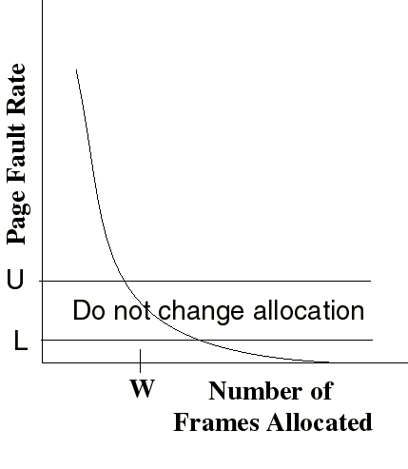
The Page-Fault Frequency (PFF) Strategy
Define an upper bound U and lower bound L for page fault rates
Allocate more frames to a process if fault rate is higher than U
Allocate fewer frames if fault rate is < L
The resident set size should be close to the working set size W
Suspend a process if the PFF > U and no more free frames are available
Add frames
Decrease frames

Slide 16
Other Considerations
Prepaging
  On initial startup
  When process is unsuspended
  Advantageous if cost of prepaging is < cost of page faults

Slide 17
Other Considerations
Page size selection
  Internal fragmentation on last page of process
    Large pages => more fragmentation
  Page table size
    Small pages => large page table size
  I/O time
    Latency and seek times dwarf transfer time (1%)
    Large pages => less I/O time
  Locality
    Smaller pages => better resolution of locality
    But more page faults
Trend is to larger page sizes

Slide 18
Other Considerations (Cont.)
TLB Reach - The amount of memory accessible from the TLB.
TLB Reach = (TLB Size) X (Page Size)
Ideally, the working set of each process is stored in the TLB. Otherwise there is a high degree of page faults.

Slide 19
Increasing the Size of the TLB
Increase the Page Size. This may lead to an increase in fragmentation as not all applications require a large page size.
Provide Multiple Page Sizes. This allows applications that require larger page sizes the opportunity to use them without an increase in fragmentation.

Slide 20
Other Considerations (Cont.)
Program structure
  int A[][] = new int[1024][1024];
  Each row is stored in one page
  Program 1 for (j = 0; j < A.length; j++)
  for (i = 0; i < A.length; i++)
  A[i,j] = 0;
  1024 x 1024 page faults
  Program 2 for (i = 0; i < A.length; i++)
  for (j = 0; j < A.length; j++)
  A[i,j] = 0;
  1024 page faults

Slide 21
Other Considerations (Cont.)
I/O Interlock – Pages must sometimes be locked into memory.
Consider I/O. Pages that are used for copying a file from a device to user memory must be locked from being selected for eviction by a page replacement algorithm.

Slide 22
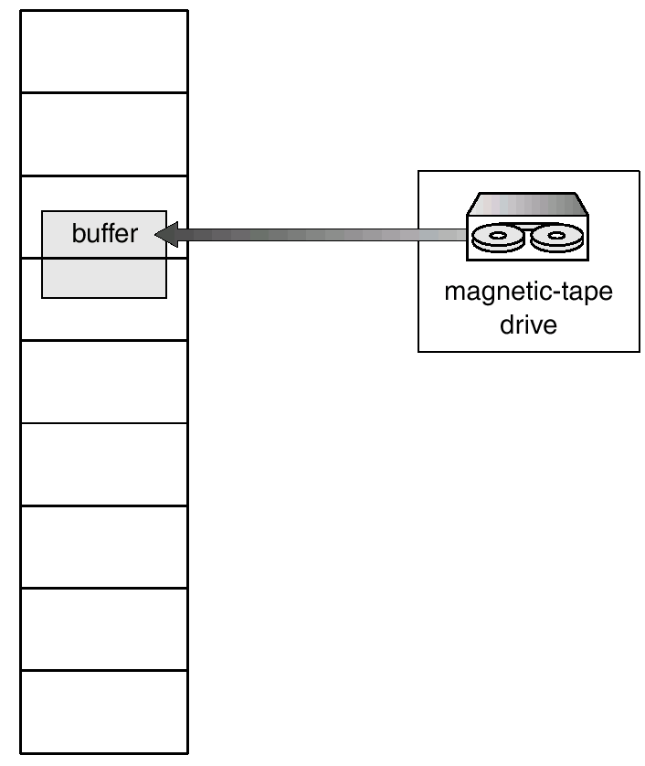
I/O Interlock
Alternative: Could also copy from disk to system memory, then from system memory to user memory, but higher overhead

