Slide 1
Chapter 11: File-System Interface
File Concept
Access Methods
Directory Structure
File System Mounting
File Sharing
Protection
Chapter 12: File System Implementation

Slide 2
File Concept
Contiguous logical address space
Types:
  Data
    numeric
    character
    binary
  Program

Slide 3
File Structure
None - sequence of words, bytes
Simple record structure
  Lines
  Fixed length
  Variable length
Complex Structures
  Formatted document
  Relocatable load file
Can simulate last two with first method by inserting appropriate control characters.
Who decides:
  Operating system
  Program

Slide 4
File Attributes
Name – only information kept in human-readable form.
Identifier - A tag which identifies file uniquely on device
Type – needed for systems that support different types.
Location – pointer to file location on device.
Size – current file size.
Protection – controls who can do reading, writing, executing.
Time, date, and user identification – data for protection, security, and usage monitoring.
Information about files are kept in the directory structure, which is maintained on the disk.

Slide 5
File Operations
Create (allocate space, make entry in directory)
Write (search directory for location of file, maintain write pointer to the location w/in file where next write is to occur)
Read (specify file name and where in memory to place next block of file, maintain read pointer)
Reposition within file/file seek (set current file position)
Delete (search directory, release file space, erase directory entry

Slide 6
File Operations
Truncate (erase contents, but keep attributes – file length reset to 0, file space released)
Open(F_{i}) – search the directory structure on disk for entry F_{i}, and move the content of directory entry to memory.
Close (F_{i}) – move the content of entry F_{i} in memory to directory structure on disk.

Slide 7

File Types – Name, Extension

Slide 8
Access Methods
Sequential Access
  Automatically advances file pointer
read next
write next
reset
Direct Access
  File has fixed length logical records
  Can read and write records in no particular order
read n
write n
(could also position to n
read next
write next )
rewrite n
n = relative block number

Slide 9

Simulation of Sequential Access on a Direct-access File

Slide 10

A Typical File-system Organization
Each partition contains information about it in the device directory

Slide 11
Information in a Device Directory
Name
Type
Address
Current length
Maximum length
Date last accessed (for archival)
Date last updated (for dump)
Owner ID (who pays)
Protection information (discuss later)

Slide 12
Operations Performed on Directory
Search for a file
Create a file
  Allocate space, make directory entry
Delete a file
  Free file space and remove directory entry
List a directory
Rename a file
  Affects only the directory
Traverse the file system
  Backup, etc.

Slide 13
Organize the Directory (Logically) to Obtain:
Efficiency – locating a file quickly.
Naming – convenient to users.
  Two users can have same name for different files.
  The same file can have several different names.
Grouping – logical grouping of files by properties, (e.g., all Java programs, all games, …)

Slide 14

Single-Level Directory
A single directory for all users.
Naming problem
Grouping problem

Slide 15

Two-Level Directory
Separate directory for each user.
Path name
Can have the same file name for different user
Efficient searching
No grouping capability (beyond grouping per user)

Slide 16

Tree-Structured Directories

Slide 17
Tree-Structured Directories (Cont.)
Efficient searching
Grouping Capability
Current directory (working directory)
  cd /spell/mail/prog
  type list

Slide 18
Tree-Structured Directories (Cont.)
Absolute or relative path name
Creating a new file is done in current directory.
Delete a file
rm <file-name>
Creating a new subdirectory is done in current directory.
  mkdir <dir-name>
Example: if in current directory /mail
mkdir count
mail
prog
copy
prt
exp
count
Deleting “mail” ⇒ deleting the entire subtree rooted by “mail”.

Slide 19
File System Mounting
A file system must be mounted before it can be accessed.
OS given name of device and location w/in file structure at which to attach the file system (mount point).
  Usually an empty directory
  But could also mount in a directory with other files
    Usually “hides” the existing files if happens

Slide 20
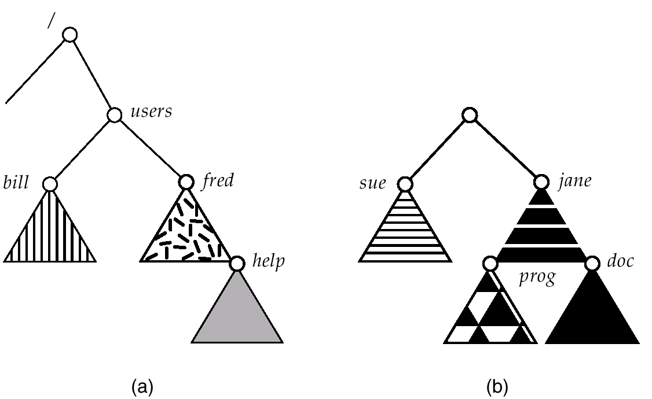
(a) Existing. (b) Unmounted Partition
Unmounted file system
What if we mounted this file
system at /users?

Slide 21
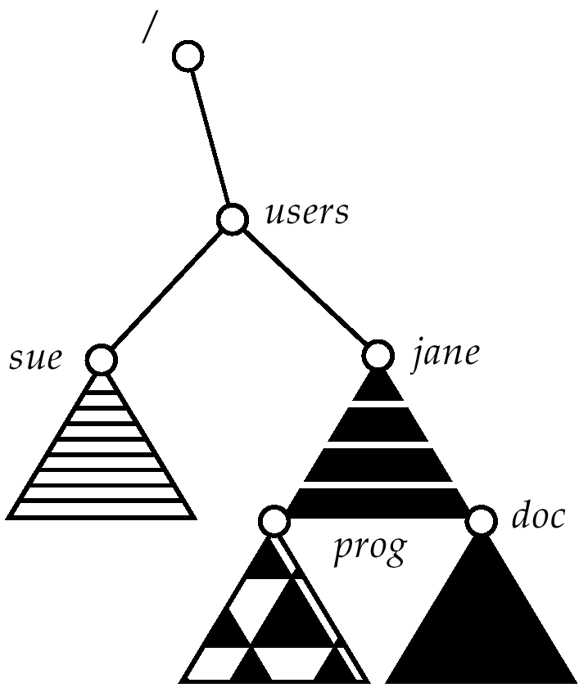
Mount Point
Mounted at /users.
Masked previous contents of /users
Old state restored when unmounted

Slide 22
Mounting File Systems in Other OS’s
Some operating systems are less flexible than Unix
And will only mount files systems at the “top level”
  Windows:
    A:, B:, C:, etc
    Automatically discovers devices and mounts all located file systems at boot time.

Slide 23
File Sharing
Sharing of files (between users) on multi-user systems is desirable.
Sharing may be managed through a protection scheme.
On distributed systems, files may be shared across a network.
Network File System (NFS) is a common distributed file-sharing method.

Slide 24
Protection
File owner/creator should be able to control:
  what can be done
  by whom
Types of access
  Read
  Write
  Execute
  Append
  Delete
  List

Slide 25
Access Lists and Groups
Mode of access: read, write, execute
Three classes of users
RWX
a) owner access 7 ⇒ 1 1 1
RWX
b) group access 6 ⇒ 1 1 0
RWX
c) public access 1 ⇒ 0 0 1
Ask system manager to create a group (unique name), say G, and add some users to the group.
For a particular file (say game) or subdirectory, define an appropriate access.
owner
group
public
chmod
761
game
Attach a group to a file
chgrp G game

