Slide 1
Chapter 12: File System Implementation
File System Structure
File System Implementation
Directory Implementation
Allocation Methods
Free-Space Management
Unix File System, Inodes, etc.

Slide 2

Moving-Head Disk Mechanism

Slide 3
Disk Addressing
Fundamental unit (block) of information is the sector (generally a power of 2 in size)
Sectors are arranged on tracks on a platter
If multiple platters, we organize the tracks into cylinders
We may also organize groups of cylinders to make partitions
File systems work in terms of logical blocks
  So one lower level issue on mass storage devices is the mapping of logical block address to physical blocks
    Platter #, Cylinder # (Track #), Sector #

Slide 4
File-System Structure
File structure
  Logical storage unit
  Collection of related information
  Sequential access, or
  Random (“direct”) access
    i.e. Selective access to individual records/blocks
Several on-disk and in-memory structures are used to implement a file system
File system organized into layers.

Slide 5

Layered File System
Manages meta date about files, file organization, directory structure, file control blocks, etc.
Mapping of logical block# (0..n) to physical block# (sector, track #, etc), free space mgmt
Issues generic commands to device drive to R/W physical blocks on disk
Device drivers, interrupt service routines, etc

Slide 6
On-disk structures
Boot control block (boot block/partition boot sector) contains info needed to boot OS from that partition. Can be empty if disk does not contain OS.
Partition control block (superblock, Master File Table) contains partition details such as: # blocks in partition, size of blocks, free-block count, free-block pointer, free FCB count and pointers
A directory structure is used to organize the files

Slide 7

File Control Block
A storage structure consisting of information about a file.
In UFS called an inode, in NTFS is stored w/in the Master File Table
(access control list)
(i.e. pointer(s) to data blocks)

Slide 8
In-memory structures
In-memory partition table containing info about each mounted partition
In-memory directory structure contains info of recently accessed directories
System-wide open-file table contains copy of FCB of each open file & other info
Per-process open-file table contain a pointer to entry in system-wide open file table & other info

Slide 9

In-Memory File System Structures
Opening
A file
Reading
A file

Slide 10
Virtual File Systems
Virtual File Systems (VFS) provide an object-oriented way of implementing file systems.
VFS allows the same system call interface (the API) to be used for different types of file systems.
  e.g. hard drives, floppy disk, CD, Network
The API is to the VFS interface, rather than any specific type of file system.

Slide 11
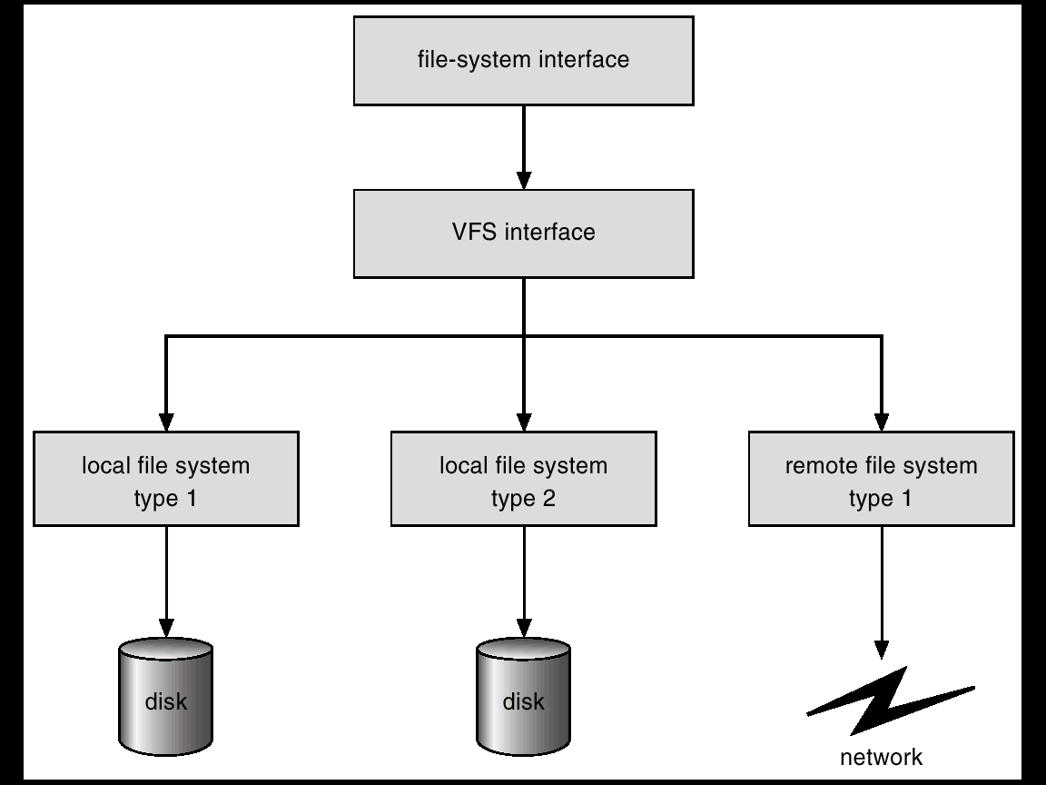
Schematic View of Virtual File System

Slide 12
Directory Implementation
Linear list of file names with pointers to the data blocks.
  simple to program
  Slow search if many files
Hash Table – linear list with hash data structure.
  Hash table takes value created from file name and returns ptr to to the file name in the linear list
  decreases directory search time
  collisions – situations where two file names hash to the same location
  fixed size

Slide 13
Allocation Methods
An allocation method refers to how disk blocks are allocated for files:
  Contiguous allocation
  Linked allocation
  Indexed allocation
For these approaches we regard the file system blocks to be numbered sequentially 0..n
  Mapping to track and sector # done at a lower level

Slide 14
Contiguous Allocation
Each file occupies a set of contiguous blocks on the disk.
Simple – only starting location (block #) and length (number of blocks) are required.
Supports sequential and direct access
Wasteful of space
  dynamic storage-allocation problem (set of holes), external fragmentation
Files cannot easily grow.

Slide 15

Contiguous Allocation of Disk Space

Slide 16
Extent-Based Systems
Some newer file systems (e.g. Veritas File System) use a modified contiguous allocation scheme.
Extent-based file systems allocate disk blocks in extents.
An extent is a contiguous block of disks. Extents are allocated for file allocation. A file consists of one or more extents.
Can add extents over time.
Large extents can lead to internal fragmentation

Slide 17
Linked Allocation
Each file is a linked list of disk blocks: blocks may be scattered anywhere on the disk.
4 bytes?
block =
pointer

Slide 18
Linked Allocation (Cont.)
Simple – need only starting address
Free-space management system – no waste of space (linked list of free blocks, too)
Sequential access easy (keep following the chain)
Random access difficult (must step through linked blocks, many disk accesses along the way)

Slide 19

Linked Allocation

Slide 20

File-Allocation Table (DOS, others)
Section of disk at start of partition
Table with one entry per disk block
Indexed by block#
Each entry contains link to next block
Special code for EOF
“0” means empty block

Slide 21
File Allocation Table
Removes link pointer from blocks themselves
FAT can be cached in memory for quick access
Better support for random access
  Can find block quickly by traversing the table
  Don’t need to access all the blocks on the way
Easy to find empty blocks, and to extend files

