Slide 1
Memory Management
Chapter 9
Review of process from source to executable (linking, loading, addressing)
General discussion of memory management issues and requirements
Physical and virtual memory
Fixed and dynamic partitioning
Paging
Segmentation

Slide 2
From Source to Executable
Machine
memory
source
program
foo.c
object
modules
foo.o
other
programs
...
main
sub1
data
printf
exit
data
other
...
...
kernel
main()
sub1()
data
main
sub1
data
load
module
a.out
?
Compiler
main
sub1
data
printf
exit
data
(system
calls)
static
library
libc.a
(Run Time)
Loader
printf
scanf
gets
fopen
exit
data
...
Linkage
Editor
“Load time”
Dynamic library case not shown

Slide 3
Linking and Loading
Linking. Bind together the different parts of a program in order to make them into a runnable entity - Linkage editor
  static (before execution)
  dynamic (on demand during execution)
Loading. Program is loaded into main memory, ready to execute. May involve address translation.
  Absolute, relocatable
  static, dynamic

Slide 4
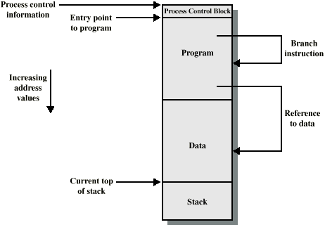
Addressing Requirements for a Process

Slide 5
Binding of Instructions and Data to Memory Addresses
Compile time: If memory location known a priori, absolute code can be generated; must recompile code if starting location changes.
Load time: If memory location is not known at compile time, compiler must generate relocatable code.
  Loader knows final location and binds addresses for that location
Execution time: If the process can be moved during its execution, binding must be delayed until run time. Need hardware support for address maps (e.g., base and limit registers).

Slide 6
Aspects of Loading
Finding free memory for load module: could be contiguous or not contiguous
Adjust addresses in program (if required) once it is known where module will be loaded

Slide 7
Addressing
Relative address
Linker unifies all object files into a common single address space
Starts at 0
Absolute address
Actual memory address in real memory when loaded
2 choices
  Add a constant (size of OS) to all addresses
  Use reallocation

Slide 8
Memory Management
Management tasks carried out by the OS and hardware to accommodate multiple programs in main memory
  If only a few programs can be in main memory, then much of the time all processes will be blocked waiting for I/O and the CPU will be idle
  So our object is to allocate memory efficiently to pack as many programs into memory as possible

Slide 9
Memory Management
In most schemes, the kernel occupies some fixed portion of main memory
the rest of memory is shared by all the other programs

Slide 10

Swapping

Slide 11
Memory-Management Issues
Relocation
Protection
Sharing
Logical Organization
Physical Organization

Slide 12
Memory Management Requirements
Relocation
  Programmer cannot know where the program will be loaded in memory when it is executed
  A program may be relocated (often) in main memory due to swapping
  Memory references in code (for both instructions and data) must be translated to actual physical memory addresses

Slide 13
Memory Management Requirements
Protection
  Processes should not reference memory locations in another process without permission
  Cannot do this at compile time, because we do not know where the program will be loaded in memory
  address references must be checked at run time by hardware

Slide 14
Memory Management Requirements
Sharing
  must allow several processes to access a common portion of data or program without compromising protection
    cooperating processes may need to share access to the same data structure
    Program text can be shared by several processes executing the same program for a different user
      Saves memory over separate copy for each
      also applies to dynamic (sharable) libraries

Slide 15
Memory Management Requirements
Logical Organization
  Programs are written in modules
    code is usually execute-only (reentrant)
    data modules can be read-only or read/write
    References between modules must be resolved at run time
    Segmentation is one useful approach for all this
      but not the only approach

Slide 16
Memory Management Requirements
Physical Organization
  Memory hierarchy: (several types of memory: from slow and large to small and fast.)
  main memory for program and data currently in use, secondary memory is the long term store for swapping and paging
  moving information between levels of memory is a major concern of memory and file management (OS)
    should be transparent to the application programmer

Slide 17
Physical and Virtual Memory
Physical Memory: the actual main memory (RAM) of the computer
Virtual Memory: the address space as seen by a program: can be much larger (or much smaller) than the physical memory.
  We’ll look at virtual memory later…..

Slide 18
Simple Memory Management
We start with the case where a process image is projected in simple fashion on physical memory
  normally, this implies that the process image is smaller than physical memory and the program is fully loaded for execution (but see overlays)..
We will look at the following simple memory management techniques :
  fixed partitioning
  dynamic partitioning
  simple paging
  simple segmentation

Slide 19
Fixed Partitioning (Single Process)
If only one process allowed (e.g. MS-DOS):
  only one user partition
  and one for the OS
Not many decisions to make:
  program either fits or it doesn’t
I/O and
Interrupt vectors
“OperatingSystem”
(BIOS)
User space
640k

Slide 20
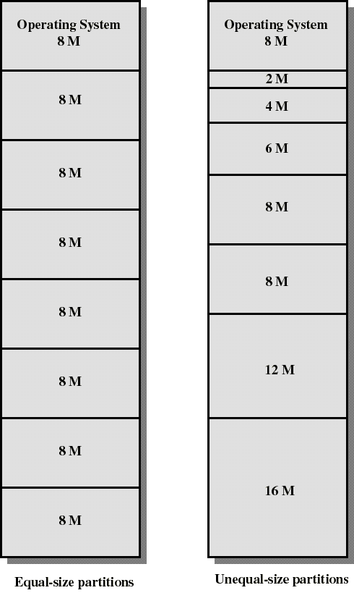
Fixed Partitioning
Partition main memory into a set of non overlapping regions called partitions
Partitions can be of equal or unequal sizes
..both pictures show partitioning of 64 M main memory

Slide 21
Fixed Partitioning
any program smaller than a partition can be loaded into the partition
if all partitions are occupied, the operating system can swap a process out of a partition to make room
a program may be too large to fit in a partition. The programmer would then use overlays:
  when a module needed is not present the user program must load that module into a part of the program’s partition, overlaying whatever program or data were there before

Slide 22
Overlays
Resident part
of the program
Partition
Swapped part
of the program

Slide 23
Fixed Partitioning
Main memory use is inefficient. Any program, no matter how small, occupies an entire partition.
  This leaves holes of unused memory inside the partitions: internal fragmentation.
Unequal-size partitions can help
  put small programs in small partitions
  but there will still be holes...
Equal-size partitions was used in early IBM’s OS/MFT (Multiprogramming with a Fixed number of Tasks)

Slide 24
Placement Algorithm with Partitions
Equal-size partitions
  If there is an available partition, a program can be loaded into that partition
    because all partitions are of equal size, it does not matter which partition is used
  If all partitions are occupied by blocked processes, choose one program to swap out to make room for a new program

Slide 25
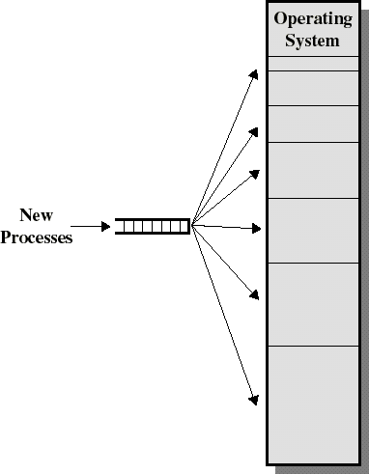
Placement Algorithm with Partitions
Unequal-size partitions: fed from a single queue
  When it is time to load a process into main memory the smallest available partition that will hold the program is selected
  increases the level of multiprogramming
    Does not eliminate internal fragmentation

