Slide 1
Deadlock is:
A set of blocked processes each holding a resource and waiting to acquire a resource held by another process in the set.
Example (hardware resources):
  System has 2 tape drives.
  P₁ and P₂ each hold one tape drive and each needs another one.
Example (“software” resource:):
  semaphores A and B, initialized to 1
        P₀ P₁
        wait (A); wait(B)
        wait (B); wait(A)
        signal(B); signal(A)
        signal(A); signal(B)

Slide 2
The (4) Conditions for Deadlock
There are three policy conditions that must hold for a deadlock to be possible (the “necessary conditions”):
Mutual Exclusion
  only one process at a time may use a resource
Hold-and-Wait
  a process may hold allocated resources while awaiting assignment of others
No Preemption
  a resource can be released only voluntarily by the process holding it, after that process has completed its task
..and a fourth condition which must actually arise to make a deadlock happen

Slide 3
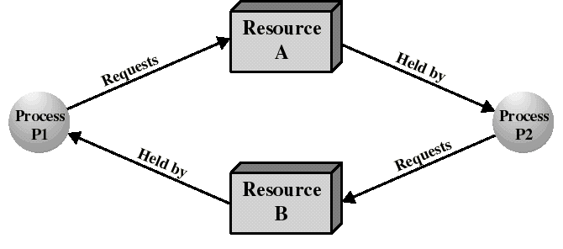
The Conditions for Deadlock
In the presence of these necessary conditions,one more condition must arise for deadlock to actually occur:
4. Circular Wait
  a closed chain of processes exists, such that each process holds at least one resource needed by the next process in the chain

Slide 4
The Conditions for Deadlock
Deadlock occurs if and only if the circular wait condition is unresolvable
The circular wait condition is unresolvable if the first 3 policy conditions hold
So the 4 conditions taken together constitute necessary and sufficient conditions for deadlock

Slide 5

Resource Allocation Graph:
A Cycle But No Deadlock
Multiple instances
of resources R₁
and R₂:
P₂ and P₄ can
complete, freeing
up resources for
P₁ and P₃

Slide 6
Approaches to Handling Deadlocks
Deadlock Prevention
  disallow 1 of the 3 necessary conditions of deadlock occurrence, or prevent the circular wait condition from happening
Deadlock Avoidance
  do not grant a resource request if this allocation might lead to deadlock
Deadlock Detection and Recovery
  grant resource requests when possible, but periodically check for the presence of deadlock and then take action to recover from it

Slide 7
Deadlock Avoidance
We accept the 3 policy conditions but make judicious choices to assure that the deadlock point is never reached
Allows more concurrency than prevention
Two approaches:
  do not start a process if its total demand might lead to deadlock: (“Process Initiation Denial”), or
  do not grant an incremental resource request if this allocation could lead to deadlock: (“Resource Allocation Denial”)
In both cases: maximum requirements of each resource must be stated in advance

Slide 8
Resource Allocation Denial
A Better Approach:
  Grant incremental resource requests if we can prove that this leaves the system in a state in which deadlock cannot occur.
  Based on the concept of a “safe state”
Banker’s Algorithm:
  Tentatively grant each resource request
  Analyze resulting system state to see if it is “safe”.
  If safe, grant the request
  if unsafe refuse the request (undo the tentative grant)
  block the requesting process until it is safe to grant it.

Slide 9
Data Structures for the Banker’s Algorithm
Let n = number of processes,
m = number of resource types
Available: Vector of length m. If Available [j] = k, there are k instances of resource type R_{j} currently available
Max: n x m matrix. If Max [i,j] = k, then process P_{i} will request at most k instances of resource type R_{j}.
Alloc: n x m matrix. If Alloc[i,j] = k then P_{i} is currently allocated (i.e. holding) k instances of R_{j.}
Need: n x m matrix. If Need[i,j] = k, then P_{i} may need k more instances of R_{j} to complete its task.
Need [i,j] = Max[i,j] – Alloc [i,j].

Slide 10
Safety Algorithm
Let Work and Finish be vectors of length m and n, respectively. Initialize:
  Work := Available
  Finish [i] == false for i = 1,2, …, n.
2. Find an i such that both:
  Finish [i] == false
  Need_{i} ≤ Work
  If no such i exists, go to step 4.
Work := Work + Allocation_{i}
(Resources freed when process completes!)
Finish[i] := true
go to step 2.
4. If Finish [i] = true for all i, then the system is in a safe state.

Slide 11
Resource-Request Algorithm for Process P_{i}
Request_{i} = request vector for P_{i} .
Request_{i} [j] = k means process P_{i} wants k instances of resource
type R_{j.}
  1. If Request_{i} ≤ Need_{i} go to step 2. Otherwise, error ( process exceeded its maximum claim).
  2. If Request_{i} ≤ Available, go to step 3. Otherwise P_{i} must wait, (resources not available).
  3. “Allocate” requested resources to P_{i} as follows:
Available := Available - Request_{i}
Alloc_{i} := Alloc_{i} + Request_{i}
Need_{i} := Need_{i} – Request_{i}
    If safe ⇒ the resources are allocated to P_{i}.
    If unsafe ⇒ restore the old resource-allocation state and block P_{i}

Slide 12
Example of Banker’s Algorithm
5 processes P₀ through P₄
3 resource types A (10 units), B (5 units), and C (7 units).
Snapshot at time T₀:
Allocation Max Available
A B C A B C A B C
P₀ 0 1 0 7 5 3 3 3 2
P₁ 2 0 0 3 2 2
P₂ 3 0 2 9 0 2
P₃ 2 1 1 2 2 2
P₄ 0 0 2 4 3 3

Slide 13
Example (cont)
Need = Max – Allocation
Need
A B C
P₀ 7 4 3
P₁ 1 2 2
P₂ 6 0 0
P₃ 0 1 1
P₄ 4 3 1
The system is in a safe state since the sequence < P₁, P₃, P₄, P₂, P₀> satisfies safety criteria.

Slide 14
Now P₁ requests (1,0,2)
Check that Request ≤ Available
(that is, (1,0,2) ≤ (3,3,2)) ⇒ true.
Allocation Need Available
A B C A B C A B C
P₀ 0 1 0 7 4 3 2 3 0
P₁ 3 0 2 0 2 0
P₂ 3 0 2 6 0 0
P₃ 2 1 1 0 1 1
P₄ 0 0 2 4 3 1

