Slide 1
Deadlock Detection revisited

Slide 2
Message Passing
(see Section 4.5 in Processes Chapter)
A general method used for interprocess communication (IPC)
  for processes inside the same computer
  or different computer (distributed systems)
Yet another means to provide process synchronization and mutual exclusion
Requires existence of a communication link of some kind between the computers/processes

Slide 3
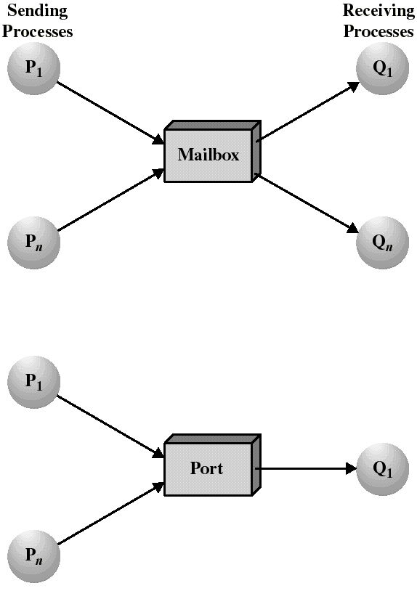
Indirect Communication
Messages are sent to/received from mailboxes (or ports)
Single mailbox shared by two (or more) processes
Send and receive primitives reference the mailbox (not the other process)
OS mechanism to create, delete mailbox
If owned by a process, owner can only read
  (others send to it)
(owned by OS)
(owned by Q₁)

Slide 4
Direct Communication (Symmetric)
Each end must name the recipient or sender of the message
  Send(P,message)
    send to process P
  Receive(Q,message)
    receive from process Q
Link established automatically
Exactly one link between any specific pair of processes

Slide 5
Direct Communication (Asymmetric)
With asymmetric addressing, only the sender needs to name the recipient
The receiver can receive from any process
  Send (P, message)
    send to process P
  Receive (id, message)
    receive from any process, sender identified by filling in “id”

Slide 6
Synchronization Variations
Blocking Send
  Sender blocked until receiver reads
Nonblocking Send
  Sender continues after send (most common form)
Blocking Receive
  Receiver blocks until message available (common form)
Nonblocking Receive
  Receiver gets either a message or a “null”
“Rendezvous”: blocking send + blocking receive
  Tight synchronization

Slide 7
Enforcing Mutual Exclusion with message passing
Create a mailbox mutex shared by n processes
Non-blocking send()
Blocking receive() (when mutex empty)
Initialization: send(mutex, msg);
First Pi to execute receive() enters CS. Others block until Pi resends msg.
Message is a “token”
Process Pi:
var msg: message;
repeat
receive(mutex,msg);
CS
send(mutex,msg);
RS
forever

Slide 8
Unix Pipes
A shared bounded FIFO queue written by one process and read by another
  based on the producer/consumer model
  OS enforces Mutual Exclusion: only one process at a time can access the pipe
  Producer blocks if not enough room to write
  Consumer blocks if reading from an empty pipe
  Accessed by a file descriptor, like an ordinary file
  Processes sharing pipe unaware of each other’s existence…

Slide 9
Low Level I/O
Low Level (numbered file descriptors)
  int open(char* name, int mode)
  int creat(char* name, int mode)
  int read(int filedes,char* buffer,int nbytes)
    (Raw Binary read, returns # of bytes read)
  int write(int filedes,char* buffer,int nbytes)
  Mode: O_RDONLY, O_WRONLY, O_RDWR, etc.
Binary, un-buffered operations
Standard shells create 3 file descriptors for processes they create: STDIN_FILENO, STDOUT_FILENO, STDERR_FILENO (0, 1, 2)
A forked child process inherits copies of all of the parent’s file descriptors

Slide 10
I/O Redirection
Every process normally has 3 file descriptors
  0 stdin
  1 stdout
  2 stderr
“wc <myfile” means to run “wc” so that when it reads from “0”(stdin) it really reads file “myfile”
To do this, after the fork() but before execv():
  infile = open (“myfile”, ------);
  dup2 (infile,0);
  --closes original “0” and
  --copies descriptor to “0”
  close(infile);
  -- original copy not needed..

Slide 11
Pipes
int fd[2];
if (pipe(fd) <0) perror (“Pipe failed”);
This creates a pipe with two ends:
fd[1] (write end)
fd[0] (read end)
If you fork() a child, the child will inherit a copy of fd[] with inherited copies of the two file descriptors to the pipe.
So if we have (in a shell, for example):
$ left_process | right_process
We want left_process(stdout) connected to the write end, and right_process(stdin) to the read end.

Slide 12
Pipes
(Shell)
pipe(fd);
fork()
(parent)
(child)
(left_process)
close(fd[0]);
dup2(fd[1],1);
close(fd[1]);
execv(.......)
(shell)
fork()
(parent)
(child)
(shell)
close(fd[0]);
close(fd[1]);
waitpid(left_process);
waitpid(right_process);
(right_process)
close(fd[1]);
dup2(fd[0],0);
close(fd[0]);
execv(.......)
Notice: after 2 forks, there are 6 (3*2) file descriptors to the pipe.
Each child closes the end it doesn’t need, and the parent closes
both ends after the forks, because it doesn’t use the pipe.
Then there are exactly 2 descriptors left open, one to each end...

Slide 13
Sockets
Like a bidirectional pipe
Can be on the same system (or not)
Don’t need a common ancestor
Web communications, ftp, use sockets
Communication across networks between processes

