Slide 1
Readers/Writers Problem
Multiple processes wanting to read an item, and one or more needing to write
  (Think of airline reservations…)
Rather than enforce mutual exclusion on every access, use these rules:
  Any number of readers can read simultaneously
  Only one writer at a time!
  No readers if a writer is writing

Slide 2
Readers/Writers Problem
“First readers/writers” problem (reader priority):
  No reader will wait (for other readers to finish) even if a writer is waiting
  Writer starvation possible
  Semaphore solution
“Second reader/writers” problem (writer priority):
  No new readers allowed once a writer has asked for access
  This solution will be discussed with monitors.

Slide 3
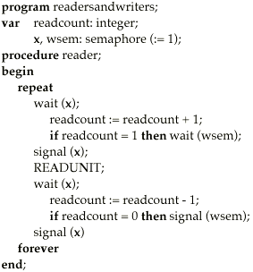
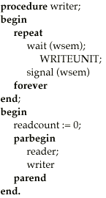
First Readers/Writers Problem
Priority to readers (writer starvation possible)

Slide 4
Notes: First Readers/Writers Solution
Semaphore “X” used only to protect the updating of readcount
First reader in must use wsem semaphore for mutual exclusion with the writer(s)
And last one out must signal wsem (indicates no more readers…)
But if another reader arrives too fast, the writer might get locked out again…

Slide 5
Conclusions on Semaphores
Semaphores provide a structured tool for enforcing mutual exclusion and coordinating processes.
Avoid busy wait, but not completely.
If used correctly, avoid deadlock and starvation.
But tricky to use
  if wait(S) and signal(S) are scattered among several processes it may be difficult to use them correctly
One bad process (unmatched wait, etc.) can fail the entire collection of processes, cause deadlock, starvation.

Slide 6
Up next…
Wednesday:
  mid-term
  Back in auditorim
Friday:
  For Assignment #3 (out on Friday) - interprocess communication (4.5, 4.6)
Monday:
  Finishing up concurrency with monitors (7.7)
Wednesday
  Deadlock (Ch. 8)

