Slide 1
Threads
Chapter 5

Slide 2
Process Characteristics
Concept of Process has two facets.
A Process is:
  A Unit of resource ownership:
    a virtual address space for the process image
    control of some resources (files, I/O devices...)
  A Unit of execution - process is an execution path through one or more programs
    may be interleaved with other processes
    execution state (Ready, Running, Blocked...) and dispatching priority

Slide 3
Process Characteristics
These two characteristics are treated separately by some recent operating systems:
  The unit of resource ownership is usually referred to as a process or task
  The unit of execution is usually referred to a thread or a “lightweight process”

Slide 4
Multithreading vs. Single threading
Multithreading: The OS supports multiple threads of execution within a single process
Single threading: The OS does not recognize the separate concept of thread
  MS-DOS supports a single user process and a single thread
  Traditional UNIX supports multiple user processes but only one thread per process
  Solaris and Windows 2000 support multiple threads

Slide 5
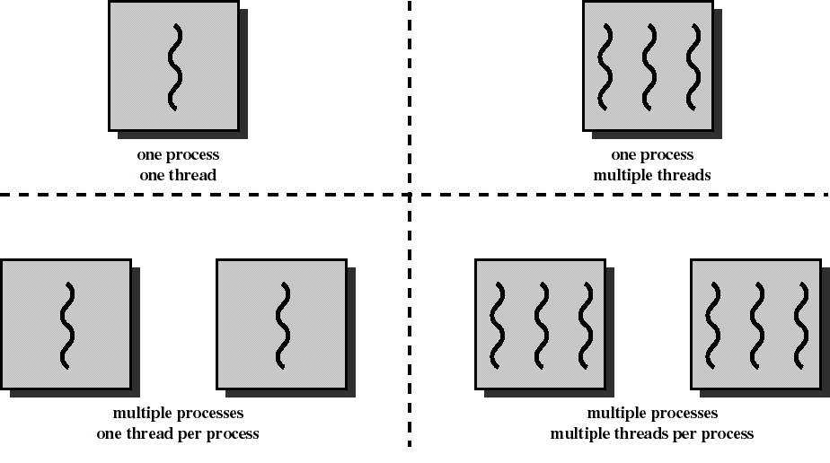
Threads and Processes
Single Threading
Multi-Threading

Slide 6
In a Multithreaded Environment, Processes Have:
A virtual address space which holds the process image
Protected access to processors, other processes (inter-process communication), files, and other I/O resources

Slide 7
While Threads...
Have execution state (running, ready, etc.)
Save thread context (e.g. program counter) when not running
Have private storage for local variables and execution stack
Have shared access to the address space and resources (files etc.) of their process
  when one thread alters (non-private) data, all other threads (of the process) can see this
  threads communicate via shared variables
  a file opened by one thread is available to others

Slide 8
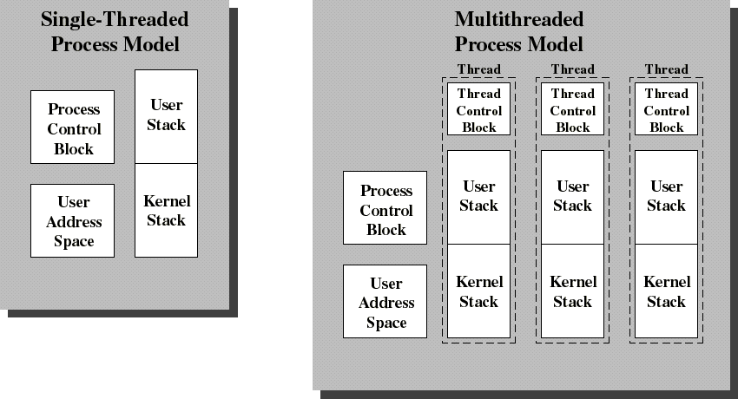
Single Threaded and Multithreaded Process Models
Thread Control Block contains a register image, thread priority and thread state information

Slide 9
Benefits of Threads vs Processes
Far less time to create a new thread than a new process
Less time to terminate a thread than a process
Less time to switch between two threads within the same process than to switch between processes
Threads can communicate via shared memory
  processes have to rely on kernel services for IPC

Slide 10
Application benefits of threads
Consider an application that consists of several independent parts that do not need to run in sequence
Each part can be implemented as a thread
Whenever one thread is blocked waiting for I/O, execution could switch to another thread of the same application (instead of switching to another process)

Slide 11
Benefits of Threads
Example 1: File Server on a LAN
  Needs to handle many file requests over a short period
  Threads can be created (and later destroyed) for each request
  If multiple processors: different threads could execute simultaneously on different processors
Example 2: Spreadsheet on a single processor machine:
  One thread displays menu and reads user input while the other executes the commands and updates display

Slide 12
Thread States
Three key states: Running, Ready, Blocked
No Suspend state because all threads within the same process share the same address space (same process image)
  Suspending implies swapping out the whole process, suspending all threads in the process
Termination of a process terminates all threads within the process
  Because the process is the environment the thread runs in

Slide 13
Thread Operations
Spawn:
Process starts with one thread. That thread can spawn another thread, placing the new thread on the Ready queue
Block (yield, suspend):
Save PC, registers, etc. and allow other thread(s) to run
Could “block” whole process if making system call which requires kernel service, otherwise it’s a single thread being suspended.
Unblock (wake):
IO finishes, or another relinquishes control, thread moves to Ready queue
Finish (terminate):
Deallocate context (stacks etc.)

Slide 14
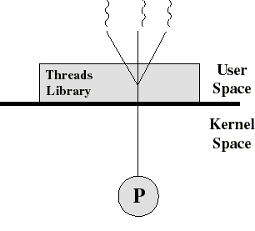
User-Level Threads (ULT) (ex. Java)
Kernel not aware of the existence of threads
Thread management handled by thread library in user space
No mode switch (kernel not involved)
But I/O in one thread could block the entire process!
“Many-to-One” model

Slide 15
Threads library
Contains code for:
  creating and destroying threads
  passing messages and data between threads
  scheduling thread execution
    pass control from one thread to another
  saving and restoring thread contexts
ULT’s can be be implemented on any Operating System, because no kernel services are required to support them

Slide 16
Kernel Role for ULTs (None!)
The kernel is not aware of thread activity
  it only manages processes
If a thread makes an I/O call, the whole process is blocked
  Note: in the thread library that thread is still in “running” state, and will resume execution when the I/O is complete
So thread states are independent of process states

Slide 17
Advantages and disadvantages of ULT
Advantages
Thread switching does not involve the kernel: no mode switching
Therefore fast
Scheduling can be application specific: choose the best algorithm for the situation.
Can run on any OS. We only need a thread library
Disadvantages
Most system calls are blocking for processes. So all threads within a process will be implicitly blocked
The kernel can only assign processors to processes. Two threads within the same process cannot run simultaneously on two processors

Slide 18
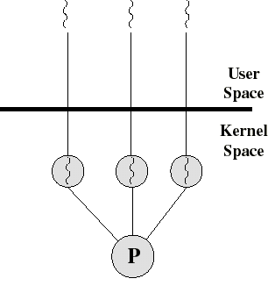
Kernel-Level Threads (KLT)
Ex: Windows NT, Windows 2000, OS/2
All thread management is done by kernel
No thread library; instead an API to the kernel thread facility
Kernel maintains context information for the process and the threads
Switching between threads requires the kernel
Kernel does Scheduling on a thread basis
“One-to-One” model

Slide 19
Advantages and disadvantages of KLT
Advantages
The kernel can schedule multiple threads of the same process on multiple processors
Blocking at thread level, not process level
  If a thread blocks, the CPU can be assigned to another thread in the same process
Even the kernel routines can be multithreaded
Disadvantages
Thread switching always involves the kernel. This means 2 mode switches per thread switch
So it is slower compared to User Level Threads
  (But faster than a full process switch)

Slide 20
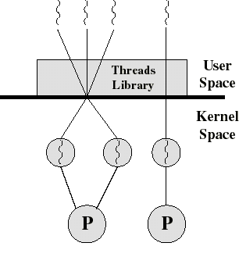
Combined ULT/KLT Approaches
(e.g. Solaris)
Thread creation done in the user space
Bulk of thread scheduling and synchronization done in user space
ULT’s mapped onto KLT’s
  The programmer may adjust the number of KLTs
KLT’s may be assigned to processors
Combines the best of both approaches
“Many-to-Many” model

Slide 21
Solaris
Process includes the user’s address space, stack, and process control block
User-level threads (threads library)
  invisible to the OS
  are the interface for application parallelism
Kernel threads
  the unit that can be dispatched on a processor
Lightweight processes (LWP)
  each LWP supports one or more ULTs and maps to exactly one KLT

Slide 22

Solaris Threads
“bound” thread
Task 2 is equivalent to a pure ULT approach ( = Old Unix)
Tasks 1 and 3 map one or more ULT’s onto a fixed number of LWP’s (&KLT’s)
Note how task 3 maps a single ULT to a single LWP bound to a CPU

Slide 23
Solaris: Kernel Level Threads
Only objects scheduled within the system
May be multiplexed on the CPU’s or tied to a specific CPU
Each LWP is tied to a kernel level thread

Slide 24
Solaris: User Level Threads
Share the execution environment of the task
  Same address space, instructions, data, file (any thread opens file, all threads can read).
Can be tied to a LWP or multiplexed over multiple LWPs
Represented by data structures in address space of the task – but kernel knows about them indirectly via LWPs

Slide 25
Solaris: versatility
We can use ULTs when logical parallelism does not need to be supported by hardware parallelism (we save mode switching)
  Ex: Multiple windows but only one is active at any one time
If ULT threads can block then we can add more LWPs to avoid blocking the whole application
Note versatility of SOLARIS that can operate like Windows-NT or like conventional Unix

Slide 26
Solaris: Light-Weight Processes
A UNIX process consists mainly of an address space and a set of LWPs that share the address space
Each LWP is like a virtual CPU and the kernel schedules the LWP by the KLT that it is attached to

Slide 27
Combination of ULT and KLT
Run-time library (RTL) ties together
Multiple threads handled by RTL
If 1 thread makes system call, LWP makes call, LWP will block, all threads tied to LWP will block
Any other thread in same task will not block.

Slide 28
Why both threads and LWPs?
Don’t want kernel to know about the ULTs
  if knows it has to allocate data structure for it and be involved in context switching among ULTs
  Lots of work, allocate instead to RTL
But kernel knows about LWPs and the ULTs can communicate with kernel through the LWPs

Slide 29
Trouble spots: Files
File descriptors are shared
Thread A opens file, all can read
Thread B closes file, all threads lose access
Read/write/seek – file only has 1 offset pointer, each read/write/seek changes position of OP for each thread

Slide 30
Trouble spots: Global variables
How to fix?
No global variables
  Not practical
  May not work if OS sets value
Keep private “globals” on a stack
  Thread library handles
Special library procedures to set and read global variables
  Thread library deals w/ errno’s and globals

Slide 31
Trouble spots: directory
Only one working directory for a process
  If 1 thread changes it, changed for entire process (all other threads)
Only 1 set of user and group Ids
  Every thread has equal access to all files and priviledges
    Potential security problems

