Slide 1
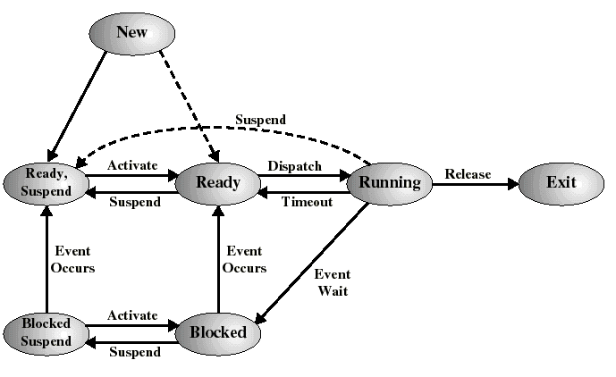
A Seven-State Process Model

Slide 2

CPU Switch From Process to Process
Silberschatz, Galvin, and Gagne©1999

Slide 3
Steps for Full Process Switch
Save context of CPU including program counter and other registers
Update the PCB of the running process with its new state and other info
Move PCB to appropriate queue
  Ready, Blocked, etc.
Select another process for execution
Update PCB of the selected process
  Running
Restore CPU context from PCB of the selected process

Slide 4
Execution of the Operating System
We have been thinking of a process as a “user process”
But OS itself is a collection of programs
  So is the OS a process (or processes) as well?
If so, how is it controlled?
The answer depends on the OS design.
There are variations:

Slide 5
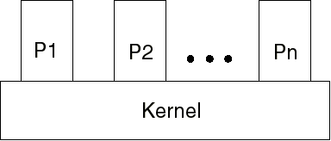
Non-process Kernel (traditional)
The concept of process applies only to user programs
OS code is a separate single entity all parts of which execute in privileged mode
OS code never gets executed within a process
  and is not considered to be a process either
  (no PCB for the OS, simple mode switch in and out)

Slide 6
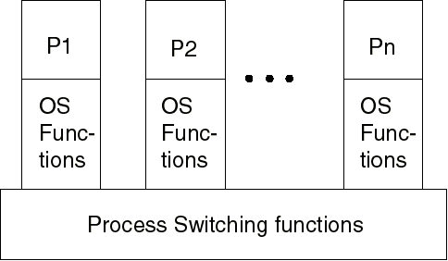
Execution within User Processes (smaller machines)
OS viewed as
collection of routines
called by user to
perform various
functions
Most OS code gets executed within the context of the user process
On Interrupts and Traps: CPU does a mode switch to kernel mode to execute OS routine within the user process
Control passes through process switching functions (outside processes) only when needed to switch to another process

Slide 7
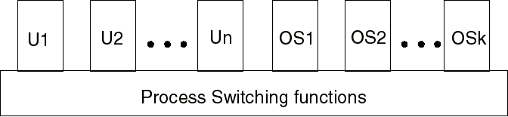
Process-based Operating System
The OS is a collection of system processes, outside of user’s address space
Each major kernel service is a separate process
Process switching functions (scheduler, etc.) are executed outside of any process
(Very modular approach…)

Slide 8
UNIX Process Management
Most of OS executes within user processes
Uses two categories of processes:
  System “processes”
    run in kernel mode for housekeeping functions (memory allocation, process swapping...)
  User processes
    run in user mode for user programs
    run in kernel mode for system calls, traps, and interrupts inside the user’s process image

Slide 9
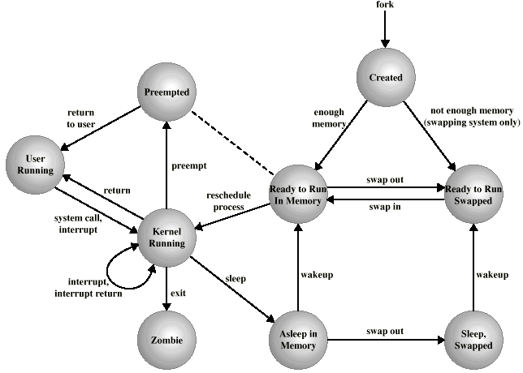
Unix Process State Transition Diagram
Preempted: returning to user mode,
but kernel schedules another process
Sleep = Blocked

Slide 10
Process Creation (Unix)

Slide 11
UNIX Process Creation
Every process, except process 0, is created by the fork() system call
  fork() allocates entry in process table and assigns a unique PID to the child process
  child gets a copy of process image of parent: both child and parent share the same code following fork(), different data
  but fork() returns the PID of the child to the parent process and returns 0 to the child process
  Optional Exec() system call can be used after a fork to replace the process’ memory space with a new program

Slide 12
UNIX Process Creation (2)
Parent process can wait() for completion of child
  The child process can pass data back to parent via exit() call, picked up by parent via the wait().
  Terminated child is a “zombie” if parent does not wait() for it

Slide 13
UNIX System Processes
“Boot” loads the kernel image
Process 0 is created at boot time and becomes the “swapper” after forking process 1 (the INIT process)
When a user logs in: process 1 creates a process for that user

Slide 14

Unix Tree of Processes
Silberschatz, Galvin, and Gagne©1999

Slide 15
Unix Subprocesses in more detail
Some system calls and how they work:
#include <unistd.h>
pid_t fork()
  Creates new process image which is an (almost) exact copy of the one that invokes it
int execv(char*filename,char* argv[])
int execl(char*filename,char* arg0, char* arg1,… NULL)
  Replace current process image with one running the named program

Slide 16
Wait functions
#include <sys/wait.h>
pid_t waitpid(pid_t pid, int* status_ptr, int options)
  Waits for completion of a particular child process
pid_t wait(int* status_ptr)
  Waits for any one child to terminate
pid_t getpid(void)
  Returns process ID
pid_t getppid(void) (parent ID)

Slide 17
/* program to fork a child process */
/* and pass arguments to it */
#include <sys/types.h>
#include <sys/wait.h>
#include <unistd.h>
#define BUFFSIZE 8192
int main(void) {
int n, status;
pid_t pid;
char buf[BUFFSIZE], commandname[20];
n=write(STDOUT_FILENO,"\ninput command: ",17);
n=read(STDIN_FILENO, buf, BUFFSIZE);
buf[n-1] = 0;
sscanf(buf,"%s",commandname);
if (( pid = fork()) < 0)
perror("fork error");
else if (pid==0)
if (execlp(commandname,buf,(char *) 0) < 0){
perror("execlp error");exit(1);
}
if ((pid = waitpid(pid, &status, 0)) < 0)
perror("wait error");
n=write(STDOUT_FILENO,"\nDone!\n",7);
exit(0);
}

Slide 18
The process executes fork()...
...
...
n=write(STDOUT_FILENO,"\ninput command: ",17);
n=read(STDIN_FILENO, buf, BUFFSIZE);
buf[n-1] = 0;
sscanf(buf,"%s",commandname);
if (( pid = fork()) < 0)
perror("fork error");
else if (pid==0)
if (execlp(commandname,buf,(char *) 0) < 0) {
perror("execlp error");
exit(1); /* Exit child process! */
}
if ((pid = waitpid(pid, &status, 0)) < 0)
perror("wait error");
n=write(STDOUT_FILENO,"\nDone!\n",7);
exit(0);
}

Slide 19
n=write(STDOUT_FILENO,"\ninput command: ",17);
n=read(STDIN_FILENO, buf, BUFFSIZE);
buf[n-1] = 0;
sscanf(buf,"%s",commandname);
if (( pid = fork()) < 0)
perror("fork error");
else if (pid==0)
if (execlp(commandname,buf,(char *) 0) < 0){
perror("execlp error");exit(1);
}
if ((pid = waitpid(pid, &status, 0)) < 0)
perror("wait error");
n=write(STDOUT_FILENO,"\nDone!\n",7);
exit(0);
}
And now there are two!
(identical process images
running the same program)
n=write(STDOUT_FILENO,"\ninput command: ",17);
n=read(STDIN_FILENO, buf, BUFFSIZE);
buf[n-1] = 0;
sscanf(buf,"%s",commandname);
if (( pid = fork()) < 0)
perror("fork error");
else if (pid==0)
if (execlp(commandname,buf,(char *)0) < 0){
perror("execlp error"); exit(1);
}
if ((pid = waitpid(pid, &status, 0)) < 0)
perror("wait error");
n=write(STDOUT_FILENO,"\nDone!\n",7);
exit(0);
}

Slide 20
n=write(STDOUT_FILENO,"\ninput command: ",17);
n=read(STDIN_FILENO, buf, BUFFSIZE);
buf[n-1] = 0;
sscanf(buf,"%s",commandname);
if (( pid = fork()) < 0)
perror("fork error");
else if (pid==0)
if (execlp(commandname,buf,(char *) 0) < 0) {
perror("execlp error"); exit(1);
}
if ((pid = waitpid(pid, &status, 0)) < 0)
perror("wait error");
n=write(STDOUT_FILENO,"\nDone!\n",7);
exit(0);
}
One is the parent..
n=write(STDOUT_FILENO,"\ninput command: ",17);
n=read(STDIN_FILENO, buf, BUFFSIZE);
buf[n-1] = 0;
sscanf(buf,"%s",commandname);
if (( pid = fork()) < 0)
perror("fork error");
else if (pid==0)
if (execlp(commandname,buf,(char *)0) < 0){
perror("execlp error");exit(1);
}
if ((pid = waitpid(pid, &status, 0)) < 0)
perror("wait error");
n=write(STDOUT_FILENO,"\nDone!\n",7);
exit(0);
}
And one is the child..
The child exec’s..

Slide 21
n=write(STDOUT_FILENO,"\ninput command: ",17);
n=read(STDIN_FILENO, buf, BUFFSIZE);
buf[n-1] = 0;
sscanf(buf,"%s",commandname);
if (( pid = fork()) < 0)
perror("fork error");
else if (pid==0)
if (execlp(commandname,buf,(char *)0) < 0){
perror("execlp error"); exit(1);
}
if ((pid = waitpid(pid, &status, 0)) < 0)
perror("wait error");
n=write(STDOUT_FILENO,"\nDone!\n",7);
exit(0);
}
Now the parent
is waiting..
/* mychild.c */
/* child program prints out argument vector */
#include <sys/types.h>
#include <sys/wait.h>
#include <stdio.h>
#include <unistd.h>
int main(int argc, char *argv[])
{
int i;
printf ("number of arguments is %d: \n",argc);
for (i=0; i<argc; i++)
printf ("argv[%d]: %s\n", i, argv[i]);
exit(0);
}
And the child substitutes a whole new process image running a different program (but same process id)..

Slide 22
n=write(STDOUT_FILENO,"\ninput command: ",17);
n=read(STDIN_FILENO, buf, BUFFSIZE);
buf[n-1] = 0;
sscanf(buf,"%s",commandname);
if (( pid = fork()) < 0)
perror("fork error");
else if (pid==0)
if (execlp(commandname,buf,(char *)0) < 0) {
perror("execlp error"); exit(1);
}
if ((pid = waitpid(pid, &status, 0)) < 0)
perror("wait error");
n=write(STDOUT_FILENO,"\nDone!\n",7);
exit(0);
}
/* mychild.c */
/* child program prints out argument vector */
#include <sys/types.h>
#include <sys/wait.h>
#include <stdio.h>
#include <unistd.h>
int
main(int argc, char *argv[])
{
int i;
printf ("number of arguments is %d: \n",argc);
for (i=0; i<argc; i++)
printf ("argv[%d]: %s\n", i, argv[i]);
exit(0);
}
The parent waits until...
...the child eventually exits (with an exit status)..

Slide 23
n=write(STDOUT_FILENO,"\ninput command: ",17);
n=read(STDIN_FILENO, buf, BUFFSIZE);
buf[n-1] = 0;
sscanf(buf,"%s",commandname);
if (( pid = fork()) < 0)
perror("fork error");
else if (pid==0)
if (execlp(commandname,buf,(char *)0) < 0){
perror("execlp error"); exit(1);
}
if ((pid = waitpid(pid, &status, 0)) < 0)
perror("wait error");
n=write(STDOUT_FILENO,"\nDone!\n",7);
exit(0);
}
And then there is only one again...

