Slide 1
CPU Scheduling
Chapter 6

Slide 2
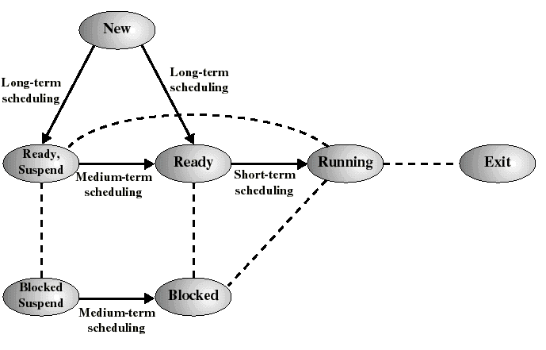
Classification of Scheduling Activity
Long-term: which process to admit
Medium-term: which process to swap in or out
Short-term: which ready process to execute next

Slide 3
Long-Term Scheduling
Determines which programs are admitted to the system for processing
Controls the degree of multiprogramming
If more processes are admitted
  less likely that all processes will be blocked
  better CPU usage
  each process has smaller fraction of the CPU
The long term scheduler may attempt to keep a mix of processor-bound and I/O-bound processes

Slide 4
Medium-Term Scheduling
Swapping decisions based on the need to manage multiprogramming
  Allows the long-term scheduler to admit more processes than actually fit in memory
  but too many processes can increase disk activity (paging), so there is some “optimum” level of multiprogramming.
Done by memory management software (chapter 8)

Slide 5
Short-Term Scheduling
Determines which process is going to execute next (also called CPU scheduling)
the focus of this chapter..
invoked on a event that may lead to choosing another process for execution:
  clock interrupts
  I/O interrupts
  operating system calls and traps, including I/O
  signals

Slide 6

The CPU-I/O Cycle
“CPU-bound” processes require more CPU time than I/O time
“I/O-bound” processes spend most of their time waiting for I/O.
Silberschatz, Galvin, and Gagne ©1999

Slide 7

Histogram of CPU-burst Times
Silberschatz, Galvin, and Gagne ©1999

Slide 8
Our focus
Uniprocessor Scheduling: scheduling a single CPU among all the processes in the system
Key Criteria:
  Maximize CPU utilization
  Maximize throughput
  Minimize waiting times
  Minimize response time
  Minimize turnaround time

Slide 9
Criteria
Maximize CPU utilization
  Efficiency
  Need to keep the CPU busy
Minimize waiting times
  Time spent waiting in READY queue
  Each process should get a fair share of the CPU

Slide 10
Criteria
Maximize throughput
  Process completions per time unit
Minimize response time
  From a user request to the first response
  I/O bound processes
Minimize turnaround time
  CPU-bound process equivalent of response time
  Elapsed time to complete a process

Slide 11
User vs. System Scheduling Criteria
User-oriented
Turnaround Time (batch systems): Elapsed time from the submission of a process to its completion
Response Time (interactive systems): Elapsed time from the submission of a request to the first response
System-oriented
CPU utilization
fairness
throughput: processes completed per unit time

Slide 12
Two Components of Scheduling Policies
Selection function
which process in the ready queue is selected next for execution?
Decision mode
at what times is the selection function exercised?
  Nonpreemptive
    A process in the running state runs until it blocks or ends
  Preemptive
    Currently running process may be interrupted and moved to the Ready state by the OS
    Prevents any one process from monopolizing the CPU

Slide 13
Policy vs. Mechanism
Important in scheduling and resource allocation algorithms
Policy
  What is to be done
Mechanism
  How to do it
Policy: All users equal access
Mechanism: round robin scheduling
Policy: Paid jobs get higher priority
Mechanism: Preemptive scheduling algorithm

Slide 14
A running example to discuss various scheduling policies
Arrival
Time
Burst
Time
Process
1
0
3
2
2
6
3
4
4
4
6
5
5
8
2

Slide 15
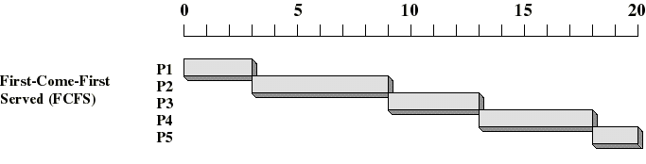
First Come First Served (FCFS)
Selection function: the process that has been waiting the longest in the ready queue (hence, FCFS, FIFO queue)
Decision mode: nonpreemptive
  a process runs until it blocks itself (I/O or other)

Slide 16
FCFS Drawbacks
Favors CPU-bound processes
  A process that does not perform any I/O will monopolize the processor!
  I/O-bound processes have to wait until CPU-bound process completes
  They may have to wait even when their I/Os have completed
    poor device utilization
  We could reduce the average wait time by giving more priority to I/O bound processes

Slide 17
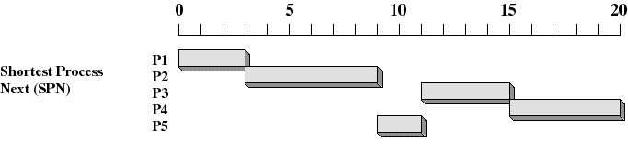
Shortest Job First (SJF)
Shortest job
First (SJF)
Selection function: the process with the shortest expected CPU burst time
Decision mode: non-preemptive
I/O bound processes will be picked first
We need to estimate the expected CPU burst time for each process: on the basis of past behavior.

Slide 18
Estimating the Required CPU Burst
Can average all past history equally
But recent history of a process is more likely to reflect future behavior
A common technique for that is to use exponential averaging
  S[n+1] = α T[n] + (1-α) S[n] ; 0 < α < 1
  Puts more weight on recent instances whenever α > 1/n

Slide 19
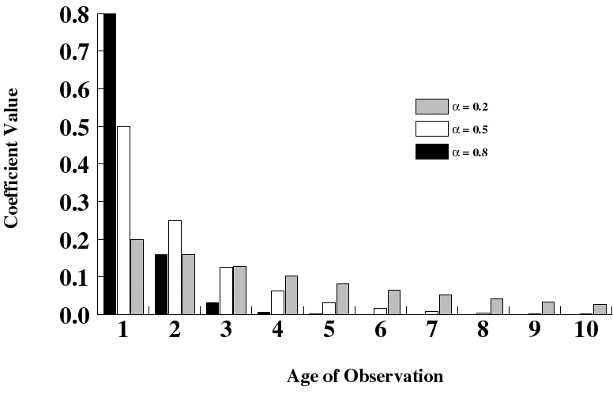
Exponentially Decreasing Coefficients

Slide 20
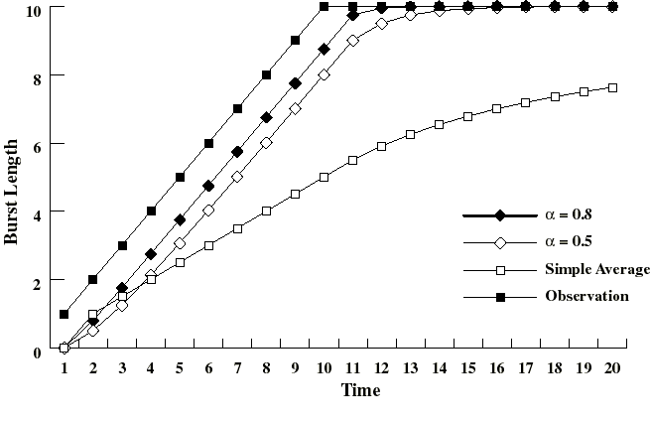
Exponential Averaging
Set S[1] = 0 to give new processes high priority.
Exponential averaging tracks changes in process behavior much faster than simple averaging.

Slide 21
Shortest Job First: Critique
SJF implicitly incorporates priorities: shortest jobs are given preference.
  Typically these are I/O bound jobs
Longer processes can starve if there is a steady supply of shorter processes
Lack of preemption not suitable in a time sharing environment
  CPU bound process gets lower priority
  But a process doing no I/O at all could monopolize the CPU if it is the first one in the system

Slide 22
Shortest Remaining Time (SRT) = Preemptive SJF
If a process arrives in the Ready queue with estimated CPU burst less than remaining time of the currently running process, preempt.
Prevents long jobs from dominating.
  But must keep track of remaining burst times
Better turnaround time than SJF
  Short jobs get immediate preference

Slide 23
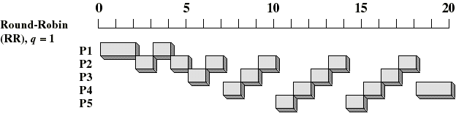
Round-Robin
Selection function: same as FCFS
Decision mode: Preemptive
  Maximum time slice (typically 10 - 100 ms) enforced by timer interrupt
  running process is put at the tail of the ready queue

Slide 24
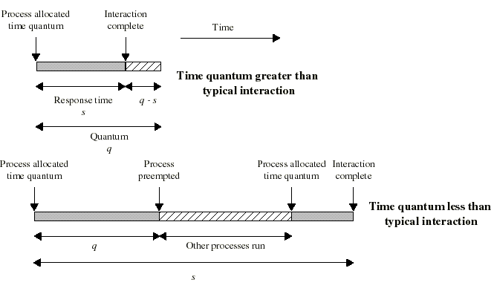
Time Quantum for Round Robin
must be substantially larger than process switch time
should be larger than the typical CPU burst
If too large, degenerates to FCFS
Too small, excessive context switches (overhead)

Slide 25
Fairness vs. Efficiency
Each context switch has the OS using the CPU instead of the user process
  give up CPU, save all info, reload w/ status of incoming process
  Say 20 ms quantum length, 5 ms context switch
  Waste of resources
    20% of CPU time (5/20) for context switch
  If 500 ms quantum, better use of resources
    1% of CPU time (5/500) for context switch
    Bad if lots of users in system – interactive users waiting for CPU
  Balance found depends on job mix

Slide 26
Round Robin: Critique
Still favors CPU-bound processes
  An I/O bound process uses the CPU for a time less than the time quantum and then is blocked waiting for I/O
  A CPU-bound process runs for its whole time slice and goes back into the ready queue (in front of the blocked processes)
One solution: virtual round robin (VRR, not in book…)
  When a I/O has completed, the blocked process is moved to an auxiliary queue which gets preference over the main ready queue
  A process dispatched from the auxiliary queue gets a shorter time quantum (what is “left over” from its quantum when it was last selected from the ready queue)

