Slide 1
Our focus
scheduling a single CPU among all the processes in the system
Key Criteria:
  Maximize CPU utilization
  Maximize throughput
  Minimize waiting times
  Minimize response time
  Minimize turnaround time

Slide 2
Two Components of Scheduling Policies
Selection function
which process in the ready queue is selected next for execution?
Decision mode
at what times is the selection function exercised?
  Nonpreemptive
    A process in the running state runs until it blocks or ends
  Preemptive
    Currently running process may be interrupted and moved to the Ready state by the OS
    Prevents any one process from monopolizing the CPU

Slide 3
A running example to discuss various scheduling policies
Arrival
Time
Burst
Time
Process
1
0
3
2
2
6
3
4
4
4
6
5
5
8
2

Slide 4
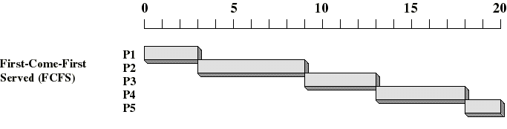
First Come First Served (FCFS)
Selection function: the process that has been waiting the longest in the ready queue (hence, FCFS, FIFO queue)
Decision mode: nonpreemptive
  a process runs until it blocks itself (I/O or other)
Drawbacks: favours CPU-bound processes

Slide 5
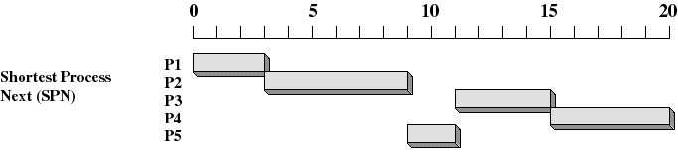
Shortest Job First (SJF)
Shortest job
First (SJF)
Selection function: the process with the shortest expected CPU burst time
Decision mode: non-preemptive
I/O bound processes will be picked first
Estimate the expected CPU burst time for each process: on the basis of past behavior.
Drawback: Longer processes can starve if steady supply of I/O bound jobs

Slide 6
Shortest Remaining Time (SRT) = Preemptive SJF
If a process arrives in the Ready queue with estimated CPU burst less than remaining time of the currently running process, preempt.
Prevents long jobs from dominating.
  But must keep track of remaining burst times
Better turnaround time than SJF
  Short jobs get immediate preference
P1 | P2 | P3 | P5 | P2 | P4
0..3 | 3..4 | 4..8 | 8..10 | 10..15 | 15..20

Slide 7
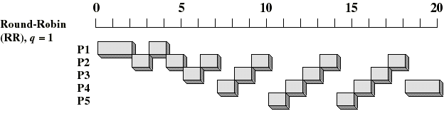
Round-Robin
Selection function: same as FCFS
Decision mode: Preemptive
  Maximum time slice enforced by timer interrupt
  Running process is put at tail of ready queue

Slide 8
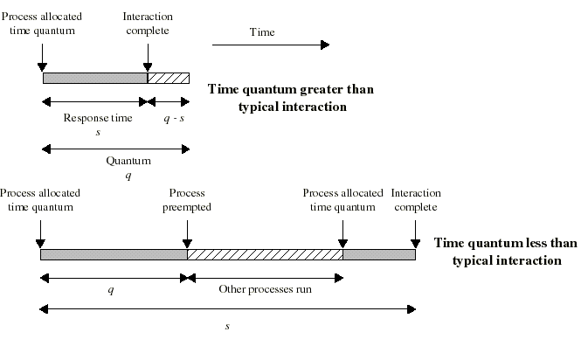
Time Quantum for Round Robin
must be substantially larger than process switch time
should be larger than the typical CPU burst
If too large, degenerates to FCFS
Too small, excessive context switches (overhead)

Slide 9
Round Robin: Critique
Still favors CPU-bound processes
  An I/O bound process uses the CPU for a time less than the time quantum and then is blocked waiting for I/O
  A CPU-bound process runs for its whole time slice and goes back into the ready queue (in front of the blocked processes)
One solution: virtual round robin (VRR, not in book…)
  When a I/O has completed, the blocked process is moved to an auxiliary queue which gets preference over the main ready queue
  A process dispatched from the auxiliary queue gets a shorter time quantum (what is “left over” from its quantum when it was last selected from the ready queue)

Slide 10
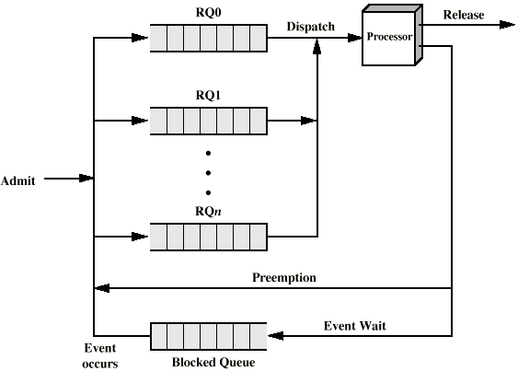
Priority Queues
Scheduler chooses from low priority queue only if higher ones are empty
Hi priority
Low priority

Slide 11
Multilevel Feedback Queues
Several READY queues with decreasing priorities:
  P(RQ0) > P(RQ1) > ... > P(RQn)
  But lower priority queues get longer time slice
New processes are placed in RQ0
If they use their time quantum, they are placed in RQ1. If they time out again, they go to RQ2, etc. until they reach lowest priority
Automatically reduces priority of CPU-bound jobs, leaving I/O-bound ones at top priority
Dispatcher always chooses a process from highest non-empty queue
Problem: long jobs can “starve”
  Solution: “aging” (promote priority of a process that waits too long in a lower priority queue)

Slide 12
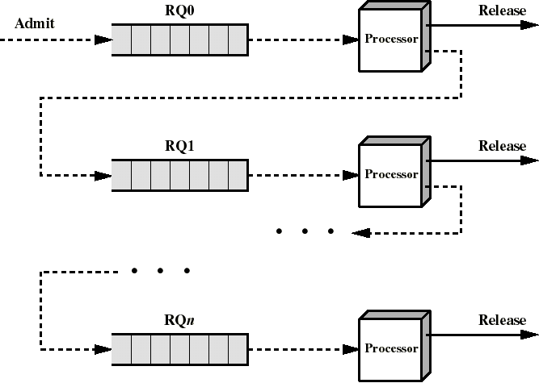
Multilevel Feedback Queues
RR,
Q=1
RR,
Q=2
... Q=4 etc.
FCFS
Note: many variations of policies possible
  including different policies at different levels..

Slide 13
Multilevel Feedback Scheduling
Multilevel feedback scheduling is the most flexible method
can customize:
  Number of queues
  Scheduling algorithm per queue
  Priority “upgrade” criteria
  Priority “demotion” criteria
  Policy to determine which queue a process starts in

Slide 14
Algorithm Comparison
Which one is best?
It depends:
  on the system workload (extremely variable)
  hardware support for the dispatcher
  relative weighting of performance criteria (response time, CPU utilization, throughput...)
  The evaluation method used
  Management priorities
    machine efficiency vs. user service..

Slide 15
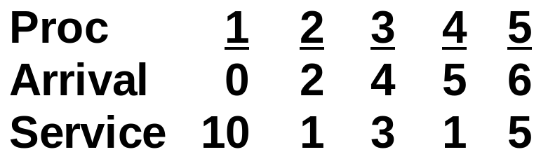
Let’s do some examples..
Work out schedules for:
  FCFS
  RR(Q=1)
  RR(Q=4)
  SJF
  SRT
Compute:
  T_{r} (response time)
  T_{w}(wait time)
For each process, and
Average for all 5

Slide 16
Some Useful Relationships
T_{a} : Arrival Time
T_{s} : Service Time (CPU burst)
T_{f} : Finish time
T_{w} : Wait time
T_{r} = T_{f} - T_{a} (response time)
Note that:
T_{f} = T_{a} + T_{s +} T_{w} , or
T_{f -} T_{a} = T_{s} + T_{w} = T_{r}
Therefore: T_{w} = T_{r} - T_{s}
We start by working out the finish time

Slide 17
Example to evaluate various scheduling policies
Arrival
Time
Burst
Time
Process
1
0
10
2
2
1
3
4
3
4
5
1
5
6
5

Slide 18
Summary Results
Proc
1
2
3
4
5
Ta
0
2
4
5
6
Ts
10
1
3
1
5
Average
Tf
10
11
14
15
20
FCFS
Tr
10
9
10
10
14
10.6
Tw
0
8
7
9
9
6.6
Tf
20
3
11
7
18
RR(Q=1)
Tr
20
1
7
2
12
8.4
Tw
10
0
4
1
7
4.4
Tf
19
5
8
13
20
RR(Q=4)
Tr
19
3
4
8
14
9.6
Tw
9
2
1
7
9
5.6
Tf
10
11
15
12
20
SJF
Tr
10
9
11
7
14
10.2
Tw
0
8
8
6
9
6.2
Tf
20
3
8
6
13
SRT
Tr
20
1
4
1
7
6.6
Tw
10
0
1
0
2
2.6

