Slide 1
Midterm 1 – Wednesday, June 4
Chapters 1-3:
  understand material as it relates to concepts covered
Chapter 4 - Processes:
  4.1 Process Concept
  4.2 Process Scheduling
  4.3 Operations on Processes
Chapter 6 - CPU Scheduling:
  6.1 Basic Concepts
  6.2 Scheduling Criteria
  6.3 Scheduling Algorithms
Chapter 7 - Process Synchronization:
  7.1 Background
  7.2 Critical-Section Problem
  7.3 Synchronization Hardware

Slide 2
Process Synchronization
Continued
7.4 Semaphores
7.5 Classic Problems of Synchronization
  Producer/Consumer (unbounded buffer)
  Producer/Consumer (bounded buffer)

Slide 3
Busy Waiting Semaphores
The simplest way to implement semaphores.
Useful when critical sections last for a short time, or we have lots of CPUs.
S initialized to positive value (to allow someone in at the beginning).
S is an integer variable that, apart from initialization, can only be accessed through 2 atomic and mutually exclusive operations:
wait(S):
while S<=0 do ;
S--;
signal(S):
S++;

Slide 4
Using semaphores for solving critical section problems
For n processes
Initialize semaphore “mutex” to 1
Then only one process is allowed into CS (mutual exclusion)
To allow k processes into CS at a time, simply initialize mutex to k
Process P_{i}:
repeat
wait(mutex);
CS
signal(mutex);
RS
forever

Slide 5
Synchronizing Processes using Semaphores
Two processes:
  P₁ and P₂
Statement S₁ in P₁ needs to be performed before statement S₂ in P₂
Need to make P₂ wait until P₁ tells it it is OK to proceed
Define a semaphore “synch”
  Initialize synch to 0
Put this in P₂:
  wait(synch);
  S₂;
And this in in P₁:
  S₁;
  signal(synch);

Slide 6
Busy-Waiting Semaphores: Observations
When S>0:
  the number of processes that can execute wait(S) without being blocked = S
When S=0: one or more processes are waiting on S
Semaphore is never negative
When S becomes >0, the first process that tests S enters enters its CS
  random selection (a race)
  fails bounded waiting condition

Slide 7
Blocking Semaphores
In practice, wait and signal are system calls to the OS
  The OS implements the semaphore.
To avoid busy waiting:
  when a process has to wait on a semaphore, it will be put in a blocked queue of processes waiting for this to happen.
Queues are normally FIFO. This gives the OS control on the order processes enter CS.
  There is one queue per semaphore
  just like I/O queues.

Slide 8
Blocking Semaphores: Implementation
A semaphore can be seen as a record (structure):
typedef struct {
int count;
struct PCB *queue;
} semaphore;
semaphore S;
When a process must wait for a semaphore S, it is blocked and put on the semaphore’s queue
Signal(S) removes one process from the queue and moves it to Ready.

Slide 9
Semaphore Operations in OS (atomic)
void wait(semaphore S){
S.count--;
if (S.count<0) {
add this process to S.queue
block this process
}
}
signal(S){
S.count++;
if (S.count<=0) {
move one process P from S.queue
to ready list
}
Negative count indicates number of processes waiting

Slide 10
Semaphores: Implementation
wait() and signal() themselves contain critical sections! How to implement them?
Notice: they are very short critical sections.
Solutions:
  uniprocessor: disable interrupts during these operations (ie: for a very short period).
    Fails on a multiprocessor machine.
  multiprocessor: use some busy waiting scheme, such as test-and-set.
    The busy-wait will be short, so it can be tolerated.

Slide 11
Deadlocks and Semaphores
Process P₀:
wait(S);
wait(Q);
.
.
signal(S);
signal(Q);
Process P₁:
wait(Q);
wait(S);
.
.
signal(Q);
signal(S);
This could function correctly sometimes, but:
What if P₀ reaches dotted line, and context switch to P₁?

Slide 12
Binary Semaphores
The semaphores we have studied are called counting semaphores
We can also have binary semaphores
  similar to counting semaphores except that “count” can only be 0 or 1
  simpler to implement on some hardware
Can still be used in “counting” situations
  need to add additional counting variables protected by binary semaphores.
  See example in section 7.4.4

Slide 13
Binary Semaphores
waitB(S):
if (S.value == 1) {
S.value = 0;
} else {
place this process in S.queue
block this process
}
signalB(S):
if (S.queue is empty) {
S.value = 1;
} else {
move a process P from S.queue
to ready list
}

Slide 14
Some Classic Synchronization Problems
Bounded Buffer (Producer/Consumer)
Dining Philosophers Problem
Readers-Writers Problem

Slide 15
The Producer/Consumer Problem
A producer process produces information that is consumed by a consumer process
  Example: Implementation of pipes on Unix systems
We need a buffer to hold items that are produced and eventually consumed
and a way for the producer and the consumer of the items to coordinate their access to the buffer
A common paradigm for cooperating processes

Slide 16
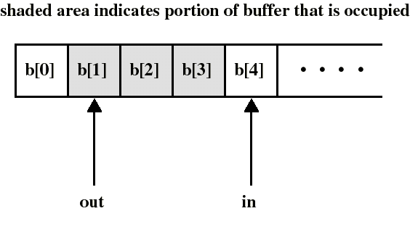
Producer/Consumer: Unbounded Buffer
We look first at an unbounded buffer consisting of a linear array of elements
in points to the next item to be produced
out points to the next item to be consumed
Number of elements = (in-out)

Slide 17
Unbounded Buffer: Observations
If only the producer alters the pointer in and only the consumer alters out, and only the producer writes to the buffer itself, mutual exclusion in this simple case may not be an issue if the code is written carefully
The producer write whenever it wants, but
..the consumer must check to make sure the buffer is not “empty” (in==out)?
So the consumer may have to busy-wait, waiting for the producer to provide at least one item

Slide 18
Pitfalls with Simple Solution
Producer basically does
  b[in] = item; in++;
and consumer does
  while (out >= in) ; /* Wait… */
  item = b[out]; out++;
What could happen if the producer adjusted “in” before it put the data in?
  in++; b[in-1] = produced_item;

Slide 19
Producer/Consumer: Unbounded Buffer Semaphore Solution
Let’s make it “clean”
  declare the buffer and its pointers to be critical data
  And protect them in a critical section
Use a semaphore “mutex” to perform mutual exclusion on the buffer and pointers
Use another semaphore “number” to synchronize producer and consumer on the number (= in - out) of items in the buffer
  an item can be consumed only after it has been created
  (The semaphore value itself is the item count)

Slide 20
Producer/Consumer: Unbounded Buffer
The producer is free to add an item into the buffer at any time: it performs wait(mutex) before appending and signal(mutex) afterwards to prevent access by the consumer
It also performs signal(number) after each append to increment number
The consumer must first do wait(number) to see if there is an item to consume and then use wait(mutex) / signal(mutex) to access the buffer

Slide 21
Solution of Producer/Consumer: Unbounded Buffer
Initialization:
mutex.count:=1; //mutual exclusion
number.count:=0; //number of items
in:=out:=0; //indexes to buffer
append(item):
b[in]:=item;
in++;
Producer:
repeat
produce item;
wait(mutex);
append(item);
signal(mutex);
signal(number);
forever
Consumer:
repeat
wait(number);
wait(mutex);
item:=take();
signal(mutex);
consume item;
forever
take():
item:=b[out];
out++;
return item;
critical sections

Slide 22
Producer/Consumer: Unbounded Buffer
Remarks:
  Putting signal(number) inside the CS of the producer (instead of outside) has no useful effect since the consumer must always wait for both semaphores before proceeding
  The consumer must perform wait(number) before wait(signal), otherwise deadlock occurs if consumer enters CS while the buffer is empty. Why?
    because it would lock the producer out!
  Disaster if you forget to do a signal after a wait.
So using semaphores still has pitfalls...
Now let’s look at what happens if the buffer is bounded

Slide 23
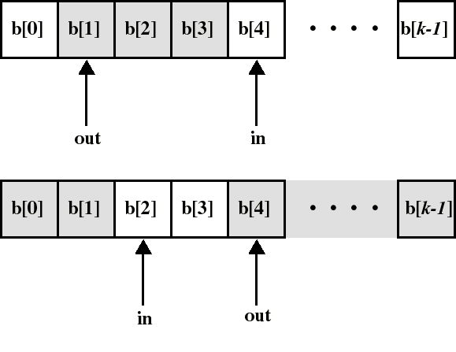
Producer/Consumer: Circular Buffer of Size k (Bounded Buffer)
can consume only when number of (consumable) items is at least 1 (now: number != in-out)
can produce only when number of empty spaces is at least 1

Slide 24
Producer/Consumer: Bounded Buffer
Again:
  Use a semaphore “mutex” for mutual exclusion on buffer access
  and a semaphore “full” to synchronize producer and consumer on the number of consumable items (full spaces)
But we have to add:
  a semaphore “empty” to synchronize producer and consumer on the number of empty spaces

Slide 25
Producer/Consumer:
Bounded Buffer (Solution)
Initialization: mutex.count:=1; //mutual excl.
full.count:=0; //full spaces
empty.count:=k; //empty spaces
append(item):
b[in]:=item;
in=(in+1)mod k;
Producer:
repeat
produce item;
wait(empty);
wait(mutex);
append(item);
signal(mutex);
signal(full);
forever
Consumer:
repeat
wait(full);
wait(mutex);
item:=take();
signal(mutex);
signal(empty);
consume(item);
forever
take():
item:=b[out];
out=(out+1)mod k;
return item;
critical sections

Slide 26
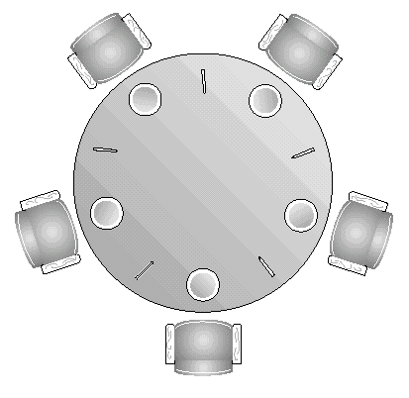
The Dining Philosophers Problem
( read 7.5.3 for next class)
5 philosophers who only eat and think
each needs to use 2 forks for eating
but we have only 5 forks!
A classical synchronization problem
Illustrates the difficulty of allocating resources among process without deadlock and starvation

