Slide 1
Stuff
Exam timetable now available
Class back in CS auditorium as of Wed, June 4th
Assignment 2, Question 4 clarification

Slide 2
Some Classic Synchronization Problems
Bounded Buffer (Producer/Consumer)
Dining Philosophers Problem
Readers-Writers Problem

Slide 3
Solution of Producer/Consumer: Unbounded Buffer
Initialization:
mutex.count:=1; //mutual exclusion
number.count:=0; //number of items
in:=out:=0; //indexes to buffer
append(item):
b[in]:=item;
in++;
Producer:
repeat
produce item;
wait(mutex);
append(item);
signal(mutex);
signal(number);
forever
Consumer:
repeat
wait(number);
wait(mutex);
item:=take();
signal(mutex);
consume item;
forever
take():
item:=b[out];
out++;
return item;
critical sections

Slide 4
Producer/Consumer: Unbounded Buffer
Remarks:
  Putting signal(number) inside the CS of the producer (instead of outside) has no useful effect since the consumer must always wait for both semaphores before proceeding
  The consumer must perform wait(number) before wait(signal), otherwise deadlock occurs if consumer enters CS while the buffer is empty. Why?
    because it would lock the producer out!
  Disaster if you forget to do a signal after a wait.
So using semaphores still has pitfalls...
Now let’s look at what happens if the buffer is bounded

Slide 5
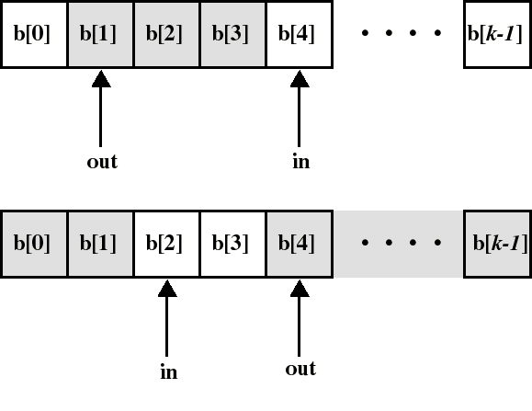
Producer/Consumer: Circular Buffer of Size k (Bounded Buffer)
can consume only when number of (consumable) items is at least 1 (now: number != in-out)
can produce only when number of empty spaces is at least 1

Slide 6
Producer/Consumer: Bounded Buffer
Again:
  Use a semaphore “mutex” for mutual exclusion on buffer access
  and a semaphore “full” to synchronize producer and consumer on the number of consumable items (full spaces)
But we have to add:
  a semaphore “empty” to synchronize producer and consumer on the number of empty spaces

Slide 7
Producer/Consumer:
Bounded Buffer (Solution)
Initialization: mutex.count:=1; //mutual excl.
full.count:=0; //full spaces
empty.count:=k; //empty spaces
append(item):
b[in]:=item;
in=(in+1)mod k;
Producer:
repeat
produce item;
wait(empty);
wait(mutex);
append(item);
signal(mutex);
signal(full);
forever
Consumer:
repeat
wait(full);
wait(mutex);
item:=take();
signal(mutex);
signal(empty);
consume(item);
forever
take():
item:=b[out];
out=(out+1)mod k;
return item;
critical sections

Slide 8
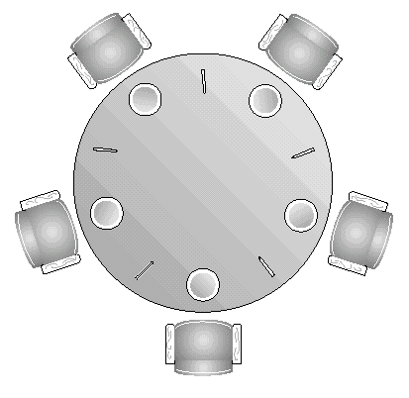
The Dining Philosophers Problem
(7.5.3)
5 philosophers who only eat and think
each needs to use 2 forks for eating
but we have only 5 forks!
A classical synchronization problem
Illustrates the difficulty of allocating resources among process without deadlock and starvation

Slide 9
The Dining Philosophers Problem 1
Each philosopher is a process
One semaphore per fork
fork: array[0..4] of semaphores
Initialization: fork[i].count:=1 (for i:=0..4)
5 Philosopher processes
Executing in parallel:
Process Pi:
repeat
think;
wait(fork[i]); //left
wait(fork[i+1 mod 5]);//right
eat;
signal(fork[i+1 mod 5]);//right
signal(fork[i]); //left
forever
What happens if each philosopher
starts by picking his left fork?
(Deadlock!)

Slide 10
The Dining Philosophers Problem 2
A solution: allow only 4 philosophers to sit at the table at one time
Then at least 1 philosopher can always eat even if the other 3 are holding 1 fork
Create another semaphore T that limits the number of philosophers at the table
Initialize: T.count:=4
Process Pi:
repeat
think;
wait(T); //get a chair
wait(fork[i]);
wait(fork[i+1 mod 5]);
eat;
signal(fork[i+1 mod 5]);
signal(fork[i]);
signal(T); //get up
forever

