Slide 1

What is an Operating System?
Users
Application Programs
Operating System
Hardware

Slide 2
Some Functions of an Operating System
Interface between application programs and the hardware
  “Hide” the complexities of hardware interfaces from application programs
  “Protect” the hardware from user mistakes and programming errors (prevent “crashes”).
Manage the resources of the computer system (CPU, memory, disk space, input/output hardware)
Protect users’ programs and data from each other
Support inter-process communications

Slide 3
The OS and the Hardware
An Operating System sits between the user and the hardware and contains all the code that deals directly with the hardware.
Chapter 2 reviews the computer hardware concepts which are most important for understanding of these issues. Read it!

Slide 4
Hardware Protection
Dual-Mode Operation
I/O Protection
Memory Protection
CPU Protection

Slide 5
Historical Evolution of OS
The beginning: I/O routines, manual setup
Simple Batch OS
Multi-programmed Batch OS
Time-Sharing Systems
The Personal Computer
Networked systems, Client-Server
Web computers, Multimedia
Peer-to-peer, etc.

Slide 6
In The Beginning...
Primitive, Very Expensive Machine
Card Reader, Card Punch (or paper tape)
“Single User”, booked one at a time
  Bring deck to cards to machine
  Operate Console Switches
  Run cards through the card reader
  Machine punches output on more cards
  Next user comes with another “job”
  Take O/P card deck to printer for “listing”
  Throw cards into the garbage..

Slide 7
Early “Operating System”
I/O programming was complex, so:
  ..provide subroutine library (device drivers)
  Loads into top of memory and stays there
Expensive computer sits idle while programmer gets set up
  Hire a “computer operator”
  Keep the programmers out of the computer room!

Slide 8
Simple Batch Systems
Were the first “real” operating systems (50s and early 60s)
The user submits a job (typically, cards) to a computer operator
The computer operator places a batch of jobs on an input device (e.g. card reader)
A special program, the monitor, manages the execution of each program in the batch
Resident monitor is in main memory and always available for execution
Monitor utilities are loaded when needed
Only one program at the time in memory, which is executed to the end before the next one.

Slide 9
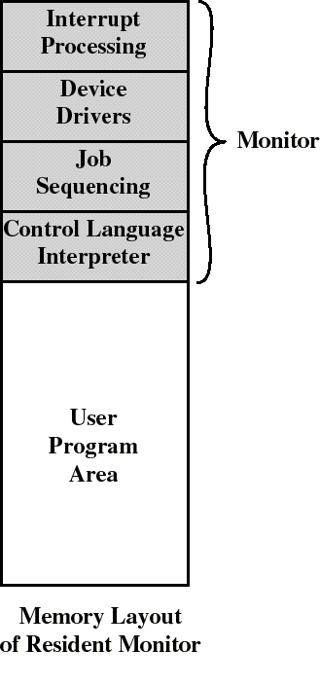
The Monitor
Monitor reads jobs one at a time from the input device
Monitor places a job in the user program area
A monitor instruction branches to the start of the user program
Execution of user program continues until:
  end-of-program occurs
  timeout or error occurs
This causes Monitor to resume control

Slide 10
Desirable Hardware Features
Memory protection
  memory area containing the monitor must be protected from user programs
Timer
  an interrupt occurs when allocated time expires
  prevents a job from monopolizing the system

Slide 11
CPU Protection
Timer – interrupts computer after specified period to ensure operating system maintains control.
  Timer is decremented every clock tick.
  When timer reaches the value 0, an interrupt occurs.
Timer commonly used to implement time sharing.
Timer also used to compute the current time.
“Load-timer” is a privileged instruction.
  ..or the timer is treated as an I/O device

Slide 12
Other Desirable Hardware Features
Dual Mode Operation
  Privileged instructions can be executed only by the OS
  interrupt occurs if user program tries privileged instructions
    CPU can execute in Monitor or User mode
    Privileged instructions possible only in Monitor mode
    User programs cannot change the mode
    User programs execute in User mode only
Extended role of Interrupts
  relinquishing/regaining control to/from user programs
  concept of a System Call

Slide 13
Interrupts and Dual-Mode
Interrupts were originally invented to allow the CPU to respond immediately to hardware-related events
  Timer, Disk I/O completion, keystroke
...without having to wait for the current program to finish first
Interrupt-Service Routines (ISR’s) need to deal with the hardware that triggered the interrupt
  So the ISR should run in “monitor” mode

Slide 14
Interrupt Terminology
Varies between systems (manufacturers)
Let’s distinguish between :
  Interrupts: independent of program that is executing. Examples: I/O, timer
  Traps: caused by program execution. Examples: illegal access, divide by zero.
    also includes (deliberate) System Calls
  The word fault is also used, esp. with paging and segmentation (“page fault”).
Handling mechanisms are pretty much the same
  Mode switch, interrupt vectors, etc.

Slide 15
System Calls (Software Interrupt)
Need a mechanism for user-mode programs to invoke support routines in kernel to do I/O operations, etc.
Kernel needs to be in monitor mode to do its work
Introduce “trap” or “system call” instruction which triggers a “software interrupt”
Switches to monitor mode and jumps to kernel service routine via trap vector

Slide 16
System Call
Special instruction executed in user mode
a “software interrupt” with a numeric parameter
fetch new PC value from “trap vector”
switch to monitor mode
execute protected OS code
“return from interrupt” instruction used to restore mode, state, and PC to return to user program
trap vector
.
sys call n
.
.
monitor
mode
trap to
monitor
read
monitor
user
program
return
from
monitor
.
.
sys call n
.
.
user
mode

Slide 17
Memory Protection
Must provide memory protection at least for the interrupt vector and the interrupt service routines.
Add two special registers that determine the range of legal addresses a program may access:
  base register – holds the smallest legal physical memory address.
  Limit register – contains the size of the range
Memory accesses outside the defined range are forbidden.
  They cause a memory address violation trap, processed like an interrupt by the OS

Slide 18
Memory Protection with Base And Limit Register
When executing in monitor mode, the operating system has unrestricted access to both monitor and user’s memory.
The load instructions for the base and limit registers are privileged instructions.
0
monitor
job 1
300040
300040
base reg
job 2
420940
120900
limit reg
job 3
job 4
1024000

Slide 19
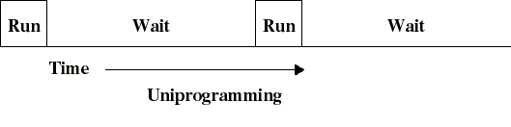
Next Stage:
Multiprogrammed Batch Systems
I/O operations are exceedingly slow (compared to instruction execution)
A program containing even a small number of I/O ops will spend most of its time waiting for them
Poor CPU usage when only one program is executing

Slide 20
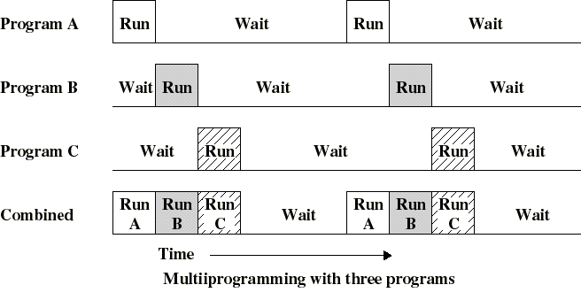
Multiprogrammed Batch Systems
If several programs can execute, then CPU can switch to another whenever one is waiting for completion of I/O
This is multitasking (multiprogramming)

Slide 21
Requirements for Multiprogramming
Hardware support:
  I/O interrupts
    our mechanism for switching “programs”
  Memory management
    several ready-to-run jobs must be kept in memory (real or virtual)
  Extended Memory protection to protect applications from each other, as well as the monitor
Software support from the OS:
  To manage resource contention, especially:
    CPU scheduling (which program runs next)
    Memory allocation

Slide 22
CPU-Bound and I/O-Bound Programs
A “CPU-bound” program does a lot of computing but relatively little input-output
  The run time is determined primarily by CPU speed
An “I/O-bound” job does very little computation but a lot of input-output
  Example: copying a large file to another disk drive
  Run time is determined by the speed of the I/O device
With proper scheduling, CPU-bound jobs and I/O-bound jobs can run on the same system without impacting each other

Slide 23
Time Sharing Systems (TSS)
Batch multiprogramming does not support interaction with users
  It just improves utilization and throughput of the machine
TSS extends multiprogramming to handle multiple simultaneous interactive jobs
Multiple users simultaneously access the system through terminals
Processor’s time is shared among the users
Need new definition of “response time”
  responsiveness to each user input, vs. total “job time”

Slide 24
Time Sharing Systems (TSS)
Because of slow human reaction time, a typical user might need, say, 2 seconds of processing time per minute
Then up to 30 users should be able to share the same system without noticeable delay in the computer response time to each user’s actions
We need to add more to the OS to make this work well:

Slide 25
New OS Issues for Time-Sharing
Process scheduling, in particular use of the “time slice” to give each user a share and minimize user waiting
Synchronization issues
  properly organize interrupts/traps, avoid loss of signals or duplication of signals
Mutual exclusion
  protect critical data so only one program can access it at a time
Avoid “hung programs”
  deadlock & starvation prevention, detection, resolution.

Slide 26
Arrival of the “PC”
Time Sharing was in widespread use by the end of the 1970’s
Then the “PC” was invented.....
Back to single user computer!
  But this time the computer is cheap..
Early models didn’t even have “hard disk”
  (this changed quickly....)
People predict the death of the “mainframe”
No competing other users, and no concern about computing efficiency, protection, etc.
  Back to the shared subroutine library (“BIOS”)
Users learn to live with machine crashes….

Slide 27
Rise of the Network
People realize they need to share data and information
PC’s become information transfer, manipulation, and storage devices more than computational machines
Sharing information on networks revives the issues of protection, security, data integrity, etc.
  but on the network this time...
Client-server computing
  database on central server, accessed via user interface on user’s machine
Sophisticated OS services start appearing again, and Unix systems evolve into “servers”

Slide 28
The PC Keeps Growing
PC’s get faster, with more memory, disk space, and horsepower
Users again start to run more than one program at a time
Multiprogramming is back, on the desktop this time
But we still need to make sure the programs don’t crash each other..

Slide 29
The Internet
Internet is a huge popular success, reaches right into the home
The “mainframe” is back in the form of “server farms”, functioning as major Web sites, “Database machines”, etc.
Electronic Commerce, electronic transactions of Internet raise even more privacy, security, and data integrity issues

Slide 30
The Operating System Landscape
Operating systems are among the most complex systems ever developed.
5 key areas we will look at
  Concept of process
  Memory management
  Information protection and security
  Scheduling and resource management
  Operating System Structuring

Slide 31
Process Concept
Introduced to provide a systematic way of monitoring and controlling program execution
A process is a “program in execution” with:
  associated data (variables, buffers…)
  execution context: all the information that:
    the CPU needs to execute the process
      content of the processor registers, PSW, etc
    the OS needs to manage the process:
      priority of the process
      events (if any) for which the process is waiting
      files that are open, etc….

Slide 32
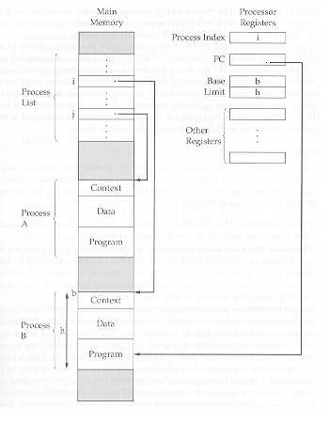
A simple implementation of processes
Main
memory
Processor
registers
The process index register contains the index into the process list of the currently executing process (B)
A process switch from B to A consists of storing (in memory) B’s context and loading (in CPU registers) A’s context
  Save/Restore all registers is necessary overhead
Process Index
PC
base
limit
Process
List
i
j
Context
Process
A
Data
Program
Context
Process
B
Data
Program

Slide 33
Memory Management
Key development is virtual memory
Allows programs to address memory from a logical point of view without regard to where is is located in physical memory
While a program is running only a portion of the program and data needs to be kept in “real” memory
  Other portions are kept in blocks on disk
  the user program has access to a “virtual” memory space that is larger than real memory

Slide 34
Virtual Memory
All memory references made by a program are to virtual memory
The hardware (mapper) must map virtual memory address to real memory address
If a reference is made to a virtual address not in memory, then
  (1) a block of real memory is freed up by swapping out to disk
  (2) the desired (missing) block of data is swapped in

Slide 35
Virtual Memory
Real
Memory
CPU
MMU
Virtual address
Physical address
(Interrupt)
(Page Fault)
Secondary
Store

Slide 36
File System
Implements “long-term memory” (usually on disk)
Information stored in named objects called files
  a convenient unit of access and protection for the Operating System
Files (and portions) may be copied into virtual memory as required by programs

Slide 37
Security and Protection
Access control to resources
  forbid intruders (unauthorized users) to enter the system
  forbid user processes from accessing resources which they are not authorized to
  protects users and OS from each other
    File permissions, memory protection, etc.
  Encryption

Slide 38
Scheduling and Resource Management
Differential responsiveness
  discriminate between different classes of jobs
    Process waiting for disk might be given more priority than one waiting for keyboard
Fairness
  give equal and fair access to all processes of the same class
Efficiency
  maximize throughput, minimize response time, and accommodate as many users as possible

Slide 39
Key Elements for Scheduling
OS maintains queues of processes waiting for resources
  Short term queue of processes in memory ready to execute
    The dispatcher decides who goes next
  Long term queue of new jobs waiting to use the system (at least on “batch” systems)
    OS should not admit more processes to the short-term queue than can be handled
  A queue for each I/O device consisting of processes waiting for an event related to that I/O device
Scheduling Policies
    Round-robin, etc.

Slide 40
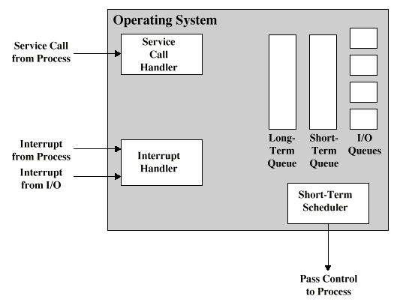
Key Elements for Scheduling

Slide 41
System Structure
Because of their complexity, OS systems are usually structured in layers (onion-skin architecture)
Each layer performs a certain subset of functions
Each layer relies on the next lower layer to perform more primitive functions
The lowest layer (the centre) is the hardware
Well defined interfaces: one layer can be modified without affecting other layers
The problem is decomposed into a number of more manageable sub problems

Slide 42
Simple “Onion” Structure (early Unix)
The User
Commands and libraries
System Call interface
Kernel
Hardware

Slide 43
Monolithic vs. Microkernel architecture
Monolithic kernel is one large program which runs as a single process (early Unix)
  To add drivers, services, need to rebuild entire executable image
Microkernel:
  Only a few essential functions in the kernel:
    primitive memory management (address space)
    Interprocess communication (IPC)
    basic scheduling
  Other OS services are provided by processes running in user mode (servers)
    device drivers, file system, virtual memory…
  More modular, easy to add new services, etc.

Slide 44
Multithreading
View a process as a collection of one or more threads that can run simultaneously
All threads within the same process share the same data and resources and a part of the process’s execution context
Easier to create or destroy a thread and switch between threads (of the same process) than to create/switch processes
  “Context switch” for a process is a bigger operation than switching threads, because threads run in the same virtual memory space, etc, shares open files, etc….

Slide 45
Summary: An Operating System is:
a program that controls the operation of the whole system and execution of application programs
  OS must relinquish control to user programs but make sure that it can regain it when necessary
an interface between the user and hardware
  Hides the details of the hardware from application programs
which tries to optimize the use of computing resources for maximum performance

